Slide 1
Face Recognition
Presenters’ Names:
Shiva kumar Rangapuram
Venkat DUgasani
Shreyas V Katagi

Slide 2
Challenges
Insufficient images
Variations in image sizes
Inadequate cropping
Solution
Data Preprocessing Approach Augmentation and Cleaning Techniques Enhance image quality and uniformity

Slide 3
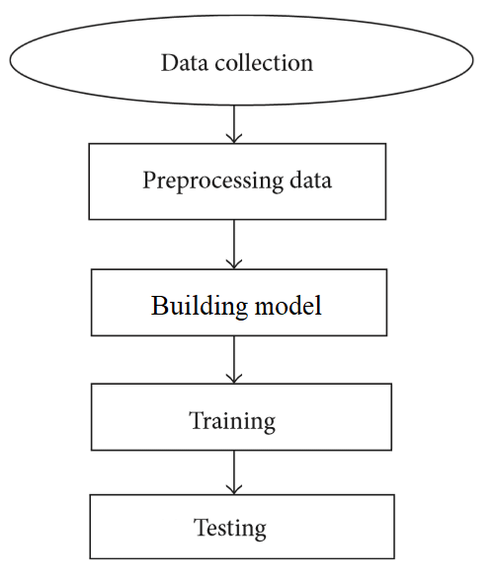
Workflow

Slide 4
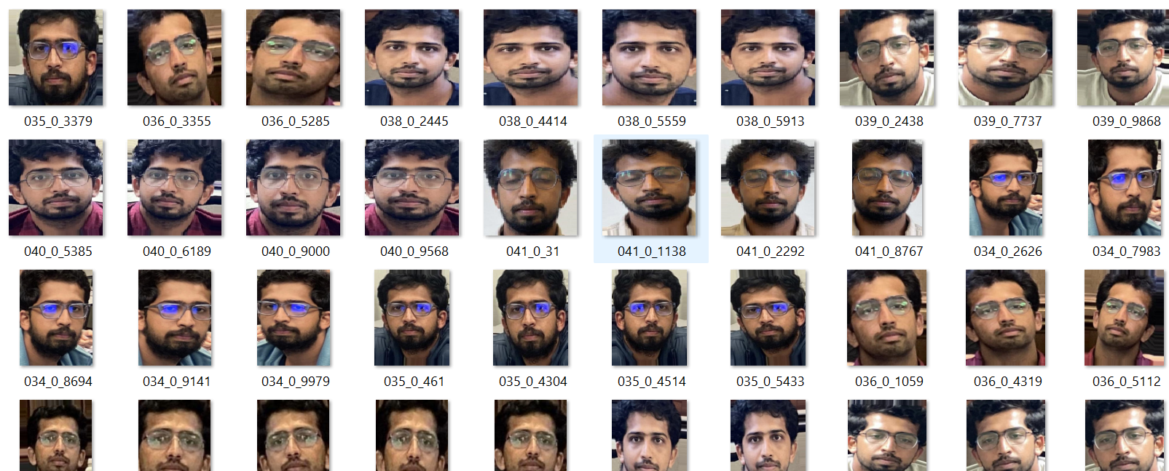
Image Augmentation
Objective: Achieving Increased Quantity and Diversity in the Dataset

Slide 5

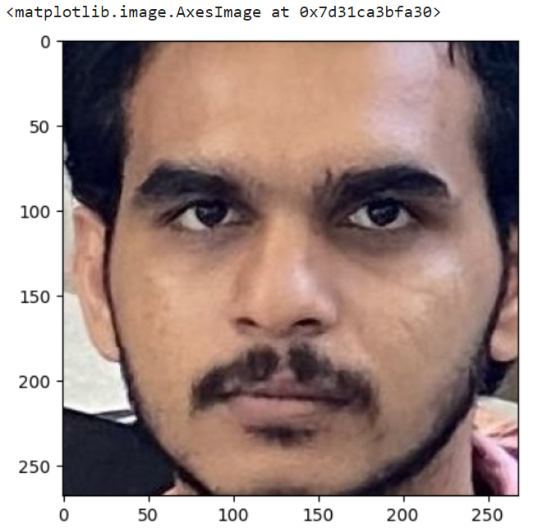
Face Detection and cropping
• Detect the face in the image and crop the image only to that face
• Helps remove unwanted background features which could present themselves as noise
• Used DeepFace for face extraction

Slide 6
Importance of Preprocessing and Augmentation
Improves Data Quality
Noise reduction
Normalization
Enhances Model Performance
Feature scaling
Balances classes
Boosts Robustness & Generalization
Augmentation techniques (rotations, flips)
Synthetic data generation
Prevents Overfitting
Acts as a regularizer
Introduces variability
Optimizes Data Efficiency
Maximizes learning from limited data
Reduces need for extensive data collection

Slide 7
Machine Learning Pipeline
Standard Scaler
PCA (Principal Component Analysis)
LDA (Linear Discriminant Analysis)
SVM (Support Vector Machine)

Slide 8
Results
SVM without augmentation 0.39
RF 0.64
SVM 0.69
LDA +SVM 0.77
Scaler + PCA + LDA + RF 0.67
Scaler + PCA + LDA + SVM 0.84

Slide 9
Key Learnings
Data Preprocessing: Using proper techniques can significantly boost accuracy.
Feature Extraction: Applying PCA before traditional algorithms (SVM, Random Forest) reduces training time.
Model Selection: SVM consistently outperforms Random Forest, DT, and other models.

Slide 10
THANK YOU

