Slide 1
working title: cricRGUKT
a cricket scoreboard system

Slide 2
cricRGUKT
Project by: Guided by:
Team 5 CSE 3E Y.Kumar sekhar
S160447-V.Devi Srinivas Asst. professor
S160082-K.Venkat CSE Dept.
S160281-Rehmath Banu RGUKT,Srikakulam.

Slide 3
CONTENTS:
Problem Statement
Abstract
Introduction
Implementation Details
Prototype
Details of project upto now

Slide 4
PROBLEM STATEMENT
Department premiere leagues are very famous in RGUKT and these cricket matches happen often. Students show a lot of interest in DPL and are always excited about the updates. The score of the match is displayed on the scoreboard near the match and nowhere else. People near the ground can have an update of the score but the people who are busy with their works and are unable to attend the match do not have any proper updates of the match happening.
Our project displays the scores of the matches held and other updates regarding the cricket matches so that everyone who are excited about the match get the updates no matter wherever they are and whatever they are doing.

Slide 5
ABSTRACT
The project entitled(working title) "cricRGUKT" is a cricket scoreboard system that is utilized by the user with an update of the cricket score even when the user is not watching the match. This project aims to make a cricket scoreboard that will update the scores of a match.The website is mainly for RGUKT students and can be used during Department Premier Leagues(DPL) and other individual matches.The live updates of the matches being played can be updated on this website and can be viewed by anyone.

Slide 6
INTRODUCTION:
Cricket being a special part of the lives of many people, there will be many takers for such a system, and the ability to follow the match without seeing the video will make it interesting for many.
Each and every match details such as the description about the team and team members will be stored in the repository system in the form of a database.
As soon as someone checks the scoreboard, details of a particular player can be viewed with a single click on his name.

Slide 7
INTRODUCTION
A user who is unable to watch the event like someone who is busy with their work can easily check the scores on a regular basis and get updates on what is happening.
The system will keep posting updated scores and the team line-up during the match.
All details including the toss,matches already played,score,wickets, number of overs completed,number of 4s and 6s,details of a particular player,details of balls played in an over etc can be viewed.

Slide 8
INTRODUCTION
A person who creates the match is the admin.An accont must be there for the same.After match creation, the admin must add the players who are going to play the match.After all the necessary details are entered,only the admin can update the scores and make other changes.
The scores and other updates of the match are displayed to the user once the user opens the website.There is no need of refreshing the website every time to view updated scores, they and other fields will be updated automatically

Slide 9
Implementation Details
FRONT END:
HTML, CSS, java Script, bootstrap
BACK END:
PHP ,Ajax
DATABASE:
MySQL

Slide 10
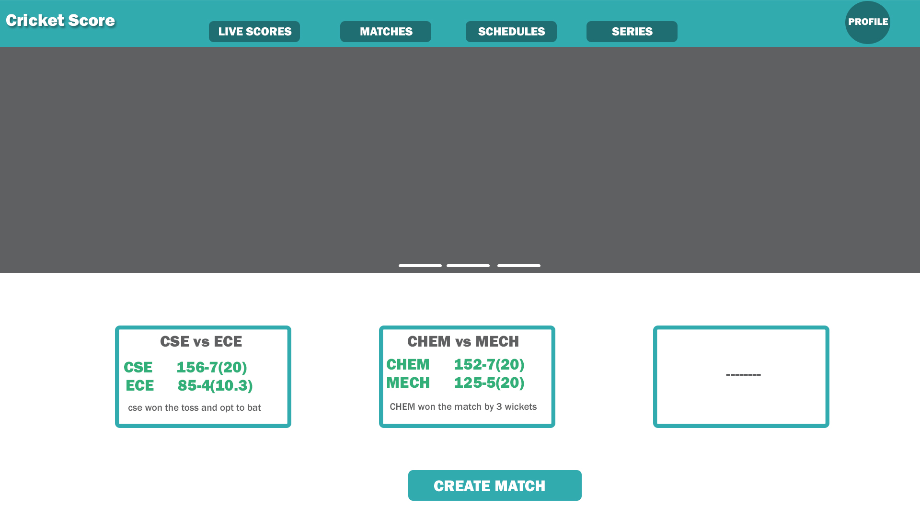
PROTOTYPE
Home page:

Slide 11
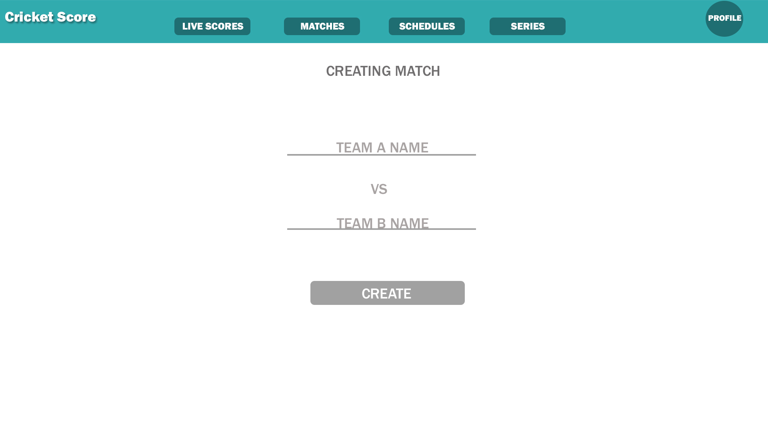
PROTOTYPE:
Create Match

Slide 12
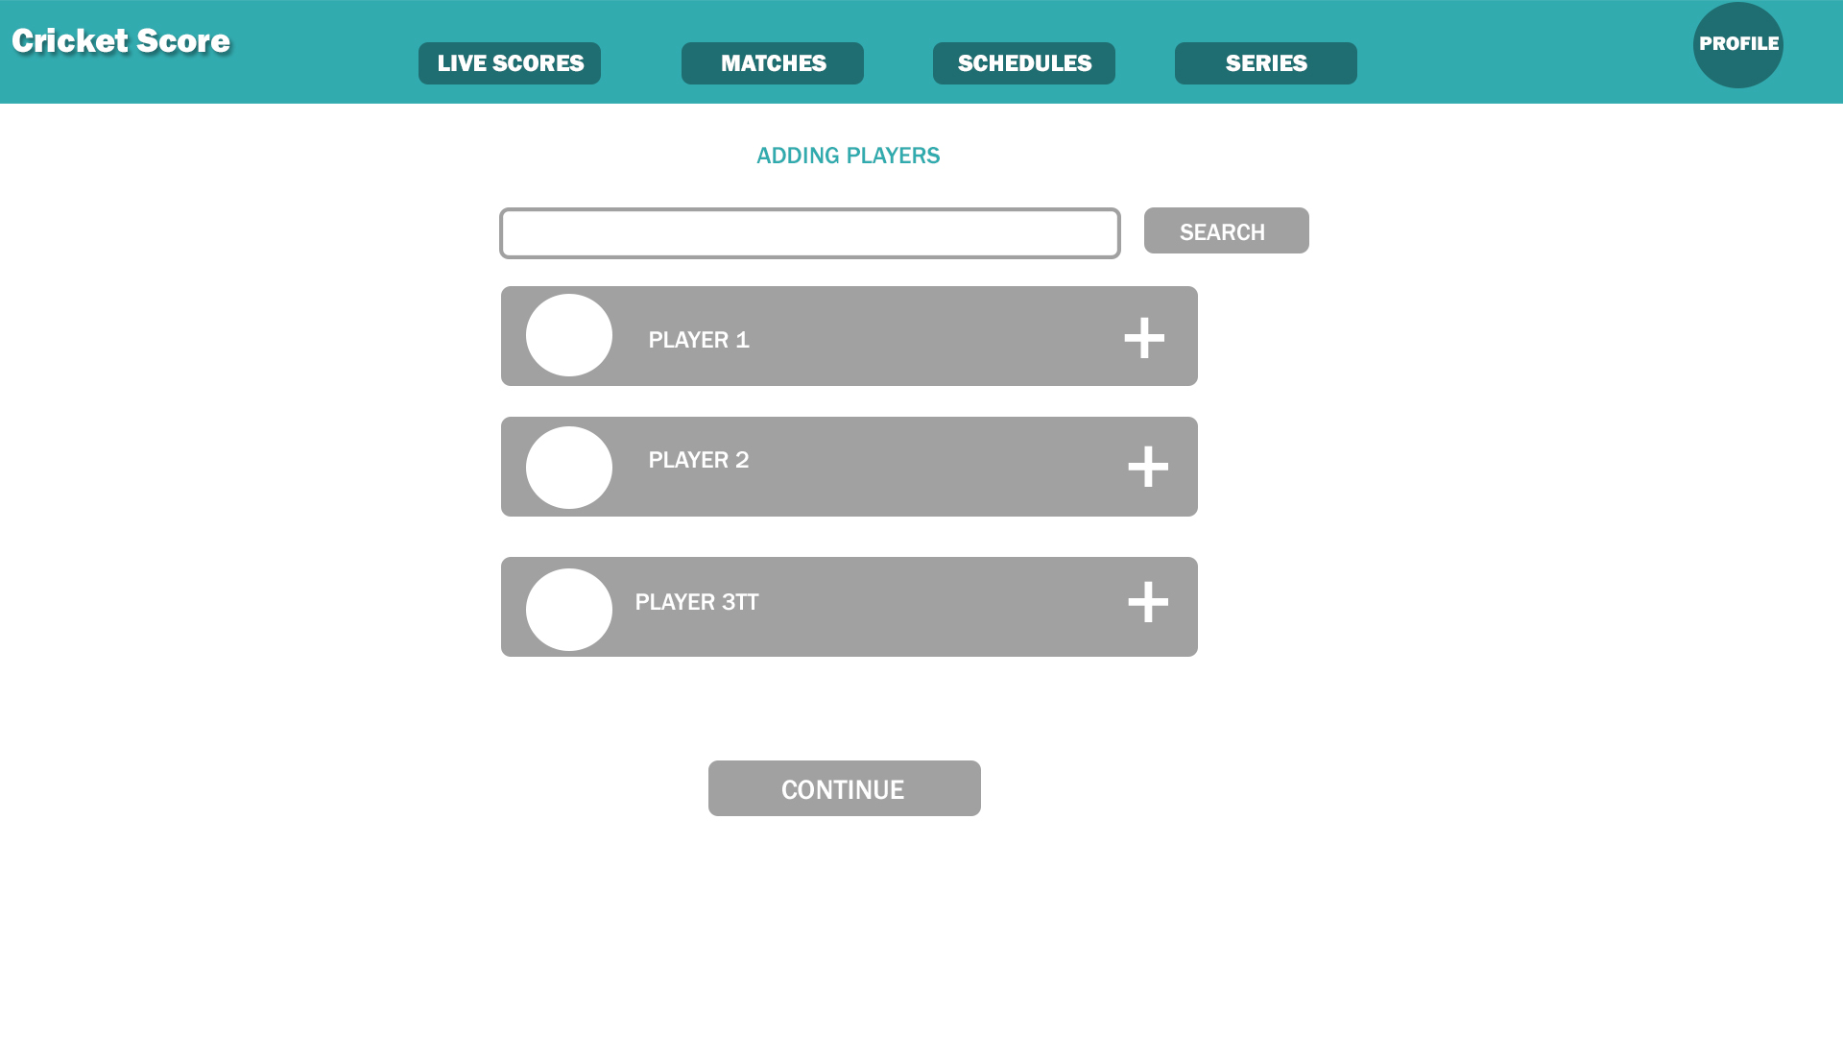
PROTOTYPE
Enter Players:

Slide 13
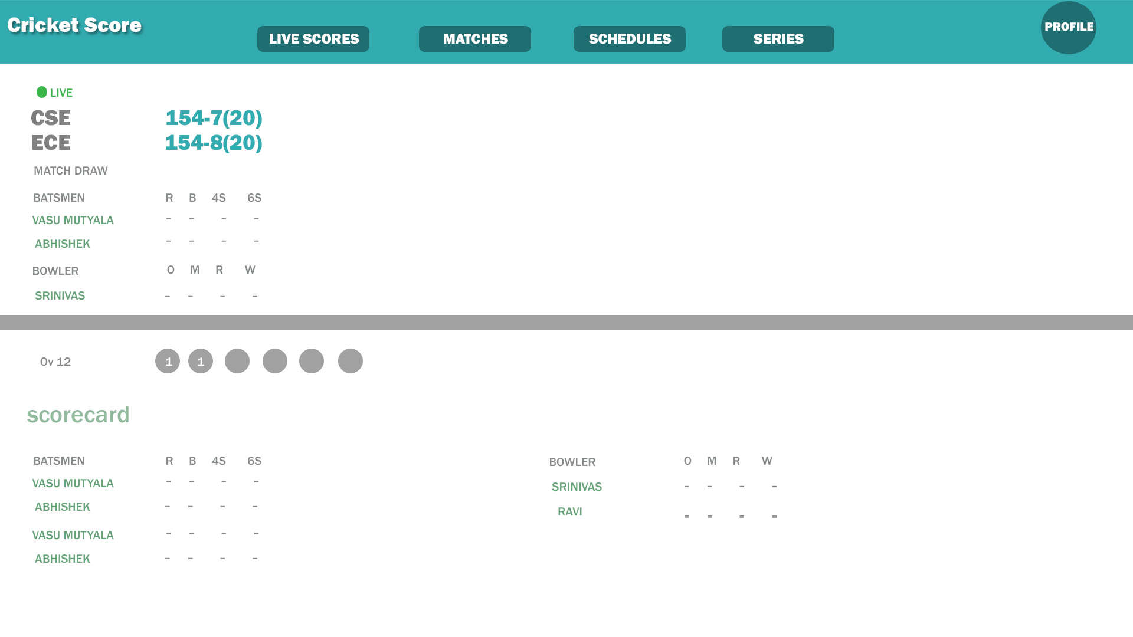
PROTOTYPE Live Score:

Slide 14
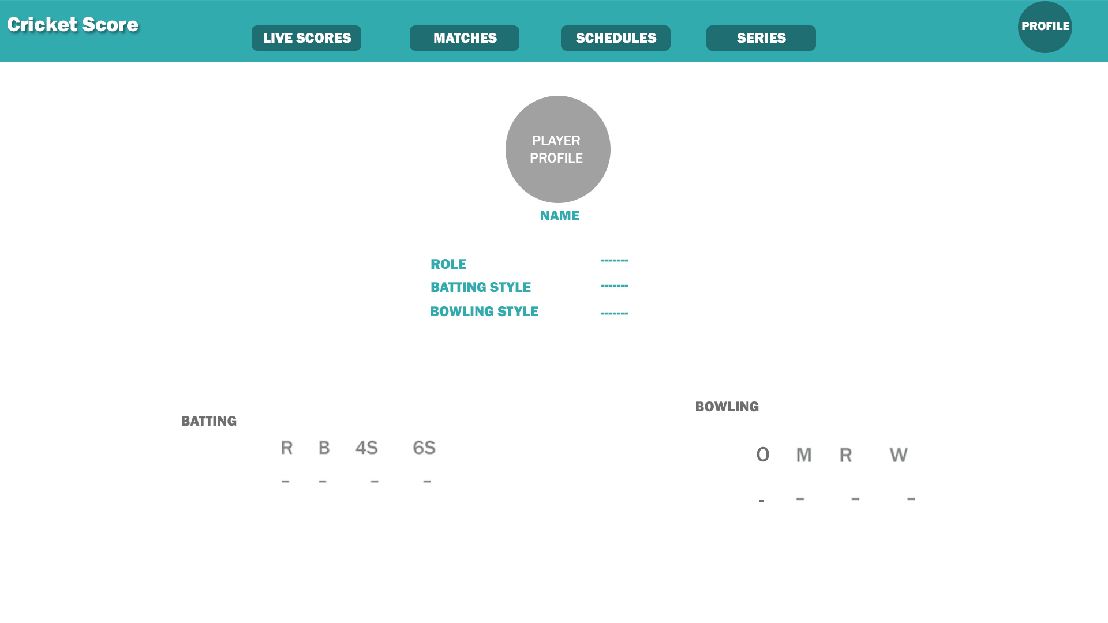
PROTOTYPE
Profile:

Slide 15
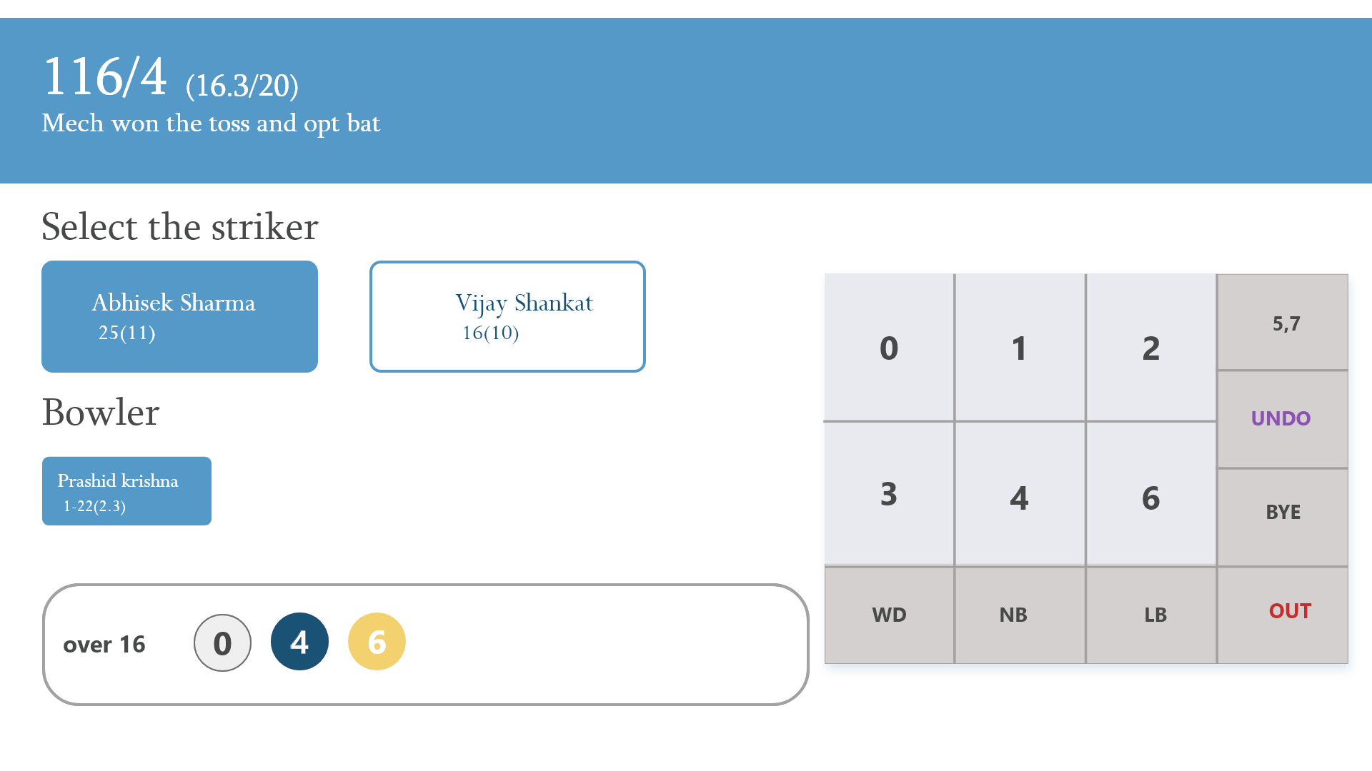
PROTOTYPE
Admin page:

Slide 16
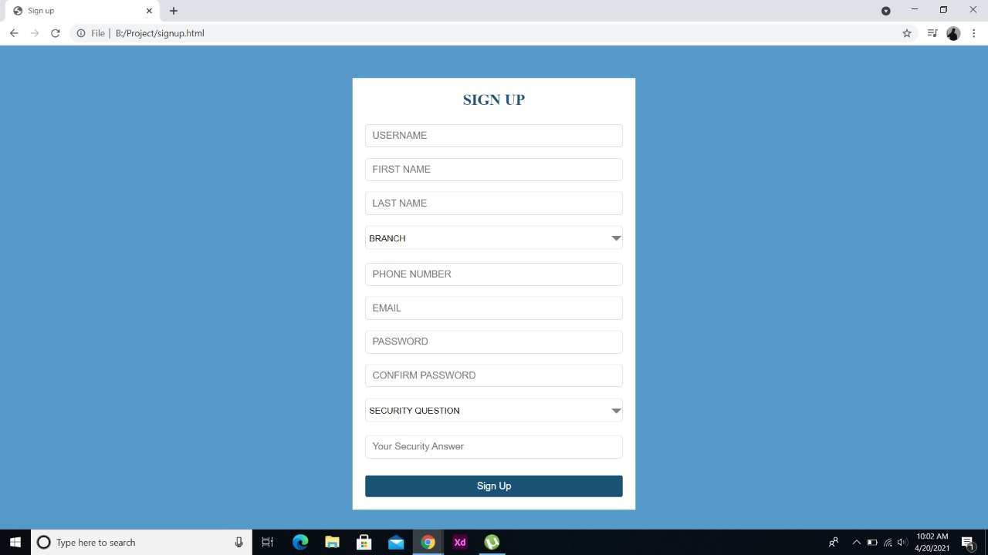
DETAILS OF PROJECT UPTO NOW
Sign Up:

Slide 17
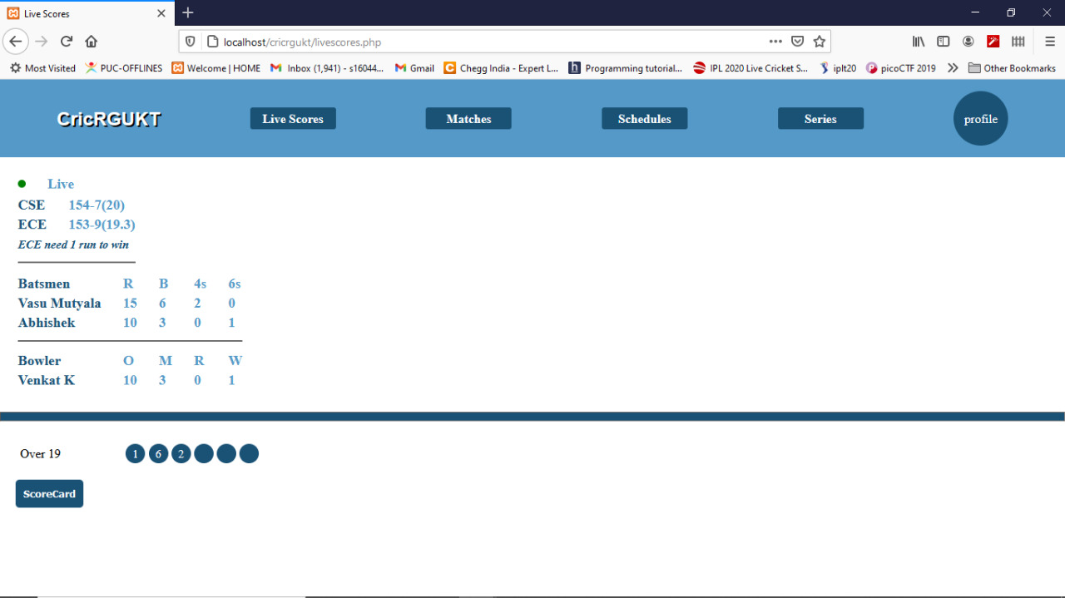
DETAILS OF PROJECT UPTO NOW
Live Score

Slide 18
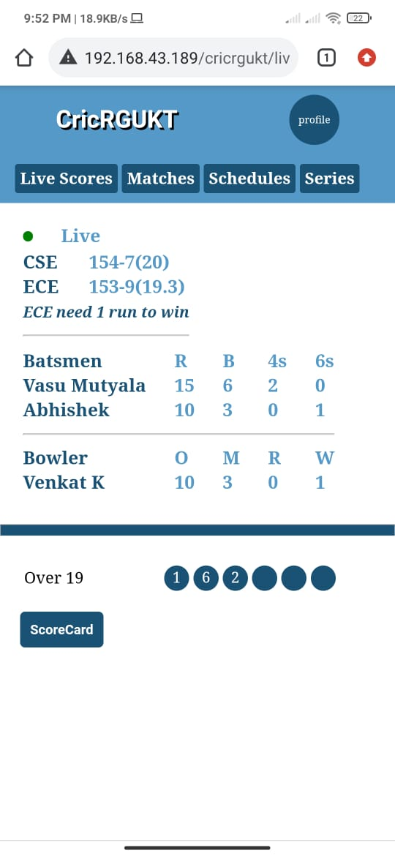
DETAILS OF PROJECT UPTO NOW
Live Score mobile view

Slide 19
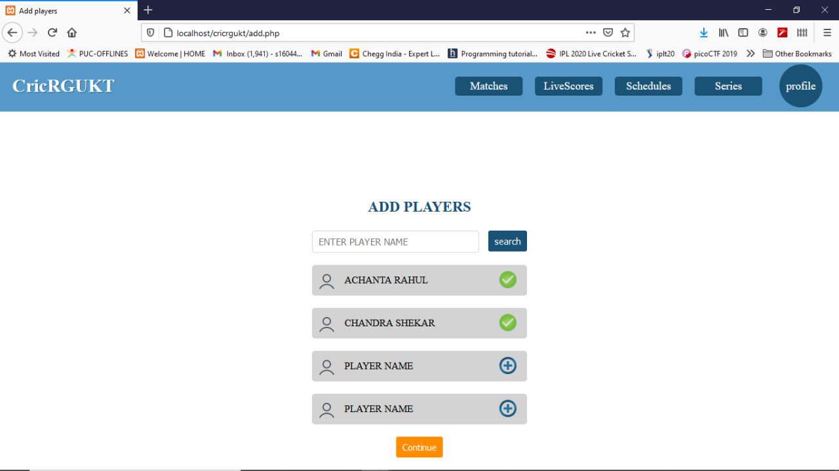
DETAILS OF PROJECT UPTO NOW Add players desktop view

Slide 20
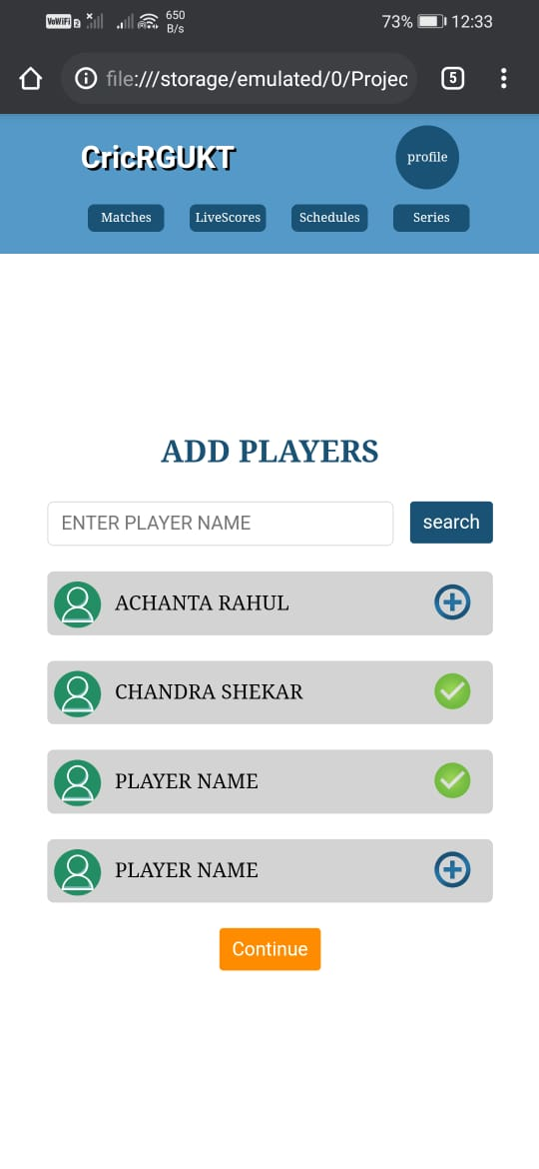
DETAILS OF PROJECT UPTO NOW
Add players mobile view

Slide 21
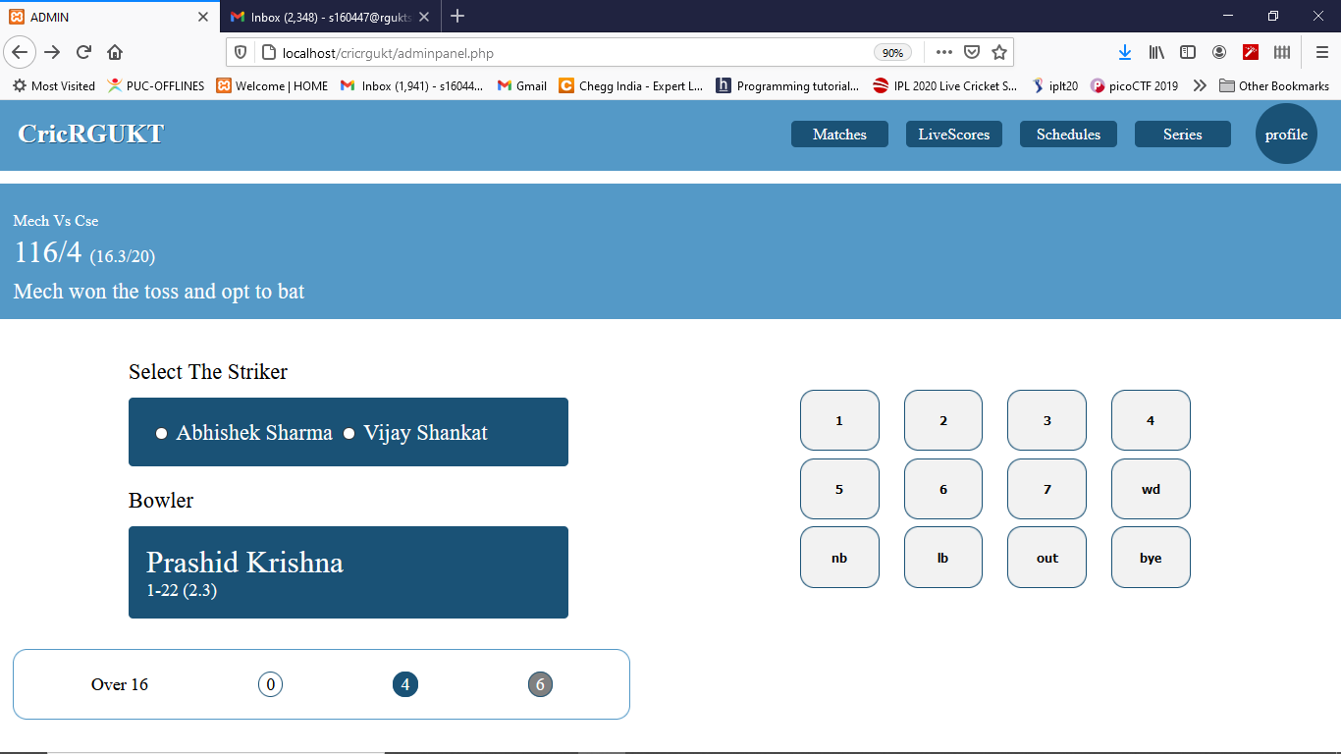
DETAILS OF PROJECT UPTO NOW
Admin page Desktop view

Slide 22
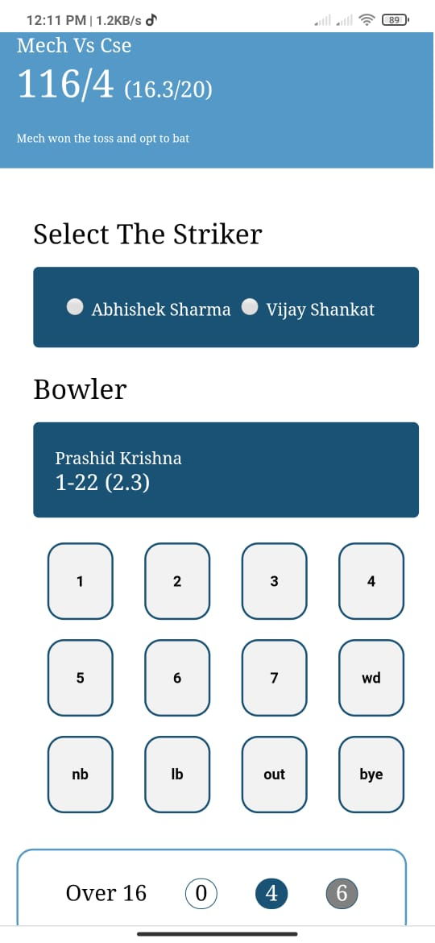
DETAILS OF PROJECT UPTO NOW
Admin page Desktop view

Slide 23
THANK YOU

