Slide 1
British Airways
Customer ratings analysis and insights
2023-10-03

Slide 2
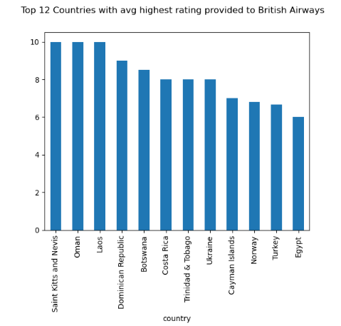
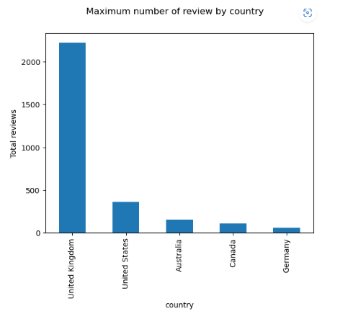
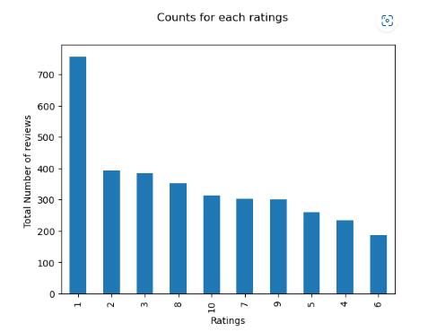



Key metrics

Slide 3

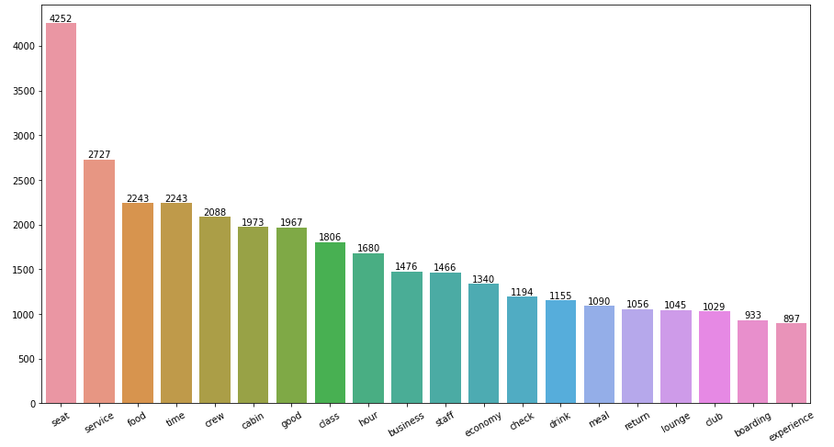
Key metrics
Average Overall Rating
4.83/10
Reviews from 69 Countries
3481Total reviews
collected
The top 6 words used in the reviews are:
1. Seat
2. Service
3. Food
4. Time
5. Crew
6. Good

