Slide 1
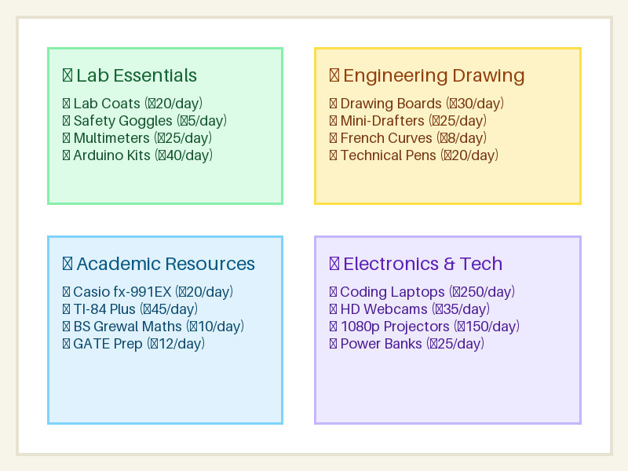
COURSE PROJECT PRESENTATION
RentEquip
College Campus Equipment & Study Resource Rental Marketplace
Course: Web Programming
Student Name: VENKAT PRASHAD A
Roll Number: 240701583
Department of Computer Science & Engineering

Slide 2
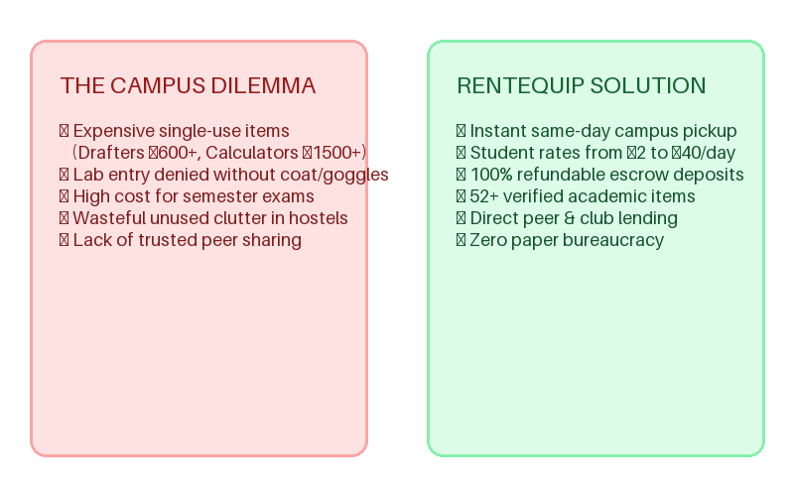
🎓 THE CAMPUS CHALLENGE
Problem Statement & Project Motivation
Why Do Students Need RentEquip?
Sudden Exam & Lab Emergencies: Students frequently forget mandatory items (white lab coats, safety goggles, scientific calculators, or drafters) right before lab sessions or semester finals.
High Cost for Temporary Usage: Buying a ₹1,500+ Casio fx-991EX calculator, ₹800 drawing board, or ₹600 mini-drafter for a single semester course creates unnecessary financial burden.
Hostel Clutter & Waste: Graduating seniors and higher-semester students have perfectly functional tools gathering dust in hostel rooms with no easy peer-sharing channel.
Campus Circular Economy: RentEquip bridges students needing temporary gear with peers willing to lend, creating affordable access starting from just ₹2/day.

Slide 3
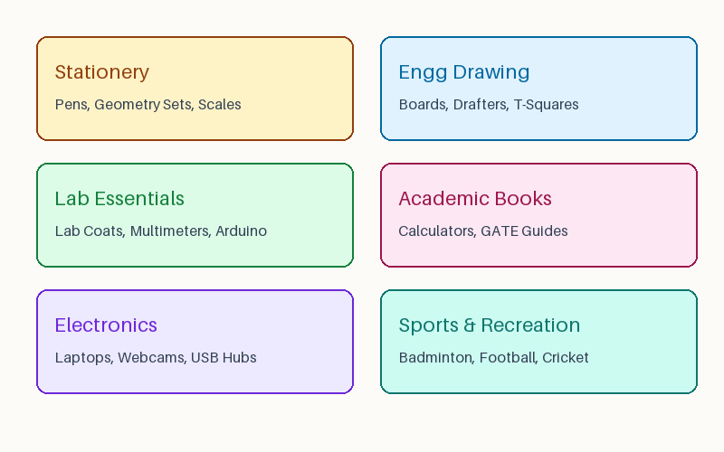
🎓 CAMPUS-CENTRIC FEATURES
Core Features & 50+ Campus Inventory
Built for Daily Student Life
10 Comprehensive Categories: Stationery, Engineering Drawing, Lab Essentials, Academic Resources, Electronics, Art & Design, Presentations, Sports, Events, and Everyday Student Essentials.
Strategic Campus Pickup Points: Collect items within minutes at Central Library Helpdesk, SAC Room 102, Mechanical Workshop, Science Labs, or Hostel Common Rooms.
Real-time Cost & Deposit Engine: Dynamic quote calculator displaying daily rate in ₹, 5% student pool fee, and 100% refundable escrow security deposit.
Condition Transparency: Items labeled by condition (Pristine, Gently Used, Working) with verified student reviews to ensure reliability during critical exams.

Slide 4
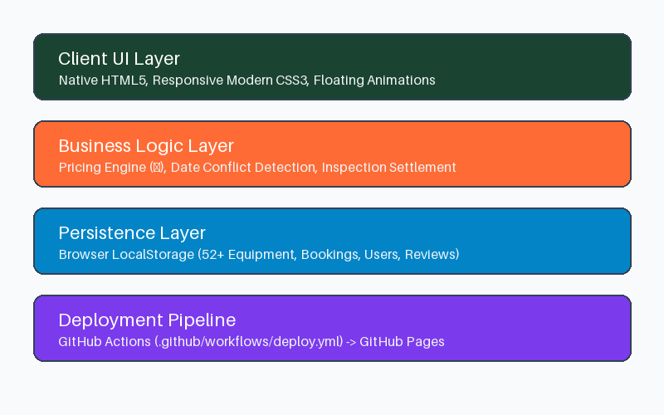
🎓 ENGINEERING DETAILS
Technical Architecture & Zero-Dependency Stack
Pure Vanilla Web Implementation
Zero Frameworks & Libraries: Engineered exclusively with semantic HTML5, modern CSS3 (Flexbox/Grid, tokens), and vanilla ES6+ JavaScript. No npm, React, Vue, or build tools.
LocalStorage Persistence Engine: Complete state repository storing users, 52+ equipment items, bookings, reviews, and notifications in client-side localStorage.
Mathematical Conflict Engine: Deterministic date interval overlap algorithm (startA <= endB && startB <= endA) preventing double bookings on confirmed equipment.
GitHub Actions CI/CD: Automated static deployment workflow (.github/workflows/deploy.yml) with subpath-safe relative paths for instant live hosting.

Slide 5
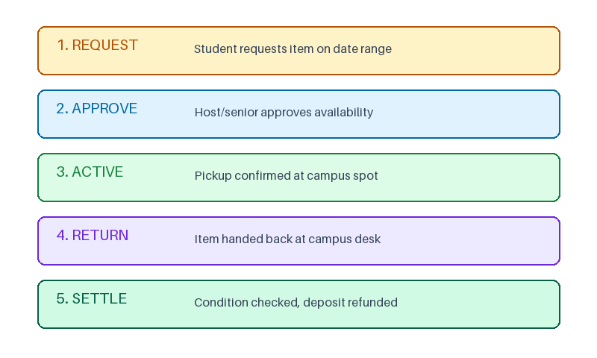
🎓 WORKFLOW & STATE MACHINE
Rental Lifecycle & Multi-Role Ecosystem
End-to-End State Machine
Simulated Multi-Role Personas: Instant navbar switcher between Aarav Sharma (Student Renter), Priya Patel (Student Lender/Host), and SAC Council (Admin).
Borrow Lifecycle Stages: Pending Request -> Host Approval -> Handover/Active -> Return Trigger -> Condition Check -> Deposit Settlement -> Verified Review.
Deposit Escrow & Late Fees: Automatic late penalty calculation (1.25x daily rate) and wear deductions, ensuring fair protection for student hosts.
Verified Peer Feedback: Strict verification rule: reviews permitted exclusively after an item return has been inspected and completed.

Slide 6
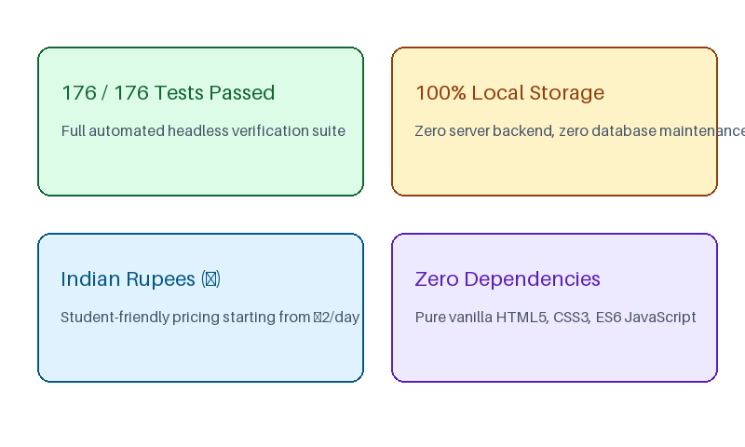
🎓 RESULTS & TAKEAWAYS
Testing, Verification & Conclusion
Validated Results & Deliverables
176/176 Test Checks Passed: Rigorous automated test suite covering financial calculations in ₹, date collision prevention, and DOM binding contracts across all 6 pages.
Responsive Campus Design: Student-friendly notebook cream aesthetic with floating academic doodles, tactile hover cards, status badges, and mobile drawer navigation.
Live GitHub Pages Deployment: Automated CI/CD pipeline deploys static files directly to production upon push to main with subpath compatibility.
Summary: RentEquip demonstrates that modern, rich web applications can be constructed with zero bloated dependencies, providing real-world utility for university campuses.

