Slide 1
VBG Online Digital - Case Study
Aug 2020

Slide 2



VBG Online - Application Overview
Verizon Online Portfolio for enterprise comprises of set of self serve functions available online for Verizon’s enterprise customers (VEC) as well as a bunch of support functions exposed on an employee portal (VECRM) available for Verizon call center representatives who assist their end customers. The self service functions include but not limited to online billing, ticketing, eCommerce as well as e - Bonded capabilities. The portals provide heightened authorization controls for registration and entitlements
As of today, this VEC application supports ~110K online customer users and VECRM application supports ~9K VZ Employees
Technology Stack involves - Java + Restful services + Apigee + Angular 5
As part of Verizon Large AMBER deal Infosys supports the Application Development with the Task Order process.
Infosys also responsible for the Application Maintenance efforts such as fixing root cause issues for JIRA/ETMS Production defects /Service NOW tickets. It also takes care of Verizon’s stringent Security requirement by doing regular static/dynamic code scans and Black duck scans and also provide remediation plans as appropriate
We are 70% AD and 30% AM. Offshore/onshore is nearly 90/10%
BTN Idea is suggested and implemented in the application with notable business benefits.
Team size ADM Level
42
Peak Team size
50
Project start: Dec 31, 2019

Slide 3
Agile Scrum Process
Backlog Grooming and Sprint Planning Meetings Scheduled Every Iteration.
Sprint Review Meetings with Clients and business stake holders weekly once to discuss clarity on user stories and for demo
T-Shirt Size Estimation of Enhancements with Granular Level Tasks each having Estimated LOE entered in JIRA.
LOE Approval Process and Clarity 2.0 Authorization with Service IDs availability For Enhancement Effort to begin.
Daily Offshore and Onshore Scrum Stand Up Meetings.
Scrum Sprint Dashboard maintained in JIRA for the Enhancements Effort and Developers update the progress in JIRA Tasks with Effort Spent everyday.
Weekly internal huddle meetings conducted within the team for internal progress checkpoint
Change Requests follow the same LOE Estimation process with getting added to Backlog for prioritization in the next Sprint.
Sprint Retrospective Meeting Scheduled every Iteration at the end of the Sprint on the learning of what went good and what needs to be improvised in the upcoming Sprint

Slide 4
Standard Operating Procedures

Slide 5








Verizon Enterprise Center
>60K
Total Customers
$13M
Online Payments /day
> 15K
Invoice Views /day
Network
Security
Cloud
>215K
Interfacing app incoming calls/day
9.5M
Page Views /day
80%
Service Online vs. Offline
World-Class Online & Mobile Customer Self-service
Integrated across all VES Products & Services
Robust application security & entitlement management
Service Assurance
Ordering
Billing
Automated Tools
Managed Services
Professional Services
Reporting
170
Developers (US, Peru, India)
>5.9M
Lines of Code
~1000
Automated test cases
~400 Deployments /wk
6,794
Change Packages to prod yearly
~100
DB changes to Prod /wk

Slide 6
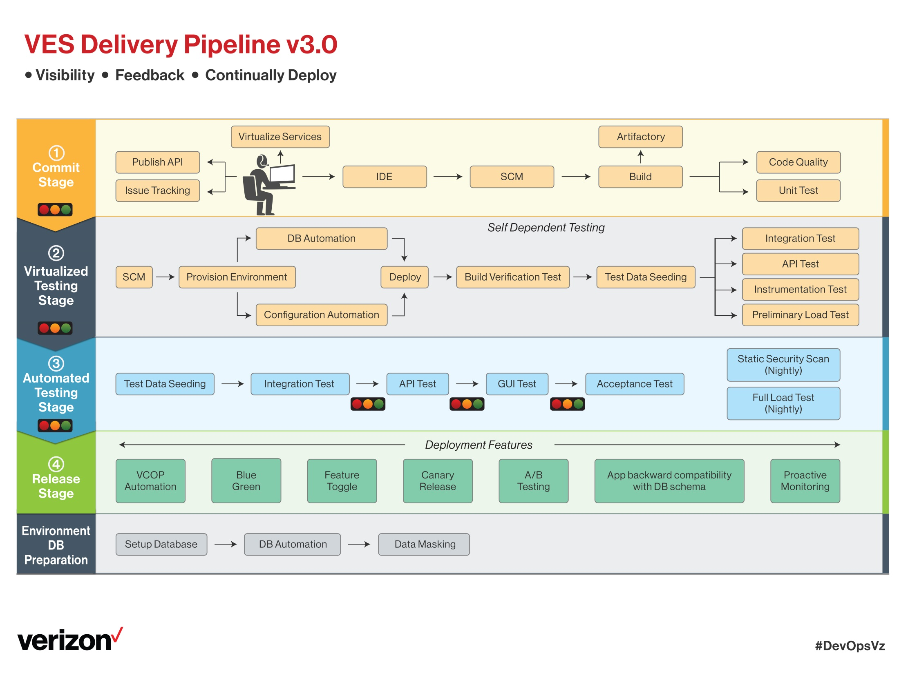
CICD Assessment completed with SPRINT status

Slide 7
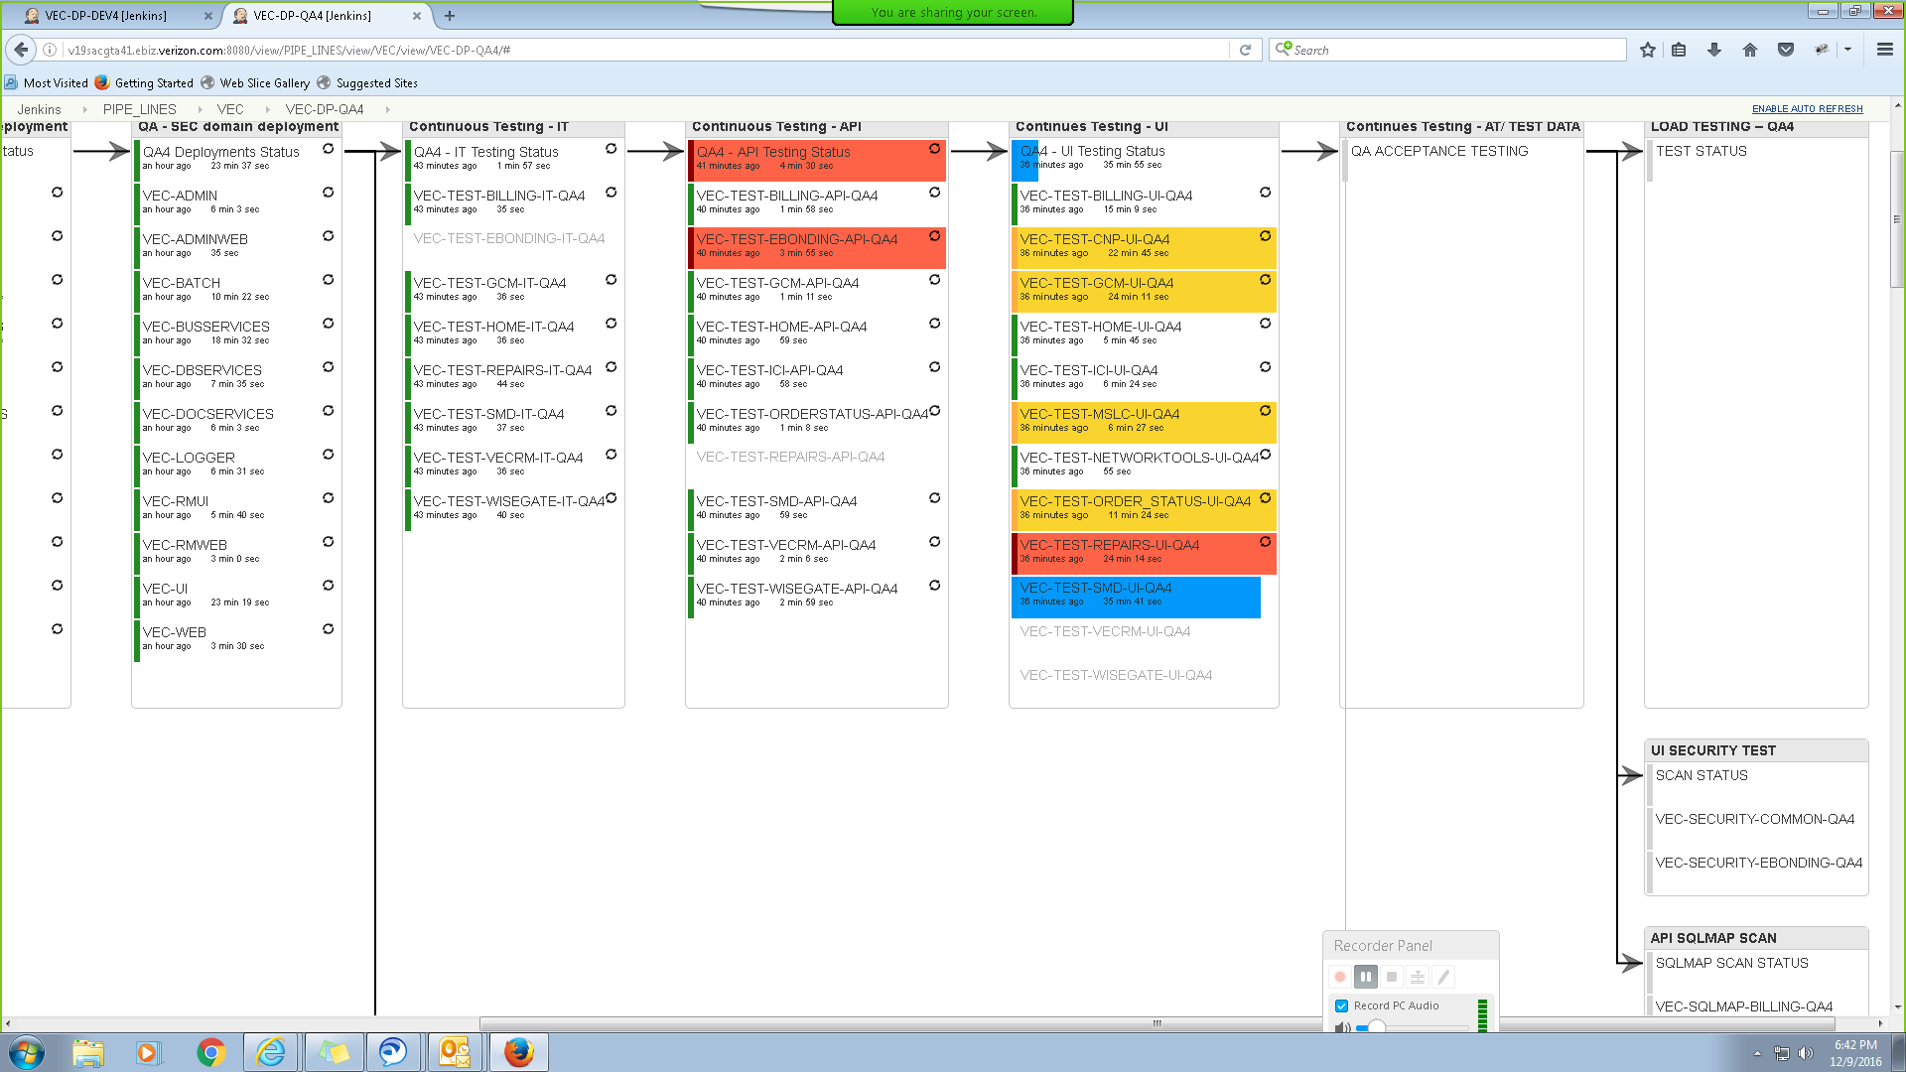
Verizon Enterprise Center – CICD
Automated Delivery Pipelines
Automated Notifications (every step of the process)
Automated deployment has been scheduled for once in 3 hours
Plan for CICD Metrics dashboard
Plan to configure Hygeia dashboard to globally monitor CICD build / deployments
Configure Simple Jenkins dashboard to monitor CICD process. Metrics captured manually today

Slide 8
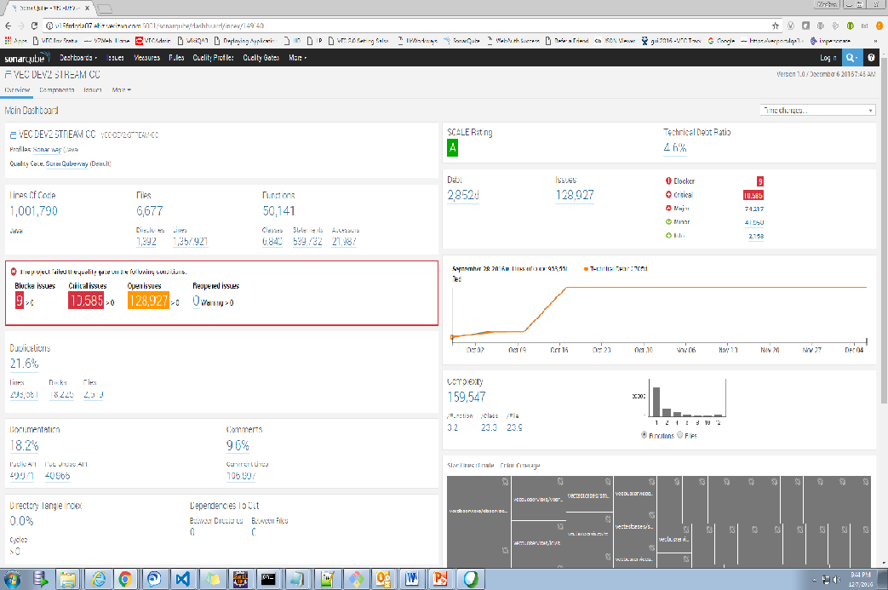
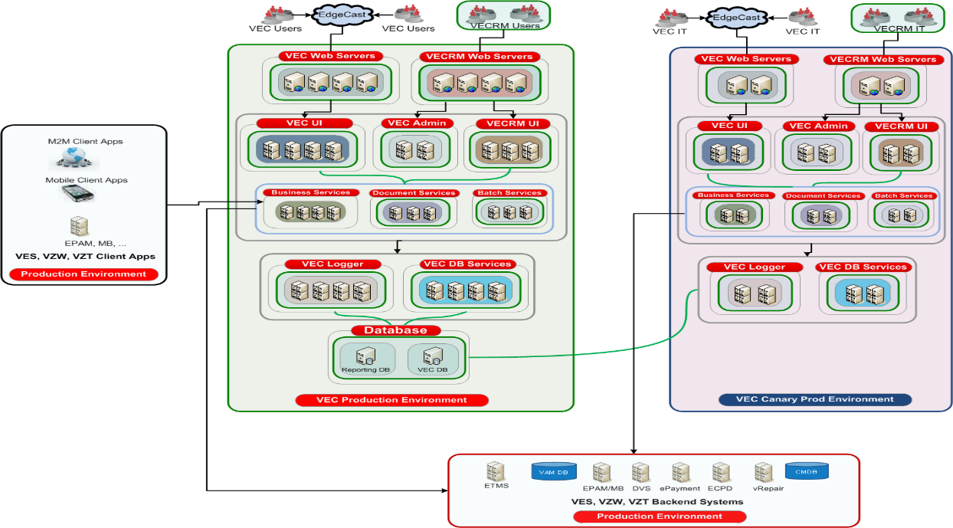
VEC Automated Operations – Quality
Sonar covers the 7 sections of code quality
PMD Integration with Sonar – In progress
Code Smells
Unit tests
Duplicated code
Potential bugs
Complex code
Coding standards
Comments
Canary Environment
Scaled down middleware environment for IT only testing
Exactly setup like prod
Validate new code in advance with prod back-ends
Next Steps in roadmap
Selenoid – AWS Docker implementation for Test Automation
Improve smoke test coverage by 40% besides saving infrastructure costs for VZ
8

Slide 9
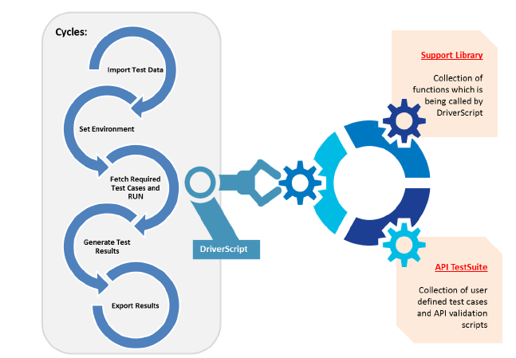

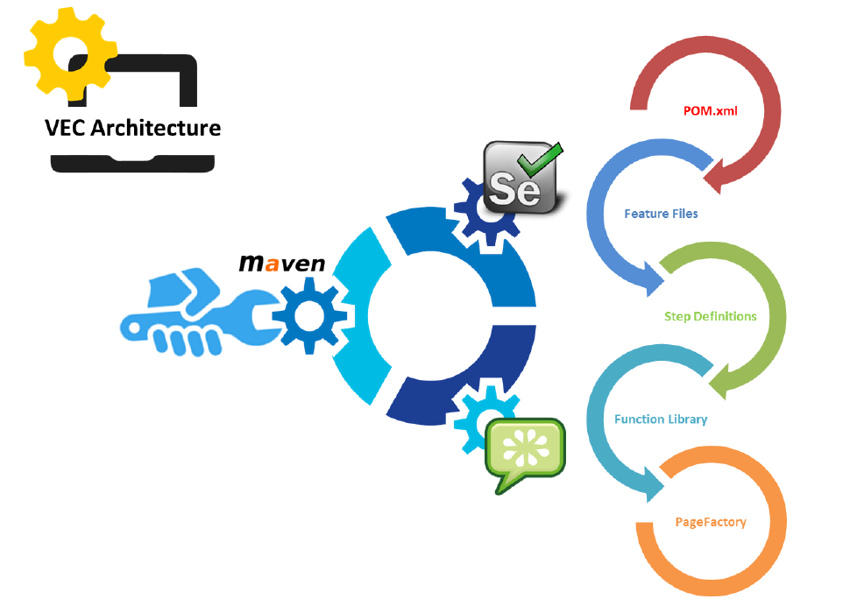
VECRM Automated Operations - Testing
API
Test Automation Architecture
UI
We are at 80% test automation coverage on this framework
With new platform migration, Cucumber BDD Framework coupled with selenium-protractor. Best practice use case being evaluated and tracked in the Automation roadmap
9

Slide 10







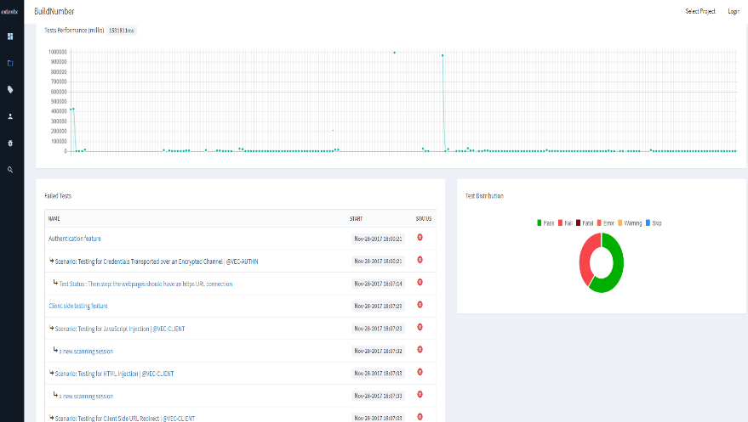
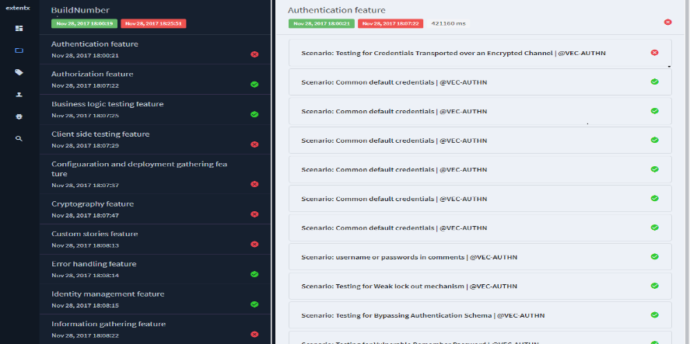
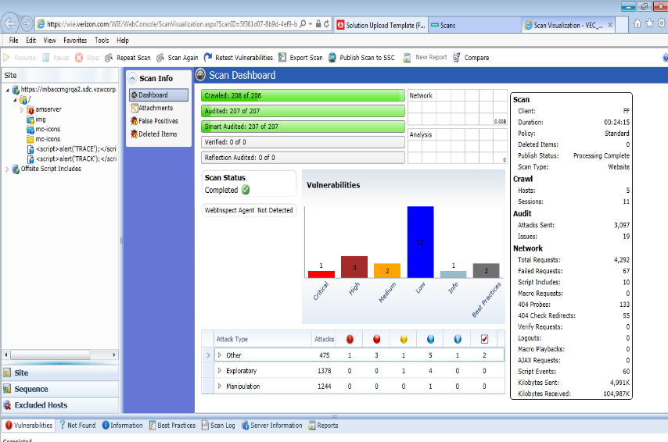
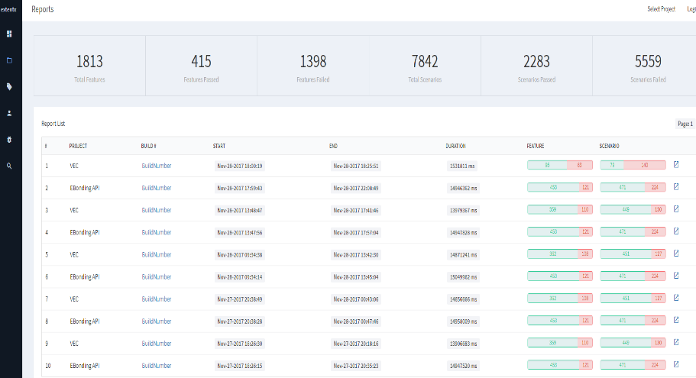
DevSecOps - Security
Automated & Integrated Scanning & Analysis
Scanning & Dashboard
Pipeline Integration
BDD – Security Framework
WebInspect
SQLMap
Threat Modeling Analysis
BDD Security (Selenium & ZAP API)
10

Slide 11
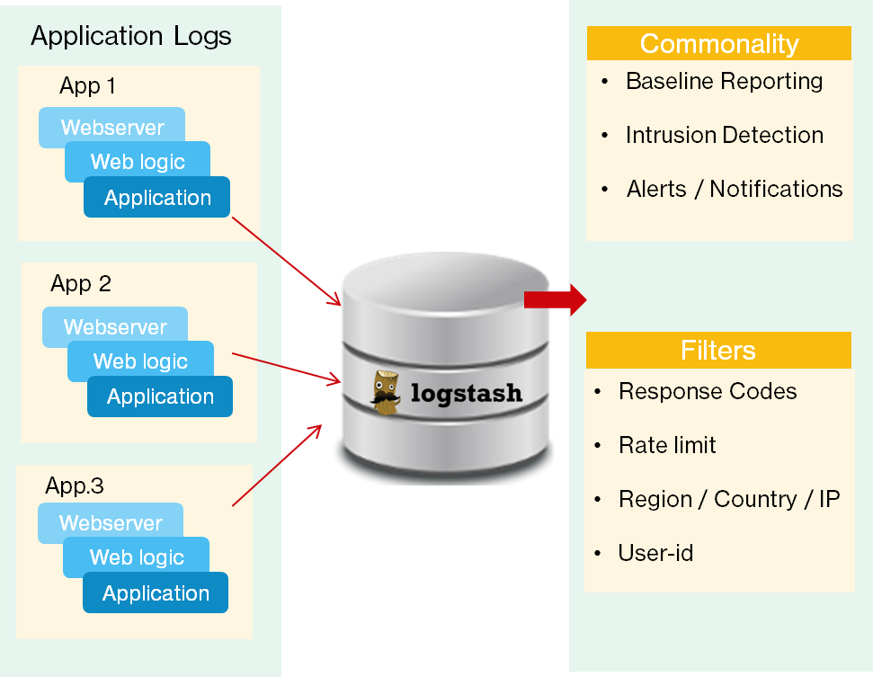
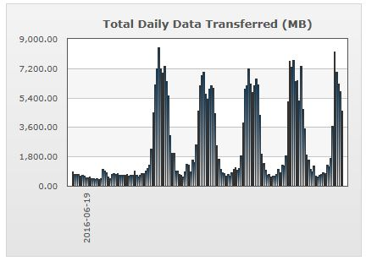
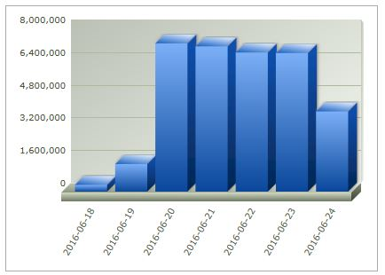
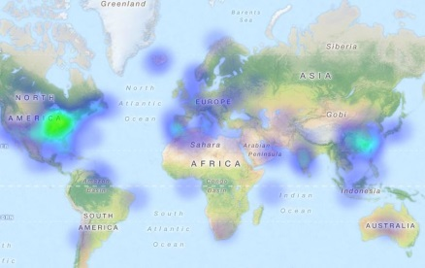
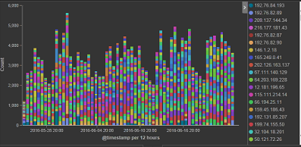
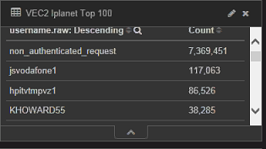
Streamlining & Standardizing Application Logging Practices
ELK Stack
Daily operational monitoring of anomalous data conditions
Log Analysis
Intrusion Dashboard
Alerts
CA-APM Alerts
Public URI Responses
Sample View From VEC application
Data Volume
URL Hits
Location
Recent Accomplishments – June2020:
Create AppSec logging framework with usecases to push to central Splunk
Separate Federal logs to different server to enable Prod clearance request from InfosysDTS
IP
User-ID
Views by:
Quarter
Month
Week
Hour
Exception Based Notify
11

Slide 12
BTN Payment Auto-Reprocessing
Opportunity :
Payments submitted online through Verizon Enterprise
Center portal are sent to backend for processing. Often
when there is a failure in backend system, the payment
fails and customer is required to resubmit the transaction
by submitting an incident. This adversely impacts the
online experience.
Implementation:
We can auto reprocess payment transactions that are
failed or Pending due to intermittent downstream system
issues. We have implemented a daily batch that will
monitor transactions that got failed and will resubmit
those transactions same day
Benefits: Around 20 calls per month is saved for Verizon due to this automation. This relates to around 8% of their total call volume. This will result in around 4.3K USD annual savings.

Slide 13
Lean Automation Improvements
Opportunity :
PDF – Online Bill data comparison which is being tested manually can be automated
Every line item of the bill and the associated charges have to be compared manually
It is a mundane task and takes up at least 7 min to validate one bill
Bills for at least 21 OSIDs are validated for every weekly release
This validation has been automated using Automation Anywhere which completes all the test cases in less than 3 minutes
Implementation:
Benefits: Around 98% savings achieved in the time required for online invoices validation.

Slide 14
DevOps Metrics
KPI | Metrics | CI/CD | CI/CD
 |  | RUN | SPRINT | Suggestions
Unit test coverage | Unit test coverage | 20 | 59 | JUNIT/JACOCO
Unit test success rate | Unit test success rate | 25 | 48 | SonarQube
Rule compliance/violations | Rule compliance/violations | 10 | 0 | SonarQube Scans
Code Review | Code Review % | 50 | 82 | SonarQube Scans
Build Time | Average (Time when build was completed - time when build was triggered) | 60 mins | 39 mins | Jenkins/GIT-Lab Repo
Successful builds | Number of successful build/ Total number of builds | 20 Per Day | 24 Per Day | Jenkins/GIT-Lab Repo
Builds /Day | Specifically on the Dev environment/Branch | 24 Per Day | 30 Per Day | Jenkins
Production Deployment Frequency | How often is the team deploying new code to production? | Monthly | Weekly | Jenkins pipeline
Release date adherence percentage | Whether the planned and actual release dates were same? | 90 | 100 | Jenkins
Deployments/Day | How often is the team deploying new code to various environments (not just production)? | Weekly | Daily | Jenkins/Ansible /Shellscript
Change Volume | How many user stories/changes are being deployed? | 10 | 20 | Jenkins
Lead Time (from development to deployment) | Time lag from when new code starts getting developed to when it successfully gets deployed into production | 1 Month | 1 Week | Jenkins
Percentage of Failed Deployments | What is the percentage of deployments which have caused an outage or negative user reaction OR could not be successfully deployed to production | 5% | 0 | Jenkins/Ansible /Shellscript
Percentage of successful Deployments | What is the percentage of deployments which were successfully deployed? | 95 | 100 | Jenkins/Ansible /Shellscript
Failed builds | Number of build failures | 15% | 5% | Jenkins

Slide 15
Key Performance Indicators – Application Development
15
# | Parameters | Target | Jul | Aug | Sept | Comments
1 | Schedule Adherence | >=95% | 100% | 100% | 100%
2 | Estimation Accuracy over/(under) |  | 0% | 0% | 0%
3 | Defect Density |  | 0.02 | 0.02 | 0.02 | Defect Density (QA + UAT) Per Unit Size.
4 | Readiness | >95% | 100% | 100% | 100%
5 | Change Requests | 10% | 0% | 0% | 0% | (Effort of the Change Request/Total WR Effort) * 100
6 | Defect Injection Rate |  | 0.60 | 0.61 | 0.61 | Number of defects injected during coding/Rework Effort of coding
7 | Delivered Defect Density |  | 0.23 | 0.27 | 0.29 | Defect Density (QA + UAT) Per Unit Size
8 | Story Point Variance |  | 100% | 100% | 100% | Delivered vs Estimated Story Points
9 | Productivity |  | 10.5 | 9.3 | 7.2 | (Total Story Points*8/160)/Total Persons in a month We aim at maintaining at least 95% sustained productivity
10 | Velocity |  | 67 | 41 | 37 | Number of Story Delivered Per month
11 | Done User Stories |  | 100% | 100% | 100% | (User Stories Delivered/User Stories Planned)* 100
12 | Code Quality Change | <=2 | 0 | 0 | 0 | # of Emergency Code changes within 5 days of Code Delivery per Application tracked per Quarter => Warranty Period for Code Changes
13 | Rework | <30% | 5% | 9% | 10% | Relates to the defect density metrics and hence the rework effort
14 | Testing Effectiveness | 100% | 99% | 97% | 95% | Objective is to ensure 100% test effectiveness

Slide 16
Key Performance Indicators – Application Maintenance
16
Category | Jul | Aug | Sep | Comments
Overall Ticket Closure Rate | 99% | 98% | 97% | Tickets Closed/Total Open Tickets for the Application. Our objective is to improve to 80%
Overall Ticket Inflow Rate | 24% | 58% | 22% | Tickets Opened per month/Total open tickets for the application SLA Metrics not available since team is not using AYS and uses ETMS for Prod tickets
P1 Tickets Closure Rate | 100% | 100% | 100% | P1 Tickets Closed/Total Open Tickets for the Application
P1 Tickets Inflow Rate | 88% | 52% | 84% | P1 Tickets Opened /Total Open Tickets Open for the Application
Bug Fix Productivity | 23.2 | 24.9 | 21.0 | Total No. of Bugs Fixed /Person Month Internal target is to maintain 25
Aging View of Tickets | 2.67 | 4.2 | 2.2 | Monthly average age of tickets Verizon recommended age – not greater than 7 Days average age
Security Vulnerabilities | Fortify-0 Blackduck- 758 | Fortify-0 Blackduck-433 | Fortify-0 Blackduck-380 | Critical, High, Medium, Low Fortify/Black duck Vulnerabilities
Aging View of Vulnerabilities | 5 Days | 5 Days | 5 Days

Slide 17
L3 Measurement Analysis – Customer ticket trend
Best Practices Followed
Several customer tickets on backlog with Helpdesk team pending clarification or confirmation from reporter to close
A regular weekly cadence set up with Tier2 VZ Helpdesk team to clarify issues and push the closure of pending tickets
A regular pattern of decrease in the number of outstanding tickets noticed from Jan to March. 12% decrease in Feb and 19% in March, with an overall decrease of 29%

Slide 18
Silver to Gold Assessment

Slide 19
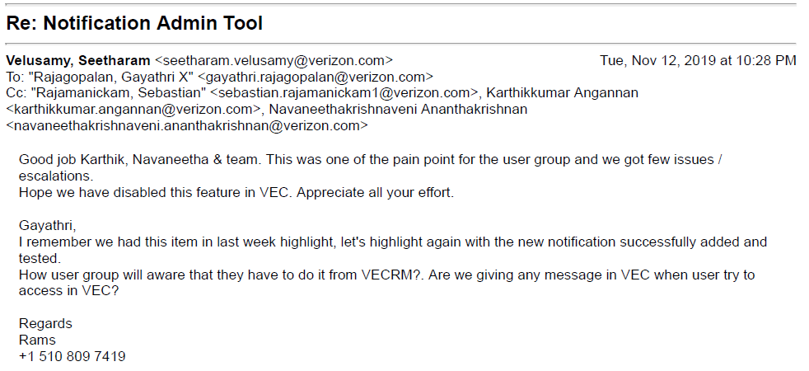
Client Requested Action Items and Feedback
Customers had pain point in updating marketing communication and notifications from an existing Admin tool. The tool had issues supporting marketing content, rich text etc which customer wanted us to address
The tool was analyzed for a tech refresh and was revamped to the new platform using Angular 5 and native Apigee exposed APIs. Team analyzed that the revamp would require lesser effort and better experience rather than fixing the legacy tool
The tool was implemented in a 3 week window and was well appreciated by Clients
All COVID-19 notifications to VZ Enterprise online customers are being posted from the new tool!!

Slide 20
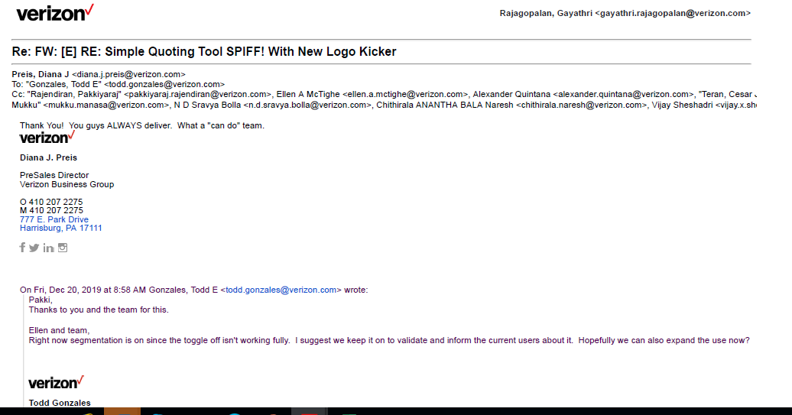
Client Recognition and Appreciation
Successful launch of the Simple Quoting tool to medium business customers within just 2 Iterations

Slide 21
Below are techniques/levers/opportunities considered in the analysis to improve the margin.
Agile Scrum Process Integrated to achieve the speed to market with frequent demos to Client with early feedback to correct any deviations faced.
DevOps CICD pipeline integration with Fortify/Black duck/SonarQube integration for Code review, Jenkins Build Deployment, Code Coverage tools and Automation HCs in QA improvising on the code quality with reduced Manual Effort.
BTN Ideas implemented successfully in production with nearly 4.3K savings
Lean Automation Improvement resulting in 98% improvement in test execution timelines for PDF Invoices

Slide 22
Thank You

