Slide 1
VBG Online Digital - Case Study
Aug 2020

Slide 2



VBG Online - Application Overview
Verizon Enterprise Customer Relationship Management helps sales, service, assurance and planning team to have a customer-centric view of revenue, Voice of Customer Scores, Details of circuits, Services Information and issues etc. Under Case management umbrella, application helps to track and manage various customer-centric issues spread across billing, ordering or assurance domain in one central place. This system will also provide near real-time data from work horse systems in the area of sales, forecasting, provisioning, billing, repair and monitoring.
As of today, VECRM supports ~10k VZ Employees
Technology Stack involves - Java + Restful services + Apigee + Angular 5
As part of Verizon Large AMBER deal Infosys supports the Application Development with the Task Order process.
Infosys also responsible for the Application Maintenance efforts such as fixing root cause issues for JIRA/ETMS Production defects /Service NOW tickets. It also takes care of Verizon’s stringent Security requirement by doing regular static/dynamic code scans and Black duck scans and provides remediation plans as appropriate
We are 70% AD and 30% AM. Offshore/onshore is nearly 90/10%
BTN Ideas have been shared with client / business with notable business benefits
Team size ADM Level
15
Peak Team size
25
Project start: Dec 31, 2019

Slide 3
Agile Scrum Process
Backlog Grooming and Sprint Planning Meetings Scheduled Every Iteration.
Sprint Review Meetings with Clients and business stake holders weekly once to discuss clarity on user stories and for demo
T-Shirt Size Estimation of Enhancements with Granular Level Tasks each having Estimated LOE entered in JIRA.
LOE Approval Process and Clarity 2.0 Authorization with Service IDs availability For Enhancement Effort to begin.
Daily Offshore and Onshore Scrum Stand Up Meetings.
Scrum Sprint Dashboard maintained in JIRA for the Enhancements Effort and Developers update the progress in JIRA Tasks with Effort Spent everyday.
Weekly internal huddle meetings conducted within the team for internal progress checkpoint
Change Requests follow the same LOE Estimation process with getting added to Backlog for prioritization in the next Sprint.
Sprint Retrospective Meeting Scheduled every Iteration at the end of the Sprint on the learning of what went good and what needs to be improvised in the upcoming Sprint

Slide 4
Standard Operating Procedures
Phase
Entry
Task
Verfication
Exit
Deliverable
Ownership
Application Development
Release Planning
Release prioritization and
Concept Review by online marketing
Marketing team(Dawna) accepts
High level User Stories
High Level User stories
VZ
Shibumi tracker
defined
1. Grooming sessions involving VEC
1. Dev reviews and accepts
1. Dev accepts and sign off
1. Groomed user story in Jira
Backlog Grooming
High Level User stories
BA, DEV SME, VZ business
users tories
groomed user story
2. Signed off Wireframes
Vz, Infosys
ready
2. Wireframes creation and branding
2. Business reviews design
2. Business signs off
ready
styles established for UI impacts
wireframes
wireframes
1. Groomed User story
1. Business agrees to the
1. Dev tasks and Subtasks
ready
Assign Dev resources. Create task and
sprint timeline and
Dev Tasks/ sub tasks created
ready for execution
Sprint Planning
2. Signed off Wireframes
subtask and schedule user stories to
deliverable
and due date updated in Jira
2. Approved wireframes
Vz, Infosys
ready
sprint
2. All CSS specifications ready
attached to user stories in
for UI development
Jira
1. Dev tasks and Subtasks
1. Develop and commit code to Git lab
1. Code Review and Unit
ready for execution
2. Any configuration/DB changes
testing completed
Sprint Execution
2. Approved wireframes
required are completed
2. DTP to review progress and
Tasks/sub tasks are QA ready
Tasks/sub tasks QA ready
Infosys team
attached to user stories in
3. Daily effort logged in Jira and status
huddles
Jira
update progress
1. Tasks/sub tasks QA
Sprint Review / Demo
ready.
Demo to VZ VTF and ATF and QA team
Demo accepted by VTF
Sprint deliverable signed off
User stories ready for QA
Vz, Infosys
2. High level scenario
by VTF
validated
Retrospection
User stories and agile
Review what went wrong and what
Team agrees to action items
Action items created and
Action items with owners
Infosys team
team available for Retro
can be improved
on Retro
tracked for progress
and ETA established
Application Maintenance
Ticket Queue Monitoring
ETMS
Create tickets in ETMS for customer
Tickets assigned to right
Email sent out to team distro
Ticket details shared with
Vz
incidents
queues
with ticket details
AM team
Ticket Resolution
ETMS / Jira
AM team creates Jira entry, resolves
Fix verified in QA
QA testing successful
Fix available with the
Infosys
the ticket and add effort in Jira
scheduled Release
Ticket Updates
ETMS / Jira
AM Team updates ticket status in Jira
VZ verifies issue resolution
VZ accepts the ticket fix
Fix working for end user
VZ, Infosys
and notifies VZ
AM Team tracks all ticket details in
List of tickets matches
AM Reports available for
AM Reports
Jira
Jira. Pulls consolidated reports from
between ETMS/Jira
AM Reports in Jira
tracking AM metrics
Infosys
Jira
Retrospection
Jira
5 Why analysis
Cause analysis documented
implementation plan for
Opportunities
Infosys
improvement
implementation

Slide 5








Verizon Enterprise Customer Relationship Management
>10K
Total Customers
>12K
Customer Specific Information View
> 105K
Dashboard View
Network
Security
Cloud
>200K
Interfacing app incoming calls/day
>100
Report Views
100%
Service Online vs. Offline
World-Class Online & Mobile Customer Self-service
Integrated across all VES Products & Services
Robust application security & entitlement management
Service Assurance
Ordering
Billing
Automated Tools
Managed Services
Professional Services
Reporting
25
Developers (US, Peru, India)
>5.9M
Lines of Code
~800
Automated test cases
~20 Deployments /wk
250
Change Packages to prod yearly
~100
DB changes to Prod /wk

Slide 6
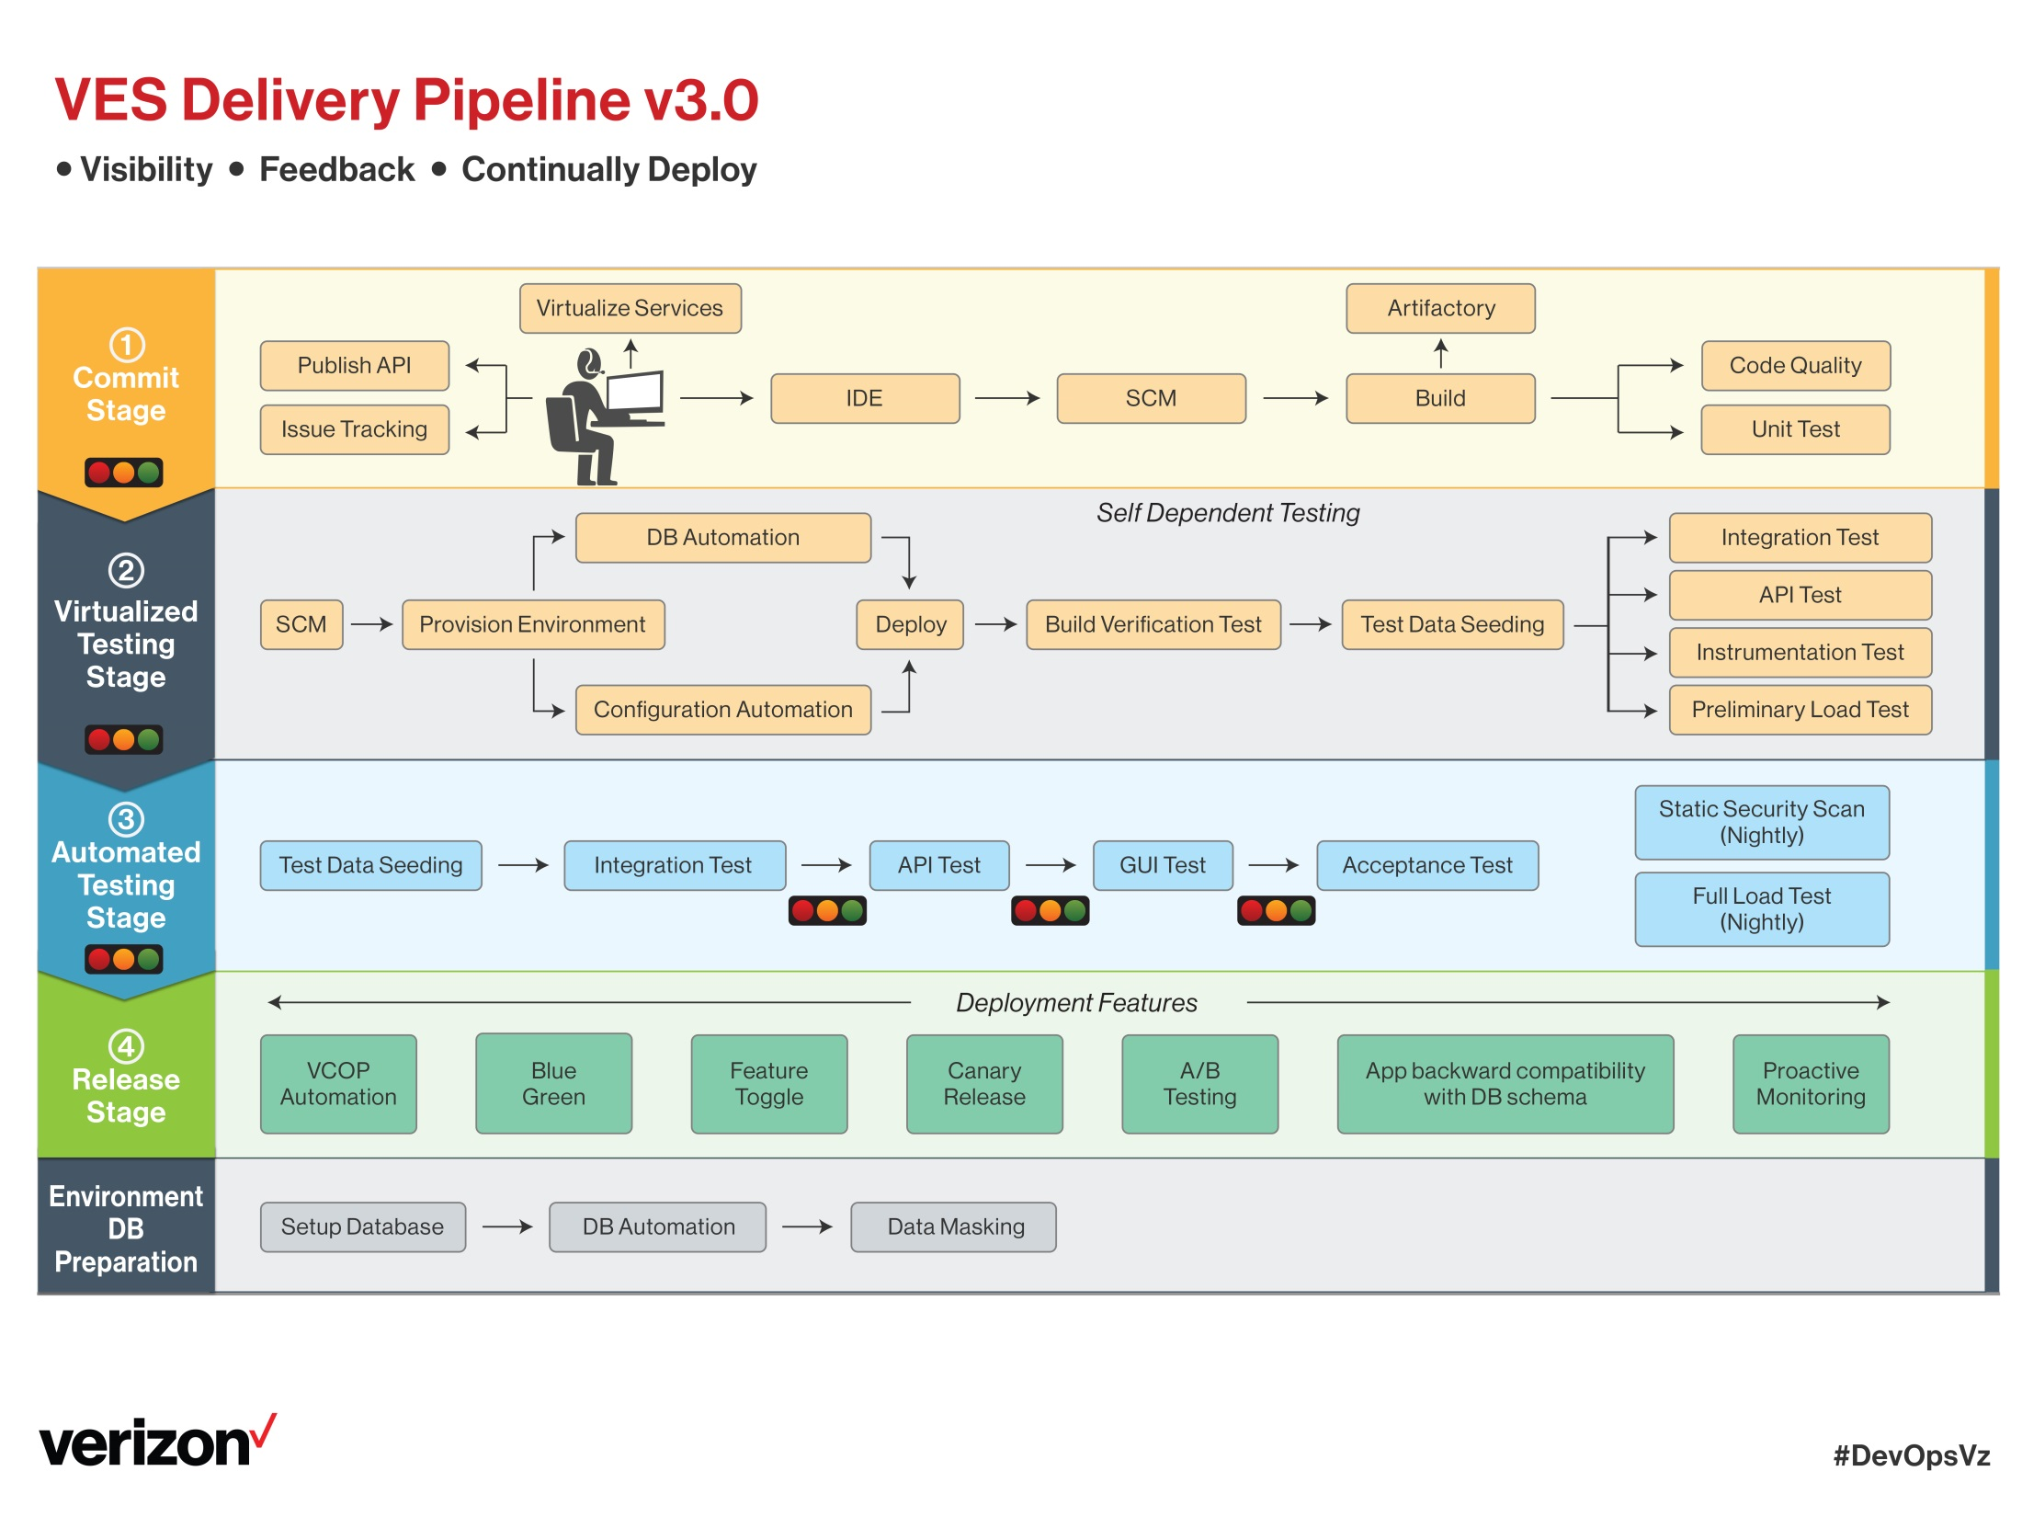
CICD Assessment completed with SPRINT status

Slide 7
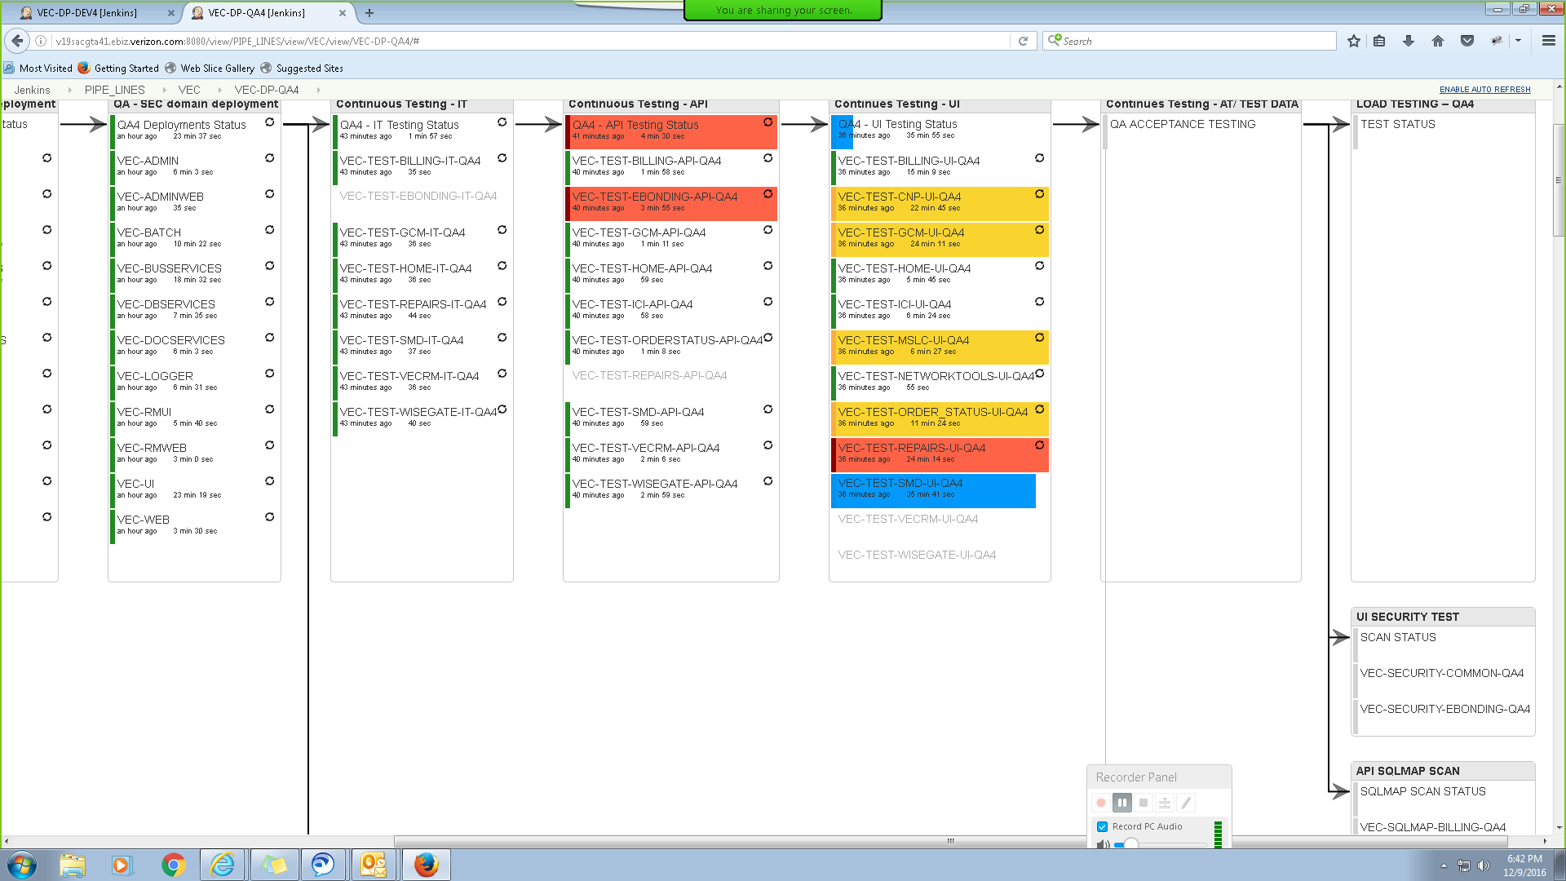
Verizon Enterprise Center – CICD
Automated Delivery Pipelines
Automated Notifications (every step of the process)
Automated deployment has been scheduled for once in 3 hours
Plan for CICD Metrics dashboard
Plan to configure Hygeia dashboard to globally monitor CICD build / deployments
Configure Simple Jenkins dashboard to monitor CICD process. Metrics captured manually today

Slide 8
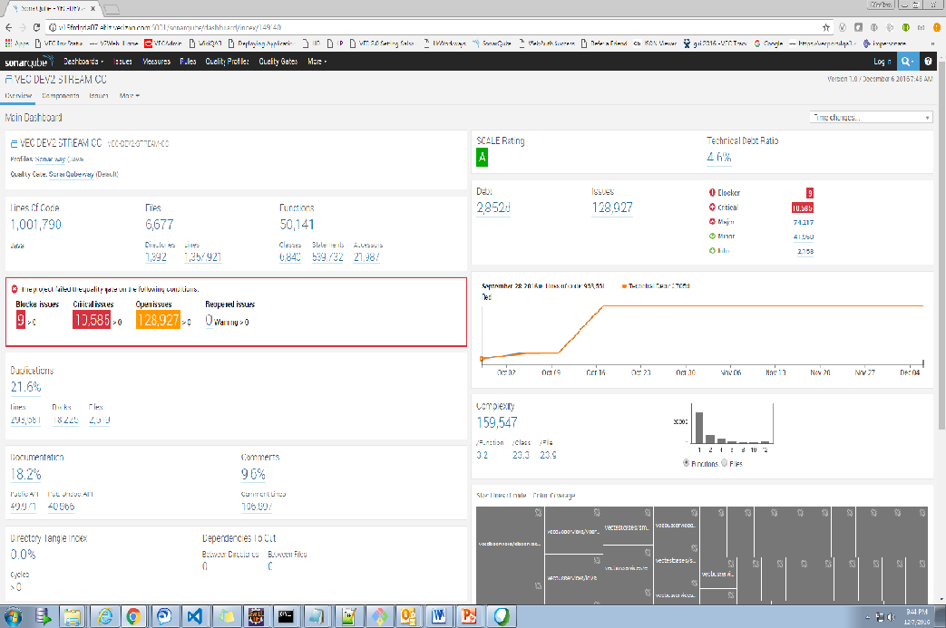
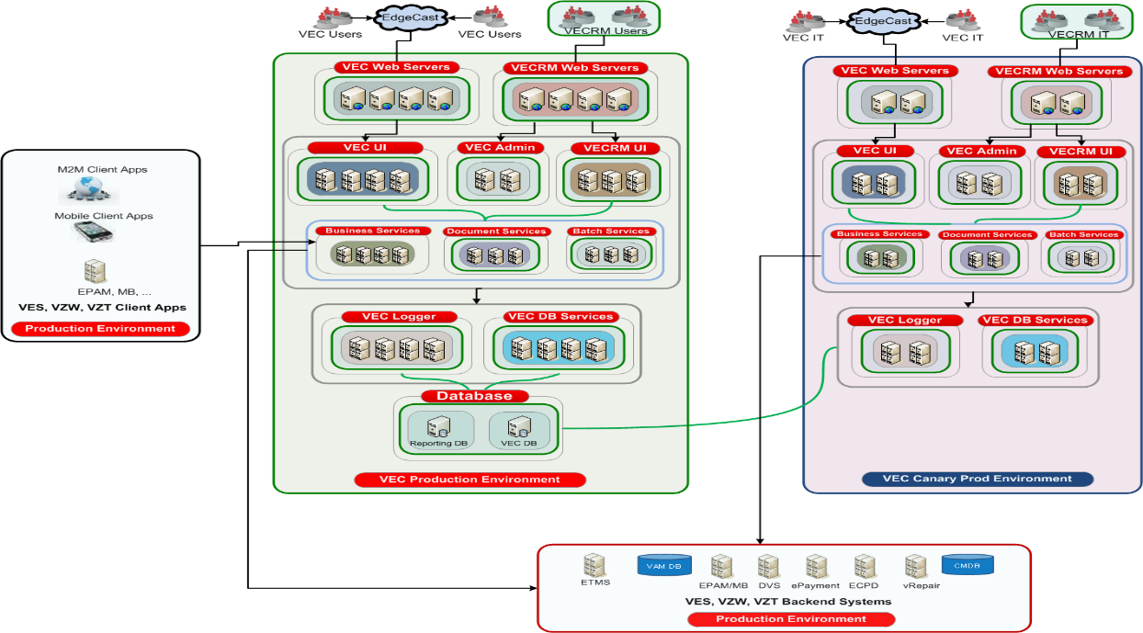
VEC Automated Operations – Quality
Sonar covers the 7 sections of code quality
PMD Integration with Sonar – In progress
Code Smells
Unit tests
Duplicated code
Potential bugs
Complex code
Coding standards
Comments
Canary Environment
Scaled down middleware environment for IT only testing
Exactly setup like prod
Validate new code in advance with prod back-ends
Next Steps in roadmap
Selenoid – AWS Docker implementation for Test Automation
Improve smoke test coverage by 40% besides saving infrastructure costs for VZ
8

Slide 9
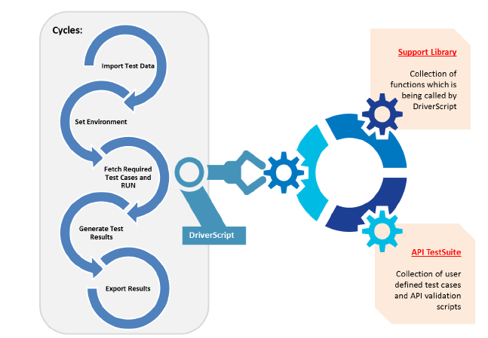

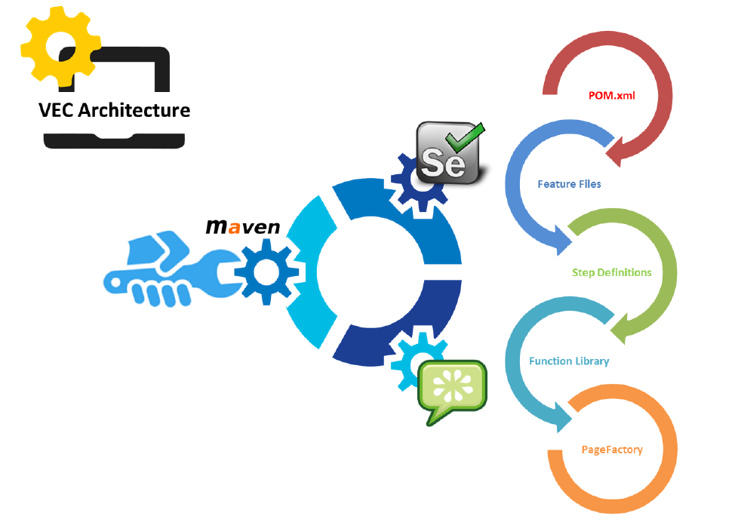
VECRM Automated Operations - Testing
API
Test Automation Architecture
UI
We are at 80% test automation coverage on this framework
With new platform migration, Cucumber BDD Framework coupled with selenium-protractor. Best practice use case being evaluated and tracked in the Automation roadmap
9

Slide 10







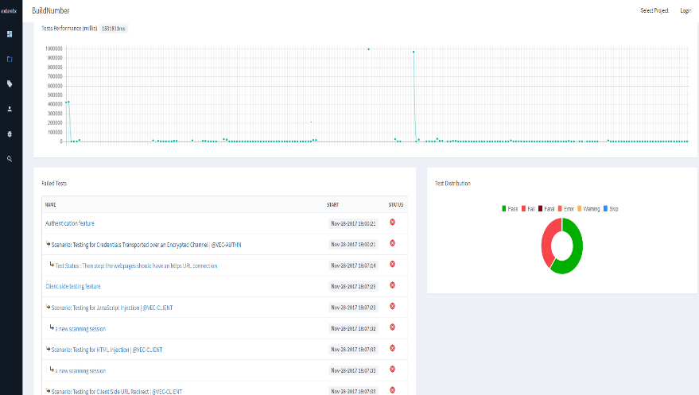
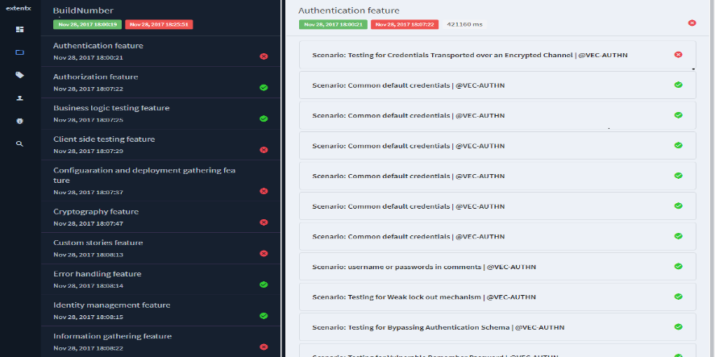
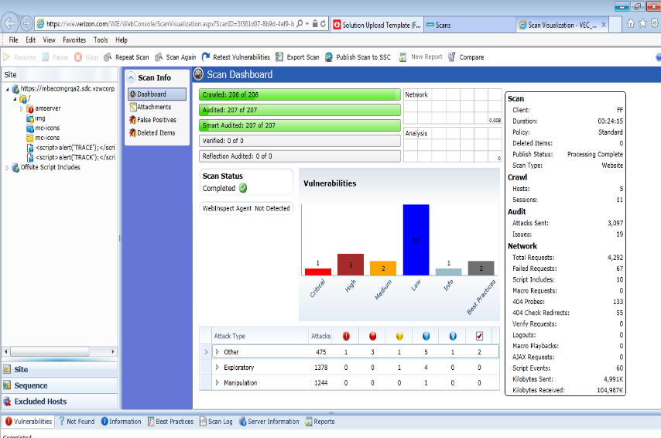
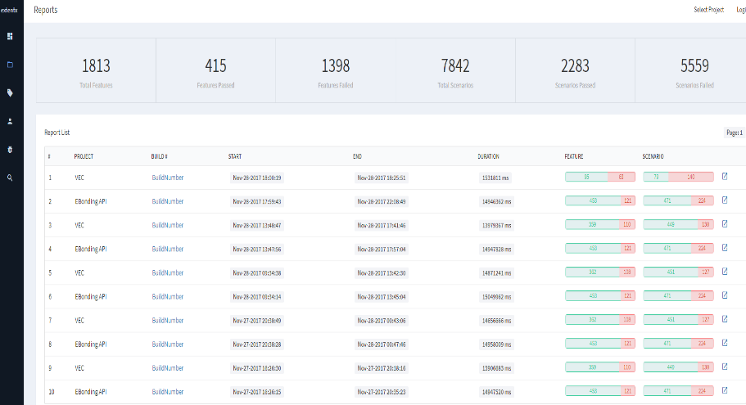
DevSecOps - Security
Automated & Integrated Scanning & Analysis
Scanning & Dashboard
Pipeline Integration
BDD – Security Framework
WebInspect
SQLMap
Threat Modeling Analysis
BDD Security (Selenium & ZAP API)
10

Slide 11
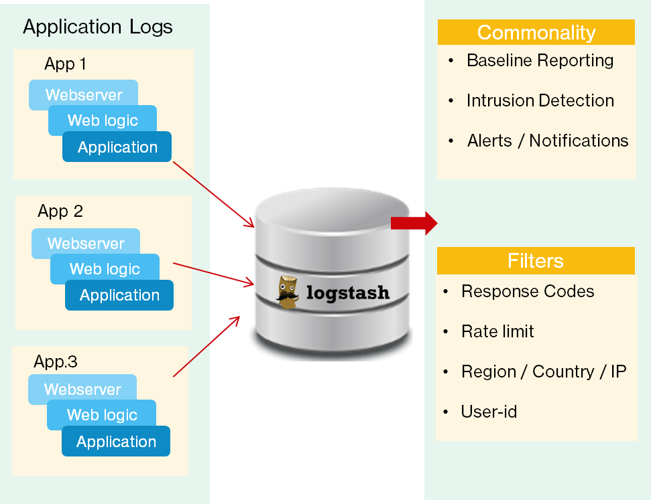
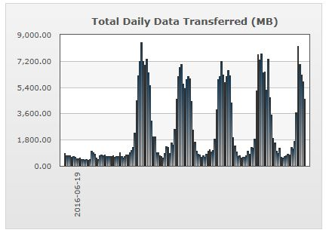
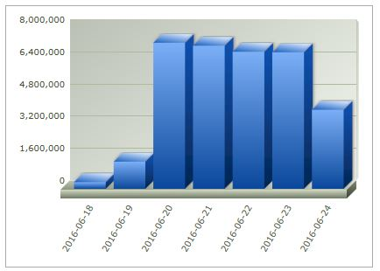
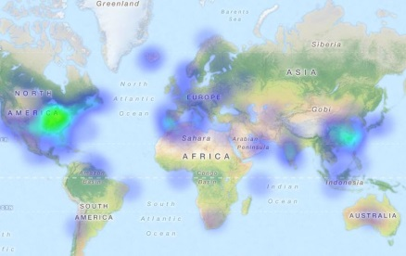
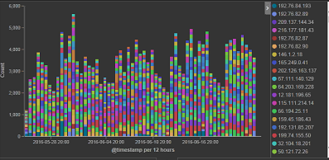
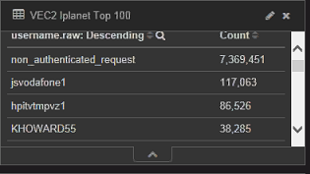
Streamlining & Standardizing Application Logging Practices
ELK Stack
Daily operational monitoring of anomalous data conditions
Log Analysis
Intrusion Dashboard
Alerts
CA-APM Alerts
Public URI Responses
Sample View From VEC application
Data Volume
URL Hits
Location
Recent Accomplishments – June2020:
Create AppSec logging framework with usecases to push to central Splunk
Separate Federal logs to different server to enable Prod clearance request from InfosysDTS
IP
User-ID
Views by:
Quarter
Month
Week
Hour
Exception Based Notify
11

Slide 12
Lean Automation Improvements
Opportunity :
Leverage the Regression automation test suite and using it on a daily basis
VECRM functionalities like dashboard, daily alerts, customer 360 , Kedb, DMS are all targeted
Customized suite using the reusable classes are built for all the regression test cases
Test suite run has been done on the daily basis
The entire regression suite run which includes testing all the critical functions and validations would take 45 mins.
Implementation:
Benefits: Around 90% savings achieved in the run time using the automated test approach rather than manual

Slide 13
DevOps Metrics
KPI | Metrics | CI/CD | CI/CD
 |  | RUN | SPRINT | Suggestions
Unit test coverage | Unit test coverage | 20 | 59 | JASMINE / KARMA
Unit test success rate | Unit test success rate | 25 | 48 | SonarQube
Rule compliance/violations | Rule compliance/violations | 10 | 0 | SonarQube Scans
Code Review | Code Review % | 50 | 82 | SonarQube Scans
Build Time | Average (Time when build was completed - time when build was triggered) | 60 mins | 39 mins | Jenkins/GIT-Lab Repo
Successful builds | Number of successful build/ Total number of builds | 20 Per Day | 24 Per Day | Jenkins/GIT-Lab Repo
Builds /Day | Specifically on the Dev environment/Branch | 24 Per Day | 30 Per Day | Jenkins
Production Deployment Frequency | How often is the team deploying new code to production? | Monthly | Weekly | Jenkins pipeline
Release date adherence percentage | Whether the planned and actual release dates were same? | 90 | 100 | Jenkins
Deployments/Day | How often is the team deploying new code to various environments (not just production)? | Weekly | Daily | Jenkins/Ansible /Shellscript
Change Volume | How many user stories/changes are being deployed? | 10 | 20 | Jenkins
Lead Time (from development to deployment) | Time lag from when new code starts getting developed to when it successfully gets deployed into production | 1 Month | 1 Week | Jenkins
Percentage of Failed Deployments | What is the percentage of deployments which have caused an outage or negative user reaction OR could not be successfully deployed to production | 5% | 0 | Jenkins/Ansible /Shellscript
Percentage of successful Deployments | What is the percentage of deployments which were successfully deployed? | 95 | 100 | Jenkins/Ansible /Shellscript
Failed builds | Number of build failures | 15% | 5% | Jenkins

Slide 14
Key Performance Indicators – Application Development
14
# | Parameters | Target | Jul | Aug | Sept | Comments
1 | Schedule Adherence | >=95% | 100% | 100% | 100%
2 | Estimation Accuracy over/(under) |  | 0% | 0% | 0%
3 | Defect Density |  | 0.02 | 0.02 | 0.02 | Defect Density (QA + UAT) Per Unit Size.
4 | Readiness | >95% | 100% | 100% | 100%
5 | Change Requests | 10% | 0% | 0% | 0% | (Effort of the Change Request/Total WR Effort) * 100
6 | Defect Injection Rate |  | 0.60 | 0.61 | 0.61 | Number of defects injected during coding/Rework Effort of coding
7 | Delivered Defect Density |  | 0.23 | 0.27 | 0.29 | Defect Density (QA + UAT) Per Unit Size
8 | Story Point Variance |  | 100% | 100% | 100% | Delivered vs Estimated Story Points
9 | Productivity |  | 10.5 | 9.3 | 7.2 | (Total Story Points*8/160)/Total Persons in a month We aim at maintaining at least 95% sustained productivity
10 | Velocity |  | 67 | 41 | 37 | Number of Story Delivered Per month
11 | Done User Stories |  | 100% | 100% | 100% | (User Stories Delivered/User Stories Planned)* 100
12 | Code Quality Change | <=2 | 0 | 0 | 0 | # of Emergency Code changes within 5 days of Code Delivery per Application tracked per Quarter => Warranty Period for Code Changes
13 | Rework | <30% | 5% | 9% | 10% | Relates to the defect density metrics and hence the rework effort
14 | Testing Effectiveness | 100% | 99% | 97% | 95% | Objective is to ensure 100% test effectiveness

Slide 15
Key Performance Indicators – Application Maintenance
15
Category | Jul | Aug | Sep | Comments
Overall Ticket Closure Rate | 99% | 98% | 97% | Tickets Closed/Total Open Tickets for the Application. Our objective is to improve to 80%
Overall Ticket Inflow Rate | 24% | 58% | 22% | Tickets Opened per month/Total open tickets for the application SLA Metrics not available since team is not using AYS and uses ETMS for Prod tickets
P1 Tickets Closure Rate | 100% | 100% | 100% | P1 Tickets Closed/Total Open Tickets for the Application
P1 Tickets Inflow Rate | 88% | 52% | 84% | P1 Tickets Opened /Total Open Tickets Open for the Application
Bug Fix Productivity | 23.2 | 24.9 | 21.0 | Total No. of Bugs Fixed /Person Month Internal target is to maintain 25
Aging View of Tickets | 2.67 | 4.2 | 2.2 | Monthly average age of tickets Verizon recommended age – not greater than 7 Days average age
Security Vulnerabilities | Fortify-0 Blackduck- 758 | Fortify-0 Blackduck-433 | Fortify-0 Blackduck-380 | Critical, High, Medium, Low Fortify/Black duck Vulnerabilities
Aging View of Vulnerabilities | 5 Days | 5 Days | 5 Days

Slide 16
PPM Metrics improvement process
Metrics tracking has been significantly improved over the period of time and this helped us in bringing down the SLAs of the defects.
As the project follows Agile SCRUM - sprint planning, review, rework, retrospective meeting has been conducted for all the sprints.
Cross functional training has been conducted in the team to make them fully equipped with the UI and API knowledge among both the developers and testers.
Regression Automation test framework is developed and run on a daily basis which brought down the defect leakage in subsequent stages
Causal Analysis reports, AD & AM Metrics, Scale up & Sustenance plan has been derived for all the sprints

Slide 17
L3 Measurement Analysis – Customer ticket trend
Best Practices Followed
Direct interaction with the customer for the user training tickets and guiding them about the application
A regular weekly cadence set up with Tier2 VZ Helpdesk team to clarify issues and push the closure of pending tickets
A regular pattern of decrease in the number of outstanding tickets noticed from May to July. 30 % decrease in June and 39% in June, with an overall decrease of 50%

Slide 18
Silver to Gold Assessment

Slide 19
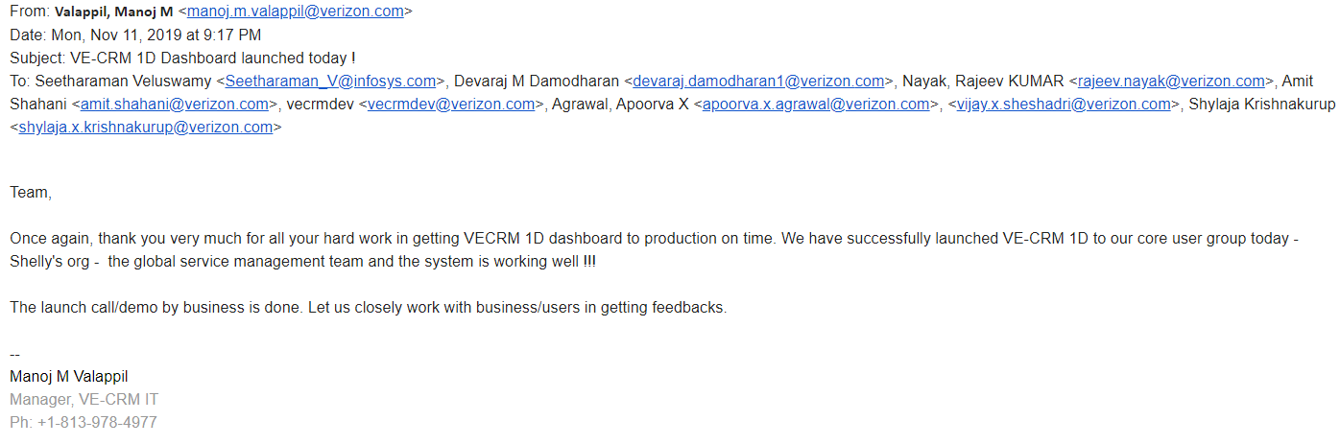
Client Recognition and Appreciation
Successful launch of the VECRM 1D Dashboard into the production

Slide 20
Below are techniques/levers/opportunities considered in the analysis to improve the margin.
Agile Scrum Process Integrated to achieve the speed to market with frequent demos to Client with early feedback to correct any deviations faced.
DevOps CICD pipeline integration with Fortify/Black duck/SonarQube integration for Code review, Jenkins Build Deployment, Code Coverage tools and Automation HCs in QA improvising on the code quality with reduced Manual Effort.
BTN Ideas have been shared with client / business with notable business benefits
Lean Automation Improvement resulting in 98% improvement in test execution timelines for PDF Invoices

Slide 21
Thank You

