Slide 1

Lead Scoring System Using Machine Learning
Accelerating Sales Efficiency with Data-Driven Insights

Slide 2



Addressing Current Challenges in Lead Management
Lead Volume & Qualification
Inefficient Resource Allocation
Missed Revenue Opportunities
Sales teams are overwhelmed by a large influx of leads from diverse sources, making it difficult to identify genuinely promising opportunities. Without a clear system, valuable time is spent on unqualified or "cold" leads.
The absence of a data-driven approach means sales resources are not optimally utilized. This leads to wasted effort on low-potential leads and a slower response to high-value prospects.
Without the ability to quickly prioritize and act on the most promising leads, the business faces delayed conversions and potentially missed revenue targets.

Slide 3
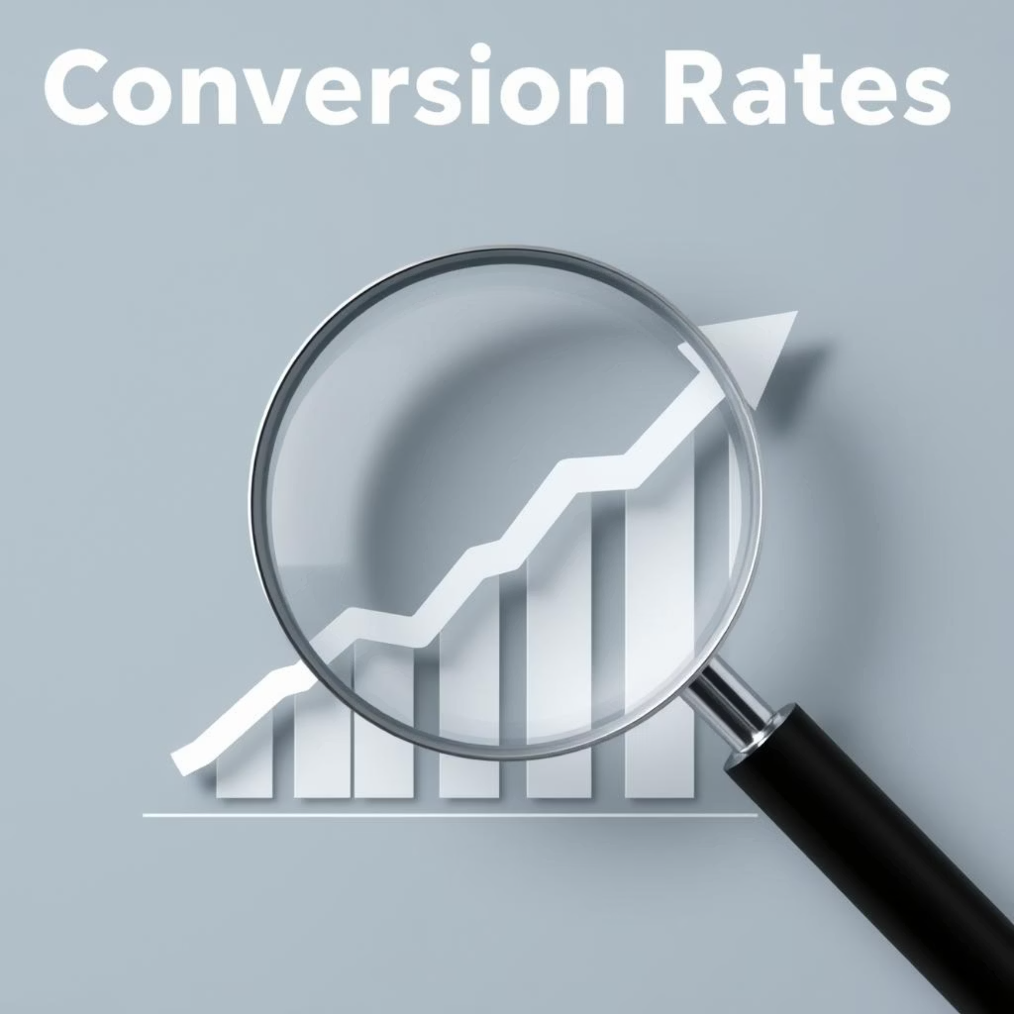
Strategic Objectives & Expected Outcomes
Core Objectives:
Smart Lead Ranking
1
Implement a system to prioritize leads based on conversion probability.
Automated ML Pipeline
2
Build a scalable, transparent, and continuous ML pipeline.
CRM Integration
3
Seamlessly integrate with existing systems for real-time intelligence.
Expected Business Outcomes:
Significant increase in conversion rates.
Measurable reduction in the sales cycle duration.
Optimized allocation of sales resources, maximizing ROI.

Slide 4
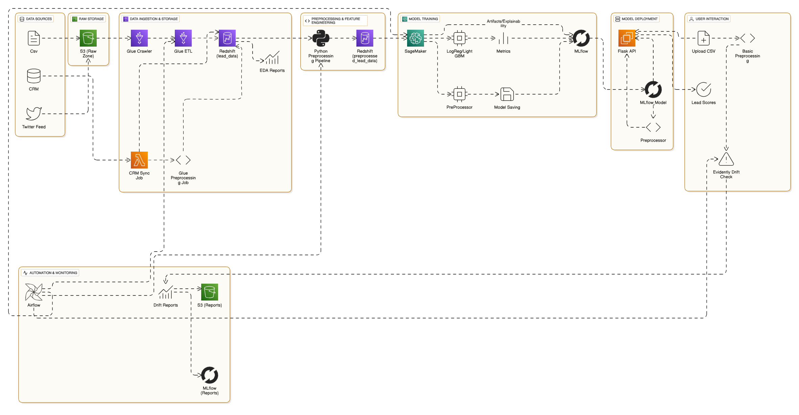
End-to-End ML Pipeline Architecture

Slide 5
Key Business Capabilities & Value
Capability
Business Value
Lead Scoring
Prioritize leads with higher conversion probability, focusing sales efforts effectively.
Automated Retraining
Ensures models remain updated with market shifts without manual intervention, maintaining accuracy.
Model Explainability (SHAP)
Provides transparency into why a lead is prioritized, building trust and enabling data-driven conversations.
CRM Integration
Makes model insights actionable by embedding them directly into existing sales workflows for immediate impact.
Scalable Infrastructure (AWS)
Designed to grow seamlessly with business needs and increasing data volumes, ensuring future readiness.

Slide 6
Optimized ROI & Performance Metrics
Advanced ML Models Deployed
Tangible Business Impact
Logistic Regression: Baseline for binary classification.
30-50%
Reduced
Random Forest: Handles complex interactions and robust against overfitting.
Gradient Boosting (XGBoost, LightGBM): State-of-the-art for high predictive accuracy.
Accuracy Increase
Sales Effort
Improvement in lead conversion prioritization accuracy, ensuring focus on best prospects.
Significantly decreased effort required per conversion, optimizing sales team productivity.
All models and experiments are meticulously tracked in MLflow for complete auditability and reproducibility.
Our Best Model Light GBM has scored an accuracy of 94%
Faster
Follow-up
High-scoring leads receive quicker attention, directly leading to higher close rates.

Slide 7




Robust Deployment & Automation
S3 & Redshift
AWS Glue
SageMaker
Secure, scalable storage for all data and a high-performance data warehouse for analytics.
Automated ETL jobs ensure clean, consistent, and reliable datasets for model training.
Enables scalable and efficient training of machine learning models.
EC2 & Flask
Airflow & Evidently
Provides a robust and responsive real-time inference endpoint for lead scoring.
Orchestrates automated retraining workflows and monitors model performance for data drift.
This fully automated and self-monitoring infrastructure ensures an "always-on" system with minimal human oversight, positioning the business for future AI/ML endeavors.

Slide 8
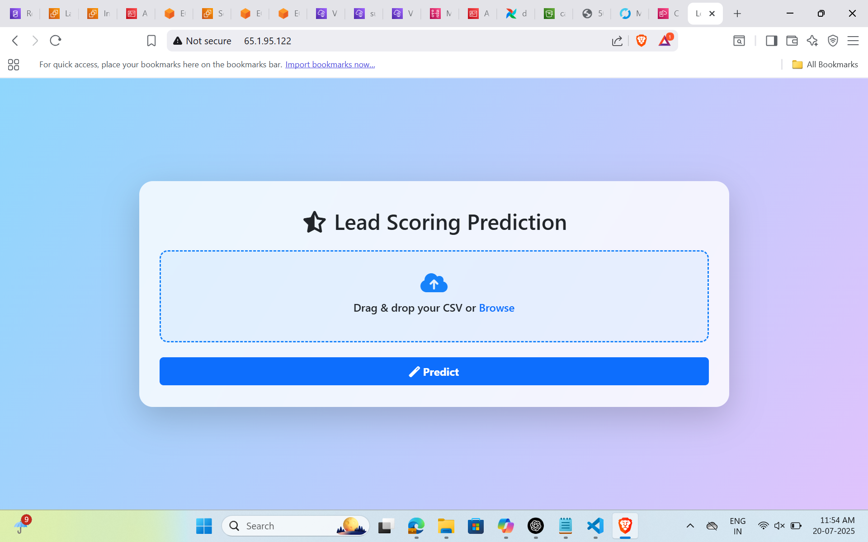
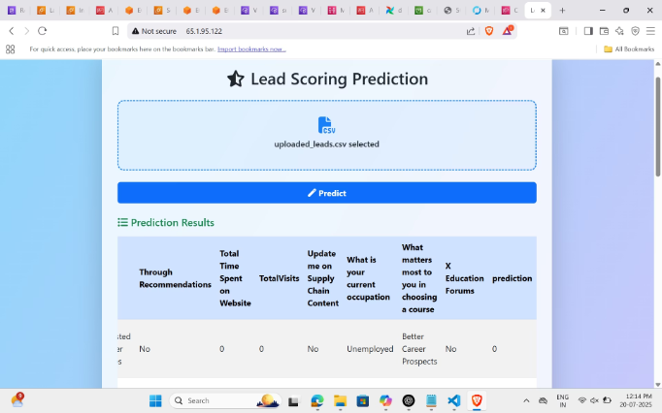
User Interface Overview

Slide 9


Transformative Impact on Sales & Marketing
Before the System
After the System
Undifferentiated Leads: All leads were treated equally, regardless of their actual potential or interest.
Prioritized Engagement: High-intent leads are identified and prioritized, ensuring immediate sales attention.
Low Campaign ROI: Marketing campaigns struggled to convert effectively due to a lack of targeted follow-up.
Improved Campaign ROI: Lead behavior analysis enables targeted follow-up, boosting conversion rates from campaigns.
Limited Insight: Sales and marketing teams had minimal understanding of true lead quality.
Faster Closures: Sales teams engage with warm leads proactively, leading to significantly faster closing cycles.

Slide 10

Got Questions?
We're ready to answer any questions you may have about the lead scoring system and its implementation. Let's discuss how this solution can benefit your business.

