Slide 1
Insert | To Insert row into a table
Select | Retrieve the data from table
Where | Specifies a condition that has to be satisfied for retrieving data from database.
Update | To update data of an existing table in database.

Slide 2
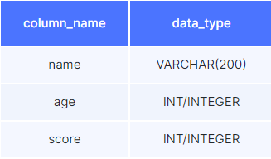
Task: Create a student table to store the following details

Slide 3
Create a student table to store the following details
create table student
(
name VARCHAR(200),
age INT,
score INT
);

Slide 4

Insert data into the table

Slide 5
Insert data into the table
INSERT INTO
player (name, age, score)
VALUES
("Rakesh", 39, 35),
("Sai", 47, 30);

Slide 6
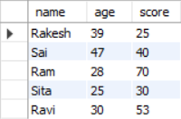
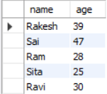

Select only name and age
Select name, age from
Player table whose name is “Sai”

Slide 7
Select only name and age
select * from player;
select
name,
age
from
player;
Select name, age from
Player table whose name is “Sai”
select
name, age
from
player
where
name = “Sai"

Slide 8
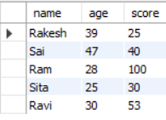
Update score of Ram to 100

Slide 9
Update score of Ram to 100
update
player
set
score = 100
WHERE
name = "Ram";

Slide 10
Create Tables:
Personal:
Product:

Slide 11
Create Table and insert data into the table:
Personal:

