Slide 1

Presentation
Cloud Computing

Slide 2
Developer Setup
Choice: Dev Test Lab
Configure and control available sizes, contingent/quota, etc.
Artifacts installed (Docker, Git, Azure CLI, WSL) over public artifact repository
Scheduler (auto-shutdown to save unnecessary cost & protect employees from extra hours ☺)
Scaleability - add more VMs easily
Limitations: Regional constraint, API/bicep config is not ideally documented
Alternatives: MS Dev Center with Dev Boxes, Single VMs deployed by IaC

Slide 3
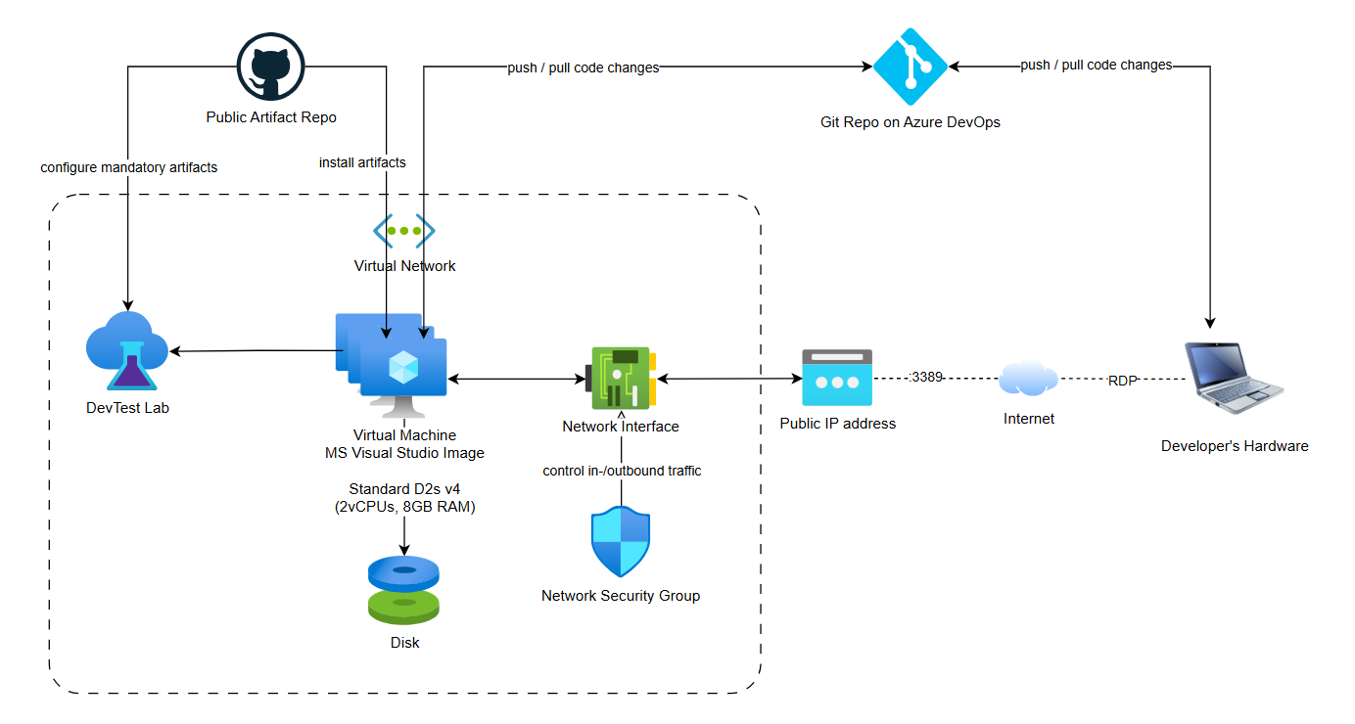
Developer Setup – Architecture sketch

Slide 4
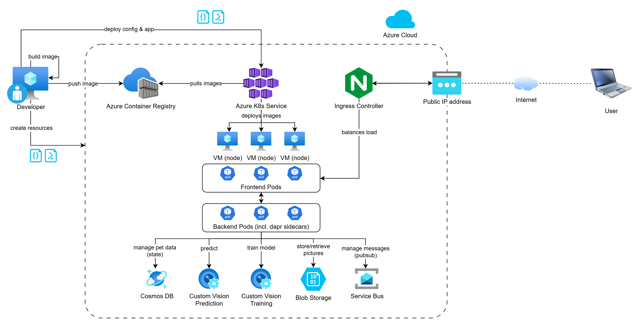
Microservice architecture
Notes:
~5min
* Deploy Azure Resources (Cluster, Cosmos DB, Custom Vision, etc.) * Build and push Docker Images for FE & BE to Azure Container Registry * Deploy config & app * Apply helm charts for dapr sidecars (using building blocks for state management, bindings and pubsub) -> RabbitMQ, Apache Kafka, Redis, Azure Service Bus

Slide 5
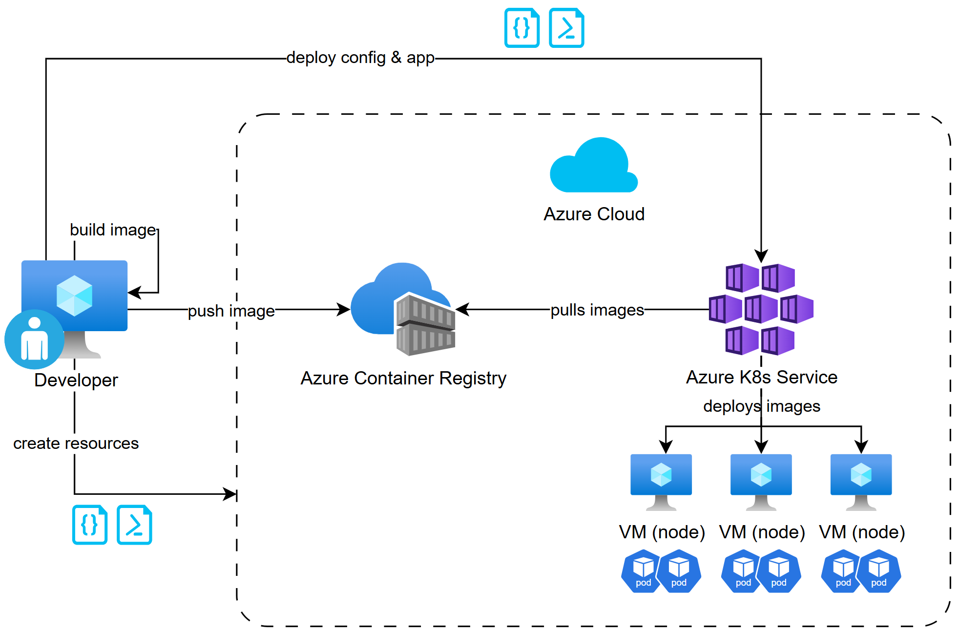
Deployments (CI/CD) - optional

Slide 6
Process Workflow
Create Azure Subscription
Prepare DevLabs
Docker Image Prep
Push Images to ACR
AKS Setup +DAPR Installation
Resource creation
CosmosDB
Storage
Servicebus
CustomVision
Adjust config.bicep and deploy
ACR Setup
Deploy .yaml-files
Upload 5 same dog-images
Start Training
Publish the Iteration manually
Validation by using Found Pet
Adjust app.bicep and deploy
Ingress Setup

Slide 7
Expected Cost
Resources | Sweden Central | Switzerland North
Azure Kubernetes Service Standard; Cluster management for 0 clusters; 2 D2s v4 (2 vCPUs, 8 GB RAM) (3 year reserved), Linux; 0 managed OS disks – S4 | CHF 46.77/ month | CHF 57.97/ month
Azure Container Registry Basic Tier, 1 Registry | CHF 4.13/ month | CHF 4.13/ month
Cosmos DB Azure Cosmos DB for NoSQL (formerly Core), Standard provisioned throughput (manual), Always-free quantity disabled, Single Region Write (Single-Master), 3 year reserved capacity, Monthly Payment option, 400 RU/sec, Sweden Central (Write Region), 100 GB storage, Analytical storage disabled, 2 copies of periodic backup storage, Dedicated Gateway not enabled | CHF 34.15/ month | CHF 38.28/ month
Storage Account Block Blob Storage, General Purpose V2, Flat Namespace, LRS Redundancy, Hot Access Tier, 0 x 1 PB, 0 x 100 TB Capacity - 3 year reserved, 20 x 10,000 Write operations, 1 x 10,000 List and Create Container Operations, 10 x 10,000 Read operations, 1 x 10,000 Other operations. 1,000 GB Data Retrieval, 1,000 GB Data Write, SFTP disabled | CHF 0.9/ month | CHF 0.98/ month
Service Bus Standard tier: Messaging Operations: 730 Hours of base charge, 10 x 1 million operations; 0 brokered connection(s); Hybrid Connections: 0 listener(s), 0 overage GB; WFC Relays: 0 x 100 relay hours, 0 x 10,000 message(s) | CHF 8.11/ month | CHF 8.11/ month
Virtual Machines 5 D2s v4 (2 vCPUs, 8 GB RAM) (3 year reserved), Windows (License included), OS Only; 0 managed disks – S4; Inter Region transfer type, 5 GB outbound data transfer from Sweden Central to East Asia | CHF 394.35/ month | CHF 658.92/ month
Total | CHF 488.91/ month ~17`600.- for 3yrs | CHF 768.39/ month ~27`662- for 3yrs
Notes:
2-3min

Slide 8
Pricing / Price Calculations Disaster Recovery setup
Resources | Description | Sweden Central → Sweden Sorth | Switzerland North → Switzerland West
AKS Cluster | 1 Node (D2s v4), Linux OS, 3-Year Reserved | CHF 60.77/ month | CHF 75.37/ month
Blob Storage | Hot tier, LRS, 1 GB capacity, ~10,000 operations | CHF 0.9/ month | CHF 1.27/ month
Cosmos DB | 400 RU/s provisioned throughput, 0 GB storage | CHF 13.49/ month | CHF 13.49/ month
Service Bus | Standard Tier Namespace (no active messages) | CHF 10.54/ month | NaN (No pricing available for your selection in this region.)
Container Registry | Basic Tier, empty (no images initially) | CHF 4.13/ month | CHF 4.13/ month
Custom Vision | Not provisioned (centrally served in primary region) | 0 | 0
Dev VM | Not required for disaster recovery | 0 | 0
Total DRS |  | CHF 89.83/ month ~3234.- (for 3yrs) | CHF 94.26/ month ~ 3393.- (for 3yrs)
Total Cost |  | CHF 578.74/ month ~20'834.- (for 3yrs) | CHF 862.65/ month ~ 31'055.- (for 3yrs)
Notes:
2-3min
Why Cosmos DB 0 Storage =

Slide 9
Potential Improvements
Different environments (PROD, UAT, DEV, etc.)
CI/CD Pipeline (automated deployments)
Protect Secrets (such as initial password for Dev-VMs, for AKS VM, etc.)
Cost optimization (e.g. cheaper dev setup, dev boxes are at ~150$ each in Switzerland)
Notes:
~2min

Slide 10
DEMO
DEMO
DEMO​

