Slide 1

Analytical and Predictive Evaluation of Heating System Modes
Team 11: Joel Cherianthanathu, Preeti Goyal, Kathrin Puthiyedathu, Venkata Ramana Tella
Challenge Partner: Plutinsus
Date: 23rd June 2025

Slide 2
Problem & Objective
Problem: Manual classification of heating system modes is inefficient and error-prone.
Goal: Detection of active Nighttime-Setback mode

Slide 3
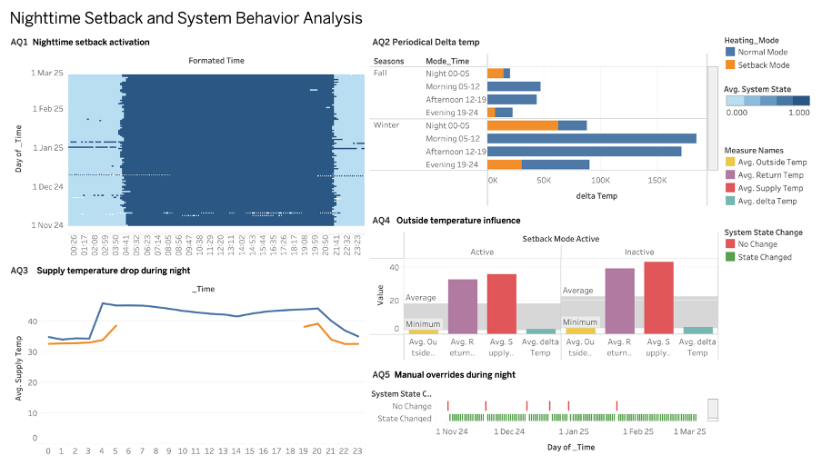
Tableau Dashboard

Slide 4
Main Analytical Insights
Setback mode typically active between 20:30–21:30 and 03:30–04:30.
Difference between supply and return temperatures tend to be higher in winter during active hours, reflecting increased heating output.
Significant drop in supply temperature confirms mode activation.
Observed Noticeable temperature changes based on nighttime setback mode activation and deactivation.
Manual overrides detected and visualized.

Slide 5
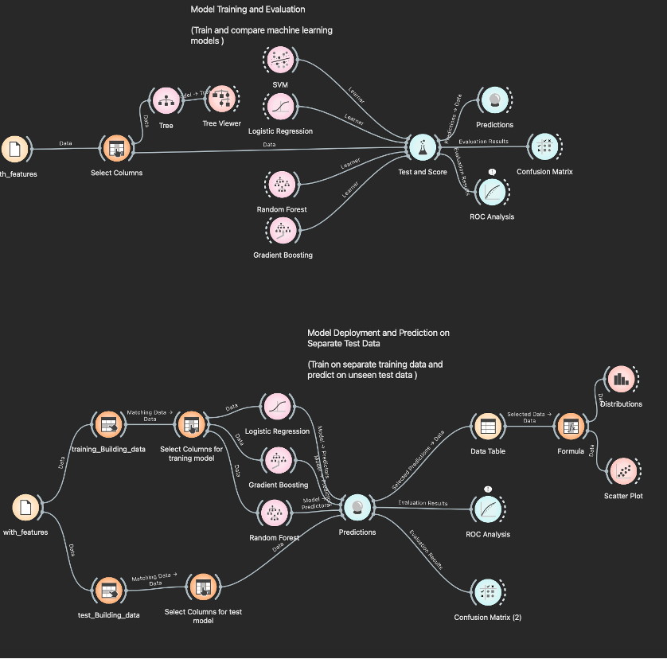
Orange Workflow – Predictive Model
Notes:
For the prediction part, you can see here our orange workflows.
The top flow indicates the training of the models logistic regression, gradient booosting, random forest and SVM
The bottom flow indicates the testing and evaluation of - which we did with to do only with logistic regression, gradient booosting, random forest.
Binary classification: Normal (1) vs. Setback (0).
Features: Hour, outside temp, supply/return temps, delta, ratios, variations.

Slide 6
Model Evaluation Results
Tested Models:
  Random Forest
  Gradient Boosting
  Logistic Regression
Best Performing Model regarding accuracy:
  Logistic Regression
Evaluation Measures Confusion Matrix shows less false negatives:
  Random Forest
  Gradient Boosting
Notes:
To summarize the evalution results, out of the three tested models, the best performing one overall regarding the accuracy is logistic regression.
To explain this result we have here
Though, with the confusion matrix shows the benefit of random forest and gradient boosting, because they predict less false negatives. To explain this result we have here

Slide 7
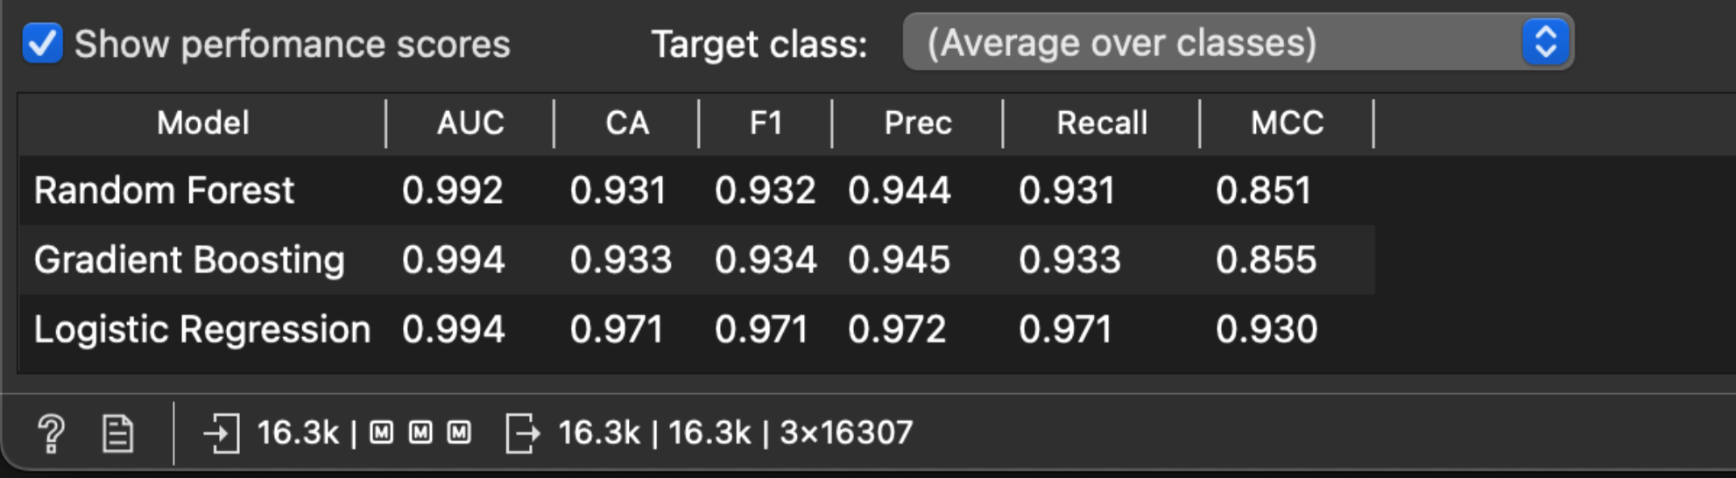
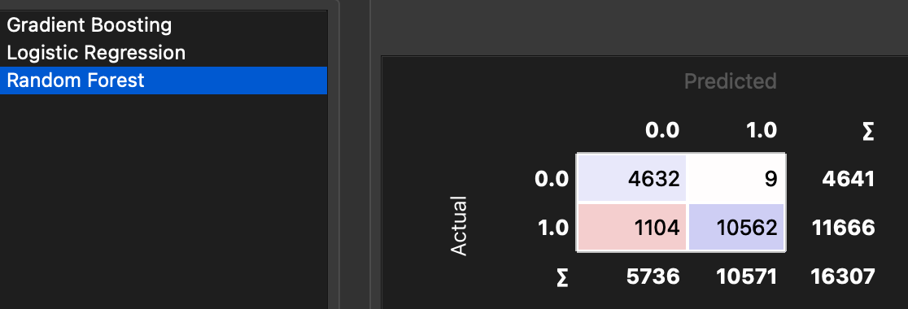
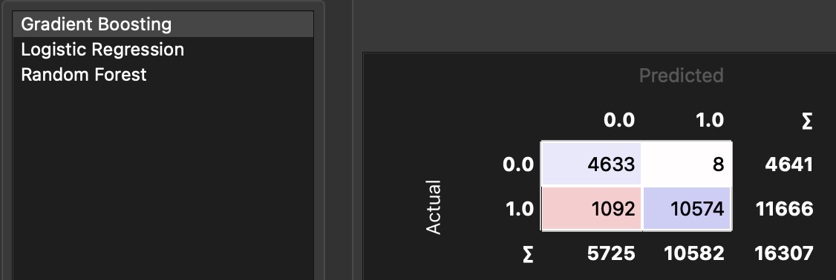
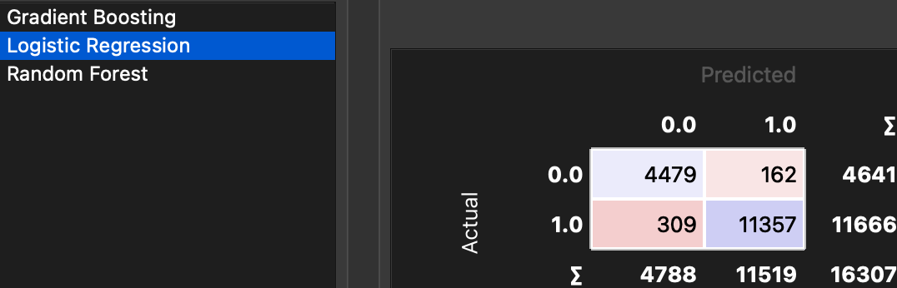
Test Data Performance Results
Notes:
The specific performance scores.
As you can see here at the top, all 3 models have quite high scores, but you can see the logistic regression performance the best.
But we wanted to also mention here in the confusion matrix' = the logistic regression misidentifies here when actual = 0 night time setback mode is active and predicts is as not active. So with the logistic regression would predict falsely to turn the nighttime set back mode off when it should be on - which we would argue is a bigger business loss, since in that case the heating would be less efficient and therefore more costly.

Slide 8
Business Value for Plutinsus
Automation reduces manual monitoring.
Models can be extended to other buildings.
Optimize heating with effective use of nighttime setback mode.
Notes:
To conclude, we wanted to highlight the business value of our analysis/model for Plutinsus:
The automated detection of the nighttime setback mode reduces manual monitoring
With an automated detection, it's easier to identify outliers – which can improve efficiency of the nighttime setback mode and help in optimizing the heating system
And, finally the models can be extended to other buildings

