Slide 1
A RAG-Powered Chatbot for CyberArk API Documentation
By Saya, Venkata Thrivedi – 2023aa05203

Slide 2
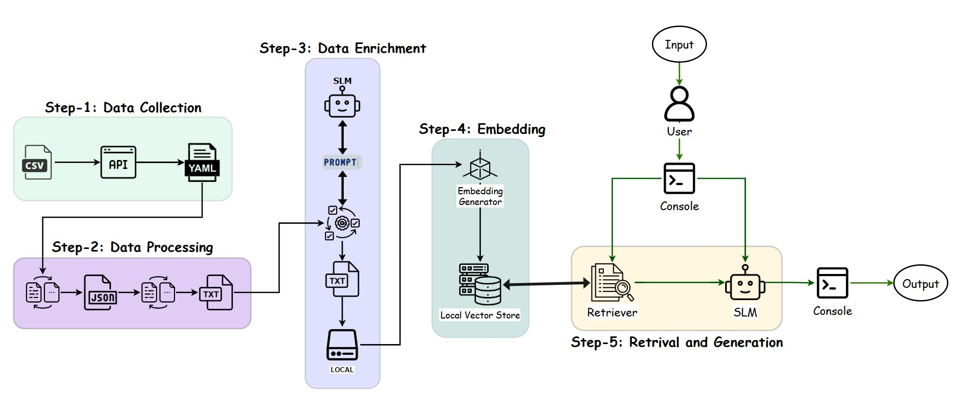
Architecture Diagram

Slide 3
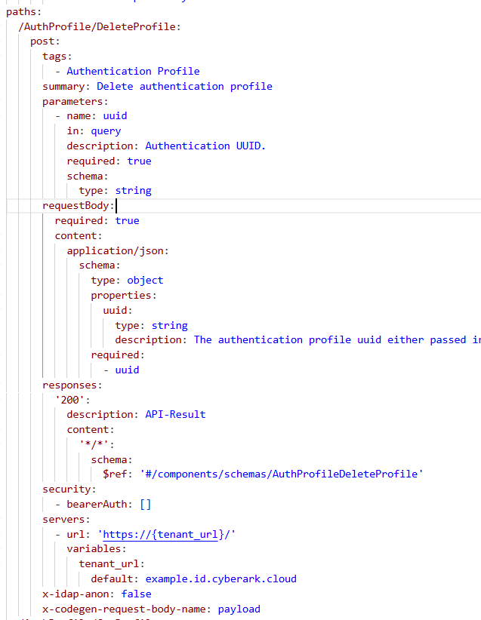
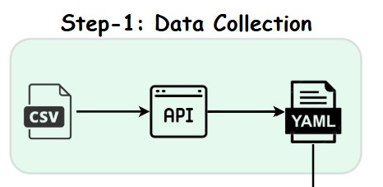
Step-1 : Data Collection
OpenAPI Spec File
Sample YAML file for an Endpoint =>

Slide 4
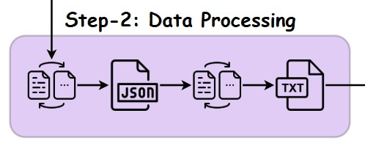
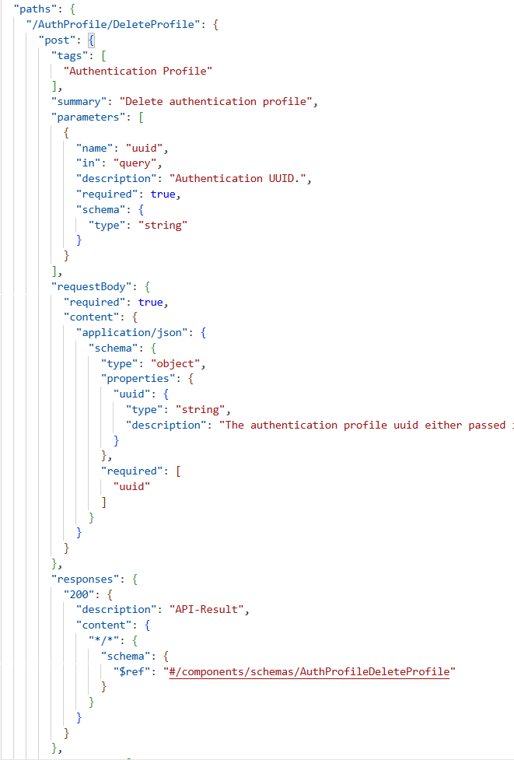
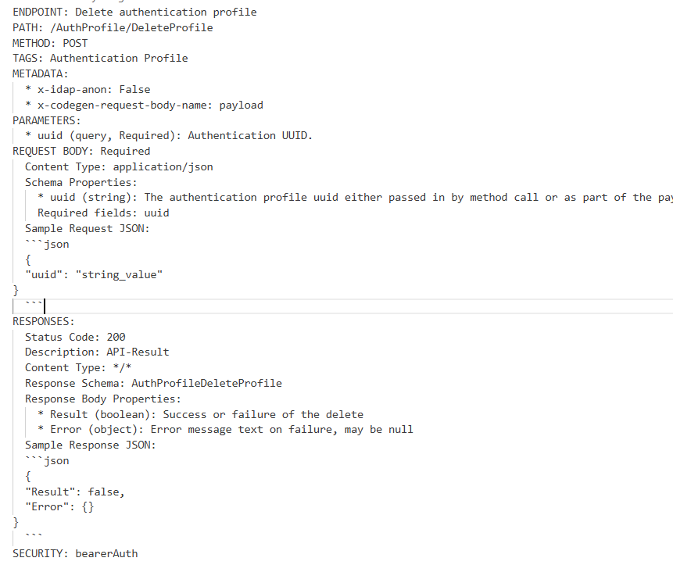
Step-2 Data Processing
=> => => => =>

Slide 5
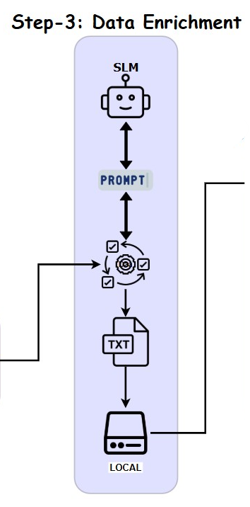
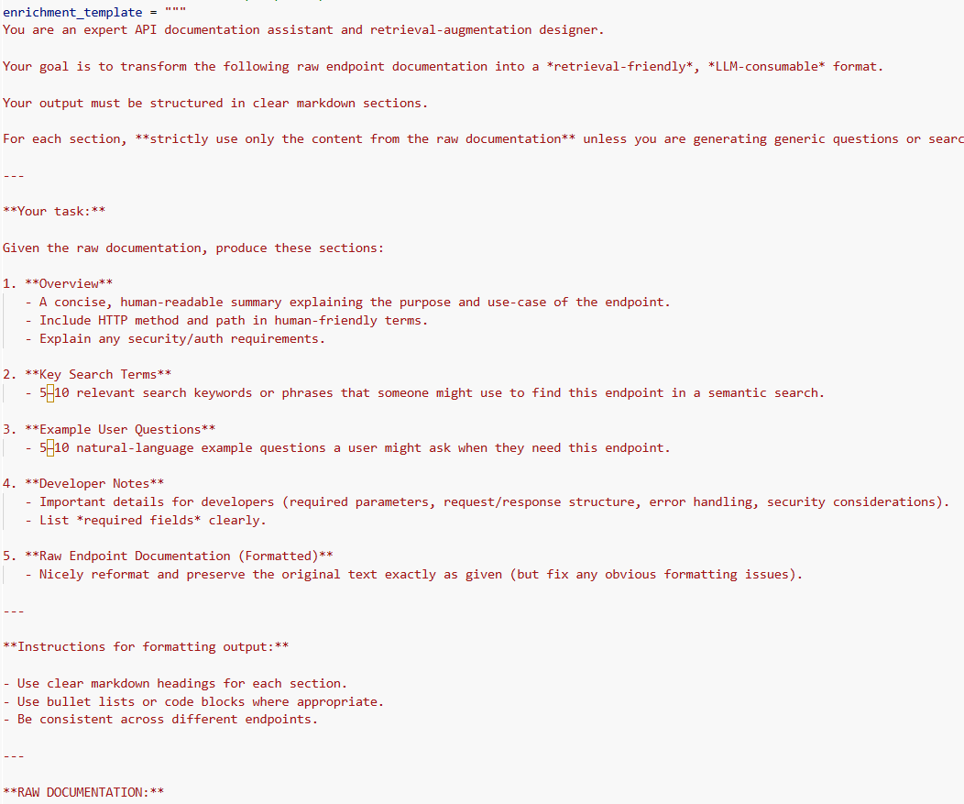
Step-3 Data Enrichment
SLM used is Ollama3.2:latest

Slide 6
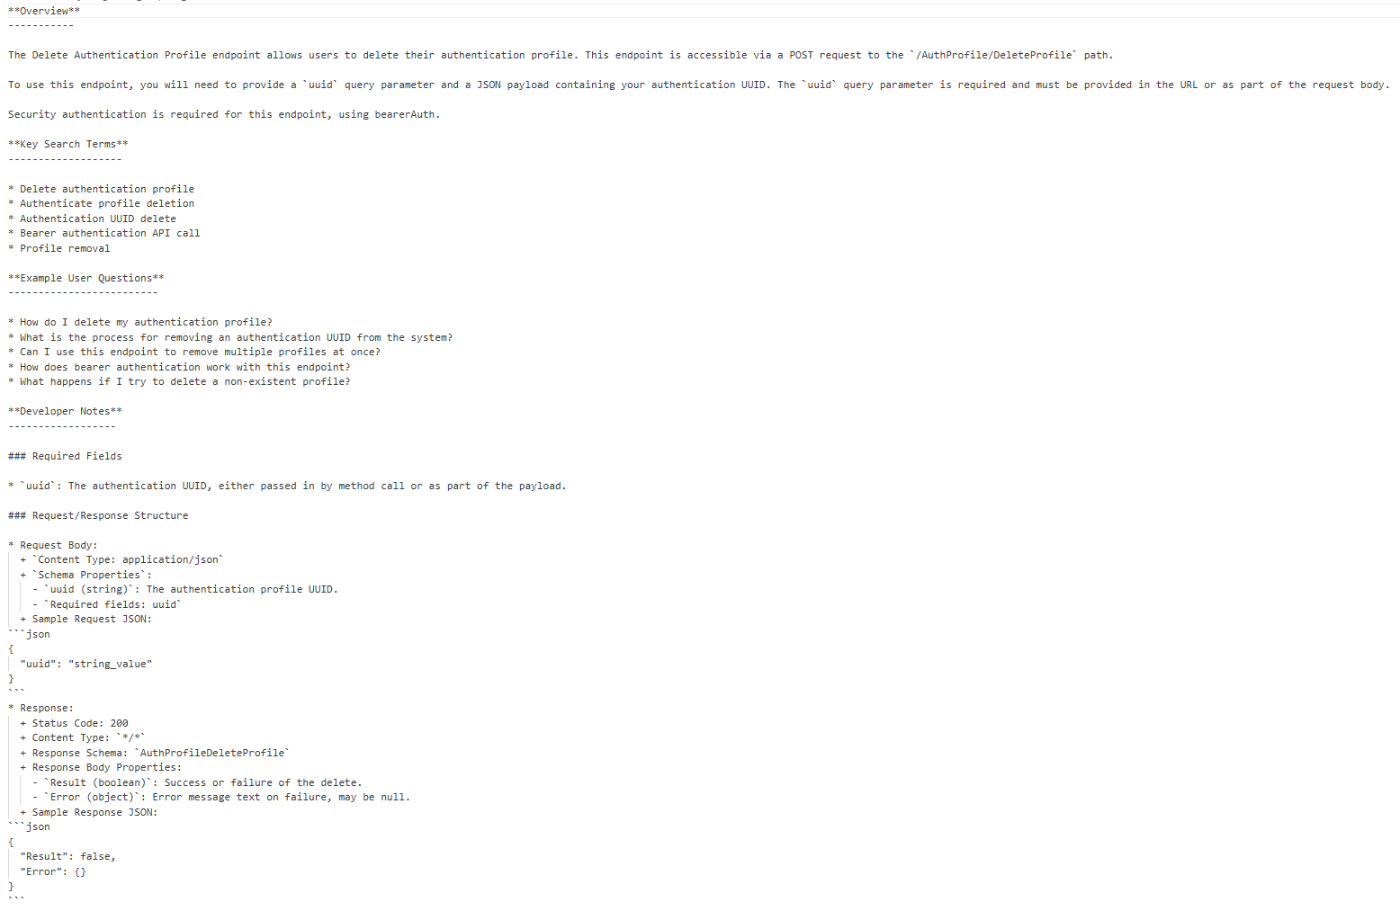
Enriched Text File

Slide 7
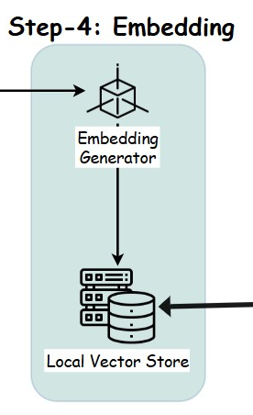
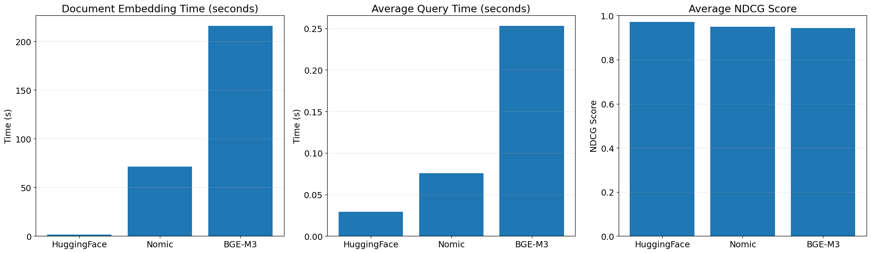
Step-4 Embedding
Studied 3 different type of embedding models
Ollama => nomic-embed-text:latest
- 768 dimensions
Ollama => bge-m3:567m
- 1024 dimensions
HuggingFace => all-MiniLM-L6-v2
- 384 dimensions
Observation: even though `all-MiniLM-L6-V2` has less dimensions, it is able to capture the best balance between retrieval quality and performance for API documentation use case.

Slide 8
Step-4 Embedding
Embedding used : HuggingFaceEmbedding - all-MiniLM-L6-v2 – 384 dimensional
Vector Store used : FAISS (Facebook AI Similarity Search)
--------------------------------------------------------------------------------------------------------------------------------------
Use the Enriched Data as document
Used text splitter to split the document ( ChunkSize : 1000 (balanced granularity) ; Overlap : 100 )
As documents are individual for each endpoint, it is made sure that there is no overlap between the documents and overlap is within the documents.
Once Embedding are generated, they are stored in local to save compute and reuse quickly.
FAISS is used as a vector store, which is an open-source library designed for efficient similarity search and clustering of dense vectors

Slide 9
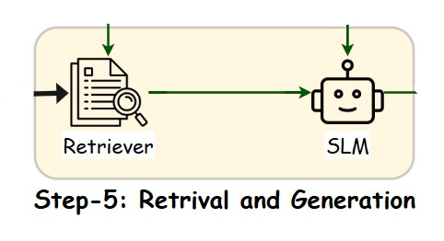
Step-5 Retrieval and generation
SLM used : Ollama3.2:latest
Retriever details:
Compared the below type of retrievers:
Observation:
Basic Vector Retriever | Simplest & default approach
Maximum Marginal Relevance (MMR) Retriever | Balanced relevance with information diversity
Similarity Score Threshold Retriever | Returns documents with a certain similarity threshold
MultiQuery Retriever | Generates multiple query variations to improve retrieval coverage.
Custom MultiQuery Retriever with Output Parser | Tailored approach to query generation for domain-specific needs
Enhanced Ensemble with Custom MultiQuery | Multiple retriever + keyword search + custom query expansion
[Notebook]

Slide 10
Step-5 Retrieval and generation
Final retriever combination used :
Ensemble Retriever |  | Weightage
1 | MMR retriever | 0.3
II | Similarity Score Retriever | 0.3
III | BM25_Retriver | 0.4
Reason for Choice of retrievers:
BM25 Retriever is well known for its keyword-based retrieval, making it suitable for the use case where the end user has endpoint details and searches using specific keywords to find the exact document.
MMR Retriever is effective at reducing redundancy in the results and promoting diversity, which helps avoid near-duplicate documents and covers different aspects of a topic.
Similarity Score Retriever is a straightforward approach to filter out low-relevance documents, improving the accuracy of the retrieved results.

Slide 11
Step-5 Retrieval and generation
SLM used and reasoning
Llama3.2:latest
Parameters : 3.1B
Size : quantized to 2GB, efficient for local serving
Knowledge Cutoff : December 2023
Ollama was utilized, and the model was deployed in Collab.
It is highly cost-effective and delivers improved results.
Provides faster response generation.
Open source, supports local serving, and ensures privacy.
Has a reasonable knowledge cutoff.
Simple to serve and scale.
Ideal for low-cost RAG architectures.
Other SLM Tried are Phi4(14b), gemma2(9b), starcoder(7b)
Llama3.2 was best at summarizing and generation.
[Notebook - DEMO]

Slide 12
Architecture Diagram

Slide 13
Future Implementations
UI Development:
  Developing a user-friendly UI on top of existing console chat
Context-Aware Chat:
  Try to retain the use conversation which can help to maintain the context in the chat.
  This can also help user to ask follow-up questions and refine their queries iteratively
Guardrails:
  Implementing guardrails for both input and system outputs
  Input guardrails detect ambiguous and malformed queries
  Output guardrails can filter or validate generated responses to ensure accuracy, prevent hallucinations, and enforce compliance with organizational guidelines
Evaluation and Benchmarking:
  Implement evaluation protocols that measure retrieval quality (e.g., precision, recall, relevance scoring) and generation quality (e.g., correctness, fluency, adherence to documentation)
  Benchmarking against existing support systems or human experts can help validate the chatbot’s effectiveness and identify areas for further refinement

Slide 14
THANK YOU!

