Slide 1


Web Search Engine Model
Instructor: Dr. Abedalrhman Alkhateeb

Slide 2

Team members
Venkata Vijaya Sri Vaishnav Vadrevu 110068649
Dharmi Krishna Vadlamudi 110061348

Slide 3

Contents
What is a Search Engine?
Few famous and common Search engines
Average searches per month in different search engines
Working of a Search Engine
Search Engine Uses
Features of our model
Flow of Operations
Result Screenshots
Conclusion

Slide 4

What is a Search Engine?
A search engine is a software program that helps people find the information they are looking for online using keywords or phrases.
Search engines are able to return results quickly—even with millions of websites online—by scanning the Internet continuously and indexing every page they find.

Slide 5

Few famous Search Engines:

Slide 6

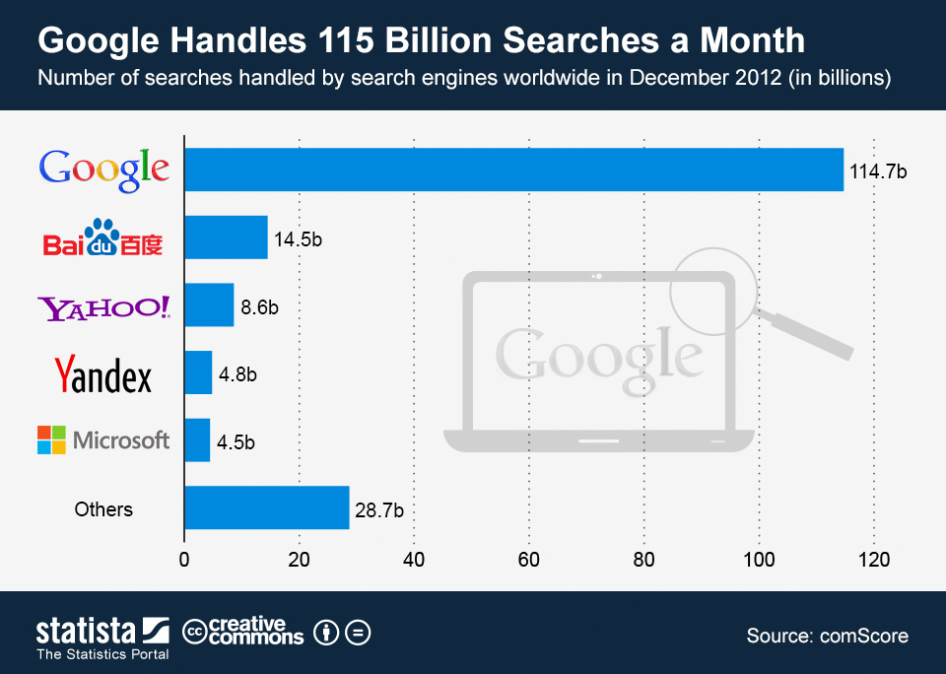
Average searches per month in different search engines
Source: https://www.statista.com/chart/898/number-of-searches-handled-by-search-engines-worldwide/

Slide 7
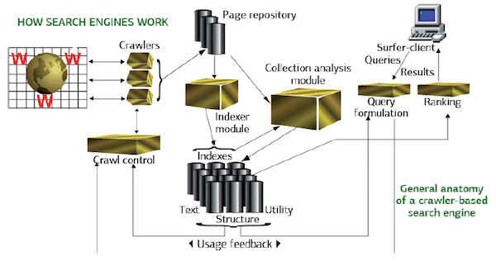
WORKING OF SEARCH ENGINE
Source: https://www.searchenginewatch.com/2012/01/11/how-search-engines-work/

Slide 8

Search Engines uses
Search Engine is taking up many advancements that it is not limited to only certain usage entities. However, some of the uses are
Research
Shopping (E-Commerce)
Entertainment (Movies, Music, Games)
News
Social Media

Slide 9
Features of our search engine
Web crawling and retrieving URLs Web crawling is reaching out to the net as a spider traverses around the web. Using Jsoup to connect the web and extract URLs for a defined domain
Parsing URLs to text and saving in text files: URLs are a resource links which lead to the linked webpages when clicked on. These links are saved in a text file using string methods and Jsoup
String Tokenization: Tokenizing a string denotes splitting a string with respect to some delimiter
Ternary Search Tree: A ternary search tree is a special tree data structure where the child nodes of a standard tree are ordered as a binary search tree. One of the advantage of using ternary search trees over trees is that ternary search trees are a more space efficient. Further, ternary search trees can be used any time a hashtable would be used to store strings

Slide 10

Contd.
Generating key words by removing stop words: every search query has stop words like for, etc. Key words are the main parts of the query which are searched. In order to prevent anomalies such, stop words are removed
Inverted Index: An inverted index is an index data structure storing a mapping from content, such as words or numbers, to its locations in a document or a set of documents. In simple words, it is a hashmap like data structure that directs you from a word to a document or a web page.
Page Ranking: Page rank is a measure of how ‘important’ a web page is. It works on the basis that when another website links to your web page, it’s like a recommendation or vote for that web page.
Caching: A cache's primary purpose is to increase data retrieval performance by reducing the need to access the underlying slower storage layer. Trading off capacity for speed, a cache typically stores a subset of data transiently, in contrast to databases whose data is usually complete and durable.

Slide 11
Flow of operations
Web Crawling
Parsing URLs to a text file
Key words tokens
Indexing URLs
Implementing Cache
Sorting
Page Ranking
TST and frequency generation

Slide 12
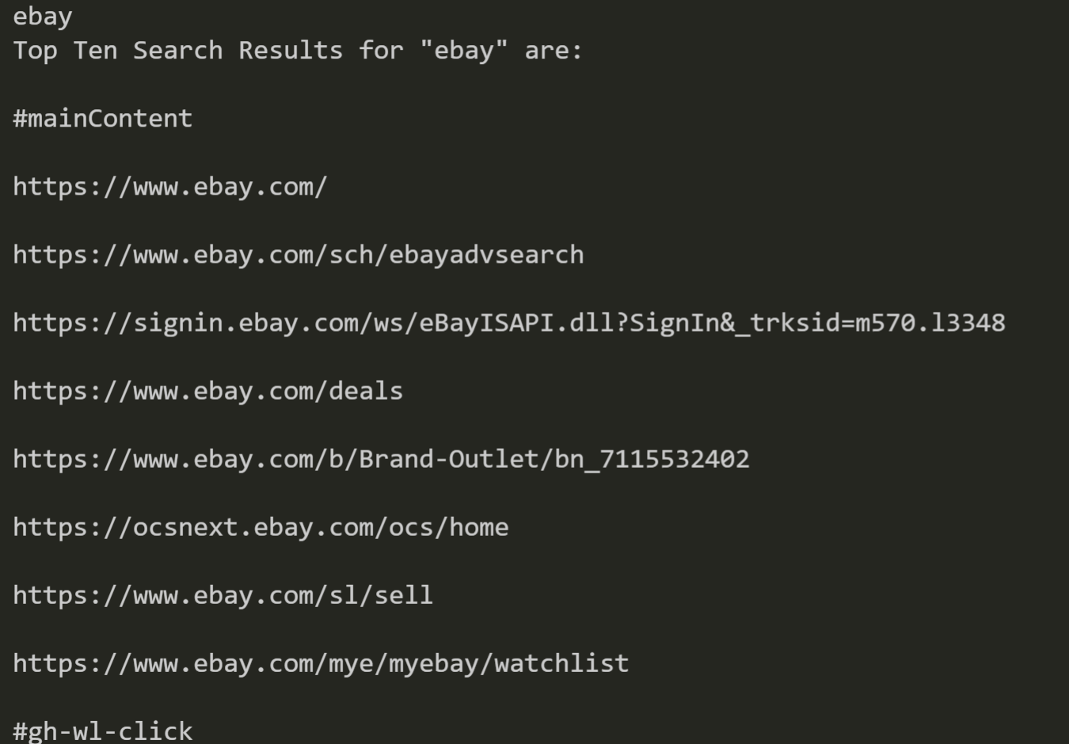
Result Screenshots
Result of Search engine

Slide 13
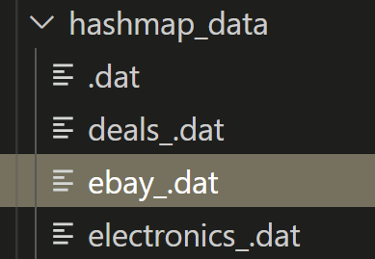
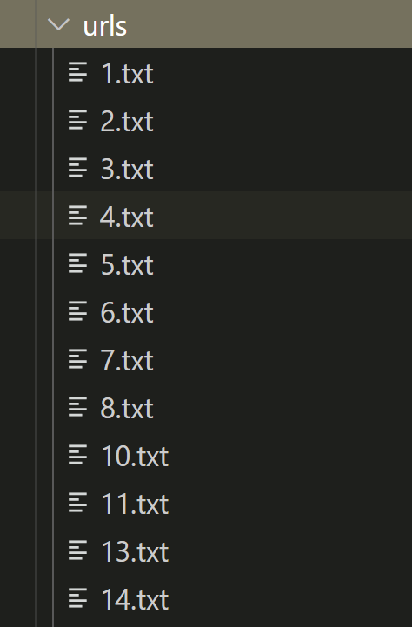
Result for Cache date (Hashmap_data)
Result of indexed urls

Slide 14
References
https://aws.amazon.com/caching/
https://business.yell.com/knowledge/what-is-page-rank-and-why-is-it-important/
https://www.geeksforgeeks.org/ternary-search-tree/
https://www.geeksforgeeks.org/inverted-index/

Slide 15

Conclusion
By implementing a search engine model
We learned how to apply the academical concepts
We experienced how a search engine works
Built a good working model using the learnt concepts

Slide 16


