Slide 1
Chapter 1
Database Systems

Slide 2
Learning Objectives
After completing this chapter, you will be able to:
Define the difference between data and information
Describe what a database is, various types, and why they are valuable assets for decision making
Explain the importance of database design
See how modern databases evolved from file systems
Understand flaws in file system data management
Outline the main components of the database system
Describe the main functions of a database management system (DBMS)

Slide 3
Why Databases?
Characteristics of data in today’s world
Ubiquitous (i.e., abundant, global, and everywhere)
Pervasive (i.e., unescapable, prevalent, and persistent)
Databases make data persistent(it should be stored to non-volatile storage) and shareable in a secure way
Specialized structures that allow computer-based systems to store, manage, and retrieve data very quickly

Slide 4
Data versus Information
Data consists of raw facts
Not yet processed to reveal meaning to the end user
Building blocks of information
Information results from processing raw data to reveal meaning
Requires context
Bedrock of knowledge
Should be accurate, relevant, and timely

Slide 5
Introducing the Database
Shared, integrated computer structure that stores data
End-user data: raw facts of interest to end user
Metadata: data about data, through which the end-user data is integrated and managed
Describes data characteristics and relationships
Database management system (DBMS)
Collection of programs
Manages the database structure
Controls access to data stored in the database

Slide 6
Role and Advantages of the DBMS (1 of 2)
Database management system (DBMS): intermediary between the user and the database
Enables data to be shared
Presents the end user with an integrated view of data
Provides more efficient and effective data management
Improves sharing, security, integration, access, decision-making, productivity, etc.

Slide 7
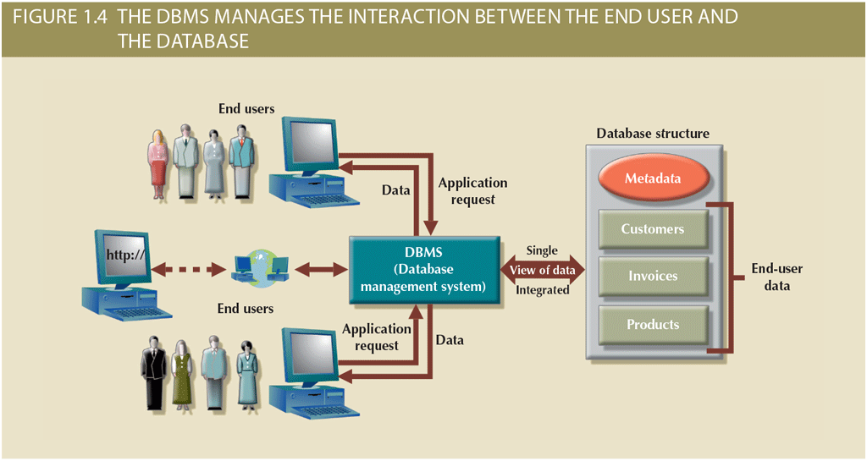
Role and Advantages of the DBMS (2 of 2)

Slide 8
Types of Databases (1 of 5)
Single-user database: supports one user at a time
Desktop database: single-user database on a personal computer
Multiuser database: supports multiple users at the same time
Workgroup databases: supports a small number of users or a specific department
Enterprise database: supports many users across many departments

Slide 9
Types of Databases (2 of 5)
Classification by location
Centralized database: data located at a single site
Distributed database: data distributed across different sites
Cloud database: created and maintained using cloud data services that provide defined performance measures for the database

Slide 10
Types of Databases (3 of 5)
Classification by data type
General-purpose database: contains a wide variety of data used in multiple disciplines
Discipline-specific database: contains data focused on specific subject areas
Operational database: designed to support a company’s day-to-day operations

Slide 11
Types of Databases (4 of 5)
Analytical database: stores historical data and business metrics used exclusively for tactical or strategic decision making
Data warehouse: stores data in a format optimized for decision support
Online analytical processing (OLAP): tools for retrieving, processing, and modeling data from the data warehouse
Business intelligence: captures and processes business data to generate information that support decision making

Slide 12
Types of Databases (5 of 5)
Databases can be classified to reflect the degree to which the data is structured
Unstructured data exists in its original (raw) state
Structured data results from formatting
Structure is applied based on type of processing to be performed
Semistructured data: processed to some extent
Extensible Markup Language (XML)
Represents data elements in textual format

Slide 13
Why Database Design Is Important
Focuses on design of database structure that will be used to store and manage end-user data
Well-designed database: facilitates data management and generates accurate and valuable information
Poorly designed database: causes difficult-to-trace errors that may lead to poor decision making

Slide 14
Evolution of File System Data Processing (1 of 3)
Manual file systems
Accomplished through a system of file folders and filing cabinets
Computerized file systems
Data processing (DP) specialist created a computer-based system to track data and produce required reports
File system redux: modern end-user productivity tools
Includes spreadsheet programs such as Microsoft Excel

Slide 15
Evolution of File System Data Processing (2 of 3)
Table 1.2 | Basic File Terminology
TERM | DEFINITION
Data | Raw facts, such as a telephone number, a birth date, a customer name, and a year-to-date (YTD) sales value. Data has little meaning unless it has been organized in some logical manner.
Field | A character or group of characters (alphabetic or numeric) that has a specific meaning. A field is used to define and store data.
Record | A logically connected set of one or more fields that describes a person, place, or thing. For example, the fields that constitute a record for a customer might consist of the customer’s name, address, phone number, date of birth, credit limit, and unpaid balance.
File | A collection of related records. For example, a file might contain data about the students currently enrolled at Gigantic University.

Slide 16
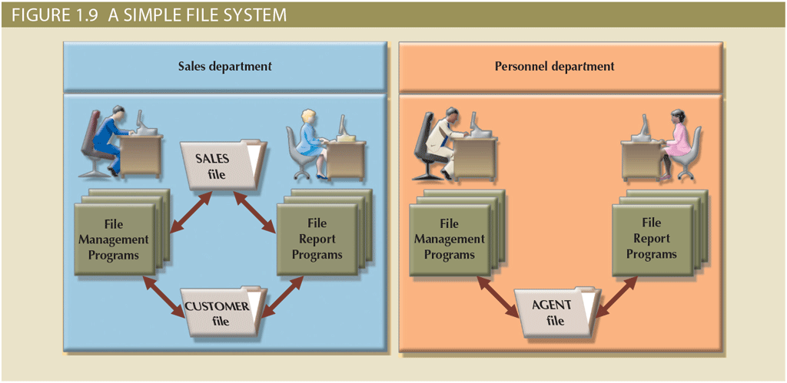
Evolution of File System Data Processing (3 of 3)

Slide 17
Problems with File System Data Processing
Problems with file systems challenge the types of information that can be created from data as well as information accuracy
Lengthy development times
Difficulty of getting quick answers
Complex system administration
Lack of security and limited data sharing
Extensive programming

Slide 18
Structural and Data Dependence (1 of 2)
Structural dependence
Access to a file is dependent on its own structure
All file system programs are modified to conform to a new file structure
Structural independence
File structure is changed without affecting the application’s ability to access the data

Slide 19
Structural and Data Dependence (2 of 2)
Data dependence
Data access changes when data storage characteristics change
Data independence
Data storage characteristics are changed without affecting the program’s ability to access the data
Practical significance of data dependence is the difference between logical and physical format.(check conceptual logical physical model differences)

Slide 20
Data Redundancy (1 of 2)
Unnecessarily storing the same data at different places
Islands of information (i.e., scattered data locations)
Increases the probability of having different versions of the same data

Slide 21
Data Redundancy (2 of 2)
Possible results of uncontrolled data redundancy
Poor data security
Data inconsistency
Data-entry errors
Data integrity problems

Slide 22
Data Anomalies
Develop when not all of the required changes in the redundant data are made successfully
Update anomalies
Insertion anomalies
Deletion anomalies

Slide 23
Database Systems (1 of 2)
Logically related data stored in a single logical data repository
Physically distributed among multiple storage facilities
DBMS eliminates most of file system’s data inconsistency, data anomaly, data dependence, and structural dependence problems
Current generation DBMS software
Stores data structures, relationships between structures, and access paths
Defines, stores, and manages all access paths and components

Slide 24
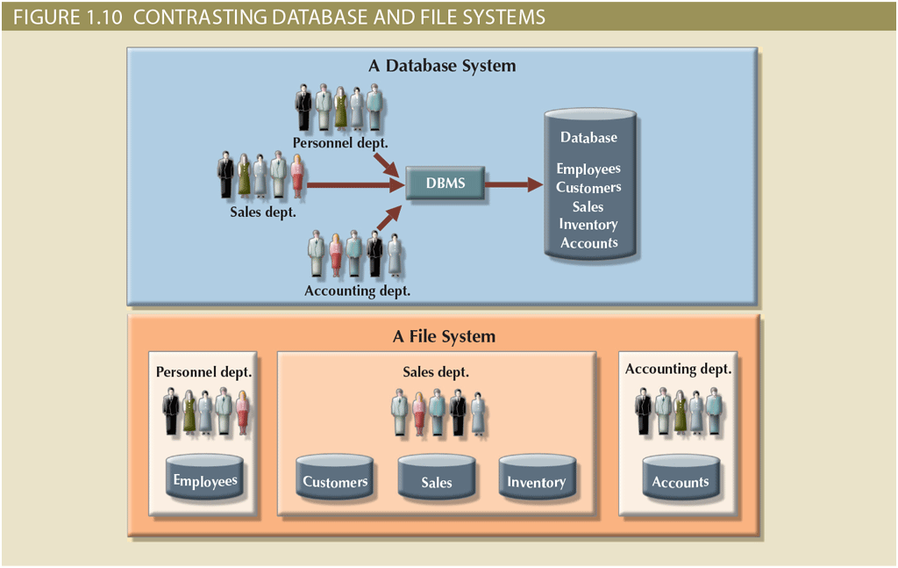
Database Systems (2 of 2)

Slide 25
The Database System Environment (1 of 2)
Database system: organization of components that define and regulate the collection, storage, management, and use of data within a database environment
Hardware
Software
People
Procedures
Data

Slide 26
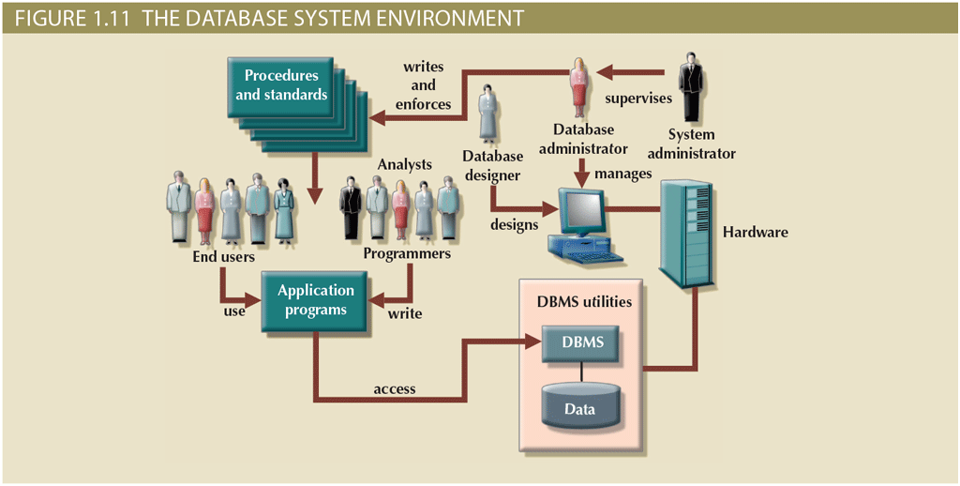
The Database System Environment (2 of 2)

Slide 27
DBMS Functions (1 of 3)
Data dictionary management
Data dictionary: stores definitions of data elements and their relationships
Data storage management
Performance tuning ensures efficient performance
Data transformation and presentation
Data is formatted to conform to logical expectations
Security management
Enforces user security and data privacy

Slide 28
DBMS Functions (2 of 3)
Multiuser access control
Sophisticated algorithms ensure that multiple users can access the database concurrently without compromising its integrity
Backup and recovery management
Enables recovery of the database after a failure
Data integrity management
Minimizes redundancy and maximizes consistency

Slide 29
DBMS Functions (3 of 3)
Database access languages and application programming interfaces
Query language: lets the user specify what must be done without having to specify how
Structured Query Language (SQL): de facto query language and data access standard supported by the majority of DBMS vendors
Database communication interfaces
Accept end-user requests via multiple, different network environments

Slide 30
Managing the Database System: A Shift in Focus
Disadvantages of database systems
Increased costs
Management complexity
Maintaining currency
Vendor dependence
Frequent upgrade/replacement cycles

Slide 31
Preparing for Your Database Professional Career
TABLE 1.3 | DATABASE CAREER OPPORTUNITIES
JOB TITLE | DESCRIPTION | SAMPLE SKILLS REQUIRED
Database Developer | Create and maintain database-based applications | Programming, database fundamentals, SQL
Database Designer | Design and maintain databases | Systems design, database design, SQL
Database Administrator | Manage and maintain DBMS and databases | Database fundamentals, SQL, vendor courses
Database Analyst | Develop databases for decision support reporting | QL, query optimization, data warehouses
Database Architect | Design and implementation of database environments (conceptual, logical, and physical) | DBMS fundamentals, data modeling, SQL, hardware knowledge, etc.
Database Consultant | Help companies leverage database technologies to improve business processes and achieve specific goals | Database fundamentals, data modeling, database design, SQL, DBMS, hardware, vendor-specific technologies, etc.
Database Security Officer | Implement security policies for data administration | DBMS fundamentals, database administration, SQL, data security technologies, etc.
Cloud Computing Data Architect | Design and implement the infrastructure for next-generation cloud database systems | Internet technologies, cloud storage technologies, data security, performance tuning, large databases, etc.
Data Scientist | Analyze large amounts of varied data to generate insights, relationships, and predictable behaviors | Data analysis, statistics, advanced mathematics, SQL, programming, data mining, machine learning, data visualization

Slide 32
Summary
Data consists of raw facts and is usually stored in a database
Database design defines the database structure
Can be classified according to the number of users, location, as well as data usage and structure
Databases evolved from manual and computerized file systems
There are some limitations of file system data management
DBMSs were developed to address the file system’s inherent weaknesses

