Slide 1
Chapter 2
Data Models

Slide 2
Learning Objectives
After completing this chapter, you will be able to:
Discuss data modeling and why data models are important
Describe the basic data-modeling building blocks
Define what business rules are and how they influence database design
Understand how the major data models evolved
List emerging alternative data models and the needs they fulfill
Explain how data models can be classified by their level of abstraction

Slide 3
Data Modeling and Data Models
Data modeling: creating a specific data model for a determined problem domain
Data model: simple representation of complex real-world data structures
Useful for supporting a specific problem domain
Model: abstraction of a more complex real-world object or event

Slide 4
The Importance of Data Models
The importance of data modeling cannot be overstated
Facilitates communication
Gives various views of the database
Organizes data for various users
Provides an abstraction for the creation of good a database

Slide 5
Data Model Basic Building Blocks
Entity: person, place, thing, or event about which data will be collected and stored
Attribute: characteristic of an entity
Relationship: association among entities
One-to-many (1:M OR 1..*)
Many-to-many (M:N or *..*)
One-to-one (1:1 OR 1..1)
Constraint: restriction placed on data
Ensures data integrity

Slide 6
Business Rules
Brief, precise, and unambiguous description of a policy, procedure, or principle
Create and enforce actions within that organization’s environment
Establish entities, relationships, and constraints

Slide 7
Discovering Business Rules (1 of 2)
Sources of business rules
Company managers
Policy makers
Department managers
Written documentation
Direct interviews with end users

Slide 8
Discovering Business Rules (2 of 2)
Reasons for identifying and documenting business rules
Standardize company’s view of data
Facilitate communications tool between users and designers
Assist designers
Understand the nature, role, scope of data, and business processes
Develop appropriate relationship participation rules and constraints
Create an accurate data model

Slide 9
Translating Business Rules into Data Model Components
Business rules set the stage for the proper identification of entities, attributes, relationships, and constraints
Nouns translate into entities
Verbs translate into relationships among entities
Relationships are bidirectional
Questions to identify the relationship type
How many instances of B are related to one instance of A?
How many instances of A are related to one instance of B?

Slide 10
Naming Conventions
Entity name requirements
Be descriptive of the objects in the business environment
Use terminology that is familiar to the users
Attribute name
Required to be descriptive of the data represented by the attribute
Proper naming
Facilitates communication between parties
Promotes self-documentation

Slide 11
Hierarchical and Network Models (1 of 2)
Hierarchical models: developed to manage large amounts of data for complex manufacturing projects (one record can have only one parent )
Represented by an upside-down tree which contains segments
Segments are the equivalent of a file system’s record type
Depicts a set of one-to-many (1:M) relationships

Slide 12
Hierarchical and Network Models (2 of 2)
Network models: created to represent complex data relationships effectively
Improved database performance and imposed a database standard
Allows a record to have more than one parent
Standard database concepts that emerged with the network model are still used by modern data models
Schema and subschema
Data manipulation language (DML)
Data definition language (DDL)

Slide 13
The Relational Model (1 of 4)
Produced an automatic transmission database that replaced standard transmission databases
Based on a relation (i.e., table): matrix composed of intersecting tuples (rows) and attributes (columns)
Describes a precise set of data manipulation constructs

Slide 14
The Relational Model (2 of 4)
Relational database management system (RDBMS)
Performs basic functions provided by the hierarchical and network DBMS systems
Makes the relational data model easier to understand and implement
Hides the complexities of the relational model from the user

Slide 15
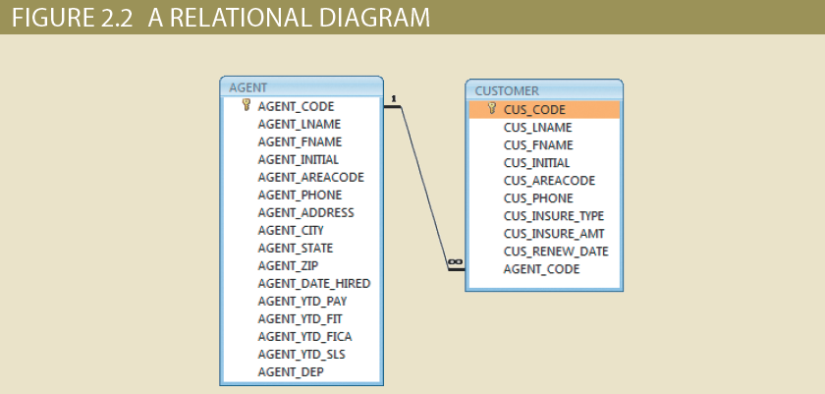
The Relational Model (3 of 4)

Slide 16
The Relational Model (4 of 4)
SQL-based relational database application
End-user interface
Allows end user to interact with the data
Collection of tables stored in the database
Each table is independent from another
Rows in different tables are related based on common values in common attributes
SQL engine
Executes all queries

Slide 17
The Entity Relationship Model (1 of 2)
Graphical representation of entities and their relationships in a database structure
Entity relationship diagram (ERD): uses graphic representations to model database components
Entity instance or entity occurrence: rows in the relational table
Attributes: describe particular characteristics
Connectivity: term used to label the relationship types

Slide 18
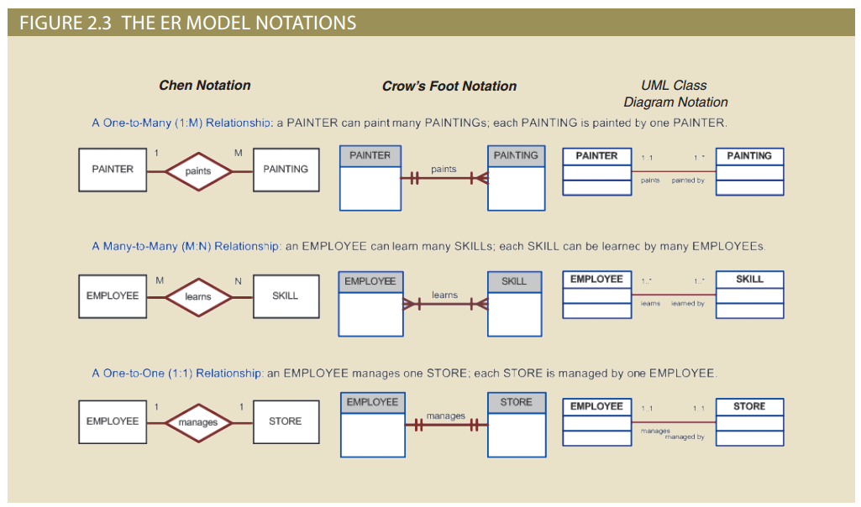
The Entity Relationship Model (2 of 2)

Slide 19
The Object-Oriented Data Model (1 of 3)
Both data and its relationships are contained in a single structure known as an object
Object-oriented database management system(OODBMS): based on OODM
Object: contains data and their relationships with operations that are performed on it
Basic building block for autonomous structures
Abstraction of real-world entity
Attribute: describes the properties of an object

Slide 20
The Object-Oriented Data Model (2 of 3) ??????
Class: collection of similar objects with shared structure and behavior organized in a class hierarchy
Class hierarchy: resembles an upside-down tree in which each class has only one parent
Inheritance: object inherits methods and attributes of classes above it
Unified Modeling Language (UML): describes sets of diagrams and symbols to graphically model a system

Slide 21
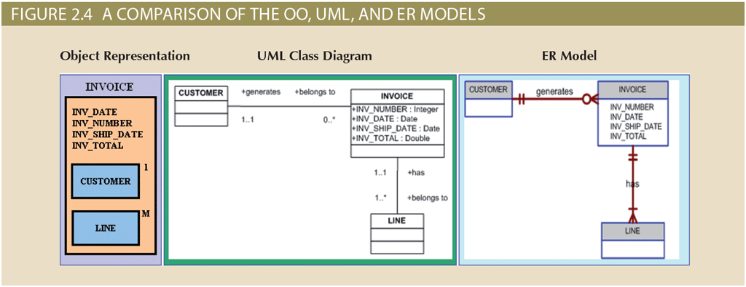
The Object-Oriented Data Model (3 of 3)

Slide 22
Object/Relational and XML
Extended relational data model (ERDM)
Supports OO features, extensible data types based on classes, and inheritance
Object/relational database management system (O/R DBMS): based on ERDM
Extensible Markup Language (XML)
Manages unstructured data for efficient and effective exchange of structured, semistructured, and unstructured data

Slide 23
Emerging Data Models: Big Data and NoSQL (1 of 3)
Goals of Big Data
Find new and better ways to manage large amounts of web and sensor-generated data
Provide high performance at a reasonable cost
Characteristics of Big Data
Volume
Velocity
Variety

Slide 24
Emerging Data Models: Big Data and NoSQL (2 of 3)
Challenges of Big Data
Volume doesn’t allow usage of conventional structures
Expensive
OLAP tools proved inconsistent dealing with unstructured data
New technologies of Big Data
Hadoop
Hadoop Distributed File System (HDFS)
MapReduce
NoSQL

Slide 25
Emerging Data Models: Big Data and NoSQL (3 of 3)
NoSQL databases
Not based on the relational model
Support distributed database architectures
Provide high scalability, high availability, and fault tolerance
Support large amounts of sparse data
Geared toward performance rather than transaction consistency
Provides a broad umbrella for data storage and manipulation

Slide 26
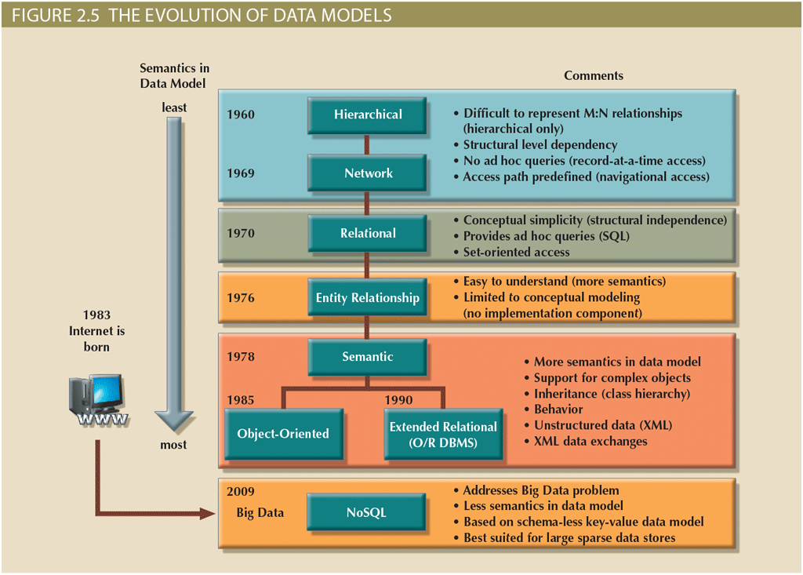
Data Models: A Summary

Slide 27
Hierarchical Model
Advantages
Promotes data sharing
Parent/child relationship promotes conceptual simplicity and data integrity
Database security is provided and enforced by DBMS
Efficient with 1:M relationships
Disadvantages
Requires knowledge of physical data storage characteristics
Navigational system requires knowledge of hierarchical path
Changes in structure require changes in all application programs
Implementation limitations
No data definition
Lack of standards

Slide 28
Network Model
Advantages
Conceptual simplicity
Handles more relationship types
Data access is flexible
Data owner/member relationship promotes data integrity
Conformance to standards
Includes data definition language (DDL) and data manipulation language (DML)
Disadvantages
System complexity limits efficiency
Navigational system yields complex implementation, application development, and management
Structural changes require changes in all application programs

Slide 29
Relational Model
Advantages
Structural independence is promoted using independent tables
Tabular view improves conceptual simplicity
Ad hoc query capability is based on SQL
Isolates the end user from physical-level details
Improves implementation and management simplicity
Disadvantages
Requires substantial hardware and system software overhead
Conceptual simplicity gives untrained people the tools to use a good system poorly
May promote information problems

Slide 30
Entity Relationship Model
Advantages
Visual modeling yields conceptual simplicity
Visual representation makes it an effective communication tool
Is integrated with the dominant relational model
Disadvantages
Limited constraint representation
Limited relationship representation
No data manipulation language
Loss of information content occurs when attributes are removed from entities to avoid crowded displays

Slide 31
Object-Oriented Model
Advantages
Semantic(relating to logic) content is added
Visual representation includes semantic content
Inheritance promotes data integrity
Disadvantages
Slow development of standards caused vendors to supply their own enhancements
Complex navigational system
Learning curve is steep
High system overhead slows transactions

Slide 32
NoSQL
Advantages
High scalability, availability, and fault tolerance are provided
Uses low-cost commodity hardware
Supports Big Data
Key-value model improves storage efficiency
Disadvantages
Complex programming is required
There is no relationship support
There is no transaction integrity support
In terms of data consistency, it provides an eventually consistent model

Slide 33
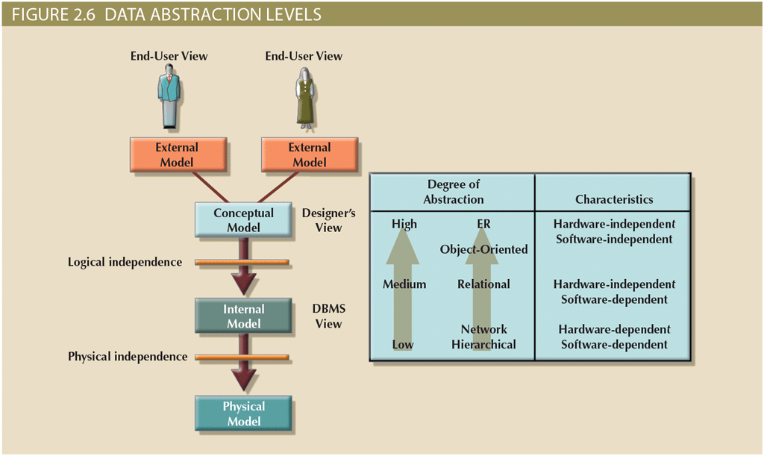
Degrees of Data Abstraction

Slide 34
The External Model (1 of 2)
End users’ view of the data environment
People who use the application programs to manipulate the data and generate information
ER diagrams are used to represent the external views
External schema: specific representation of an external view

Slide 35
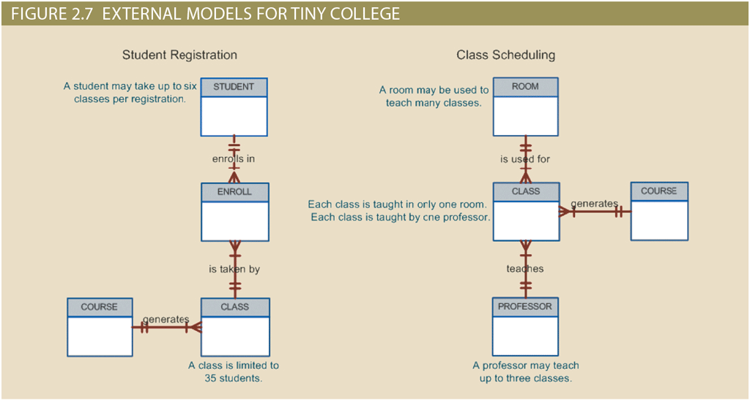
The External Model (2 of 2)

Slide 36
The Conceptual Model (1 of 2)
Represents a global view of the entire database by the entire organization
Conceptual schema: basis for the identification and high-level description of the main data objects
Logical design: task of creating a conceptual data model
Conceptual model advantages
Macro-level view of data environment
Software and hardware independent

Slide 37
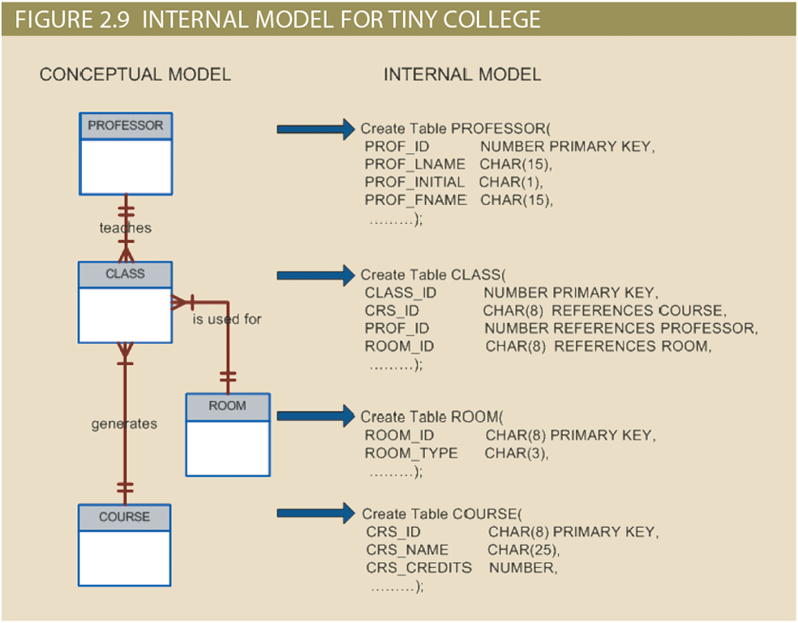
The Conceptual Model (2 of 2)

Slide 38
The Internal Model
Representing database as seen by the DBMS mapping conceptual model to the DBMS
Internal schema: specific representation of an internal model, using the database constructs supported by the chosen database
Logical independence: changing internal model without affecting the conceptual model
Hardware independent: unaffected by the type of computer on which the software is installed

Slide 39
The Physical Model (1 of 2)
Operates at lowest level of abstraction
Describes the way data are saved on storage media such as magnetic, solid state, or optical media
Requires the definition of physical storage and data access methods
Software and hardware dependent
Relational model aimed at logical level
Does not require physical-level details
Physical independence: changes in physical model do not affect internal model

Slide 40
The Physical Model (2 of 2)
Table 2.4 Levels of Data Abstraction
Model | Degree of Abstraction | Focus | Independent of
External | High | End-user views | Hardware and software
Conceptual | Medium-High | Global view of data (database model independent) | Hardware and software
Internal | Medium-Low | Specific database model | Hardware
Physical | Low | Storage and access methods | Neither hardware nor software

Slide 41
Summary
A data model is an abstraction of a complex real-world data environment
There are many types of data models (e.g., hierarchical, network, relational, object-oriented, extended relational data model, etc.)
Data-modeling requirements are a function of different data views (global versus local) and the level of data abstraction

