Slide 1
Chapter 8
Advanced SQL

Slide 2
Learning Objectives
After completing this chapter, you will be able to:
Use SQL to create a table manually
Use SQL to create a copy of a table using a subquery
Manipulate the structure of existing tables to add, modify, and remove columns and constraints
Use SQL to do data manipulation (insert, update, and delete rows of data)
Use SQL to create database views, including updatable views
Use Procedural Language SQL (PL/SQL) to create triggers, stored procedures, and PL/SQL functions
Create embedded SQL

Slide 3
Data Definition Commands (1 of 3)
Starting database model
Refer to Figure 8.1
Creating the database
Before a new RDBMS can be used, the database structure and the tables that will hold the end-user data must be created
The database schema
Logical group of database objects—such as tables and indexes—that are related to each other
Data types
Character, numeric, and date

Slide 4
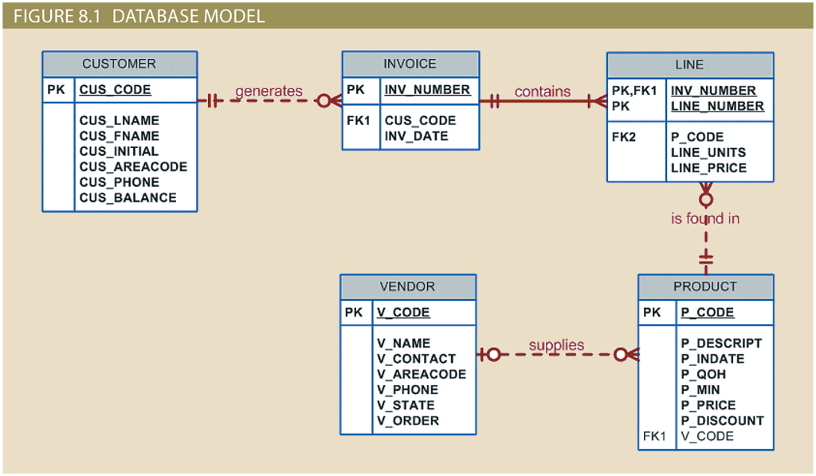
Data Definition Commands (2 of 3)

Slide 5
Data Definition Commands (3 of 3)
TABLE 8.1: Some Common SQL Data Types
Data Type | Format | Comments
Numeric | NUMBER(L,D) or NUMERIC(L,D) | The declaration NUMBER(7,2) or NUMERIC(7,2) indicates that numbers will be stored with two decimal places and may be up to seven digits long, including the sign and the decimal place (for example, 12.32 or −134.99).
 | INTEGER | May be abbreviated as INT. Integers are (whole) counting numbers, so they cannot be used if you want to store numbers that require decimal places.
 | SMALLINT | Like INTEGER but limited to integer values up to six digits. If your integer values are relatively small, use SMALLINT instead of INT.
 | DECIMAL(L,D) | Like the NUMBER specification, but the storage length is a minimum specification. That is, greater lengths are acceptable, but smaller ones are not. DECIMAL(9,2), DECIMAL(9), and DECIMAL are all acceptable.
Character | CHAR(L) | Fixed-length character data for up to 255 characters. If you store strings that are not as long as the CHAR parameter value, the remaining spaces are left unused. Therefore, if you specify CHAR(25), strings such as Smith and Katzenjammer are each stored as 25 characters. However, a U.S. area code is always three digits long, so CHAR(3) would be appropriate if you wanted to store such codes.
 | VARCHAR(L) or VARCHAR2(L) | Variable-length character data. T he designation VARCHAR2(25) or VARCHAR(25) will let you store characters up to 25 characters long. However, unlike CHAR, VARCHAR will not leave unused spaces. Oracle automatically converts VARCHAR to VARCHAR2.
Date | DATE | Stores dates in the Julian date format.

Slide 6
Creating Table Structures (1 of 2)
CREATE TABLE command
CREATE TABLE tablename (
column1 data type [constraint] [,
column2 data type [constraint] ] [,
PRIMARY KEY (column1 [, column2]) ] [,
FOREIGN KEY (column1 [, column2]) REFERENCES tablename] [,
CONSTRAINT constraint ] );
SQL constraints
FOREIGN KEY
NOT NULL
UNIQUE
DEFAULT
CHECK

Slide 7
Creating Table Structures (2 of 2)
Create a table with a SELECT statement
Rapidly creates a new table based on selected columns and rows of an existing table using a subquery
Automatically copies all of the data rows returned
SQL indexes
CREATE INDEX improves the efficiency of searches and avoids duplicate column values
DROP Index deletes an index

Slide 8
Altering Table Structures (1 of 3)
All changes in the table structure are made by using the ALTER TABLE command followed by a keyword that produces the specific change you want to make
ADD, MODIFY, and DROP
Changing a column’s data type
ALTER
Changing a column’s data characteristics
If the column to be changed already contains data, you can make changes in the column’s characteristics if those changes do not alter the data type
Adding a column
You can alter an existing table by adding one or more columns
Be careful not to include the NOT NULL clause for the new column

Slide 9
Altering Table Structures (2 of 3)
Adding primary key, foreign key, and check constraints
Primary key syntax:
ALTER TABLE PART
ADD PRIMARY KEY (PART_CODE);
Foreign key syntax:
ALTER TABLE PART
ADD FOREIGN KEY (V_CODE) REFERENCES VENDOR;
Check constraint syntax:
ALTER TABLE PART
ADD CHECK (PART_PRICE >= 0);

Slide 10
Altering Table Structures (3 of 3)
Dropping a column
Syntax:
ALTER TABLE VENDOR
DROP COLUMN V_ORDER;
Deleting a table from the database
Syntax:
DROP TABLE PART;

Slide 11
Data Manipulation Commands (1 of 2)
Adding table rows
INSERT command syntax:
INSERT INTO tablename VALUES (value1, value2, …, valuen)
Inserting rows with null attributes: use NULL entry
Inserting rows with optional attributes: indicate attributes that have required values
Inserting table rows with a SELECT subquery
Add multiple rows to a table, using another table as the source, at the same time
SELECT syntax:
INSERT INTO target_tablename[(target_columnlist)]
SELECT source_columnlist
FROM source_tablename;
Saving table changes
COMMIT command syntax:
COMMIT [WORK]

Slide 12
Data Manipulation Commands (2 of 2)
Updating table rows
UPDATE command is used to modify data in a table
UPDATE syntax:
UPDATE tablename
SET columnname = expression [, columnname = expression]
[WHERE conditionlist ];
--Update EMP_1 set JOB_CODE = 501 WHERE EMP_NUM='107’;
--create table emp_2 select * from emp_1;
Deleting table rows
DELETE statement syntax:
DELETE FROM tablename
[WHERE conditionlist ];
delete from emp_1 where emp_num='106’;
alter table emp_2add emp_pct DECIMAL(4,2),add PROJ_NUM CHAR(3);
Restoring table contents
ROLLBACK command is used restore the database to its previous condition
ROLLBACK;
set sql_safe_updates=0; (to run updates not in safe mode)

Slide 13
Virtual Tables: Creating a View
View: virtual table based on a SELECT query
Base tables: tables on which the view is based
CREATE VIEW statement: data definition command that stores the subquery specification in the data dictionary
CREATE VIEW command syntax:
CREATE VIEW viewname AS SELECT query

Slide 14
Updatable Views
Used to update attributes
Batch update routine: pools multiple transactions into a single batch to update a master table field in a single operation
Updatable view restrictions
GROUP BY expressions or aggregate functions cannot be used
Set operators cannot be used
Most restrictions are based on the use of JOINs or group operators in views

Slide 15
Sequences (1 of 2)
Many similarities in the use of sequences across these DBMSs
Independent object in the database
Have a name and can be used anywhere a value expected
Not tied to a table or column
Generate a numeric value that can be assigned to any column in any table
Table attribute with an assigned value can be edited and modified

Slide 16
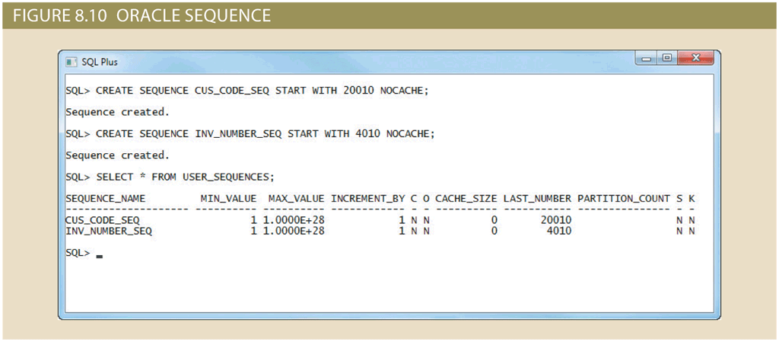
Sequences (2 of 2)

Slide 17
Procedural SQL (1 of 3)
Performs a conditional or looping operation by isolating critical code and making all application programs call the shared code
Better maintenance and logic control
Persistent stored module (PSM): block of code
Contains standard SQL statements and procedural extensions that is stored and executed at the DBMS server

Slide 18
Procedural SQL (2 of 3)
Procedural Language SQL (PL/SQL)
Use and storage of procedural code and SQL statements within the database
Merging of SQL and traditional programming constructs
Procedural code is executed as a unit by DBMS when invoked by end user
Anonymous PL/SQL blocks
Triggers
Stored procedures
PL/SQL functions

Slide 19
Procedural SQL (3 of 3)
Table 8.4 PL/SQL BASIC DATA TYPES
DATA TYPE | DESCRIPTION
CHAR | Character values of a fixed length; for example: W_ZIP CHAR(5)
VARCHAR2 | Variable-length character values; for example: W_FNAME VARCHAR2(15)
NUMBER | Numeric values; for example: W_PRICE NUMBER(6,2)
DATE | Date values; for example: W_EMP_DOB DATE
%TYPE | Inherits the data type from a variable that you declared previously or from an attribute of a database table; for example: W_PRICE PRODUCT.P_PRICE%TYPE Assigns W_PRICE the same data type as the P_PRICE column in the PRODUCT table

Slide 20
Triggers (1 of 2)
Procedural SQL code automatically invoked by RDBMS when given data manipulation event occurs
Parts of a trigger definition
Triggering timing: indicates when trigger’s PL/SQL code executes
Triggering event: statement that causes the trigger to execute
Triggering level: statement- and row-level
Triggering action: PL/SQL code enclosed between the BEGIN and END keywords

Slide 21
Triggers (2 of 2)
DROP TRIGGER trigger_name command
Deletes a trigger without deleting the table
Trigger action based on conditional DML predicates
Actions depend on the type of DML statement that fires the trigger

Slide 22
Stored Procedures
Named collection of procedural and SQL statements
Stored in the database
Can be used to encapsulate and represent business transactions
Advantages
Reduce network traffic and increase performance
Decrease code duplication by means of code isolation and code sharing

Slide 23
PL/SQL Processing with Cursors (1 of 3)
Cursor: special construct used to hold data rows returned by a SQL query
Implicit cursor: automatically created when SQL statement returns only one value
Explicit cursor: holds the output of a SQL statement that may return two or more rows
Syntax:
CURSOR cursor_name IS select-query;
Cursor-style processing involves retrieving data from the cursor one row at a time
Current row is copied to PL/SQL variables

Slide 24
PL/SQL Processing with Cursors (2 of 3)
Table 8.5 Cursor Processing Commands
Cursor Command | Explanation
OPEN | Opening the cursor executes the SQL command and populates the cursor with data, opening the cursor for processing. The cursor declaration command only reserves a named memory area for the cursor; it does not populate the cursor with the data. Before you can use a cursor, you need to open it. For example: OPEN cursor_name
FETCH | Once the cursor is opened, you can use the FETCH command to retrieve data from the cursor and copy it to the PL/SQL variables for processing. T he syntax is: FETCH cursor_name INTO variable1 [, variable2, …] The PL/SQL variables used to hold the data must be declared in the DECLARE section and must have data types compatible with the columns retrieved by the SQL command. If the cursor’s SQL statement returns five columns, there must be five PL/SQL variables to receive the data from the cursor. This type of processing resembles the one-record-at-a-time processing used in previous database models. The first time you fetch a row from the cursor, the first row of data from the cursor is copied to the PL/SQL variables; the second time you fetch a row from the cursor, the second row of data is placed in the PL/SQL variables; and so on.
CLOSE | The CLOSE command closes the cursor for processing.

Slide 25
PL/SQL Processing with Cursors (3 of 3)
Table 8.6 Cursor Attributes
Attribute | Description
%ROWCOUNT | Returns the number of rows fetched so far. If the cursor is not OPEN, it returns an error. If no FETCH has been done but the cursor is OPEN, it returns 0.
%FOUND | Returns TRUE if the last FETCH returned a row, and FALSE if not. If the cursor is not OPEN, it returns an error. If no FETCH has been done, it contains NULL.
%NOT FOUND | Returns TRUE if the last FETCH did not return any row, and FALSE if it did. If the cursor is not OPEN, it returns an error. If no FETCH has been done, it contains NULL.
%ISOPEN | Returns TRUE if the cursor is open (ready for processing) or FALSE if the cursor is closed. Remember, before you can use a cursor, you must open it.

Slide 26
PL/SQL Stored Functions
Stored function: named group of procedural and SQL statements that returns a value
Indicated by a RETURN statement in its program code
Can be invoked only from within stored procedures or triggers
Cannot be invoked from SQL statements unless the function follows some very specific compliance rules

Slide 27
Embedded SQL (1 of 4)
SQL statements contained within an application programming language
Host language: any language that contains embedded SQL statements
Differences between SQL and procedural languages
Run-time mismatch
SQL is executed one instruction at a time
Host language runs at client side in its own memory space
Processing mismatch
Conventional programming languages process one data element at a time
Newer programming environments manipulate data sets in a cohesive manner
Data type mismatch
Data types provided by SQL might not match data types used in different host languages

Slide 28
Embedded SQL (2 of 4)
Embedded SQL framework defines:
Standard syntax to identify embedded SQL code within the host language
Standard syntax to identify host variables
Communication area used to exchange status and error information between SQL and host language

Slide 29
Embedded SQL (3 of 4)
Table 8.7 SQL Status and Error Reporting Variables
Variable Name | Value | Explanation
SQLCODE |  | Old-style error reporting supported for backward compatibility only; returns an integer value (positive or negative)
 | 0 | Successful completion of command
 | 100 | No data; the SQL statement did not return any rows and did not select, update, or delete any rows
 | -999 | Any negative value indicates that an error occurred
SQLSTATE |  | Added by SQL-92 standard to provide predefined error codes; defined as a character string (5 characters long)
 | 00000 | Successful completion of command
 |  | Multiple values in the format XXYYY where: XX-> represents the class code YYY-> represents the subclass code

Slide 30
Embedded SQL (4 of 4)
Static SQL: programmer uses predefined SQL statements and parameters
SQL statements will not change while application is running
Dynamic SQL: SQL statement is generated at run time
Attribute list and condition are not known until end user specifies them
Slower than static SQL
Requires more computer resources
Inconsistent levels of support and incompatibilities among DBMS vendors

Slide 31
Summary (1 of 2)
The ANSI standard data types are supported by all RDBMS vendors in different ways
The basic data definition commands allow you to create tables and indexes
Data manipulation commands allow you to add, modify, and delete rows from tables
Views can be created to expose subsets of data to end users primarily for security and privacy reasons
In Oracle and SQL Server, sequences may be used to generate values to be assigned to a record
Procedural Language SQL (PL/SQL) can be used to create triggers, stored procedures, and PL/SQL functions

Slide 32
Summary (2 of 2)
A stored procedure is a named collection of SQL statements
When SQL statements are designed to return more than one value inside the PL/SQL code, a cursor is needed
Embedded SQL refers to the use of SQL statements within an application programming language such as Visual Basic .NET, C#, COBOL, or Java

