Slide 1
Final Team Project Milestone 1
Final Team Project Milestone 1
Group 1:
Team Members:
Chaithanya Reddy Bogadi - 013803998
Naga Sindhu Korlapati - 012467832
Nandini Puppala - 013752713
Prathusha Koouri - 013710658
Sindhu Ravichandran - 013769821
Venkata Anil Kumar Thota - 012525734
CMPE257-Spring 2019

Slide 2
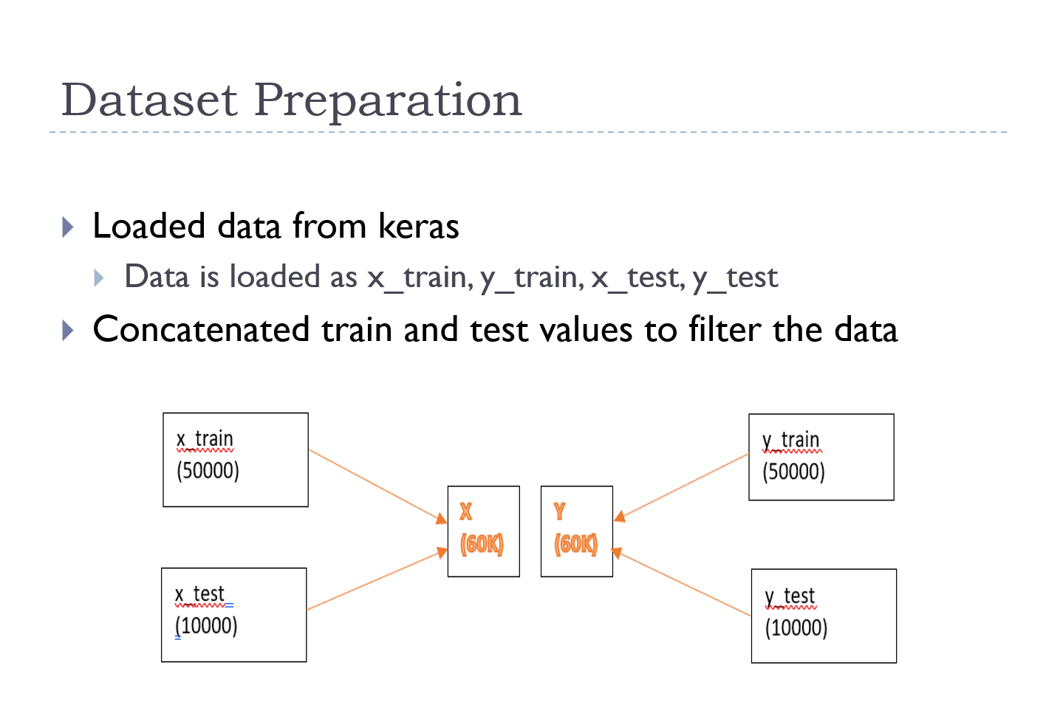

Slide 3
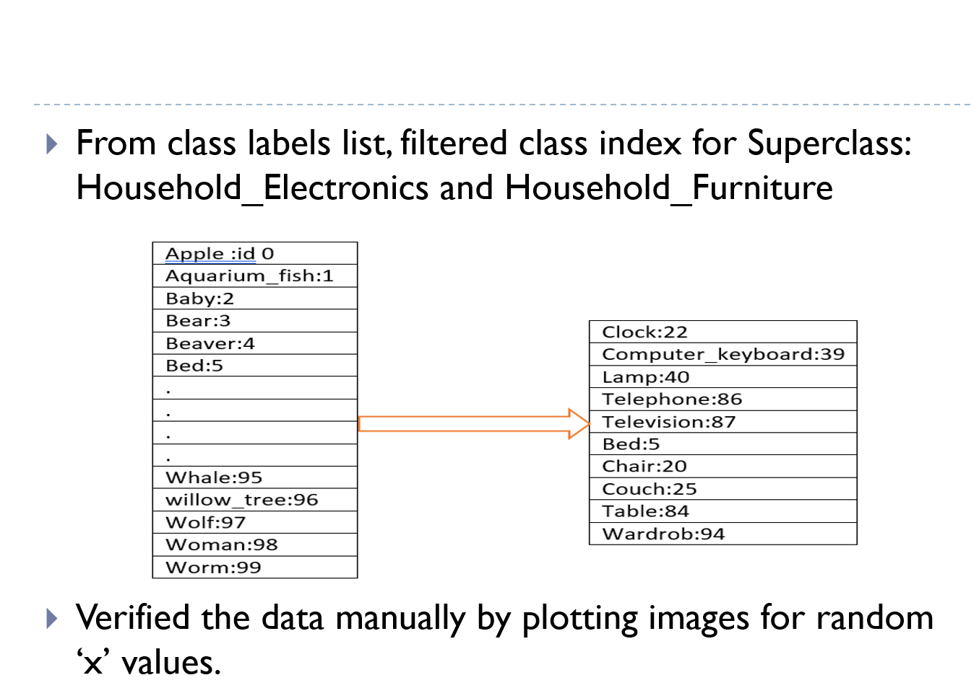

Slide 4
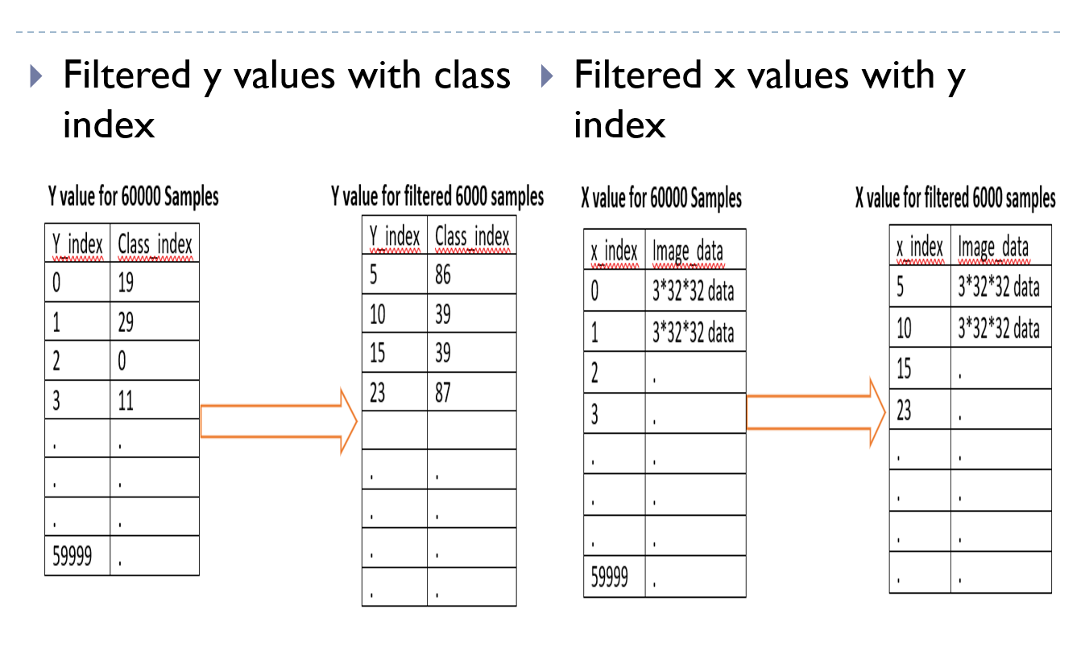

Slide 5
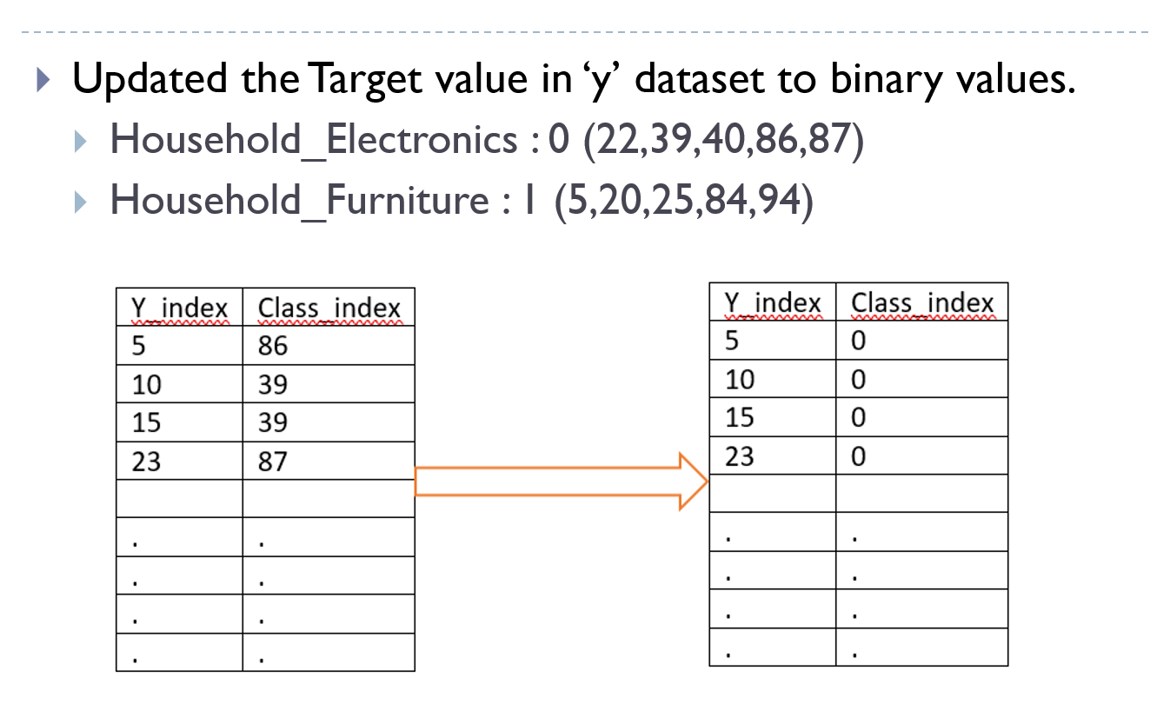

Slide 6
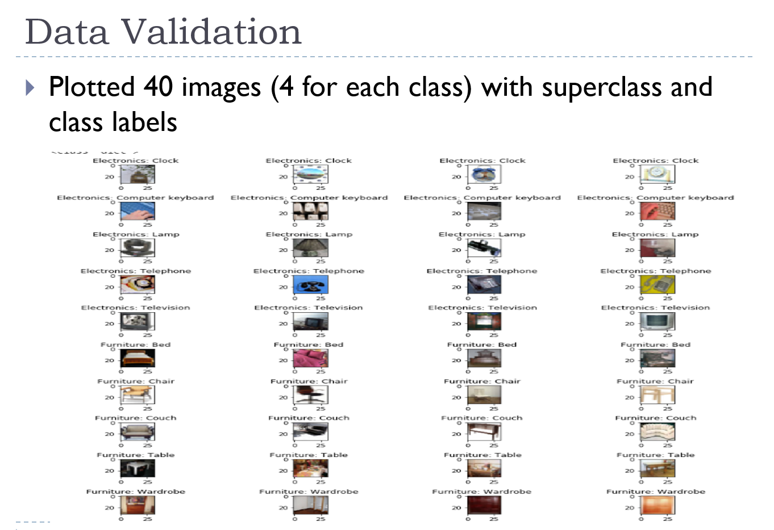

Slide 7
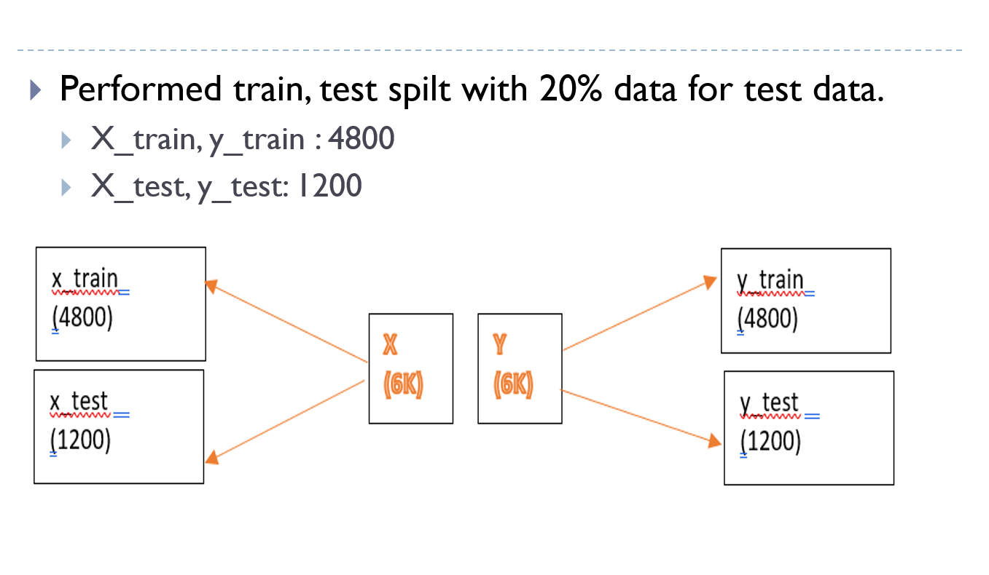

Slide 8
Machine Learning algorithms used in binary classification
Traditional ML Algorithms | Ensemble ML Algorithms | Deep Learning
Logistic Regression | Random Forest | Simple Neural Network
Support Vector Machine | Gradient Boosting | MLP
K- Nearest Neighbors | XGBoost | CNN

Slide 9
Prediction Scores with train test split
Model | Accuracy(in %) | Time Taken
Logistic Regression | 67.90 | 20 Sec
Support Vector Machine | 79.85 | 106 Sec
K- Nearest Neighbors | 73.08 | 60 Sec
Random Forest | 77.33 | 59 Sec
Gradient Boosting | 75.25 | 840 Sec
XGBoost | 76.58 | 51.88 Sec
Simple Neural Network(Keras) | 69.50 | 48 Sec
MLP(Scikit learn) | 75.67 | 113 Sec
CNN | 86.92 | 1480 Sec

Slide 10

Confusion matrix
We have Considered:
Negative Class – Household Electronics
Positive Class – Household Furniture
True Negatives – 535
True Positives – 508
False Negatives – 90
False Positives – 67

Slide 11
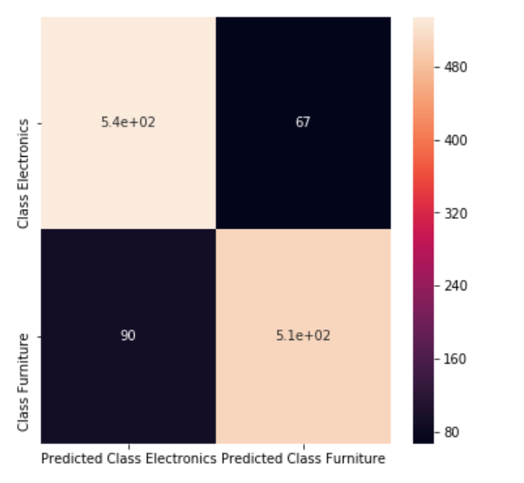
Confusion matrix using HeatMap

Slide 12
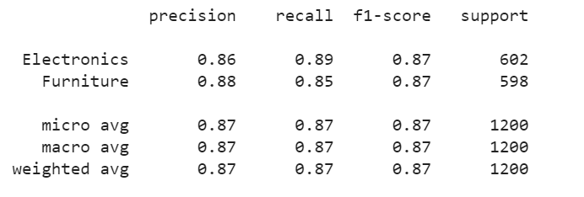
Classification Report

Slide 13

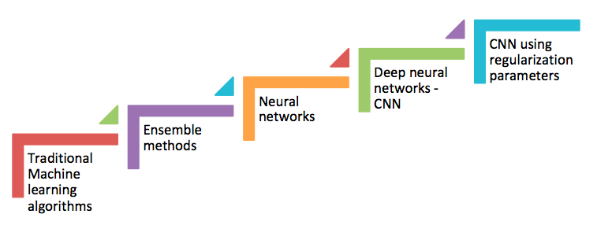
Achieved the results
CNN is the best model - 86.72 %

Slide 14
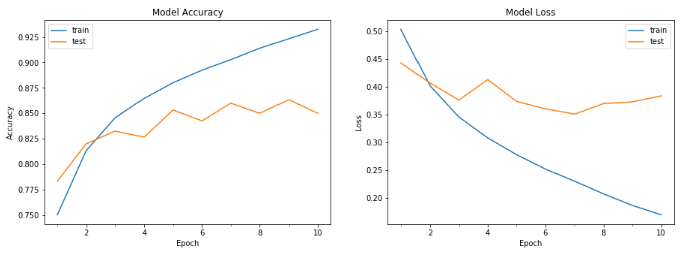
Best Model – CNN(Overfitting)
Accuracy – 85%

Slide 15
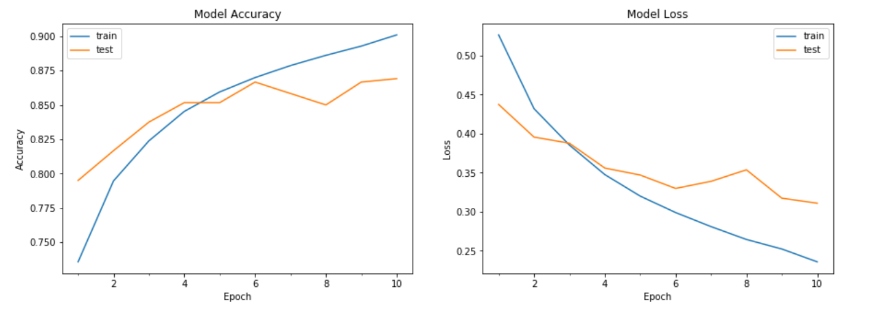
Best Model – CNN(Drop Out)
Accuracy – 86.92%

Slide 16
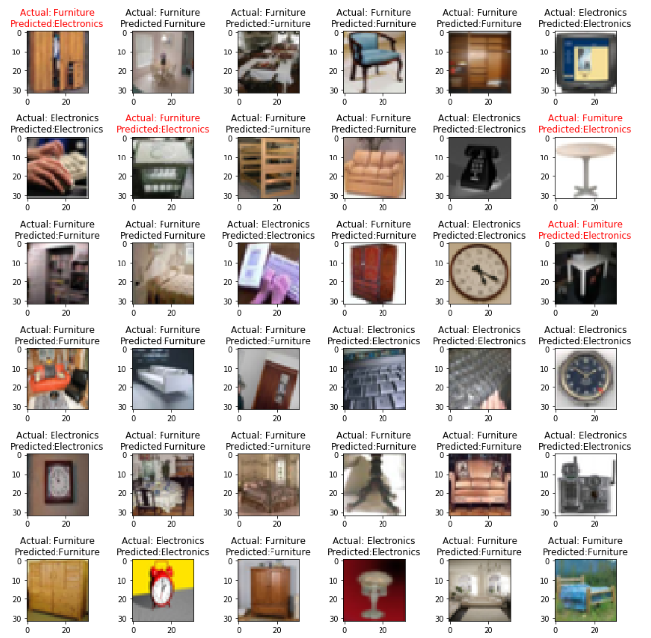
Predicted Images

Slide 17
Additional Experiments
Regularization Parameters in CNN:
More Training Examples
Drop Out
Weight Regularization
Reduce the capability of the network

Slide 18
Additional Experiments
Hyper parameter tuning
Model | Parameters Tuned
Support Vector Machine | C =1 Kernel = rbf Gamma = 0.01 | Default Accuracy: 70.50%
 |  | Final Accuracy: 79.85%
KNN | n_neighbors = 13 | Default Accuracy: 66.5%
 |  | Final Accuracy: 73.08%
Random Forest | Estimators = 500 Depth = 300 | Default Accuracy: 69.00 %
 |  | Final Accuracy: 77.30 %
Gradient Boosting | Estimators = 300 minsampleleaf = 1 minsample split = 4 max depth = 4 max_features = auto | Default Accuracy: 71.20 %
 |  | Final Accuracy:75.25 %
XGBoost | n_estimators = 50 nthread= 4 objective= binary:logistic learning_rate= 0.05 | Default Accuracy: 71.20 %
 |  | Final Accuracy:75.25 %

Slide 19
Lessons Learnt
Working with RGB image data:
Working with the 3 dimensional matrices, printing images, understanding how the data is stored was one big challenge.
Image Augmentation : Using Imagedatagenerator of keras has improved the accuracy by close to 3 %
Image Conversion to Gray Scale: We thought the computational efficiency would increase on a large scale, surprisingly it did change a lot and also accuracy has decreased.
GridSearchCV : This was one method which helped us a lot and reduced the manual effort that we had to put in. We could give a list of values for the hyper parameters to be tuned and get the results with the highest accuracy and the best hyperparameter values.

Slide 20
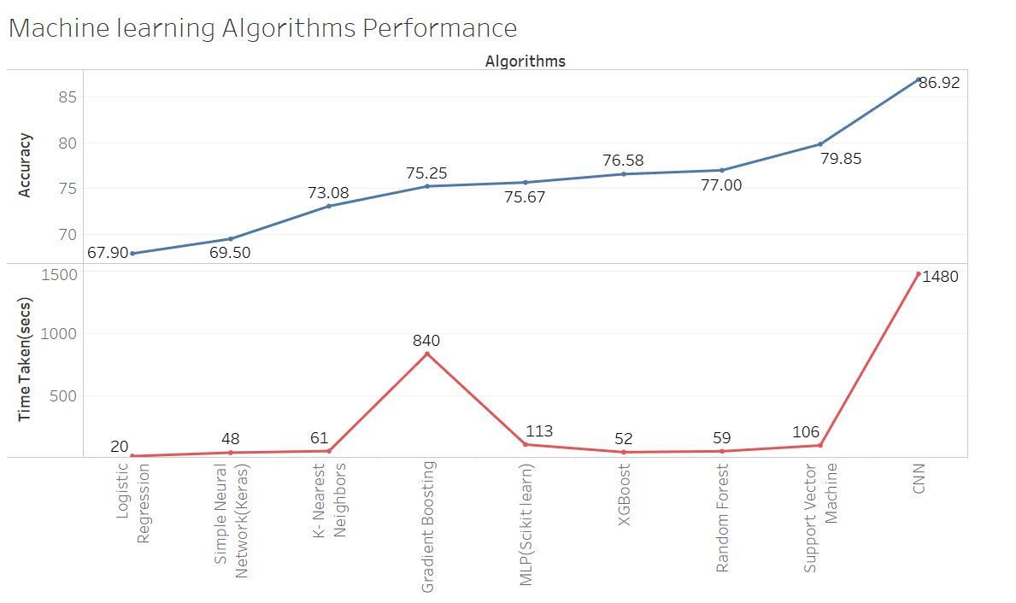

Slide 21
THANK YOU

