Slide 1
CREATING A YOU_TUBE CLONE
Presented by CHARAN_DASARI

Slide 2

Introduction about the company
I had done my internship in Prodigy InfoTech.
Prodigy InfoTech is an internship platform.
It was founded by Sunil aggarwal

Slide 3
TABLE OF CONTENTS
Introduction
Technologies used
References website

Slide 4
Technologies used
HTML
CSS
JAVASCRIPT
Bootsrap

Slide 5
HTML
HTML stands for hyper text markup language.
With HTML we can create our own website.
To describe structure of webpage.
HTML elements tell the browser how to display the
Content.

Slide 6
CSS
CSS stands for Cascading Style Sheets.
IT is used to style an HTML document.
It describes how html elements are displayed on screen.
IT is for laying out and structuring webpages.

Slide 7
bootstrap
Bootstap is free and open source front end development framework
It is used for the creation of websites and web apps
Bootsrap enabels the responsive design for websites

Slide 8
Hardware requirements
Disk space:1GB.
Minimum RAM:128MB
Operating system :Windows ,mac OS and Linux
Visual Studio should install on system.

Slide 9
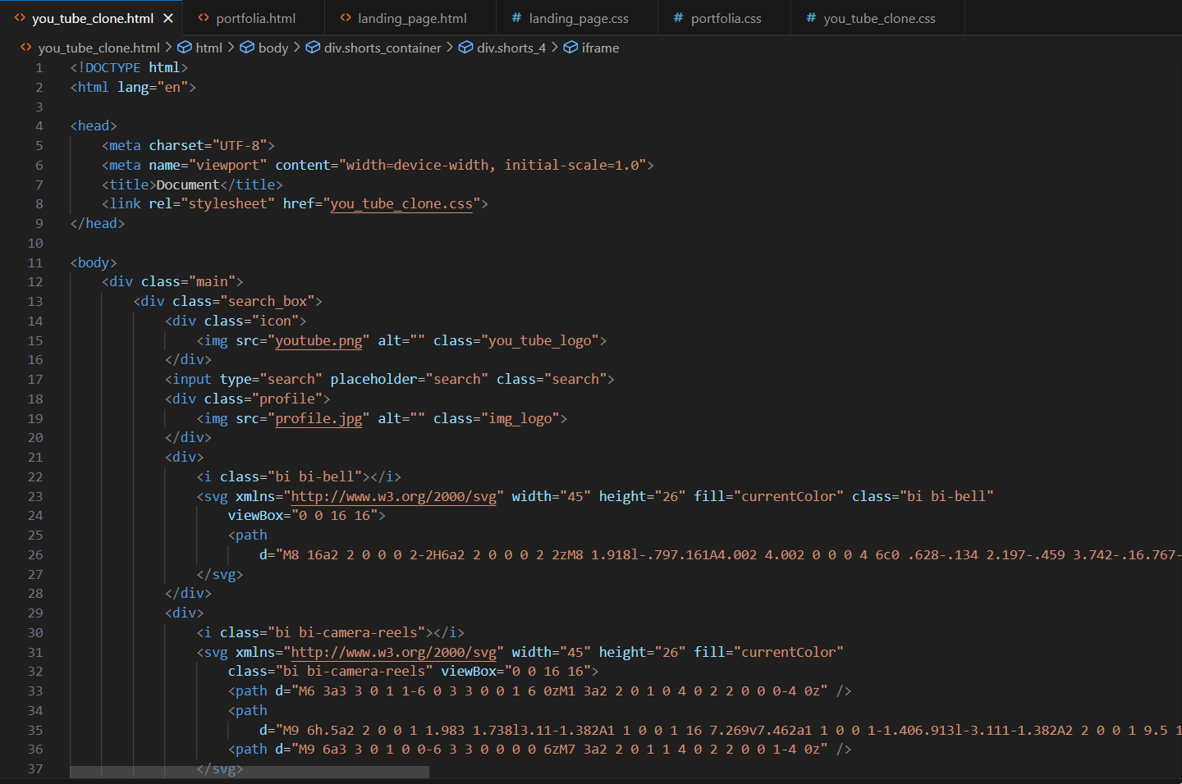
creating a YOU_TUBE frontpage CLONE
Html file :

Slide 10
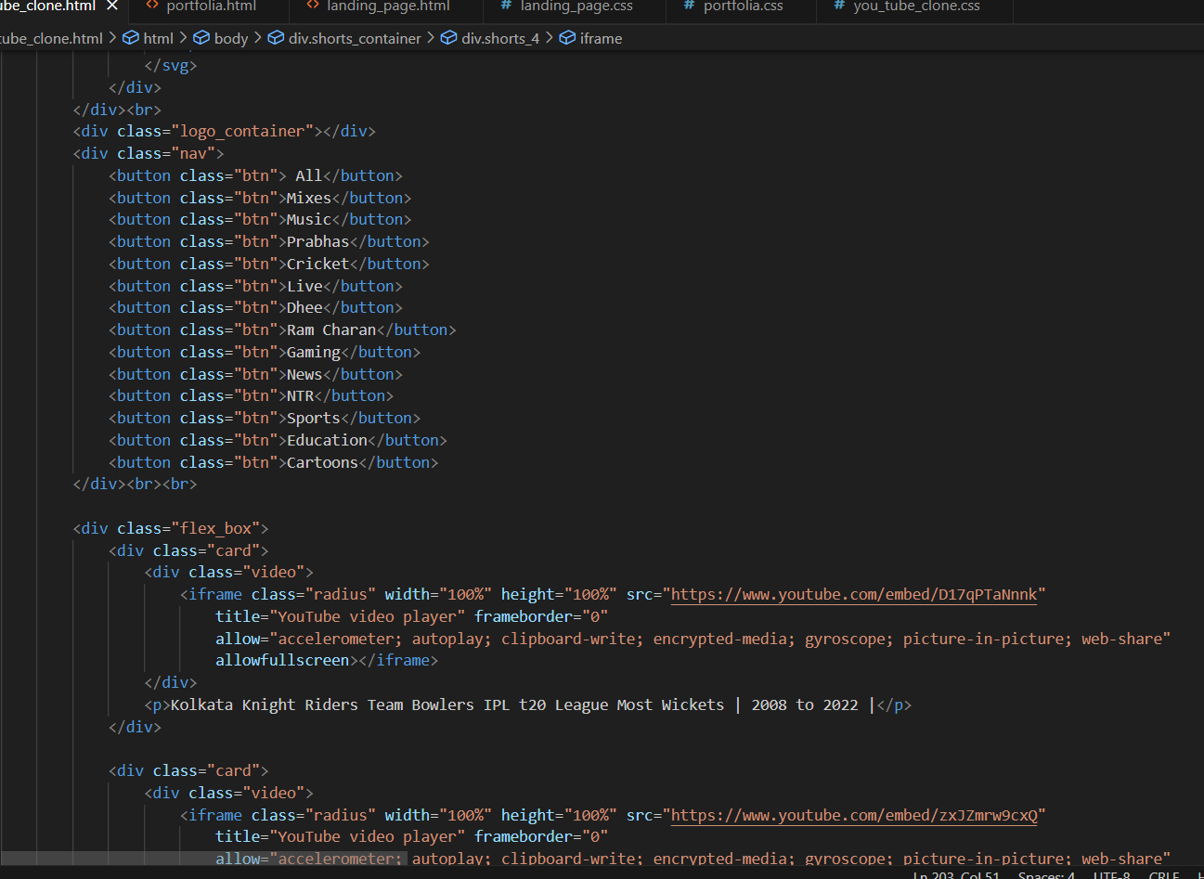
creating a YOU_TUBE frontpage CLONE
HTML FILE:

Slide 11
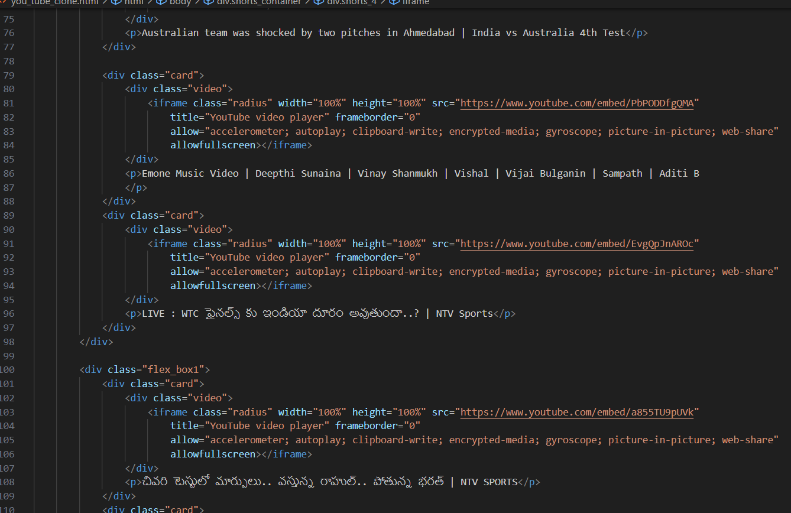
creating a YOU_TUBE frontpage CLONE
HTML FILE:

Slide 12
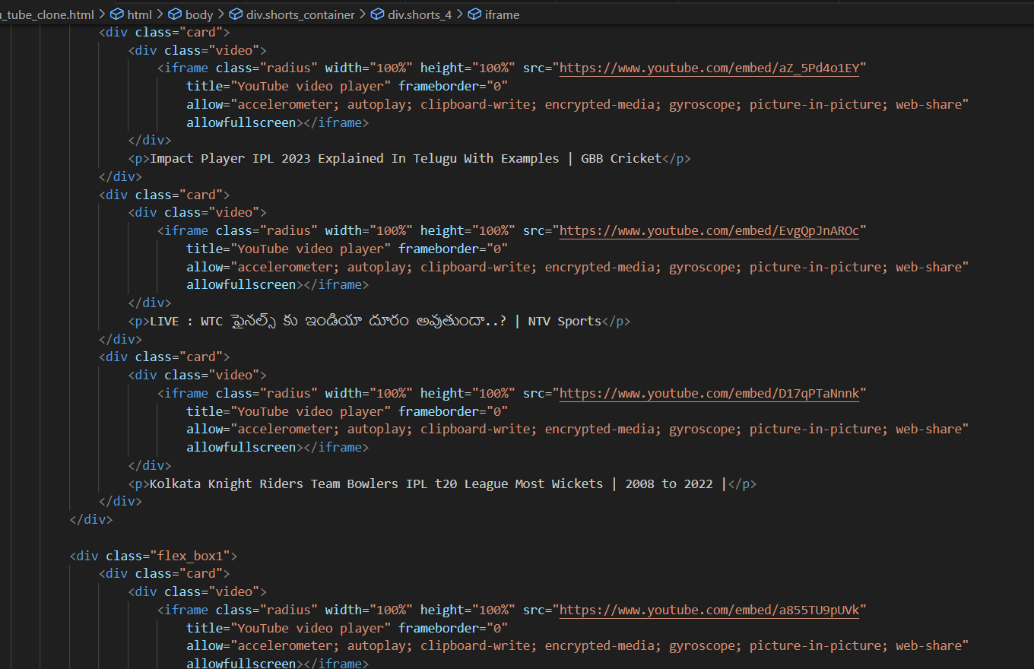
creating a YOU_TUBE frontpage CLONE
HTML FILE:

Slide 13
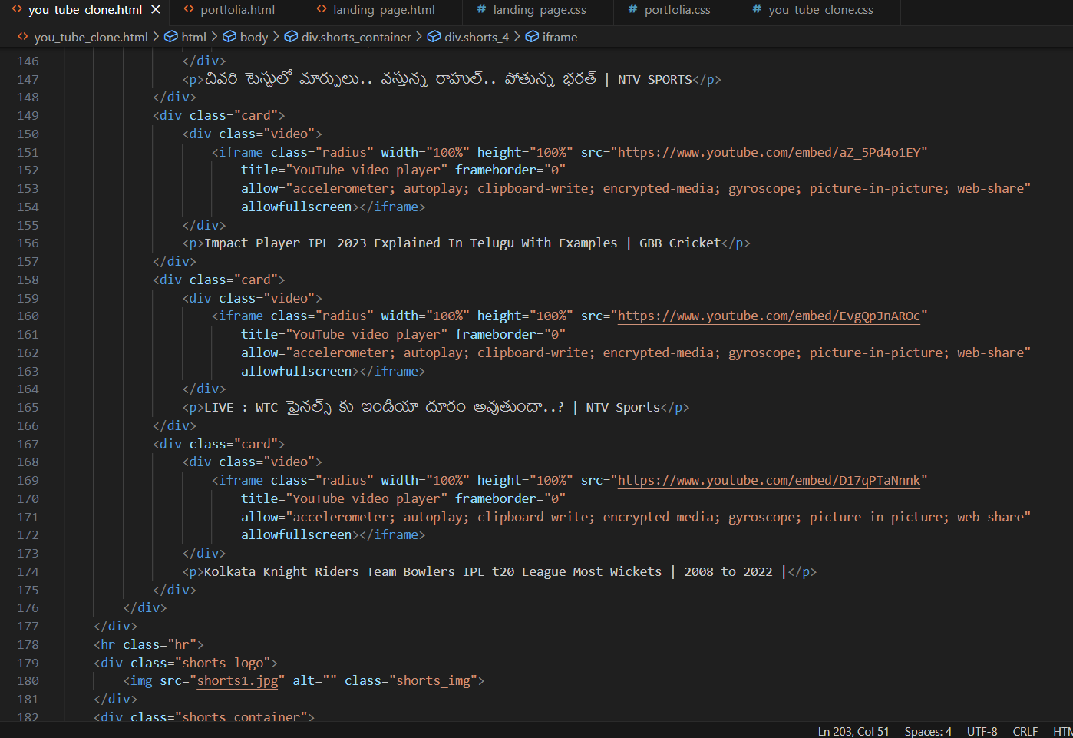
creating a YOU_TUBE frontpage CLONE
HTML FILE :

Slide 14
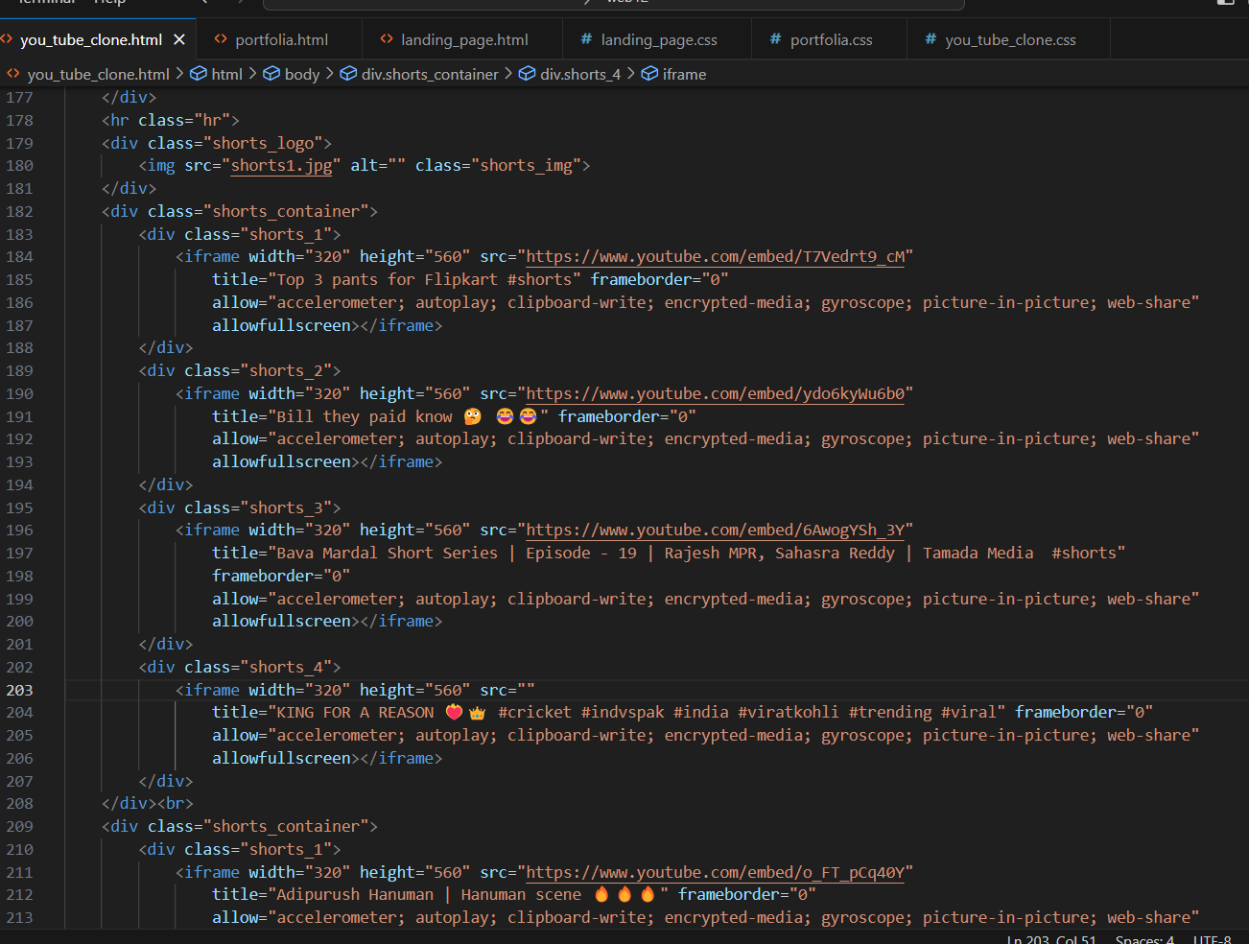
creating a YOU_TUBE frontpage CLONE
HTML FILE:

Slide 15
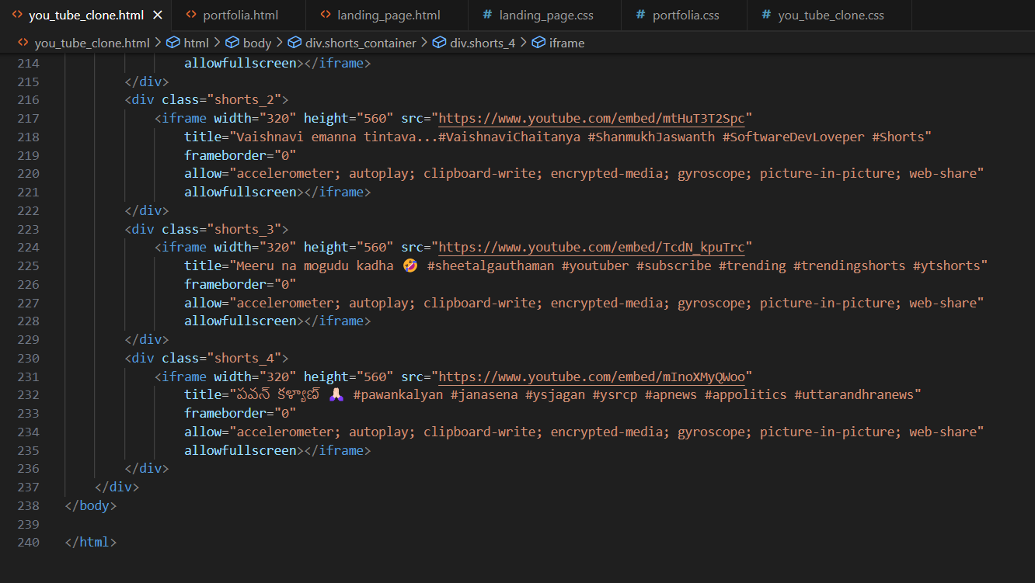
creating a YOU_TUBE frontpage CLONE
HTML FILE:

Slide 16
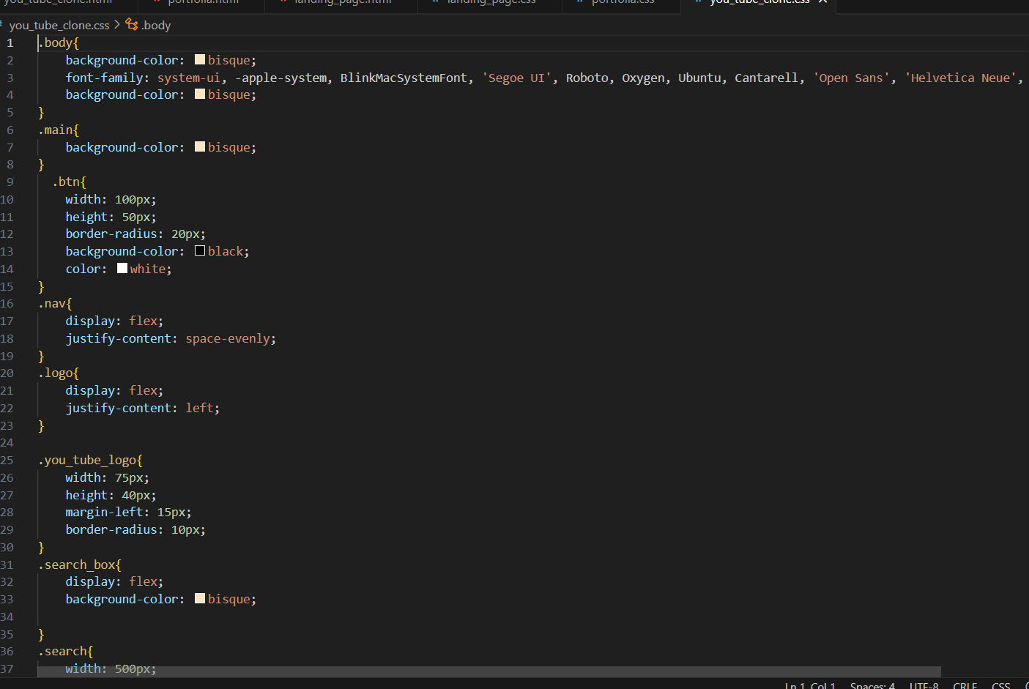
creating a YOU_TUBE frontpage CLONE
CSS FILE:

Slide 17
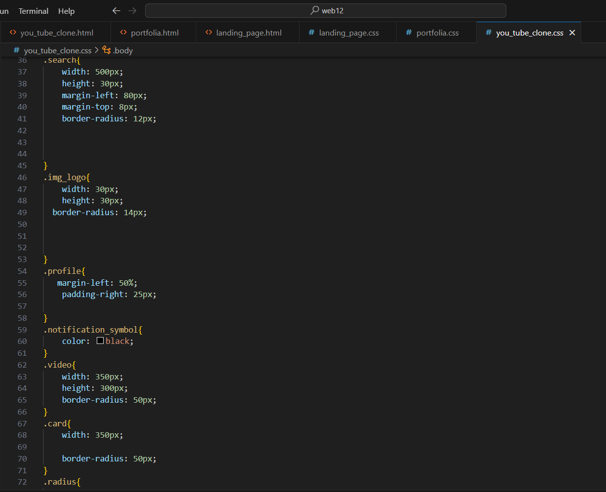
creating a YOU_TUBE frontpage CLONE
CSS FILE :

Slide 18
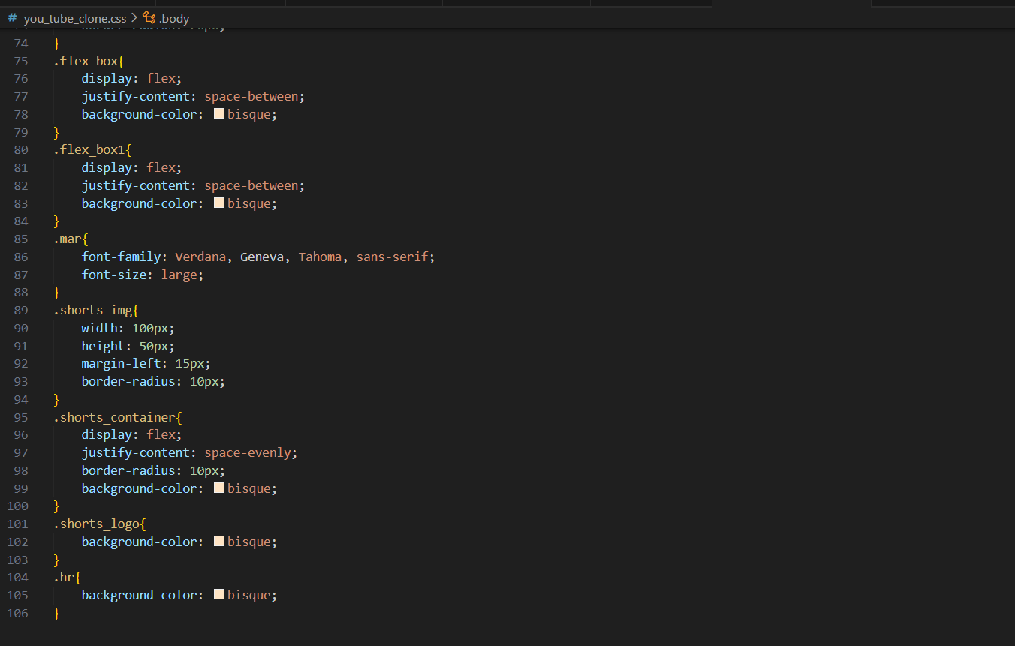
creating a YOU_TUBE frontpage CLONE
CSS FILE :

Slide 19
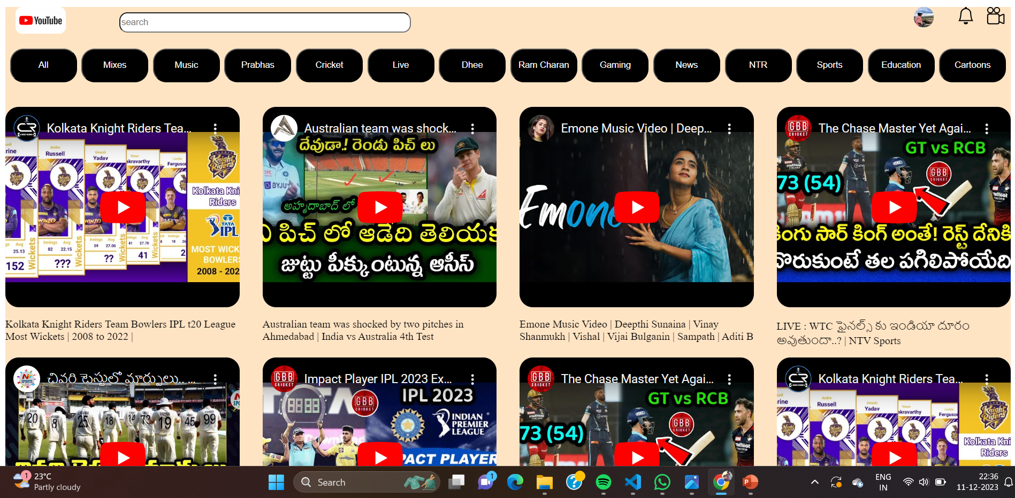
creating a YOU_TUBE frontpage CLONE
OUTPUT:

Slide 20
REFERENCE
https://prodigyinfotech.dev/
https://in.linkedin.com/company/prodigy-infotech

Slide 21

CHARAN_DASARI

