Slide 1
Georgia State University
CSC4780/6780
Fundamentals of Data Science
Final Project Presentation Heart Attack Prediction
11-12-24
The Prediction Wizards
Benedict Antonio Mervyn
Venkata Dheeraj Bhogi
Nikitha Rajendran

Slide 2
Introduction
Problem: Cardiovascular diseases cause millions of deaths annually. Early detection of heart attacks is crucial for better outcomes, but current diagnostic methods can be slow.
Data Sources: The dataset includes 1,319 patient samples with features like age, gender, heart rate, blood pressure, glucose, and cardiac markers. The target is heart attack occurrence (binary classification).
Motivation: A predictive model helps identify high-risk individuals early, enabling timely intervention and personalized treatment, improving patient outcomes.
Outline:
Implementing machine learning models (Logistic Regression, SVM, Random Forest, Gradient Boosting, XGBoost, LightGBM).
Evaluating performance using metrics like accuracy, precision, recall, and ROC-AUC.
Goal: Build a model to predict heart attack risk and support clinical decision-making.

Slide 3
Data Sources and Data Exploration
The dataset includes 1,319 patient samples, with clinical and demographic features such as age, gender, heart rate, blood pressure, glucose levels, and specific cardiac markers like creatine kinase-MB and troponin. The target variable is whether a patient has experienced a heart attack (binary classification).
Missing Values & Outliers: No missing values. Outliers in features like impulse, blood pressure, and glucose were capped using IQR to ensure data consistency while preserving valuable information.
Normalization:
StandardScaler was applied to age, impulse, pressurehigh, and pressurelow for feature scaling.
Log transformations were applied to glucose, kcm, and troponin to reduce skewness.
Feature Transformations:
Blood Pressure Ratio (bp_ratio): Created by dividing systolic by diastolic pressure.
Impulse Categorization: Heart rate categorized into Low, Normal, and High ranges.
Age Grouping: Age was grouped into Young, Middle-Aged, and Elderly categories.

Slide 4
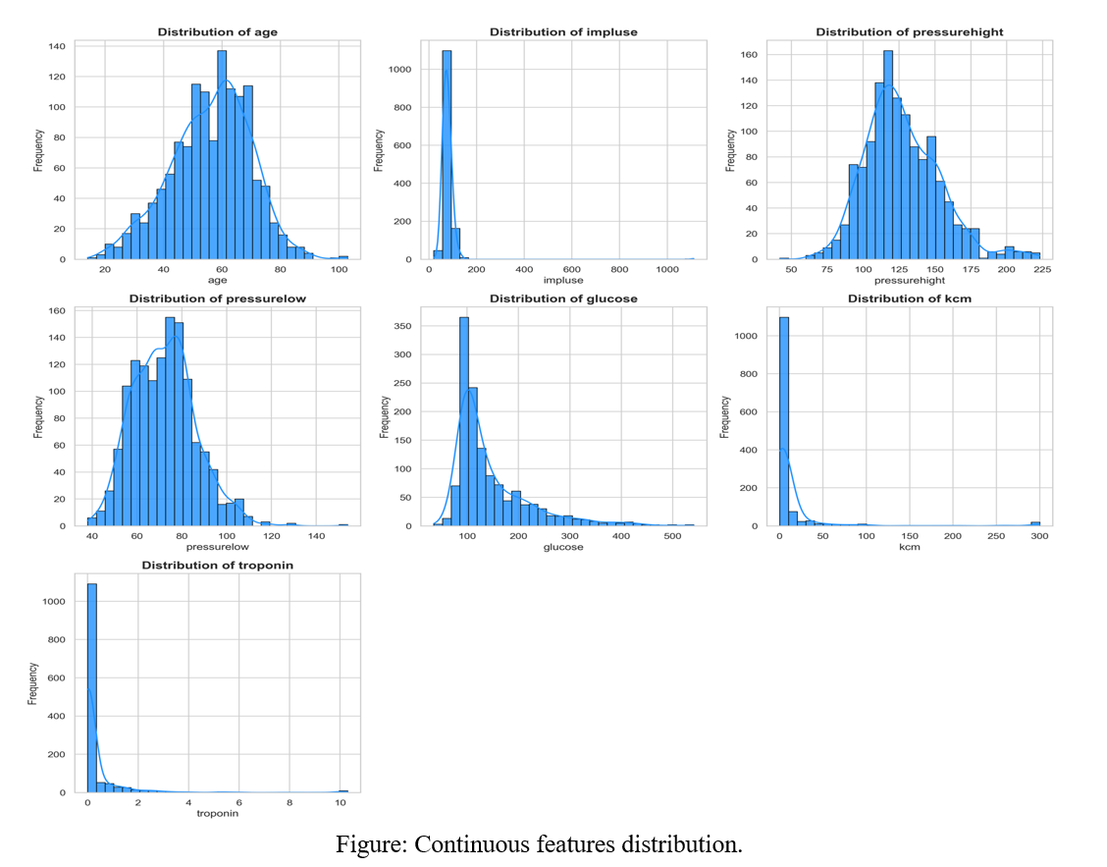
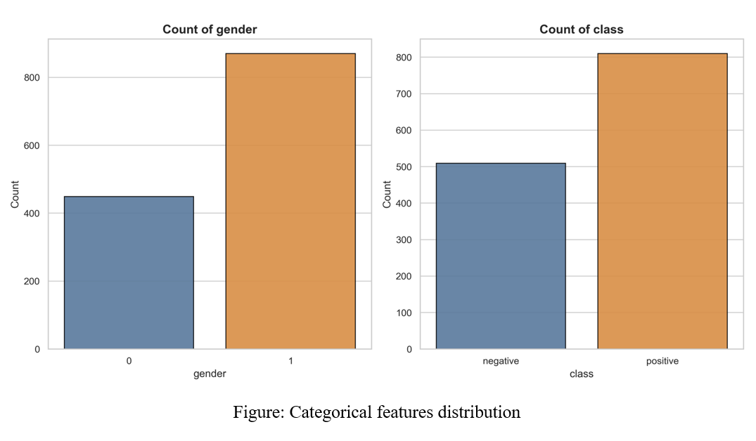

Slide 5
Model Selection
Selected Models:
Logistic Regression: Baseline model for performance benchmarking.
SVM: Linear kernel for simplicity; kernel for capturing non-linear patterns.
Random Forest: Ensemble method for robust, accurate predictions.
Gradient Boosting: Sequential method to iteratively minimize errors.
XGBoost: Advanced boosting with regularization to prevent overfitting.
LightGBM: Optimized gradient boosting for speed and scalability.
Why These Models? Chosen for their ability to handle binary classification tasks, robustness, and scalability. They offer a mix of simplicity, interpretability, and complex non-linear pattern detection.
Feature Selection: Important features retained after preprocessing and transformations. Blood Pressure Ratio, categorized Impulse, and Age Group enrich predictive power.

Slide 6
Evaluation
Settings & Sampling:
Data split: 70% training, 30% testing with random state 42 for reproducibility.
Balanced dataset ensured adequate representation of all classes.
Hyperparameter Optimization:
GridSearchCV for exhaustive tuning in small parameter spaces.
Key parameters tuned using 5-fold cross-validation guided by ROC-AUC and F1-Score.
Results:
Random Forest: Top performer (AUC, F1-Score), highly balanced predictions.
XGBoost: High metrics (Accuracy: 0.98, AUC: 0.9841, F1-Score: 0.99).
SVM: Strong Precision and Recall, slightly less robust overall.
Gradient Boosting & LightGBM: Reasonable but showed variability.
Logistic Regression: Acceptable but struggled with lower AUC and F1-Score.

Slide 7
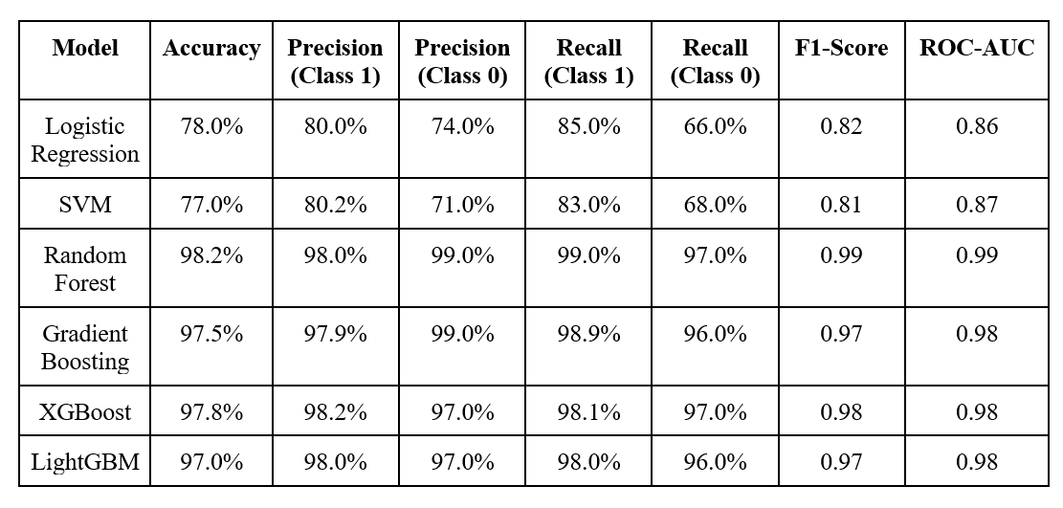

Slide 8
Conclusion
Best Model: Random Forest achieved the highest accuracy (98.2%) and ROC-AUC (0.99), proving robust and reliable for heart attack risk prediction.
Business Impact: Supports early diagnosis and intervention by providing clinicians with accurate and scalable risk assessment tools.
Recommendations:
Deploy Random Forest as the primary model for clinical use.
Enrich dataset with lifestyle factors (e.g., smoking, diet).
Build a web-based app for real-time predictions.
Integrate SHAP/LIME for model interpretability and trust.

