Slide 1
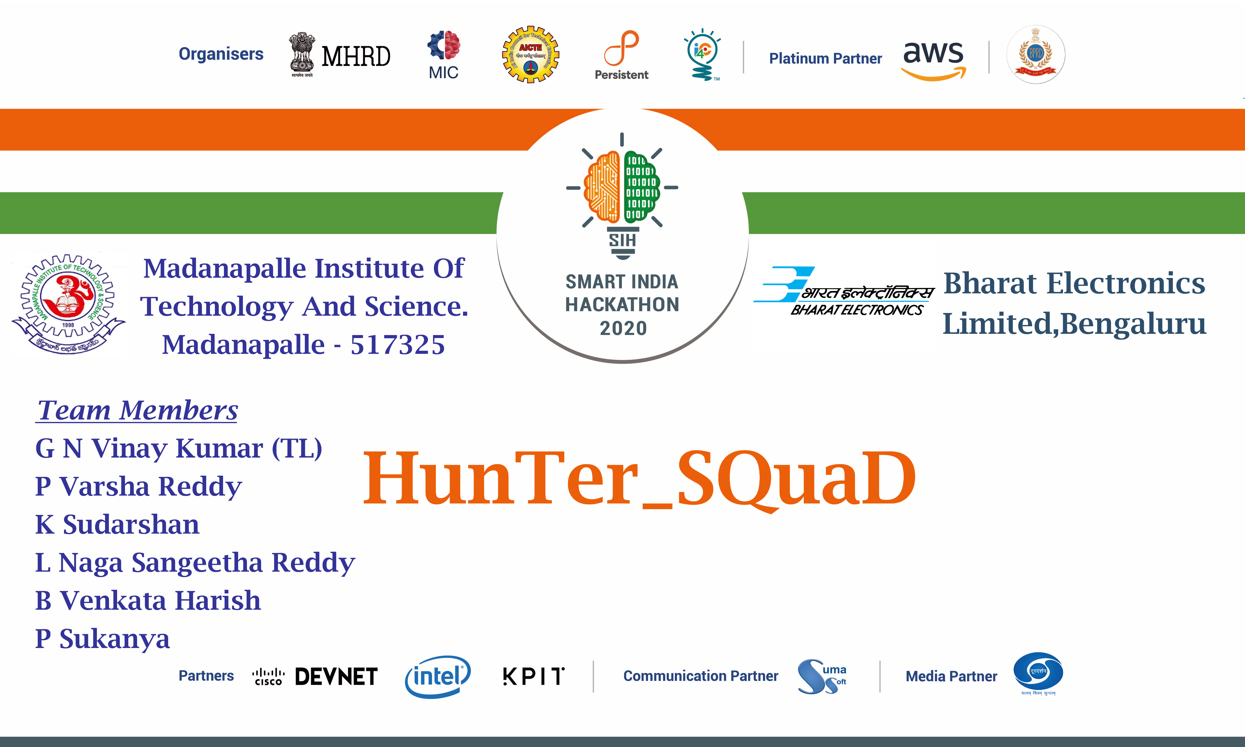
Idea/Approach Details

Slide 2
Problem Statement And Problem Description
Software based module for segmentation and identification of Indian languages from the given input audio file. Objective of the software module is: a) Input should be narrow band speech data. b) Output should be labeled for languages with respect to time. c) Language labeling for a minimum 15 seconds audio segment. d) Capable to identify all 24 official Indian languages from given audio file. e) Non-Indian languages need to be labeled as unknown. f) Capable to give high accuracy (more than 80%) in Low SNR's (as low as 20db).

Slide 3
Technology Stack
1)NumPy 5) Sound File
2)Librosa 6)SciPy
3)Wave 7)Pydub
4)Multiprocessing 8)Context Lib

Slide 4

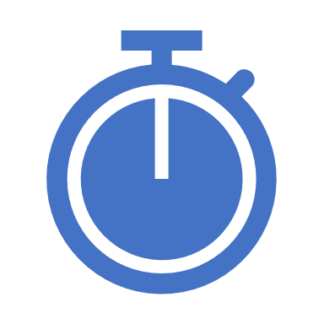
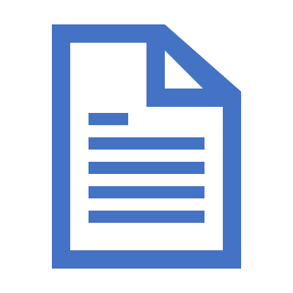
Idea / Approach details
Use Cases
Audio File
Noise elimination
Speech to text
Language
Diarization
Language Identification
Time Segmentation
Output

Slide 5
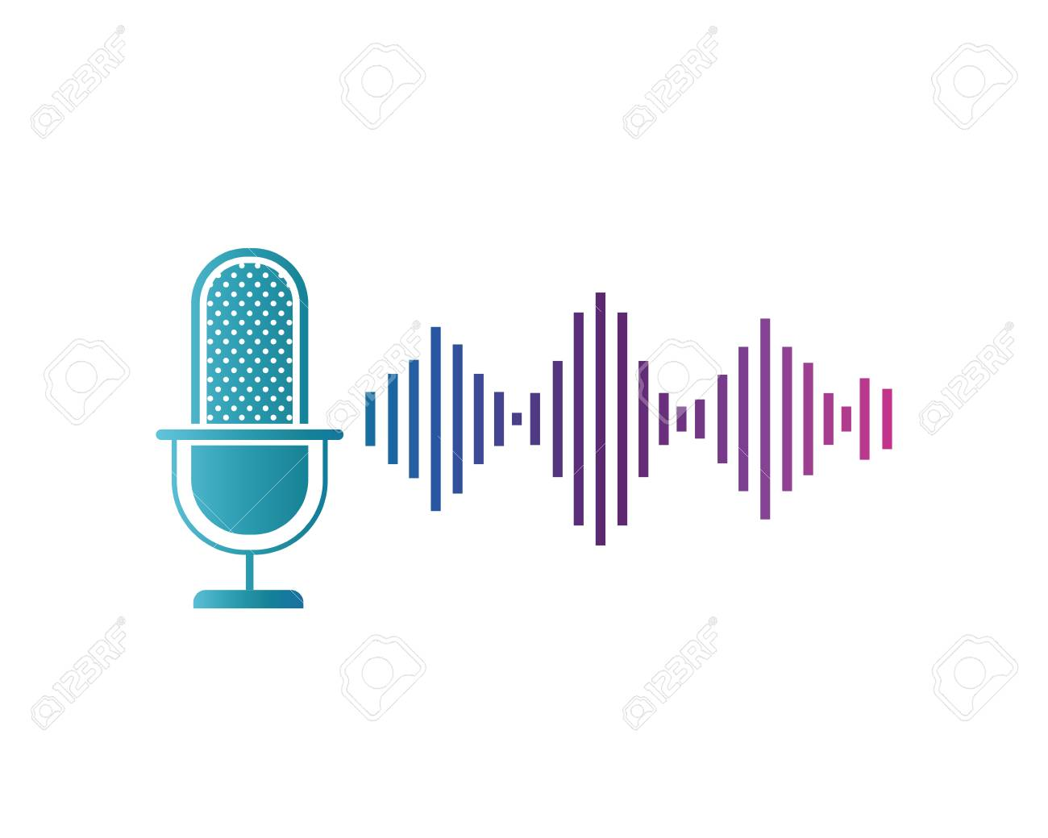

INPUT
Input can be given
manually using
microphone
Input can be given
as audio wav file

Slide 6
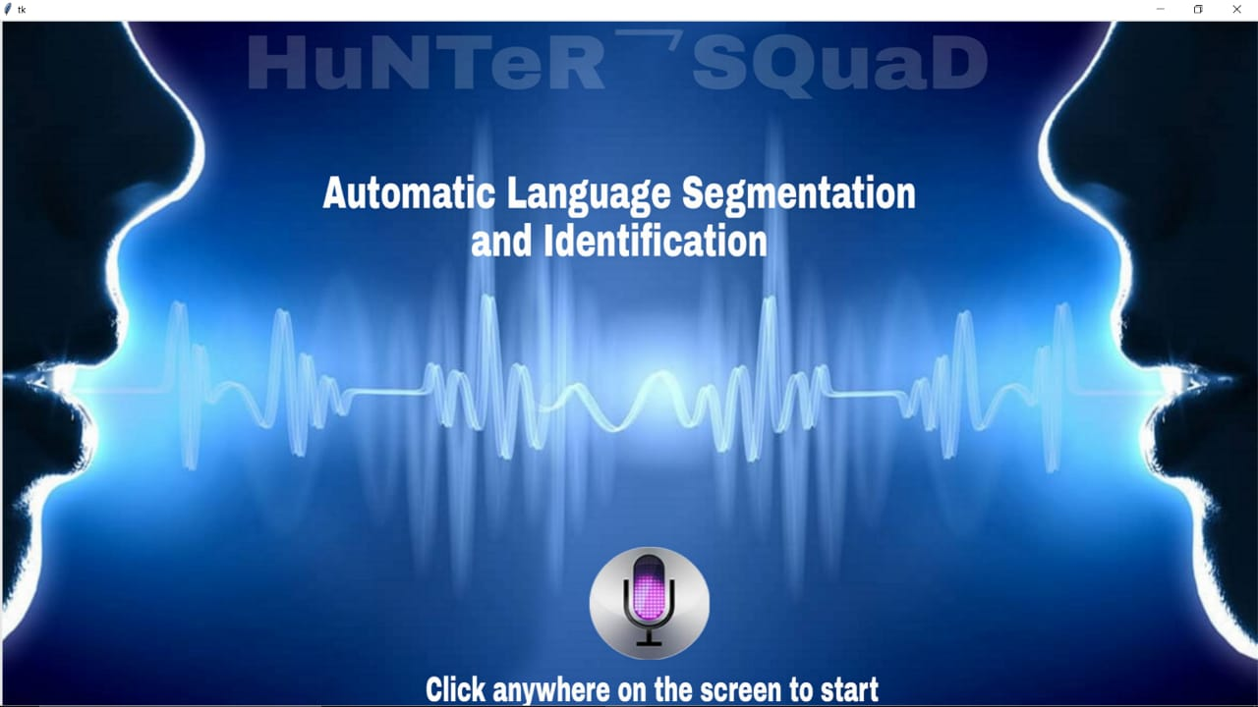
USER INTERFACE
This is the
Starting page
of our
user interface

Slide 7
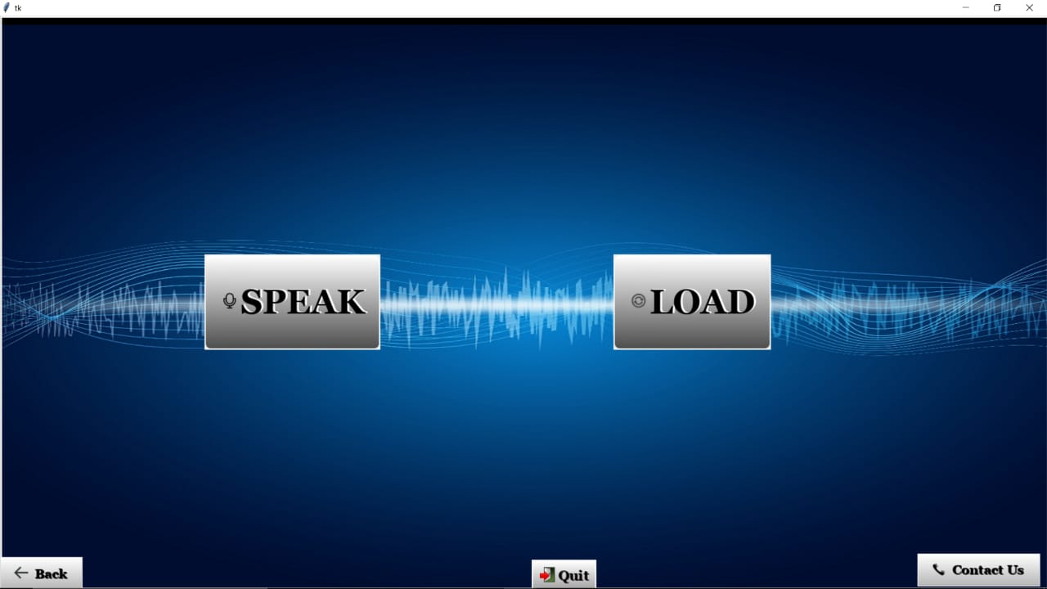
We can select
Any of the input
Methods here

Slide 8
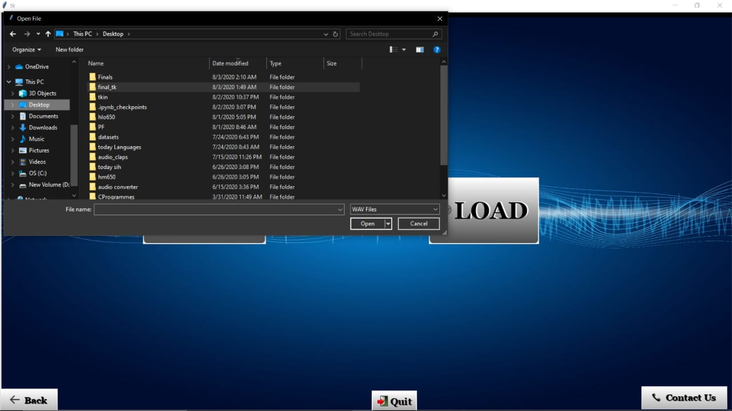
Loading of input
audio file can be
done in this way

Slide 9
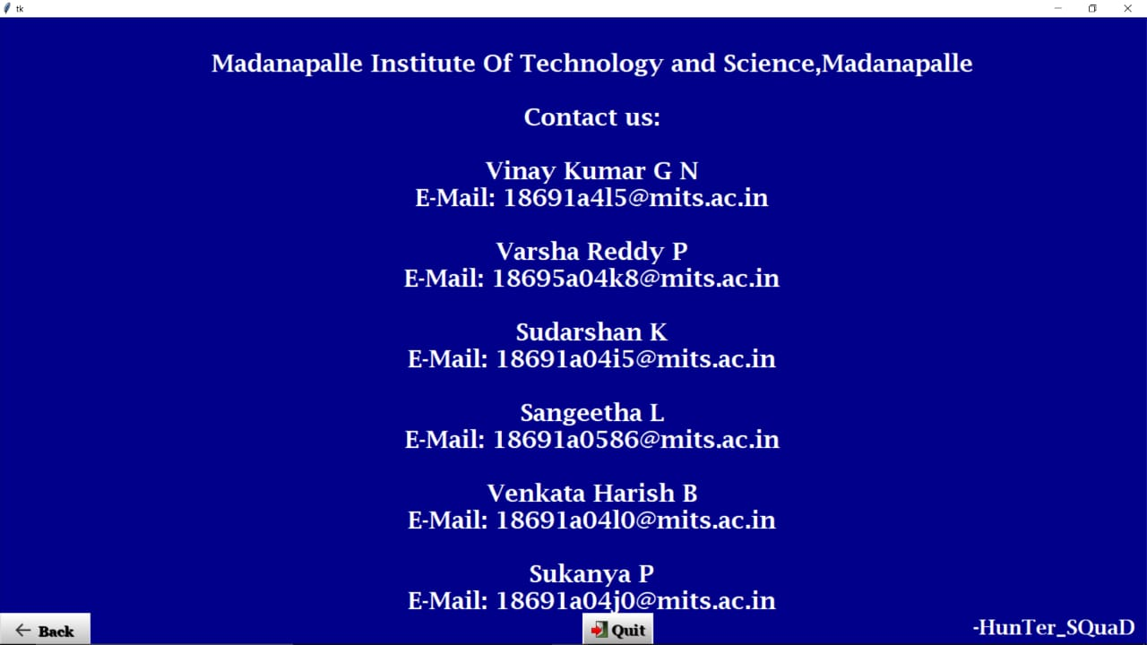
It is a user friendly
Interface.Any user
can easily use it.

Slide 10
Thank You

