Slide 1

Project Title - Seasonal Agriculture Performance Analysis
Student Name - Cherukuri Venkata Karthikeya
College Name - Vellore Institute of Technology – Amaravati (VIT-AP University)
AICTE STU ID : STU6a5e427b530f41784562299

Slide 2

PROBLEM STATEMENT
Agricultural performance can change from one season to another because of differences in rainfall, temperature, soil conditions, irrigation, farming practices, resource usage and market conditions.
This project focuses on analyzing an agricultural dataset to understand these seasonal variations and identify meaningful patterns in yield, production, water usage and profit.
The analysis uses statistical methods and visualizations to compare seasons, crops and other important agricultural factors and to provide useful data-based observations.

Slide 3
Project Description
This project analyzes 4,000 agricultural records with 28 variables covering different crops, seasons, locations, environmental conditions, farming practices and economic outcomes.
The project starts with data loading and quality checking, followed by missing-value treatment, duplicate checking and variable review. Descriptive statistics are then used to understand the overall data distribution.
Univariate, bivariate and multivariate visualizations are used to study seasonal differences and relationships between variables such as rainfall, yield, farm area, production, irrigation, water usage and profit.
The main purpose is to understand which seasonal and crop-level patterns stand out in the data and support the findings with evidence rather than assumptions.

Slide 4

WHO ARE THE END USERS?
Farmers
Understand seasonal yield and profit patterns.
Compare crop performance across seasons.
Review water and irrigation usage. Agricultural Analysts
Study relationships between environmental conditions and crop performance.
Compare regional and seasonal agricultural trends.
Agricultural Planners / Decision Makers
Use historical data to support seasonal planning.
Identify areas that need further investigation.
Researchers and Students
Use the analysis as a base for further agricultural studies.

Slide 5

Technology Used
Analysis Techniques
Data Cleaning
Exploratory Data Analysis
Descriptive Statistics
Univariate Analysis
Bivariate Analysis
Multivariate Analysis
Correlation Analysis
Outlier Analysis
Programming Language
Python
Libraries
Pandas — data handling and analysis
NumPy — numerical operations
Matplotlib — data visualization
Seaborn — statistical visualization
Development Environment
Jupyter Notebook

Slide 6
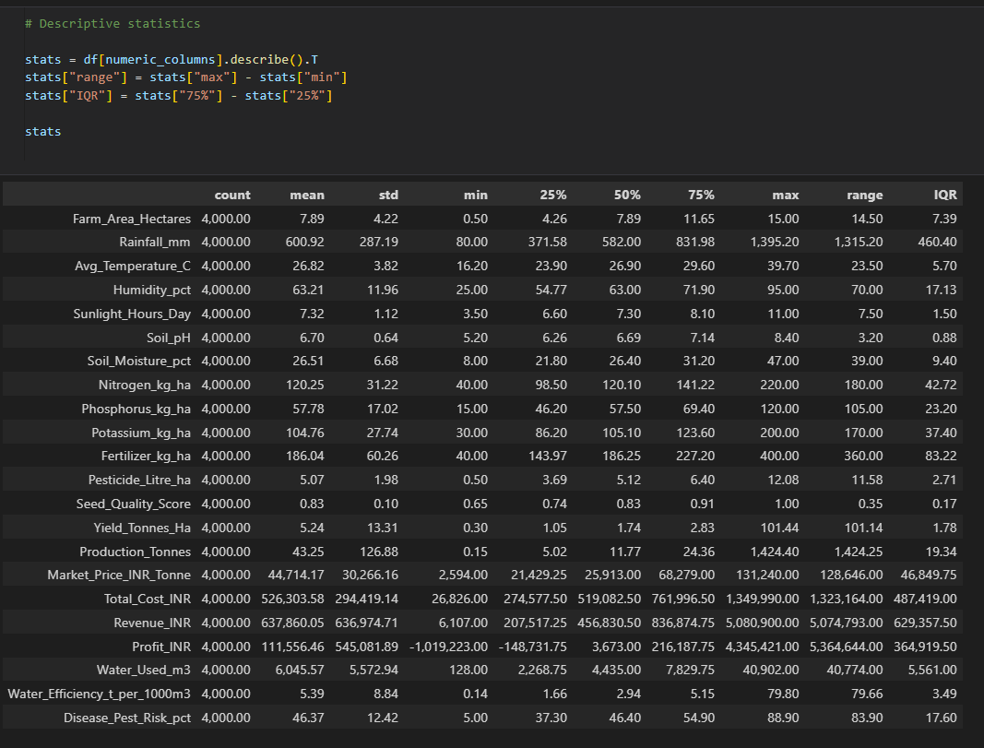
RESULTS
Statistical Summary & Outlier Analysis
Statistical Analysis
Summary table with Mean, Std, Median, Min, Max for Yield, Profit, Rainfall, Temperature, etc.

Slide 7
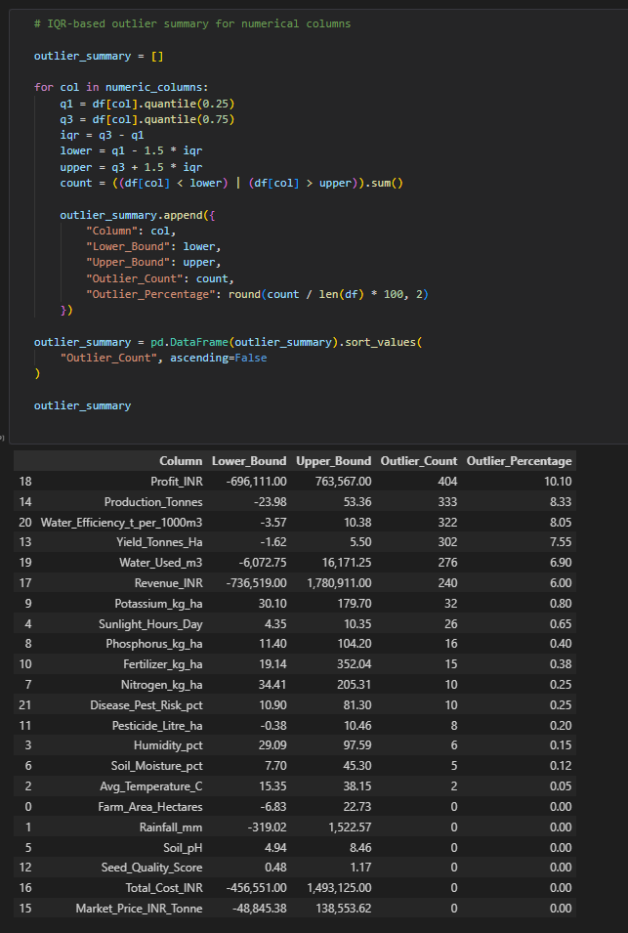
RESULTS
Statistical Summary & Outlier Analysis
Outlier Analysis
Table showing lower/upper IQR bounds, outlier counts, and percentages for each feature.

Slide 8
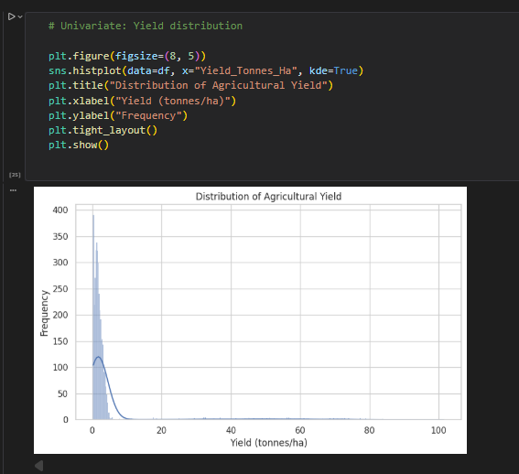
RESULTS
Statistical Summary & Outlier Analysis
Univariate Analysis
Boxplot highlighting yield spread and high-yield outlier points.

Slide 9
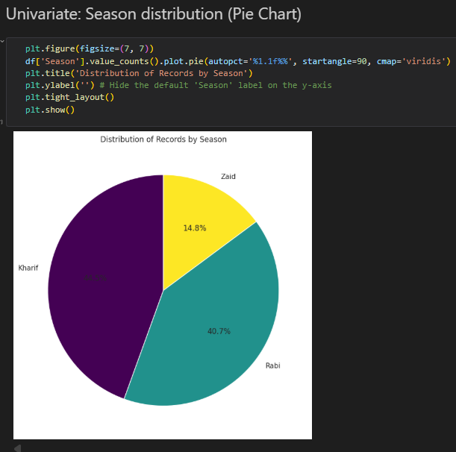
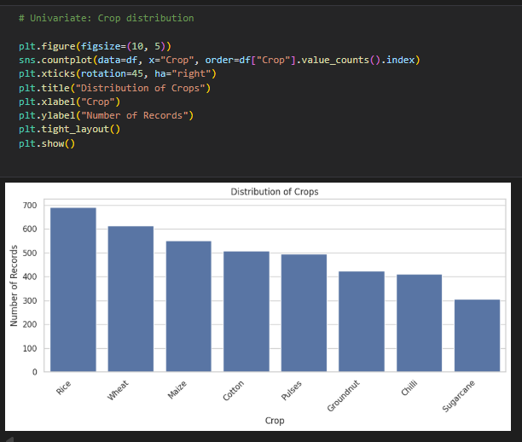
RESULTS
Univariate Analysis (Distributions & Seasonality)
Univariate: Season distribution (Pie Chart)
Univariate Analysis

Slide 10
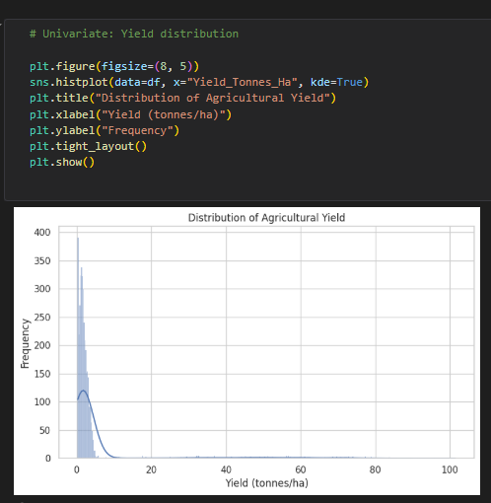
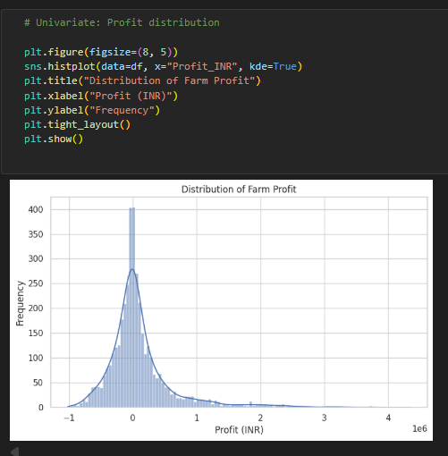
RESULTS
Univariate Analysis (Distributions & Seasonality)
Univariate Analysis
Yield / Profit distribution

Slide 11
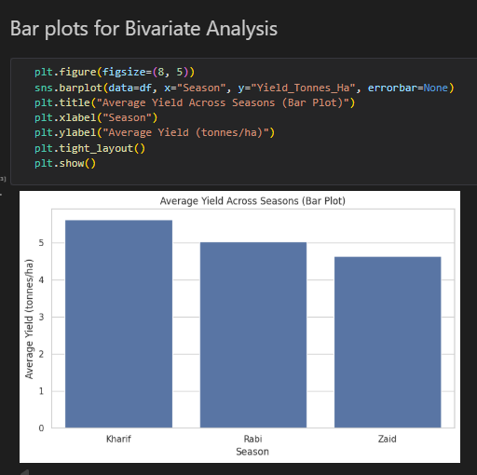
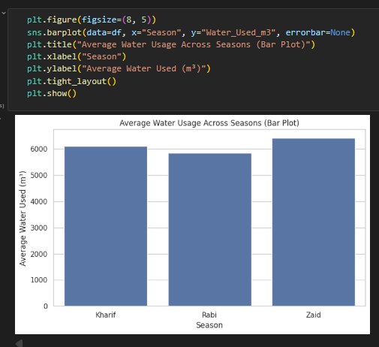
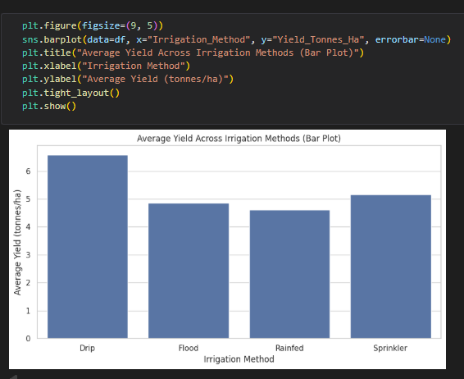
RESULTS
Bivariate Analysis (Key Performance Drivers)
Bar plots for Bivariate Analysis
Bivariate Analysis
Bivariate Analysis

Slide 12
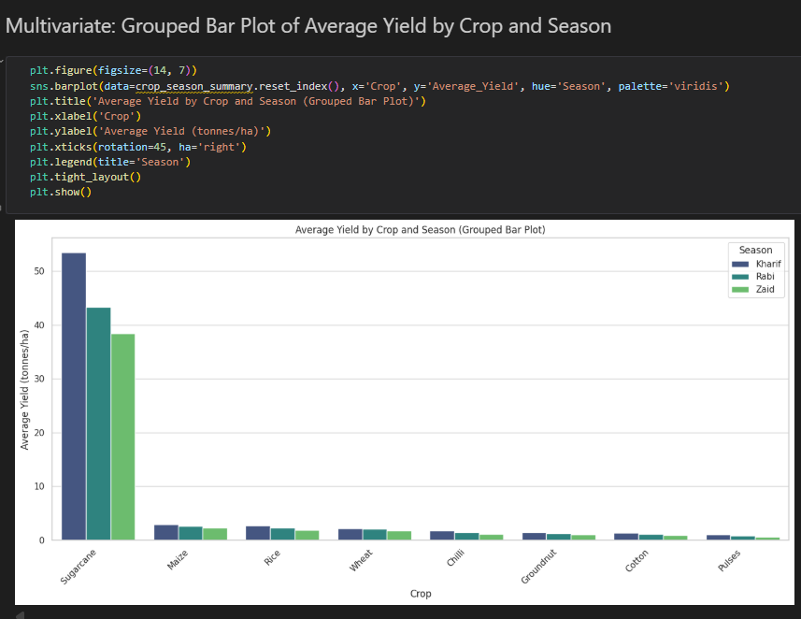
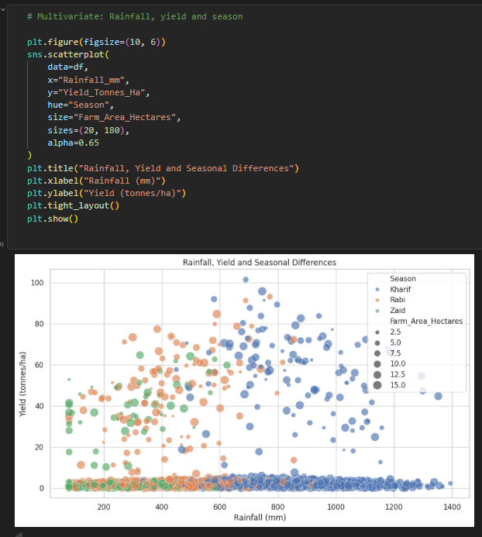
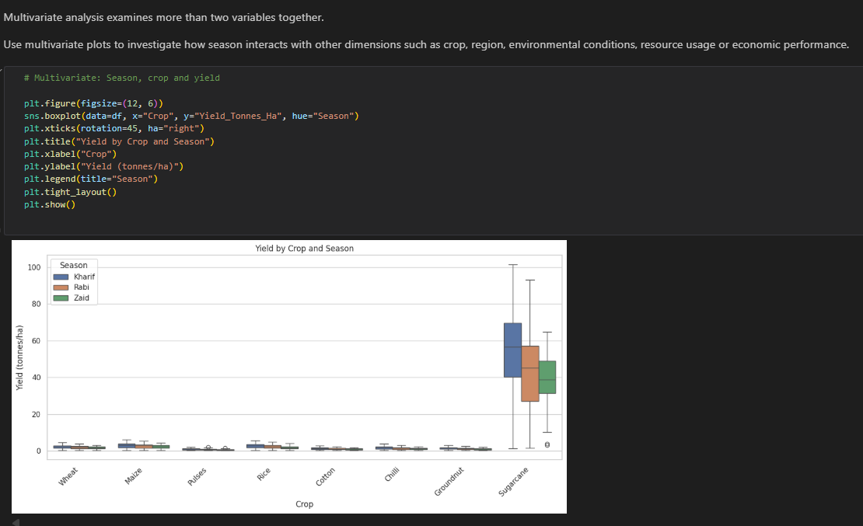
RESULTS
Multivariate Analysis (Interactions & Environmental Factors)

Slide 13
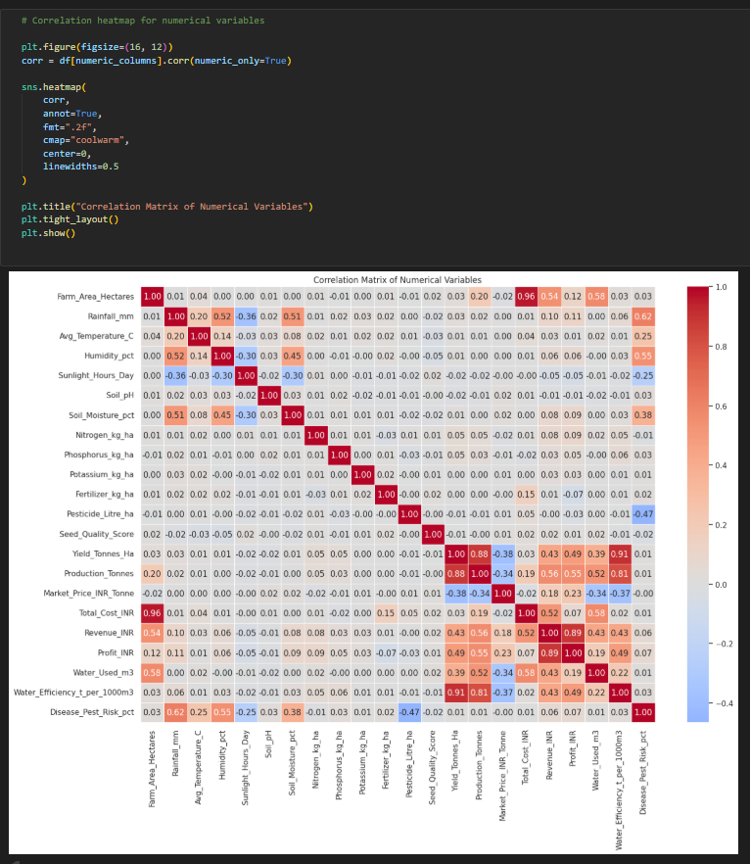
RESULTS
Correlation Matrix
Correlation Heatmap (16x12) displaying Pearson correlation coefficients across all numerical indicators.

Slide 14
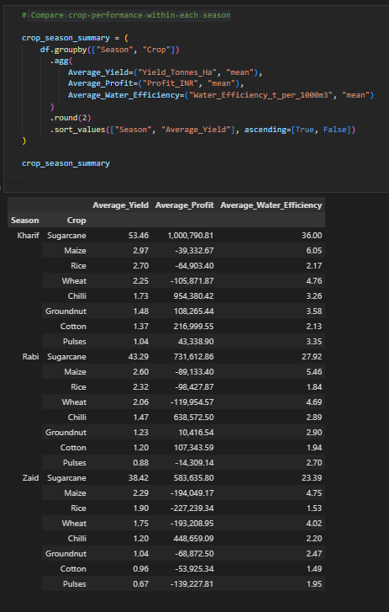
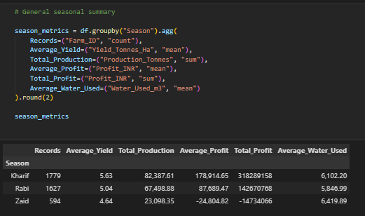
RESULTS
Seasonal Comparison
Aggregated Summary Table showing total production, average profit, water usage, and records per season.
Ranked Performance Table showing Average Yield, Profit, and Water Efficiency grouped by Season and Crop.

Slide 15
Future scope
The current project is focused on descriptive and exploratory data analytics. It can be extended in several ways.
Add more years of agricultural data for long-term seasonal trend analysis.
Perform deeper regional comparisons between states and districts.
Study crop-specific environmental requirements in more detail.
Analyze resource efficiency, especially water and fertilizer usage.
Add statistical hypothesis testing for stronger comparisons.
Develop an interactive dashboard for easier use by decision makers.
Use predictive models in a future project to estimate yield or profit.

Slide 16
GitHub Link
Project: Seasonal Agriculture Performance Analysis
Repository Link:
https://github.com/VenkataKarthikeya-eng/seasonal-agriculture-performance-analysis

Slide 17

VOIS Course completion certificate - Course name- Data Visualization

Slide 18
Thank you
.
.

