Slide 1

CAPSTONE PROJECT · BATCH 2025
GUI Automation
Testing Framework
Selenium WebDriver · Java · TestNG · Page Object Model
Student : Surisetti Venkata Kishore
Trainer : Navin CK
GitHub Repository
[https://github.com/VenkataKishore123/Capstone_Project.git]

Slide 2
Agenda
01
Project Introduction
05
Data-Driven Testing
Overview & Objectives
TestNG @DataProvider
02
Technologies Used
06
Test Reporting
Stack, Tools & Libraries
ExtentReports & Screenshots
03
Framework Architecture
07
Challenges & Solutions
POM Design & Project Structure
Real Issues & Fixes Applied
04
Test Suite — 26 Cases
08
GitHub & Conclusion
Form · Files · Tabs · Mouse · Links
Repository & Key Takeaways

Slide 3
01
Project Introduction
Overview · Objectives · Scope

Slide 4
Project Overview
What is this Project?
Key Objectives
A comprehensive end-to-end GUI Automation Testing framework built in Java using Selenium WebDriver and TestNG. It covers all major web UI interactions on a practice site, structured using the Page Object Model (POM) design pattern for maintainability and reusability.
Automate all GUI element interactions
Implement POM design pattern
Data-driven testing with DataProvider
Generate rich HTML test reports
26
6
15+
POM
Test Cases
Java Classes
UI Elements
Design Pattern
Practice GUI website → 26 automated tests → HTML report via ExtentReports

Slide 5






Technologies & Tools
Java
Selenium
TestNG
Core programming language
Browser automation engine
Test framework & runner
POM Pattern
ExtentReports
Maven
Page Object Model design
Rich HTML test reporting
Project & dependency mgmt

Slide 6
Framework Architecture — POM
Page Object Model separates test logic from element locators and actions.
T
E
S
T
F
L
O
W
Test Layer
01
GUIAutomationTest.java — 34 @Test Methods using TestNG
Page Object Layer
02
GUIPage.java — All Locators (By.*) + Action Methods
Base / Utility Layer
04
BaseTest.java · ScreenshotUtil.java · TestListener.java . ExtentReportManager
Selenium WebDriver
04
ChromeDriver → Real Browser Interactions → Assertions

Slide 7
Project Structure
Capstone_Project/
+-- src/
| +-- main/
| | +-- java/
| | +-- resources/
| +-- test/
| +-- java/
| | +-- base/
| | | +-- BaseTest.java
| | +-- pages/
| | | +-- GUIPage.java
| | +-- tests/
| | | +-- GUIAutomationTest.java
| | +-- utils/
| | +-- ExtentReportManager.java
| | +-- ScreenshotUtil.java
| | +-- TestListener.java
| +-- resources/
| +-- sample.txt
| +-- sample2.txt
+-- reports/
| +-- screenshots/
| +-- GUIAutomationReport.html
+-- pom.xml
+-- testng.xml
base/
BaseTest.java initializes WebDriver (ChromeDriver), navigates to the test URL, and tears down after tests.
pages/
GUIPage.java — the POM layer with all locators (By.id, xpath, css) and reusable action methods.
tests/
GUIAutomationTest.java hosts all 26 @Test methods that call page actions and make assertions.
ExtentReportManager builds the HTML dashboard, ScreenshotUtil captures PNG evidence, and TestListener syncs test execution data between them.
utils/

Slide 8
02
Test Suite Overview
26 Test Cases · All Major UI Interactions Covered

Slide 9
Form Elements Testing
Tests 01–07 | Text Fields · Radio Button · Checkboxes · Dropdowns · Scrolling
T01
Text Fields
enterName / enterEmail / enterPhone / enterAddress
DataProvider — 3 datasets (John, Jane, Ravi)
T02
Radio Button
selectGender("Male")
Assert isGenderSelected returns true
T03
Checkboxes
selectAllCheckboxes()
XPath: all input[@type='checkbox']
T04
Country Dropdown
selectCountry("India")
Select class – selectByVisibleText
T05
Colors Dropdown
selectColor("Blue")
Select class – selectByVisibleText
T06
Sorted List
selectFromSortedList("Dog")
3rd <select> on page (index 2)
T07
Scrolling Dropdown
selectFromScrollingDropdown(value)
Boundary: Items 1, 50, 100

Slide 10
Date Pickers & File Uploads
Tests 08–12
Date Pickers (T08 – T10)
File Uploads (T11 – T12)
T08
Date Picker 1 (mm/dd/yyyy)
T11
Single File Upload
dp.clear(); dp.sendKeys("06/13/2026");
dp.sendKeys(Keys.TAB); // confirm
String path = userDir + "/resources/sample.txt";
driver.findElement(singleFile)
.sendKeys(path);
T09
Date Picker 2 (dd/mm/yyyy)
JS: arguments[0].value="13/06/2026"
dispatchEvent(new Event("change"))
T12
Multiple Files Upload
String f1 = userDir + "/sample.txt";
String f2 = userDir + "/sample2.txt";
driver.findElement(multipleFile)
.sendKeys(f1 + "\n" + f2);
T10
Date Range Picker
startInput.sendKeys("06/13/2026")
endInput.sendKeys("06/20/2026")
endInput.sendKeys(TAB); JS.click(btn)

Slide 11
Web Tabs · Dynamic Elements · Slider
Tests 13–15
T13
Wikipedia Search
T14
Dynamic Button
T15
Range Slider
Type query in wiki search input
Button appears after a timed delay
Locate: #slider-range .ui-slider-handle
Click search button
WebDriverWait 10s timeout
wait.until(visibilityOfElement)
wait.until(elementToBeClickable(result))
ExpectedConditions.elementToBeClickable
new Actions(driver)
Click result link
JS scrollIntoView before click
.dragAndDropBy(handle, 50, 0)
numberOfWindowsToBe(2)
btn.click() after condition met
.perform()
switchTo() new tab
No fixed Thread.sleep() used
Screenshot captured after move
Verify URL contains wikipedia.org
driver.close() → switchBack

Slide 12
Alert Handling
Tests 16–18 | Simple Alert · Confirmation Alert · Prompt Alert
T16
Simple Alert
T17
Confirmation Alert
T18
Prompt Alert
driver.findElement(simpleAlertBtn)
.click();
wait.until(alertIsPresent());
driver.switchTo()
.alert().accept();
driver.findElement(confirmAlertBtn)
.click();
wait.until(alertIsPresent());
driver.switchTo()
.alert().accept();
driver.findElement(promptAlertBtn)
.click();
Alert a = driver.switchTo().alert();
a.sendKeys("Selenium Automation");
a.accept();
Clicks OK on a basic JavaScript alert
Handles OK/Cancel dialog — accepts it
Types text then accepts the prompt

Slide 13
Window & Tab Management
Tests 19–20 | New Tab · Popup Window
T19
New Tab Handling
T20
Popup Window
1. originalWindow = getWindowHandle()
1. Record initialWindowCount
2. Click "New Tab" button
2. JS.click(popupWindowBtn)
3. wait.until(numberOfWindowsToBe(2))
3. wait until count > initialCount
4. Loop all handles → switch to new
4. Loop all handles
5. Capture tab title
5. For each non-original → switch
6. driver.close() the new tab
6. Capture popupUrl
7. switchTo(originalWindow)
7. driver.close() each popup
8. Assert: tabTitle.isEmpty == false
8. switchTo(originalWindow)

Slide 14
Mouse Actions
Tests 21–23 | Mouse Hover · Double Click · Drag & Drop
T21
Mouse Hover
T22
Double Click
T23
Drag & Drop
wait(visibilityOf("Point Me" btn))
field1.sendKeys("AutoTest123")
src = wait(visibilityOf(draggable))
new Actions(driver)
new Actions(driver)
tgt = findElement(droppable)
.moveToElement(btn).perform()
.doubleClick(copyButton).perform()
new Actions(driver)
wait(visibility("Mobiles" link))
getCopiedFieldValue(field2)
.dragAndDrop(src, tgt).perform()
Assert menu.isDisplayed() == true
Assert field2.value == "AutoTest123"
Screenshot captured after drop

Slide 15
Labels, Links & Broken Link Verification
Tests 24–26
T24
Verify Mobile Labels
Assert: contains "Samsung", "Real Me", "Moto"
getMobileLabelsText() → getText() on #mobiles container
T25
Laptop Links Navigation
navigate.back() after each link click
clickLaptopLinkAndReturn("apple") → assert URL has "apple.com"
clickLaptopLinkAndReturn("lenovo") → assert URL has "lenovo.com"
clickLaptopLinkAndReturn("dell") → assert URL has "dell.com"
T26
Broken Links API Verification
Expected result: all 8 links return 4xx status codes
HttpURLConnection con = new URL(href).openConnection();
con.setRequestMethod("HEAD"); con.connect();
if (getResponseCode() >= 400) brokenCount++;
Assert.assertEquals(brokenCount, 8)

Slide 16
Data-Driven Testing
TestNG @DataProvider — testTextFields() executes automatically 3 times
@DataProvider(name = "formData")
public Object[][] getFormData() {
return new Object[][] {
{
"John Doe", "john@test.com",
"9876543210", "123 Main St",
"Male", "India", "Blue", "Dog"
},
{
"Jane Smith", "jane@test.com",
"9123456789", "456 Oak Ave",
"Female", "Canada", "Green", "Cat"
},
{
"Ravi Kumar", "ravi@test.com",
"9001122334", "789 Pine Rd",
"Male", "India", "Red", "Lion"
}
};
}
Why Data-Driven?
One test method, 3 automatic runs
3 different users, countries, genders
Reduces code duplication
Simulates real multi-user scenarios
Screenshots saved per data set
testTextFields() runs 3 times → John Doe ✓ | Jane Smith ✓ | Ravi Kumar ✓

Slide 17
03
Test Reporting
ExtentReports · Screenshots · TestNG Listener

Slide 18
ExtentReports — HTML Test Reporting
Test
Runs
TestListener
Captures
ScreenshotUtil
Snaps PNG
ExtentReports
Logs It
HTML Report
Generated
✓
Auto Screenshots
✓
Pass / Fail Log
ScreenshotUtil.capture(driver, testName) saves a PNG. Path is attached to the report entry via MediaEntityBuilder.
TestListener implements ITestListener. Every @Test pass or fail is auto-logged with name and a timestamp.
✓
HTML Report
✓
Inline Media
An interactive HTML file is generated post-run with color-coded statuses, test durations, and collapsible entries.
MediaEntityBuilder.createScreenCaptureFromPath(path) embeds screenshots directly inside the log entry.

Slide 19
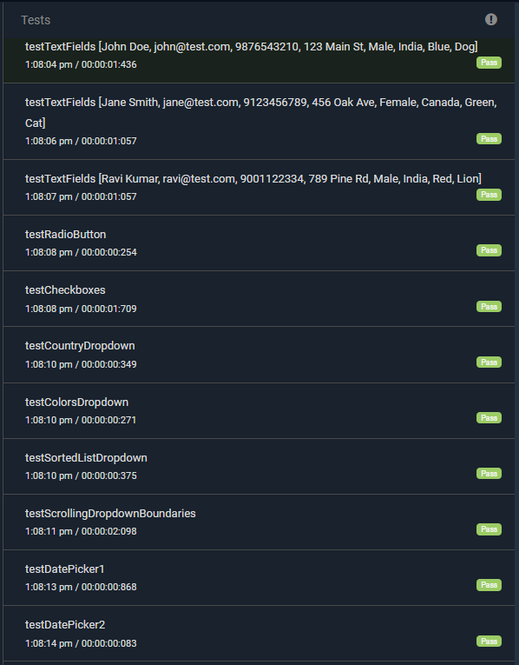
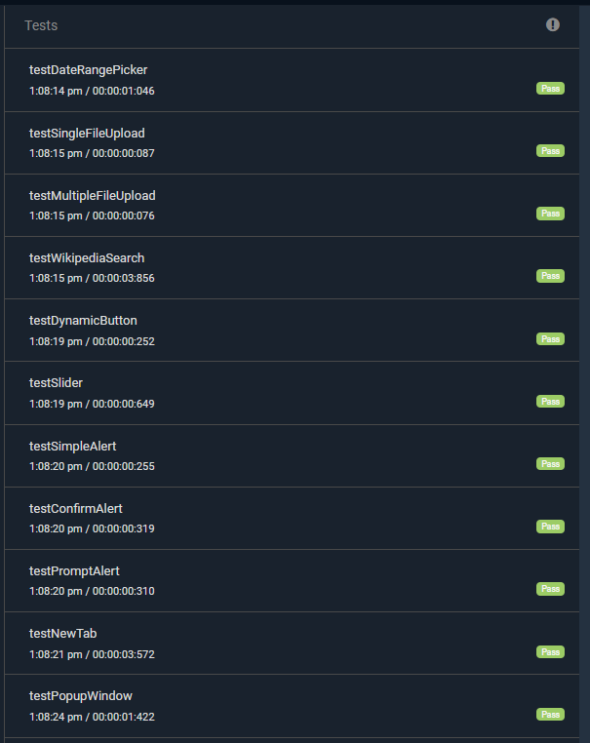
Automated Test Execution Results – (TC01–TC22)

Slide 20
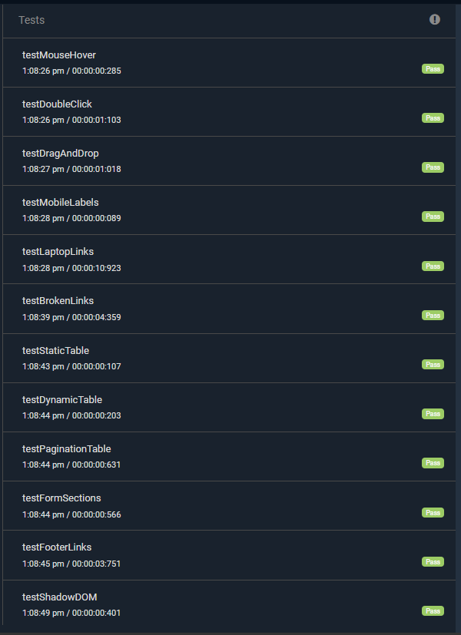
Automated Test Execution Results – (TC023–TC34)

Slide 21
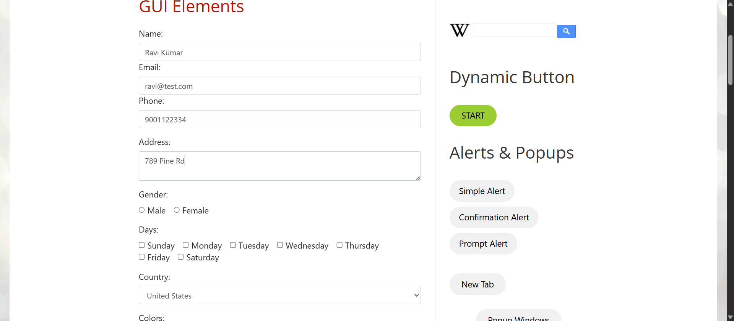
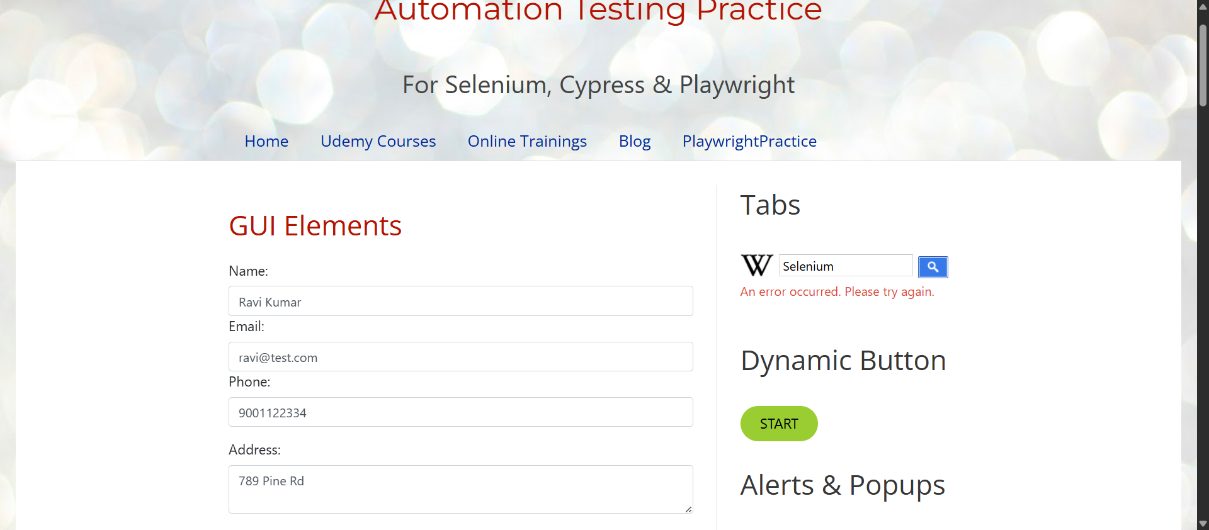
Screenshots
Text Field Input Validation
Wikipedia Search Validation

Slide 22
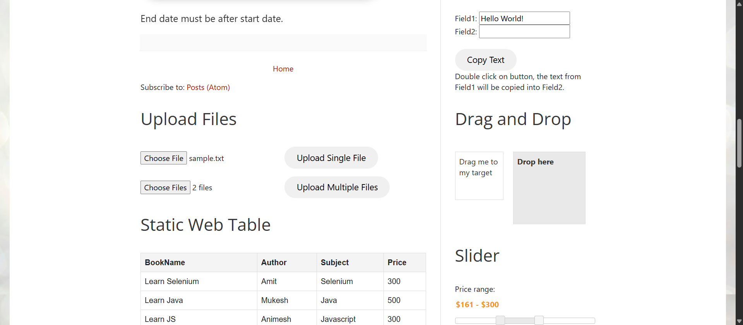
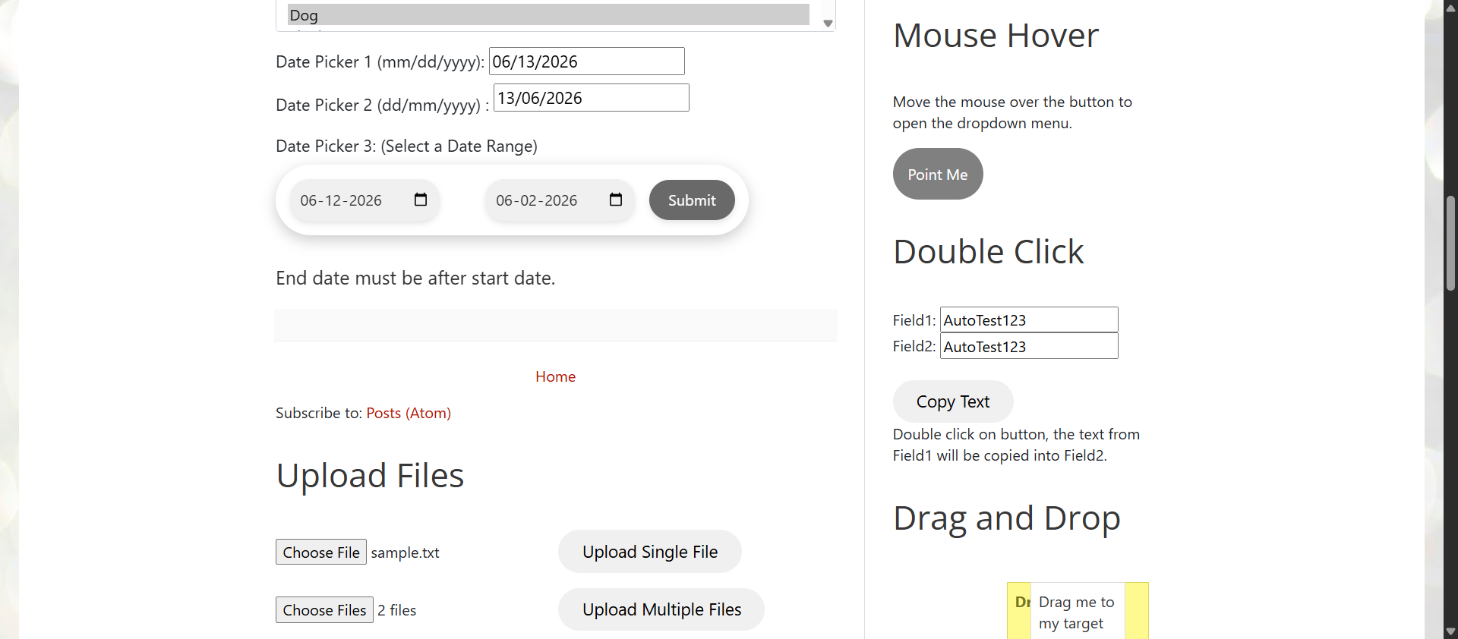
Screenshots
Slider Control Functionality Testing
Drag and Drop Functionality Validation

Slide 23
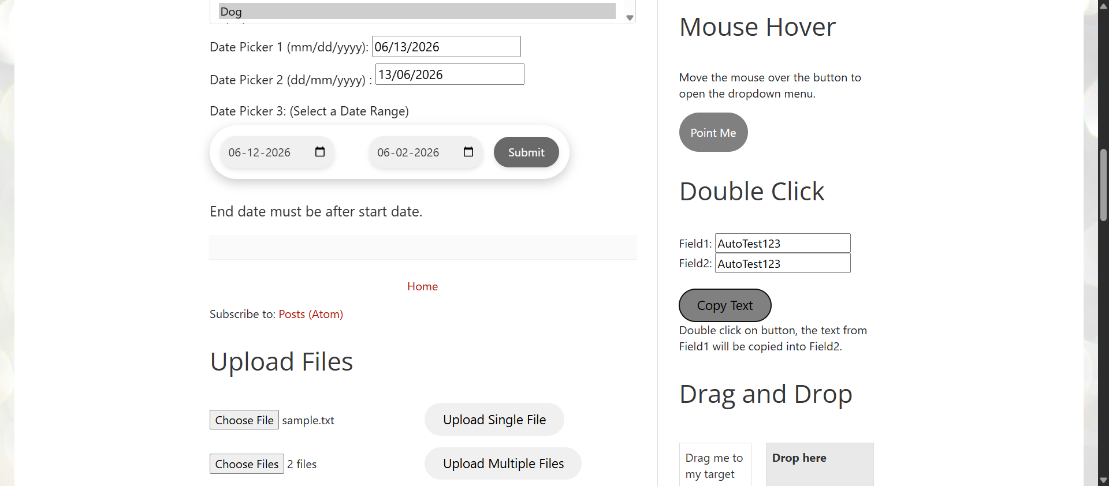
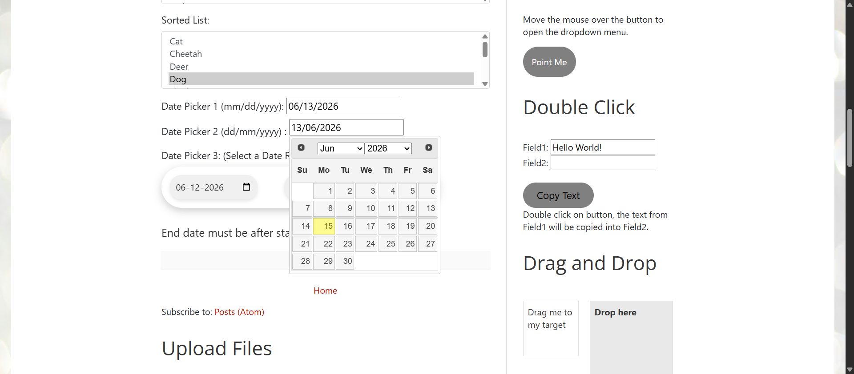
Screenshots
Double Click Functionality Testing
Date Picker Functionality Verification

Slide 24
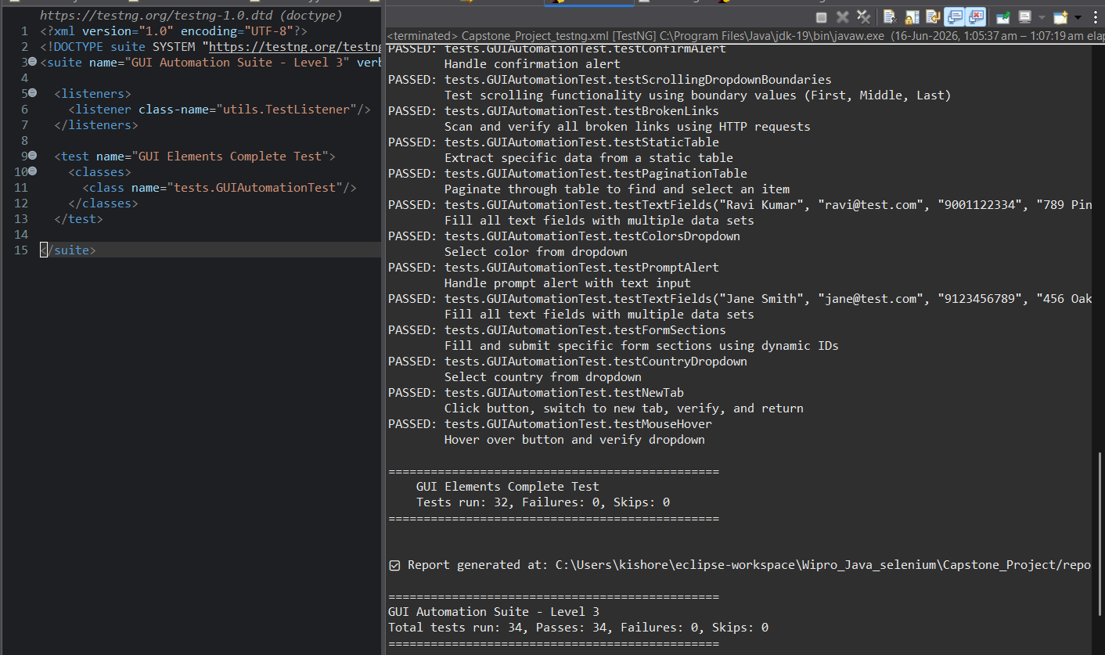
Console Output
Total 34/34 Test Cases Passed

Slide 25
Challenges & Solutions
Real problems encountered and fixed during development
✗
Read-Only Date Picker
✓
JavascriptExecutor to inject value directly + dispatchEvent('change') to trigger page logic.
✗
Custom Scrolling Dropdown
✓
Identified as a custom <div class='option'> (not a <select>). Used XPath + JS scrollIntoView to locate & click.
✗
Native Date Calendar Popup
✓
Pressed TAB after filling end date to close Chrome's native date picker before JS-clicking Submit.
✗
Multiple Popup Windows
✓
Counted window handles before click. Iterated all handles after, closed every non-original, returned URL.
✗
Dynamic Start Button Timing
✓
Replaced fixed Thread.sleep() with WebDriverWait + elementToBeClickable for a stable, non-flaky wait.

Slide 26
GitHub Repository
[https://github.com/VenkataKishore123/Capstone_Project.git ]
Includes: GUIPage.java · GUIAutomationTest.java · BaseTest.java · pom.xml · test-output/
Thank You!
Surisetti Venkata Kishore
Trainer: Navin CK
Selenium WebDriver · Java · TestNG · Page Object Model · ExtentReports

