Slide 1



To develop a CNN model to classify images of plastic waste into different categories

Slide 2

Learning Objectives
1️⃣ Understand CNN Architecture – Learn how CNNs process images using Convolution, Pooling, and Fully Connected layers.
2️⃣ Data Preprocessing & Augmentation – Clean, resize, normalize, and augment images to improve model performance.
3️⃣ Build & Train a CNN Model – Implement a CNN using TensorFlow/Keras, optimize hyperparameters, and handle overfitting.
4️⃣ Evaluate Model Performance – Use accuracy, precision, recall, and F1-score to assess classification effectiveness.
5️⃣ Deploy & Use the Model – Save, load, and apply the trained model for real-time plastic waste classification.
GOAL
Source :
www.freepik.com/

Slide 3
Tools and Technology used
1️⃣ Programming Language: Python
Used for building and training the deep learning model.
2️⃣ Deep Learning Framework: TensorFlow & Keras
TensorFlow: Open-source framework for deep learning.
Keras: High-level API for building CNN architectures easily.
3️⃣ Image Processing: OpenCV & PIL 🖼
OpenCV: Reads, resizes, and augments images for preprocessing.
PIL (Pillow): Handles image format conversions and enhancements.
4️⃣ Data Handling & Visualization: NumPy, Pandas, Matplotlib, Seaborn
NumPy: Handles numerical computations efficiently.
Pandas: Processes dataset and performs exploratory data analysis (EDA).
Matplotlib & Seaborn: Visualizes training results (accuracy, loss graphs, confusion matrix).
5️⃣ Jupyter Notebook / Google Colab
Used for writing, debugging, and running Python code interactively.
Google Colab allows GPU acceleration for faster training.
6️⃣ Cloud Platforms: Google Drive, Kaggle

Slide 4
Methodology
1️⃣ Data Collection & Preprocessing
Collected plastic waste images, resized (224×224), and applied augmentation (rotation, flipping, brightness).
2️⃣ Dataset Splitting
Split into Training (80%), Validation (10%), and Testing (10%).
3️⃣ CNN Model Development
Built a CNN with Convolution, Pooling, and Fully Connected layers.
Used ReLU activation and Softmax for classification.
4️⃣ Training & Evaluation
Trained with Adam optimizer & Cross-Entropy Loss.
Evaluated using accuracy, loss, confusion matrix, and classification report.
5️⃣ Testing & Deployment
Tested on new images and predicted categories with confidence scores.

Slide 5
Problem Statement:
1️⃣ Inefficient manual sorting of plastic waste hinders effective recycling and exacerbates environmental pollution.
2️⃣ Automated classification of plastic waste images is needed to streamline waste management processes and improve recycling rates .
3️⃣ This project aims to develop a robust CNN model capable of accurately classifying plastic waste images into different categories, enabling automated sorting and resource recovery.

Slide 6
Solution:
🔹 Key Steps Taken
1️⃣ Collected & Preprocessed Images – Resized, normalized, and applied data augmentation. 2️⃣ Built & Trained a CNN Model – Used Convolutional layers, Pooling, and Fully Connected layers for feature extraction and classification. 3️⃣ Optimized Model Performance – Used Adam optimizer, dropout, and hyperparameter tuning to improve accuracy. 4️⃣ Evaluated Model Accuracy – Measured performance using accuracy, loss graphs, confusion matrix, and classification report. 5️⃣ Tested on New Images – Successfully predicted waste categories with confidence scores. 6️⃣ Future Scope – Can integrate with IoT or mobile apps for real-world waste management.

Slide 7
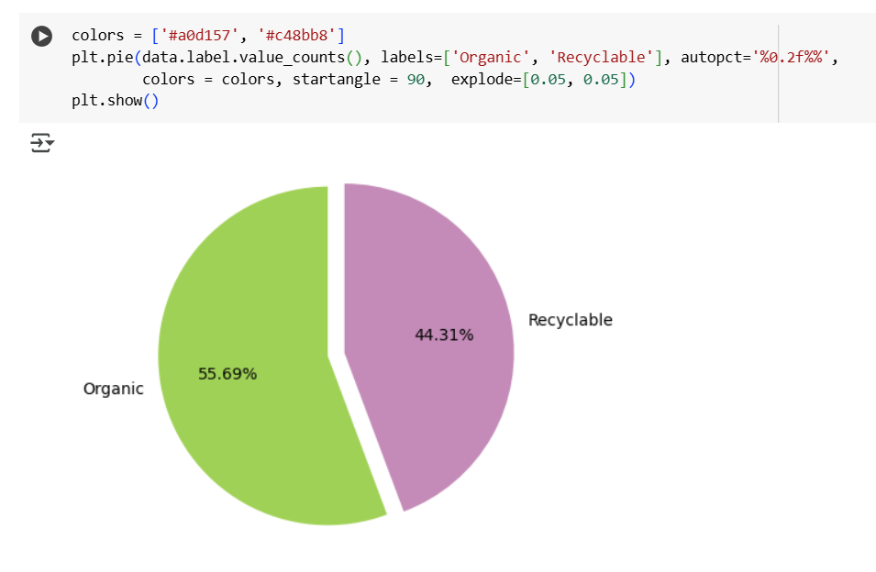
Screenshot of Output:

Slide 8
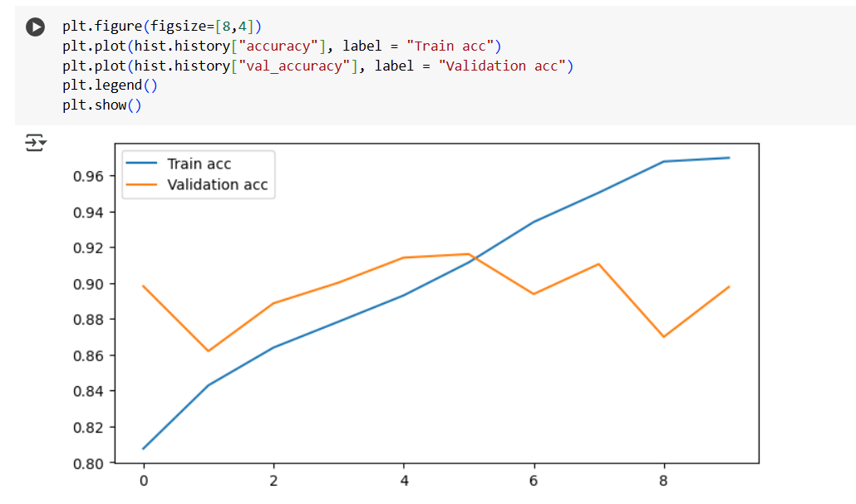
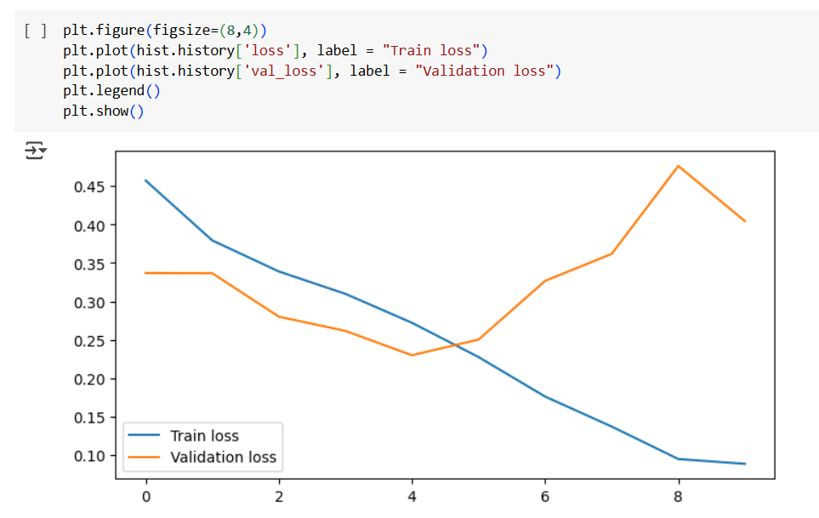

Slide 9
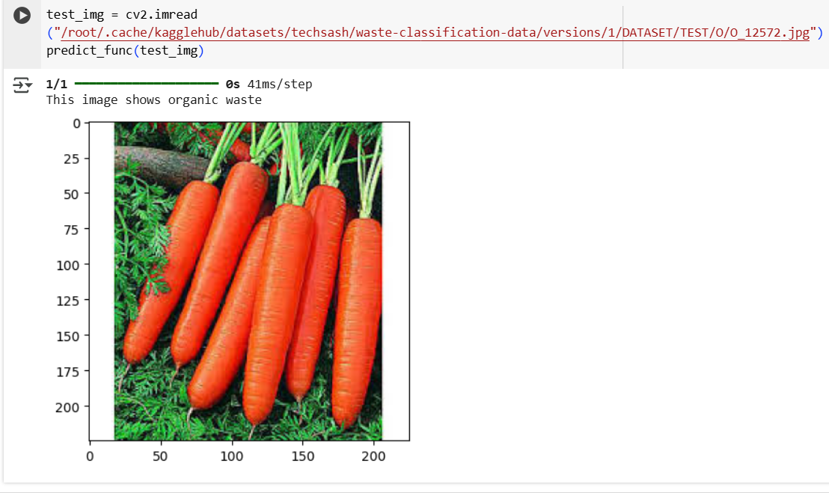
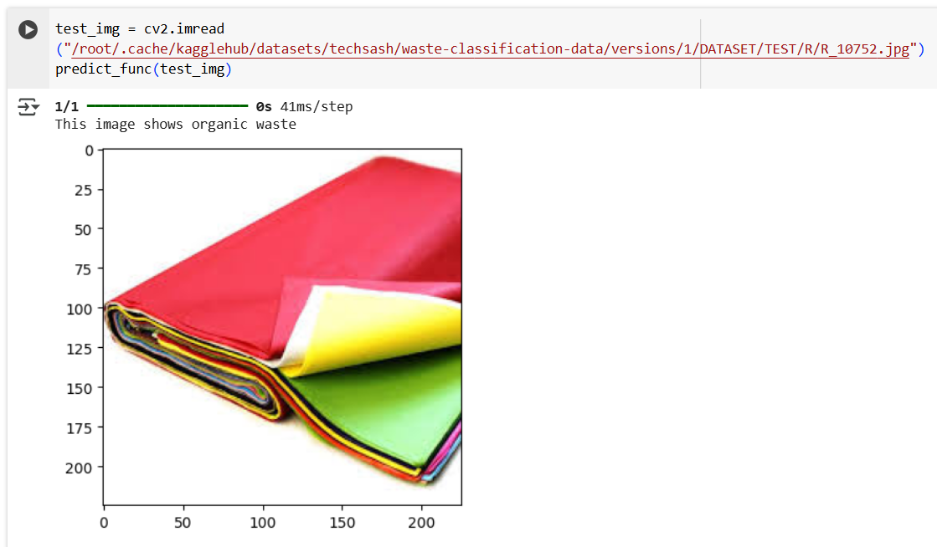

Slide 10
Conclusion:
Our CNN-based plastic waste classification model successfully automates the sorting of waste into different categories, improving efficiency and accuracy compared to manual methods. By leveraging deep learning and image processing techniques, we achieved reliable classification, which can help in better waste management and recycling efforts.
This project highlights the potential of AI in environmental sustainability, reducing human effort and promoting eco-friendly waste disposal. With further optimization and integration into real-world applications (such as IoT-based waste bins or mobile apps), this system can contribute significantly to a cleaner and greener future.

