Slide 1

FILE TRANSFER SYSTEM

Slide 2

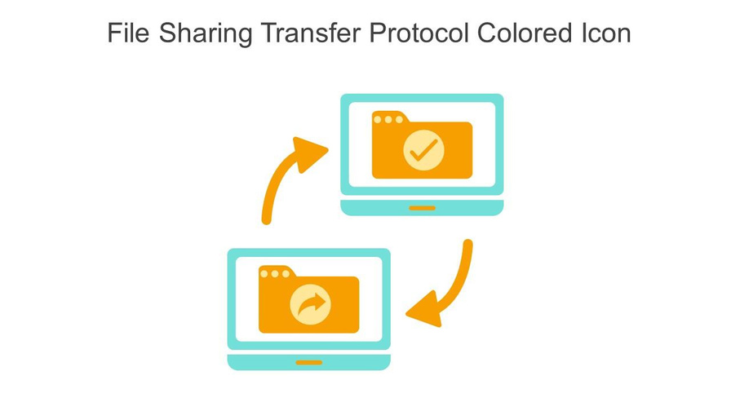
What is a File Transferring System?
Definition: A File Transferring System enables the movement of digital files (e.g., documents, images, videos) between devices.
Functionality: It allows efficient and secure file sharing over networks like the Internet or LAN.
Usage: Applicable for both personal file sharing and large-scale organizational tasks like software distribution.

Slide 3
PROJECT GOALS
Built a client-server based file transfer system using Python.
Supports upload and download functionality.
Includes basic user authentication to restrict access.
Uses TCP sockets for reliable data transfer.
Libraries used: socket, threading, os, time.

Slide 4
TECH STACK
Language: Python
Socket Type: TCP (SOCK_STREAM)
IDE: Visual Studio Code
Libraries: socket, threading, os

Slide 5
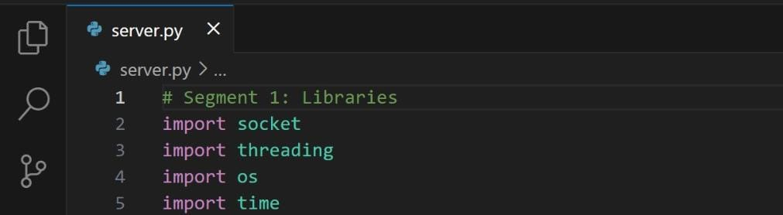
FILE HANDLING
These are the modules we’ve been using for this project.

Slide 6
SIGNIFICANCE’S
socket Module:
The socket module in Python is used for network programming.
It allows communication between computers over a network using protocols like TCP or UDP.
You can create servers or clients using sockets.
threading Module:
The threading module is used to run multiple tasks at the same time (concurrently).
It is helpful when you want, for example, a server to handle multiple clients at once.

Slide 7
SIGNIFICANCE’S
os Module:
The os module provides functions to interact with the operating system.
You can use it to access file paths, environment variables, create/remove directories, and more.
time Module:
The time module is used to work with time-related functions.
You can pause the program, measure execution time, or get the current time.

Slide 8

SERVER
TCP Socket Setup: Initializes a TCP socket and listens on port 8080.
Client Handling: Accepts client connections and spawns a new thread for each client.
Authentication & Commands: Performs basic (dummy) username/password authentication and supports upload, download, and exit commands.
File Management: Saves uploaded files and serves requested files for download.

Slide 9

CLIENT
Creates a TCP socket and connects to the server using IP and port.
Prompts user for username and password, sends to server.
Waits for server authentication response.
After login, accepts commands from user:
Upload: Reads file, sends to server with <EOF> marker.
Download: Requests file, saves incoming data as a local file.
Exit: Cleanly closes connection with the server.
Handles network errors and invalid responses gracefully.
Runs as a simple command-line application.

Slide 10
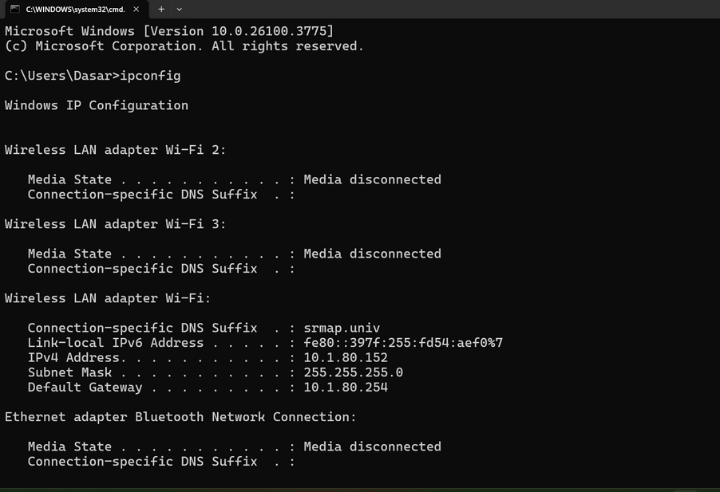
Server IP Requirement: The client must know the server’s IPv4 address (e.g., 192.168.1.5) to connect over the same local network.
How to Find IP (Windows): Use ipconfig in Command Prompt to locate the IPv4 address under Wi-Fi or Ethernet adapter.
Connection Conditions: Both devices must be on the same network, the server must be running, and firewalls/antivirus should not block port 8080.

Slide 11
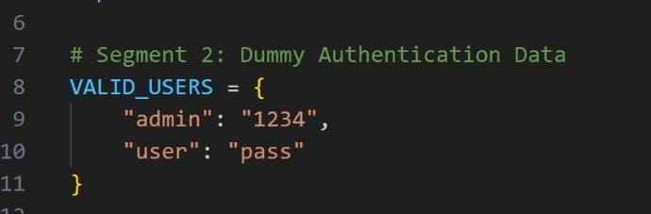
AUTHENTICATION
Here we are using an dummy authentication . That means there is no sort of Hashing involved .
The Username and password is compared to the Valid_user dictionary.
Only if the client enters the valid credentials it gets connects to the server.

Slide 12
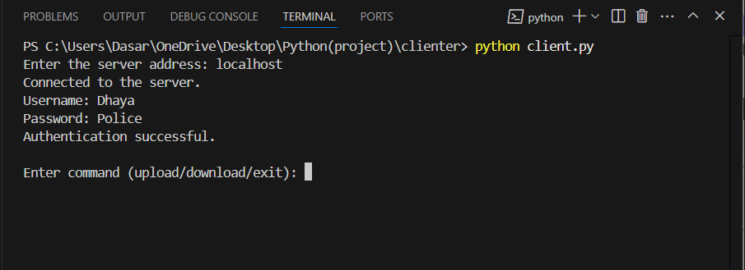
After the authentication client would send one of the three options that is upload download and exit

Slide 13
UPLOAD (CLIENTSIDE)
User enters command upload.
Client prompts for a filename.
Checks if file exists locally.
Sends filename and file content to server in chunks.
Ends the upload with <EOF> marker
The time library (module) that we imported is used at the time of EOF we create a 0.5 sec of time delay just to make sure the server is knowing the difference between the contents and the EOF.
client_socket.send(filename.encode())
Reads file in binary: f.read(4096)
Sends all chunks, then b"<EOF>"

Slide 14
UPLOAD (SERVERSIDE)
Server receives the upload command.
Receives filename and sends "OK" to client.
Opens a new file and starts writing incoming binary data.
Stops writing when it detects <EOF> in data.
Sends confirmation to client.
Behind the scenes:
with open(filename, "wb") as f:
if chunk.endswith(b"<EOF>"): → stop
client_socket.send("Upload complete")

Slide 15
RESULT
File successfully received by server.
Saved under same filename on server machine.
Client receives confirmation message.
Verified with test files (.txt, .jpg, .py etc).

Slide 16
DOWNLOAD (CLIENTSIDE)
User enters command download.
Enters filename to request from server.
Waits for server response (OK or File not found).
If OK, receives file in chunks.
Stops receiving on <EOF>.
Behind the scenes:
Creates a new file: open(filename, 'wb')
recv(4096) repeatedly
Ends when <EOF> detected

Slide 17
DOWNLOAD(SERVERSIDE)
Receives download command.
Checks if the requested file exists.
If yes, opens file in binary and sends it chunk by chunk.
Appends <EOF> to indicate transfer is complete.
Behind the scenes:
f.read(4096) and client_socket.send(chunk)
client_socket.send(b"<EOF>")

Slide 18
RESULT
Client saves the file successfully.
Output message: File '<filename>' saved successfully.
Integrity verified — file matches original.

Slide 19
EXIT
Cient sends "exit" command to server.
Server receives it, breaks the loop, and closes the connection.
Client also closes its socket.
Server stays active for other clients.
Key Points:
Clean disconnect.
No crashes or memory leaks.
Thread ends safely on server side.

Slide 20
CONCLUSION
Successfully established a TCP socket connection between client and server.
File upload and download tested with multiple file types (e.g., .txt, .pdf, .png).
Authentication system worked correctly with valid and invalid credentials.
Server handled multiple clients simultaneously using threading.
Files transferred across devices connected to the same Wi-Fi / hotspot network.
Verified integrity of transferred files — no data loss or corruption.

Slide 21
THANK YOU
AP23110011573 - M.Narayana
AP23110011587 - M.Preveen
AP23110011591 - D.Lekith Kishore
AP23110011595 - S.Vivek

