Slide 1

Vel Tech Rangarajan Dr. Sagunthala R&D Institute of Science and Technology
School of Computing
Department of Computer Science and Engineering
10211CS224 / FULL STACK APPLICATION DEVELOPMENT (JAVA)
PROJECT REVIEW : MILESTONE PROJECT – 1
Date: 23-03-2026
Responsive E-Commerce Interface with State-Persistent Cart
SDG:SDG 8 – Decent Work and Economic Growth
Presented By:
PUSHPAGIRI VENKATA RAJESH (VTU25208)
Courses Handling Faculty:
Dr .S . HEMAMALINI –Assistant
Professor(Senior Grade)-M.E,Ph.D

Slide 2
INTRODUCTION
1
Traditional shopping systems often lack cart persistence, causing data loss after refresh or session expiry.
Users expect seamless and responsive shopping experiences across multiple devices.
There is a need for a reliable system that maintains cart state and improves usability.
The proposed system is a responsive e-commerce interface with dynamic product display.
Cart operations are handled in real time for better user interaction.
Browser local Storage is used to retain cart and product data across sessions.
An admin panel enables efficient product and stock management.
The system demonstrates practical application of modern frontend web technologies.
2
3
4
5
6
7
8
9

Slide 3
PROBLEM STATEMENT
Many existing e-commerce systems do not maintain cart data after page refresh or session end.
This results in loss of selected products and poor user experience.
Some applications are not fully responsive across different devices.
Manual handling of product data increases complexity and errors.
Lack of proper admin control makes product management inefficient.
There is no reliable mechanism for stock and cart state persistence.
These limitations affect usability and system reliability.
Hence, a responsive e-commerce system with a state-persistent cart is required.
1
2
3
4
5
6
7
8
9

Slide 4
OBJECTIVE(S)
To design and develop a responsive e-commerce web interface that displays products and supports seamless user interaction across devices.
To implement a state-persistent shopping cart using browser localStorage to retain cart data across page refreshes and sessions.
1
2
3
4
5
6
7
8
9

Slide 5
PROPOSED SYSTEM
The proposed system is a responsive e-commerce web application developed using HTML, CSS, and JavaScript
It provides a dynamic product display with real-time cart updates.
The shopping cart state is preserved using browser local Storage across sessions.
.The system eliminates cart data loss during page refresh or browser restart.
An admin panel allows efficient product, price, and stock management.
The interface adapts seamlessly to different screen sizes and devices.
Automation reduces manual effort and improves operational efficiency.
The solution offers improved usability and reliability compared to traditional systems.
1
2
3
4
5
6
7
8
9

Slide 6
PROPOSED SYSTEM ARCHITECTURE
Input
User inputs include product selection, quantity selection, search queries, and cart actions.
Admin inputs include product details such as name, price, stock, and image path.
Processing
The system processes user actions like adding, removing, and updating cart items.
JavaScript handles real-time calculations of cart totals and item quantities.
Validation is performed for product stock and user interactions.
Database
Browser local Storage is used as the database.
Product details, cart data, and admin-managed items are stored persistently.
Data remains available even after page refresh or browser restart.
Output
Displays updated product listings and cart details dynamically.
Shows total price, item count, and stock availability in real time.
Generates checkout confirmation and invoice details for the user.
1
2
3
4
5
6
7
8
9

Slide 7
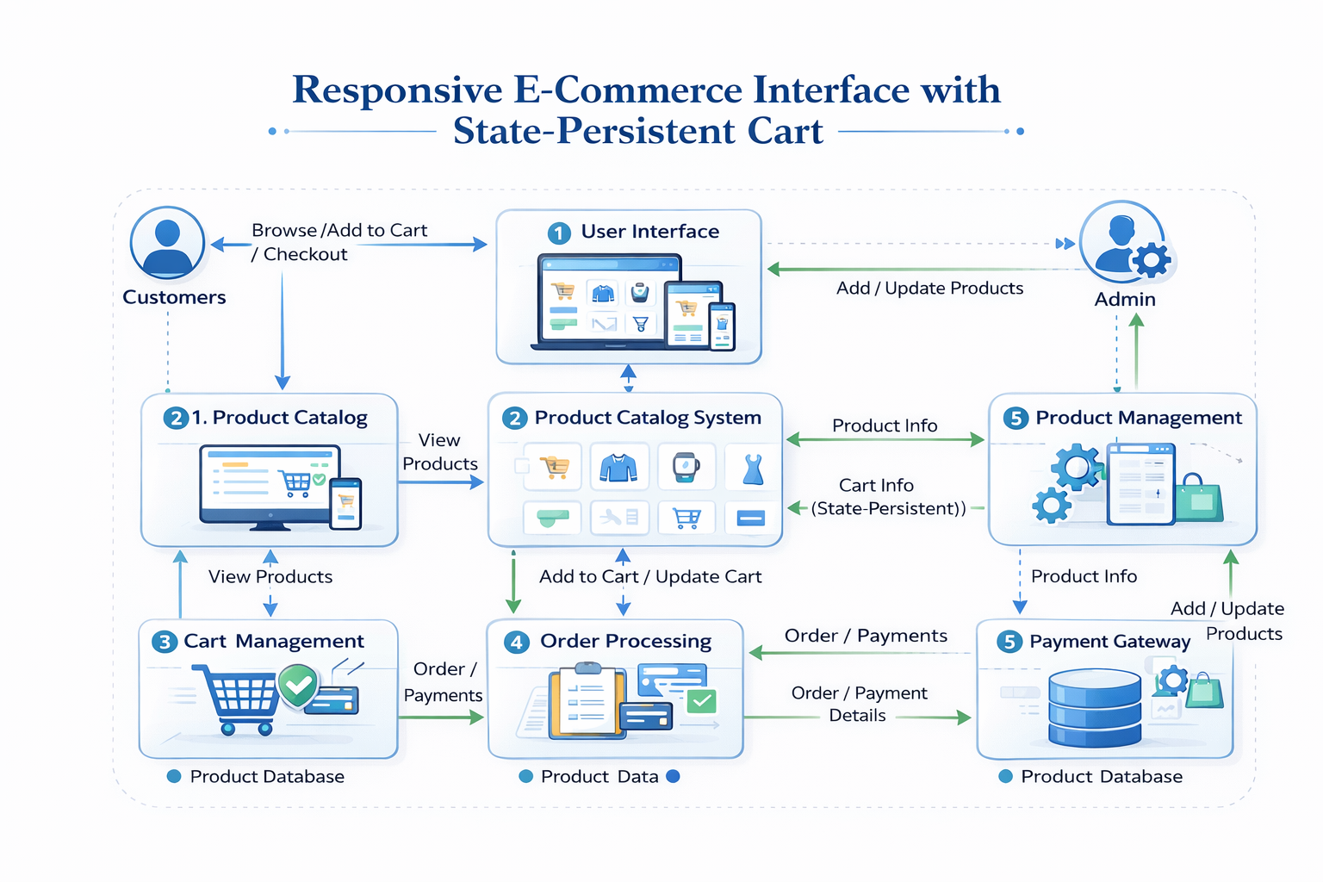
WORKFLOW
1
2
3
4
5
6
7
8
9

Slide 8
TECHNOLOGIES USED
1
Frontend: HTML5, CSS3, JavaScript
Backend: Node.js with Express.js
Database: MongoDB (NoSQL)
Tools: Visual Studio Code
Hardware/Software Requirements:
Hardware: - > Software:
Minimum 4GB RAM Web Browser (Chrome/Edge)
Processor: Intel i3 or above Node.js/python
Internet Connection Database Server(MangoDB/MySQL)
2
3
4
5
6
7
8
9

Slide 9
MODULE DESCRIPTION
Module 1: User Management
Handles user registration, login, and profile management with secure authentication. Enables users to securely access their accounts and manage personal details.
Module 2: Core Processing
Manages product browsing, selection, and cart operations. Implements a state-persistent cart to retain items even after page refresh or logout.
Module 3: Database Management
Stores and manages user data, product details, and order information. Ensures fast retrieval, consistency, and data integrity.
Module 4: Reporting & Analytics
Handles order placement, payment processing, and generates insights such as purchase history and user activity for better decision-making.
1
2
3
4
5
6
7
8
9

Slide 10
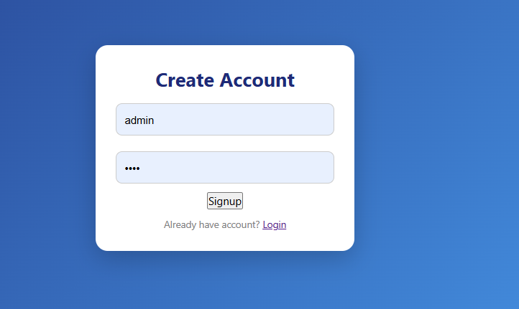
IMPLEMENTATION SCREENSHOTS
1
2
3
4
5
6
7
8
9
This signup page allows users to create an account by entering a username and password, storing the details securely using local storage. It provides a simple and user

Slide 11
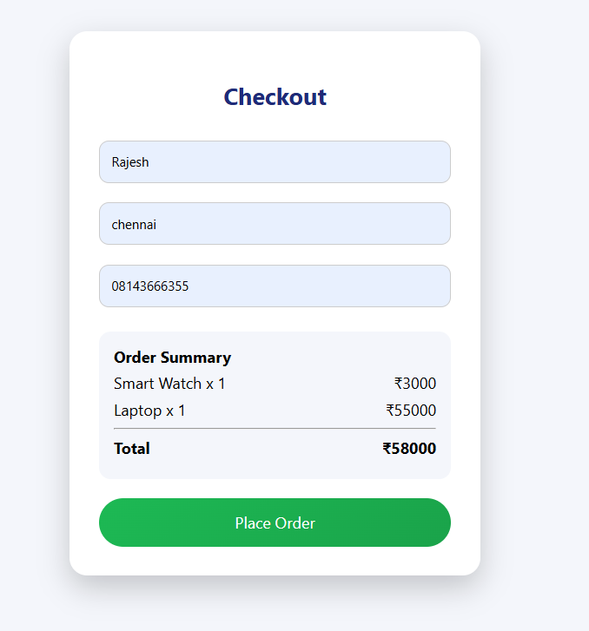
IMPLEMENTATION SCREENSHOTS
1
2
3
4
5
6
7
8(A)
9
This checkout page collects customer details and displays a clear order summary including selected items and total price.
It ensures a smooth purchase process by allowing users to review their order before placing it.

Slide 12
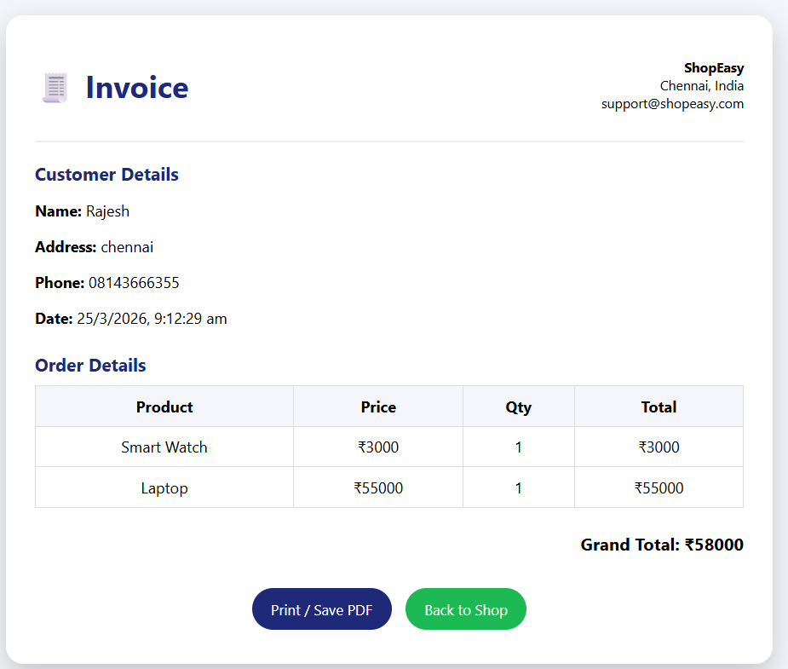
IMPLEMENTATION SCREENSHOTS
1
2
3
4
5
6
7
8(B)
9
This invoice page displays complete order details including customer information, purchased items, and the final total amount.
It provides a professional billing summary with options to print/save the invoice or return to shopping.

Slide 13
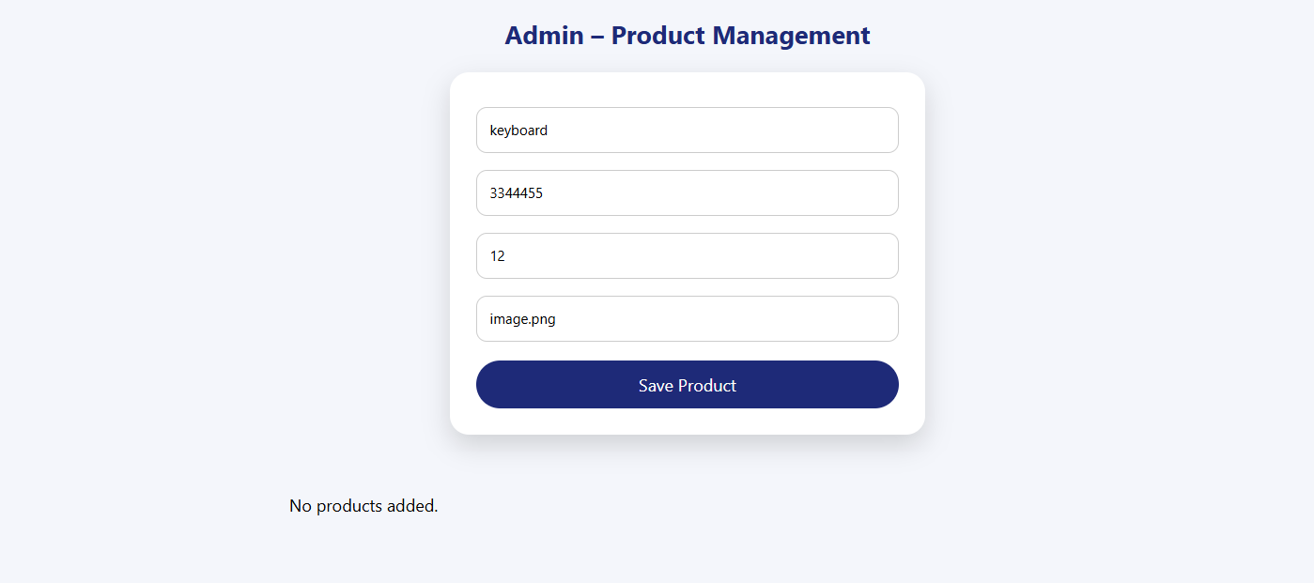
IMPLEMENTATION SCREENSHOTS
1
2
3
4
5
6
7
8(C)
9
This admin page allows authorized users to add and manage products by entering details like name, price, stock, and image.
It enables efficient product management by storing items and updating the product list dynamically.

Slide 14
Advantages
Responsive Design: Works seamlessly on mobile, tablet, and desktop
Persistent Cart: Cart items are saved even after refresh or logout
Improved User Experience: Smooth and uninterrupted shopping
Faster Navigation: Efficient browsing and product search
Scalability: Can be expanded with more features (payment, tracking, etc.)
1
2
3
4
5
Limitations
Dependency on Internet: Requires stable connection for full functionality
Security Risks: Needs strong protection for user data and payments
Storage Limitations: Local storage has size constraints
Performance Issues: May slow down with large product databases
Browser Compatibility: Some features may vary across browsers
6
7
8
9

Slide 15
Thank you

