Slide 1



AdventureWorks_Sales
View in Power BI
Last data refresh:
15/08/2024 02:32:37 UTC
Downloaded at:
15/08/2024 03:03:50 UTC

Slide 2
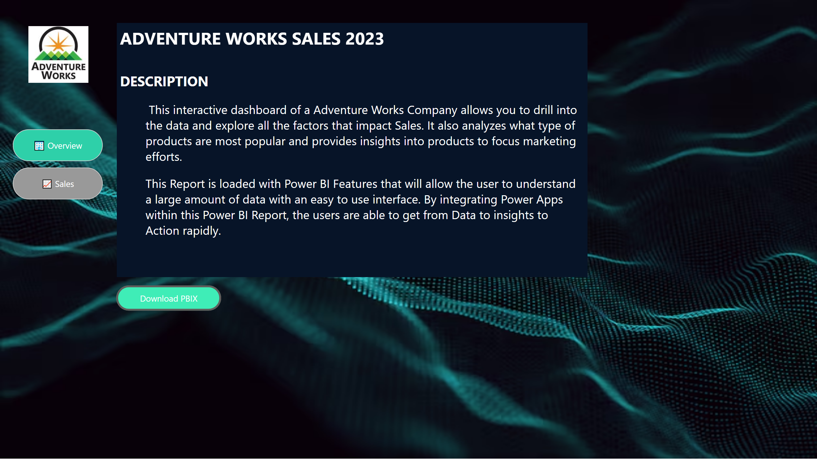
🏢 Overview
Notes:
textbox
No alt text provided
Download PBIX
No alt text provided
pageNavigator
No alt text provided
image
No alt text provided

Slide 3
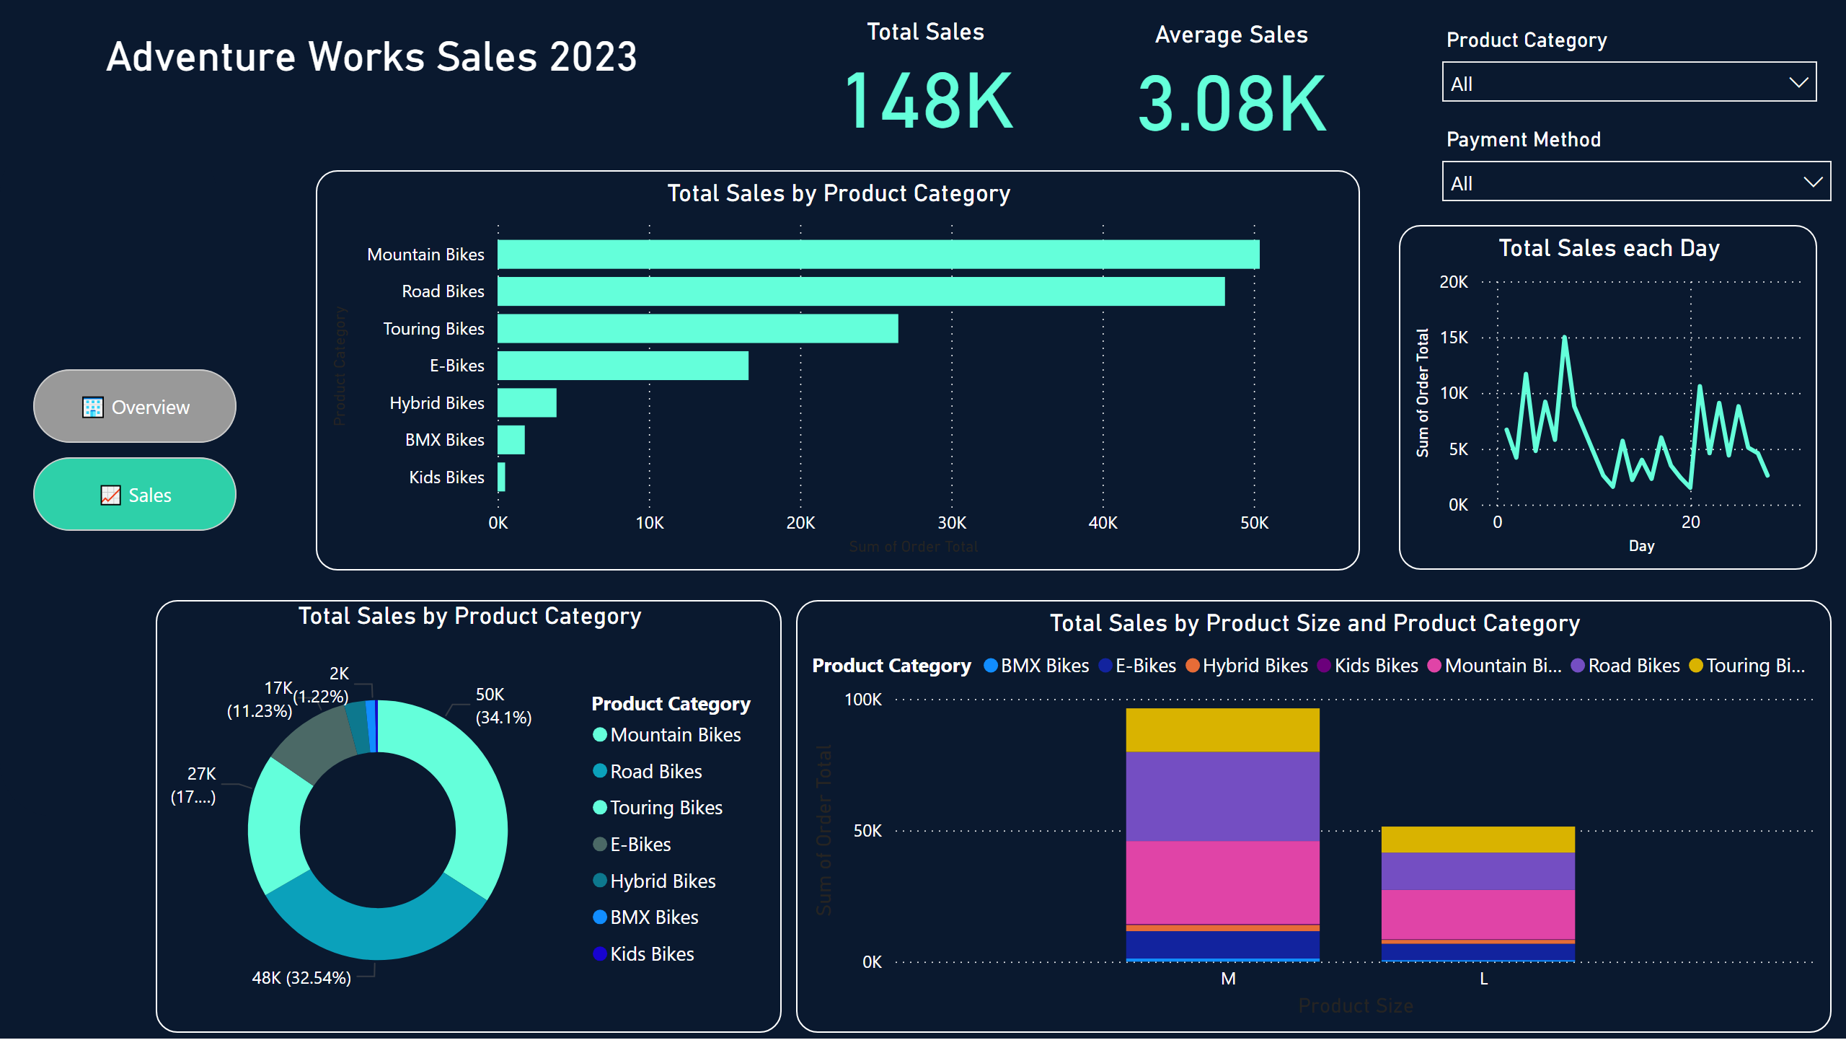
📈 Sales
Notes:
slicer
No alt text provided
slicer
No alt text provided
Total Sales by Product Category
No alt text provided
Total Sales
No alt text provided
Average Sales
No alt text provided
Total Sales by Product Category
No alt text provided
Total Sales by Product Size and Product Category
No alt text provided
shape
No alt text provided
Adventure Works Sales 2023
No alt text provided
pageNavigator
No alt text provided
shape
No alt text provided
Total Sales each Day
No alt text provided

