Slide 1
Prediction and Search of Movies
FITCHBURG STATE UNIVERSITY
[PRESENTED BY]
VenkataSatya Yenugu
Srikanth Reddy Ega
Kofi Kyei

Slide 2
Source of Data
We have obtained the data from
http://movielens.org.
Movie Lens is a free service provided by GroupLens Research at the University of Minnesota.
The dataset consists of 1 million ratings from 6000 users on 4000 movies.

Slide 3
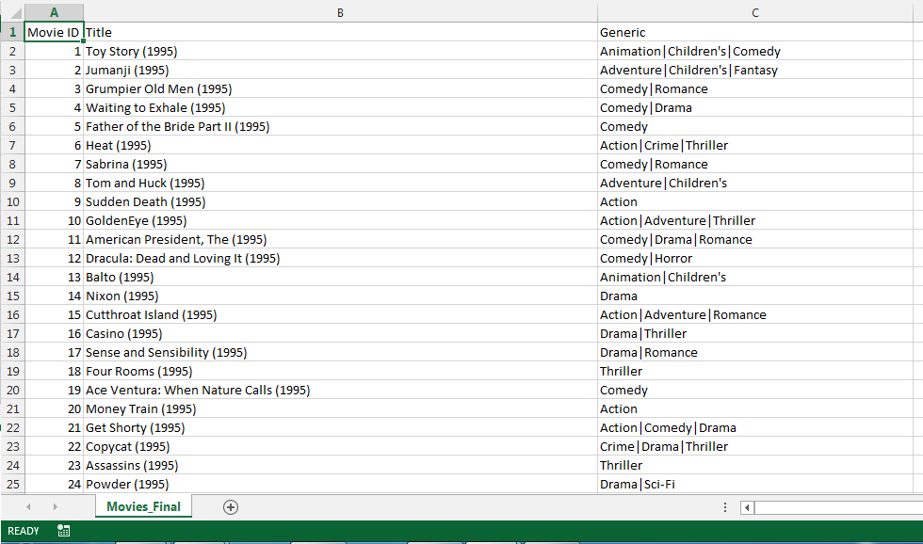
Dataset Sample for Movies

Slide 4
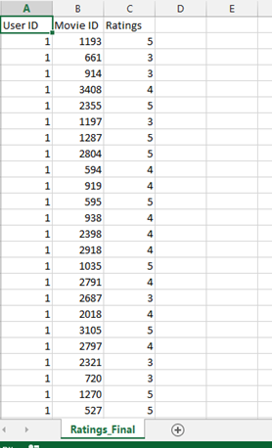
Dataset Sample for Ratings

Slide 5
Process Followed
First, we have searched for various datasets
Finally came out with this dataset from the website: movieslens.org
The website uses a very interesting way of suggesting movies to the user based upon some parameters, given by user and then it predicts
movies using the existing dataset.
But the challenge faced by us is to optimize the dataset which consists of 1 Million Records.

Slide 6
Questions Answered using Dataset
Predicting the Top 20 movies based upon the movies liked by
the user, from the given movies choice.
Predicting the Top 20 movies based upon the ratings given to the movies by the user, for a given set of movies.
Searching Movies by Year, Generic, Ratings and Movie Name.
Also gives the charts for Number of Ratings by Genre, and Average Rating by Genre.

Slide 7
Our Code and Program Results…

Slide 8


Slide 9
THANK YOU

