Slide 1
Data Mining in Healthcare

Slide 2
Outline
1.
Introduction
2.
Background – Data Mining Process
3.
Techniques Used
4.
Challenges
5.
Benefits
6.
Applications
7.
Future Direction & Conclusion

Slide 3
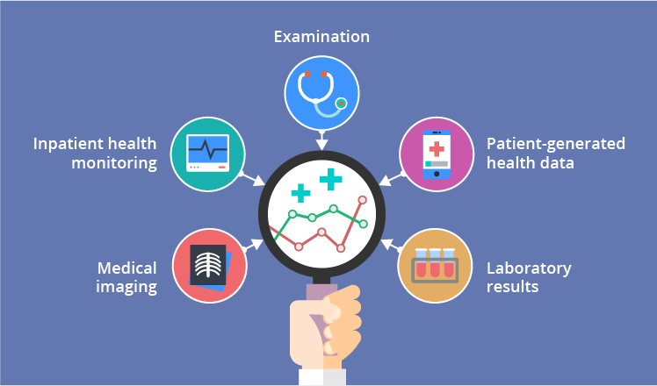
Introduction
Healthcare Industry collects enormous amounts of data.
Analyzing the health system data
helps to improve care and reduce costs.
Traditional methods fails to process and analyze bulk data because of complexity and volume
Data mining can be used to extract the hidden patterns and knowledge – used as a part of Knowledge Discovery in Databases or KDD process

Slide 4
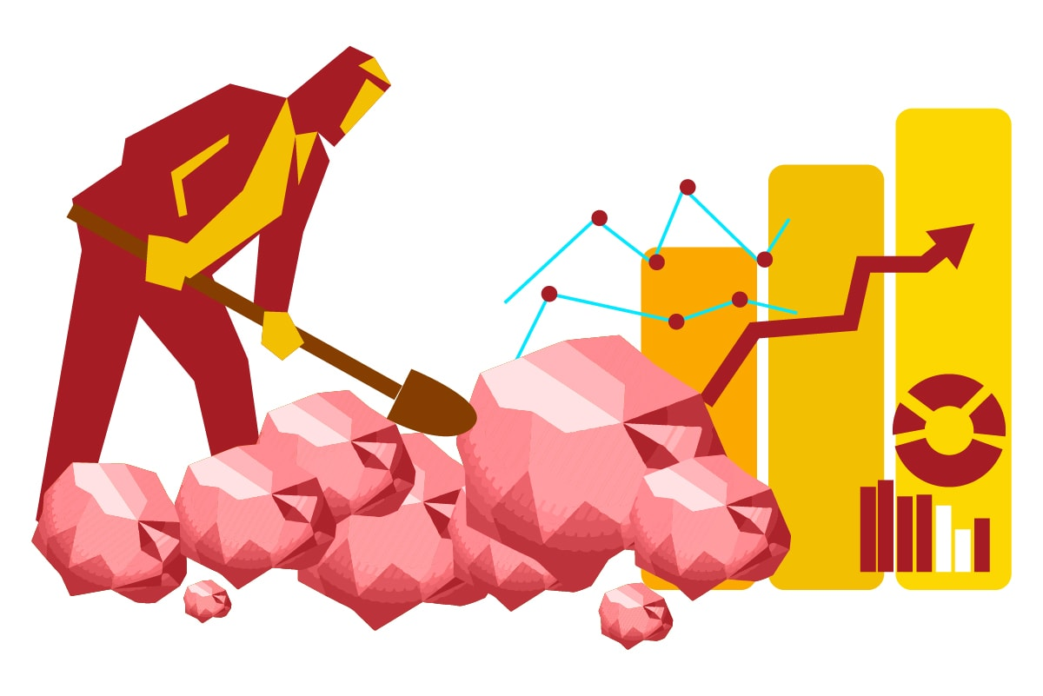
Background
What is Data Mining?
Came into existence in the middle of 1990s.
Knowledge discovery in Databases (or KDD)
Powerful tool suitable for fetching previously unknown patterns and useful information from a huge dataset.
Its reshaping many industries, including the medical sector.

Slide 5
Knowledge Discovery Process
01
Collection of Data
03
Data Transformation
05
Interpretation
Physical health records
Electronic health records
Dimensionality reduction
Normalization
Performance Measures
Revised Model
Healthcare database
Data selection and transformation
Evaluation
Data cleaning and integration
Data Mining
02
Preprocessing of Data
04
Modeling Data
Missing data, outliers
Multiple data sources
Identifying patterns
Algorithm's selection

Slide 6
Data Mining Techniques
Data Mining Techniques
Descriptive
Clustering
Association
Predictive
Classification Algorithms
Neural Networks
Decision Tree
Bayesian networks
Genetic Algorithm
Artificial Neural Network(ANN)
K-Nearest Neighbor
Naive Bayes
Aprori
K-Means
Fuzzy K-NN
Descriptive
– What happened in the past
Predictive
– What will happen in future

Slide 7
Clustering
 | Partitioned Clustering (e.g., K-Means) | Hierarchical Clustering | Density Based Clustering
Function | Partition given ‘n’ data points into ‘k’ clusters based on similarity measure | decompose the data points either using bottom-up approach or top-down approach. | Uses DBSCAN and OPTICS to discover clusters based on the basis of density connectivity analysis
Pros | Less complex method and efficient | No need to define the number of clusters in advance | No need to define the number of clusters in advance and easily handle cluster with arbitrary shape
Cons | - Can handle only spherical shaped cluster - Requires number of clusters in advance | Can handle only spherical shaped cluster | Suitable for discovering cluster of arbitrary shapes and handles outliers
Related work | grouping of person based on high blood pressure and cholesterol level into high risk and low risk of having heart disease. | Grouping the patients based on their length of stay in the hospital that enhance the capability of hospital resource management | Clustering of Skin Wound Image using DBSCAN

Slide 8
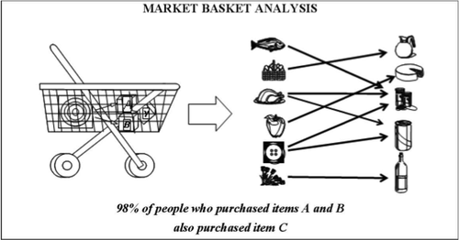
Association
Aims to observe frequently occurring patterns, correlations, or associations from datasets
Market basket analysis
Detects relationships among diseases, health state and symptoms
Utah Bureau of Medicaid Fraud used Doctor’s prescriptions and treatment materials to discover hidden and useful information in order to detect fraud

Slide 9
Classification
Methods | Advantage | Disadvantage | Related Work
K-NN | Easy to implement | Sensitive to noise | classification of cardiovascular disease in order to generate early warning system
Decision Tree | Handles both numerical and categorical data | Restricted to one categorical output variable | characterize skin diseases in adults and children
SVM | Less overfitting issues | Training process takes more time | breast cancer diagnosis using hybrid SVM based strategy
Neural Network | Able to handle noisy data | Overfitting | analyzing chest diseases using ANN
Bayesian Belief Network | Better accuracy for Huge datasets | Dependency among variables leads to inaccurate results | analyze the psychiatric patient data using BBN in making significant decision regarding patient health s

Slide 10
Benefits of Data Mining in Healthcare
Helping Physicians Determine the Best Course of Action
HELPING
Reducing Instances of Unknown Drug Interactions
REDUCING
Figuring out Purchasing Behaviors of People Filling Prescriptions
FIGURING
Improving Patient Outcomes and Safety
IMPROVING
Spotting Factors Related to Health Insurance Fraud
SPOTTING
I hope and I believe that this Template will your Time, Money and Reputation. Get a modern PowerPoint Presentation that is beautifully designed.
04
Matching Specialists to Patient Needs, etc.
MATCHING

Slide 11
Challenges
Ability of mining method in handling noise, dimensionality and versatility of the method
Decision making is done by data sharing which involves use of sensitive information
Diverse datatypes, information from multiple systems
Mining Methodology
Social
& Security
Complex
Data
Understanding the context of data available
Inter
disciplinary nature
Efficiency and scalability of data mining algorithms
Performance

Slide 12
Applications
Treatment Effectiveness
Healthcare Management
Customer Relationship Management
Detect the chronic disease
and prioritize treatments to patients
Ranking of hospitals and managing the hospital resources
Understand the needs, preferences, behavior, patterns
Fraud Detection
Smarter Treatment Techniques
Recognizing High Risk Patients
Identify improper prescriptions, irregular patterns in medical claims
Analyze effectiveness of available treatments and find which one is better
Recognize the patients which require more concern as compare to other patients

Slide 13
Future Directions
Standardization of Clinical Vocabulary
Data collection and analysis
Improved Data Sharing
Automation of data mining process
Integrating Mining Tools

Slide 14
Conclusion
Better applications of the technology can be observed by overcoming the challenges in future
The benefits of data mining in healthcare are not restricted to only identifying the medical condition
Although the process of applying data mining techniques on healthcare data is complex the uses can be boundless

Slide 15
References
https://link.springer.com/article/10.1007/s10916-011-9710-5
https://archive.siam.org/meetings/sdm11/dmhm.pdf
https://www.slideshare.net/healthcatalyst1/data-mining-in-healthcare-slide-share-37372090
https://www.slideshare.net/osmanansari1/data-mining-healthcare-healthcare-application
https://www.ijstr.org/final-print/oct2013/Data-Mining-Applications-In-Healthcare-Sector-A-Study.pdf
https://healthcareinamerica.us/how-data-mining-is-changing-health-care-27c1e9b3b372
https://www.way2smile.ae/blog/data-mining-in-healthcare/

Slide 16
Thank You !

