Slide 1
SentinelAI
AI-Powered Digital Public Safety Platform for Proactive Cyber-Fraud Mitigation

Slide 2
Abstract
Executive Summary of the SentinelAI Initiative
SentinelAI represents a unified, next-generation digital public safety platform built to tackle high-impact financial cybercrimes in India. The solution addresses critical public security challenges including digital arrest scams, counterfeit currency circulation, and structured money mule fraud rings. By leveraging a multi-agent orchestrated architecture, the platform closes the communication gap between citizens, law enforcement, banking portals, and telecom operators. The primary goal is reducing response latency from days to under 5 minutes, mitigating financial losses, and establishing court-admissible forensic intelligence files autonomously.

Slide 3
Introduction
Background & Current Threat Landscape
• The Surge in Financial Cybercrime
India lost over ₹1,776 Crore to digital arrest and transaction frauds in H1 2024 alone, targeting vulnerable demographics.
• Organized Exploits
Scammers coordinate using spoofed caller IDs, burner SIM clusters, and rented bank accounts (mules) to quickly disperse funds.
• Technical Coordination Deficit
Critical agencies operate in silos. Dispersing transaction hold requests and disjoining scam numbers requires manual, high-latency processes.
• Our Solution Objective
Introduce a real-time, AI-driven, and multi-actor unified portal to detect, flag, analyze, and block fraud paths instantly.

Slide 4
Existing Systems & Limitations
Analysing Current Security Vulnerabilities
• Reactive Reporting Portals
Platforms like cybercrime.gov.in act primarily as record-keeping systems with delayed manually-processed actions.
• Siloed Operations
Telecom block lists, bank account freezing processes, and police investigation files are completely disconnected.
• Lack of Real-Time AI Analysis
Scam audio records, spoofed caller patterns, and fake notes are checked manually, leading to low conviction rates.
• Low Asset Recovery Rate
By the time a complaint is manually reviewed (typically 24-72 hours), funds are already withdrawn or laundered.

Slide 5
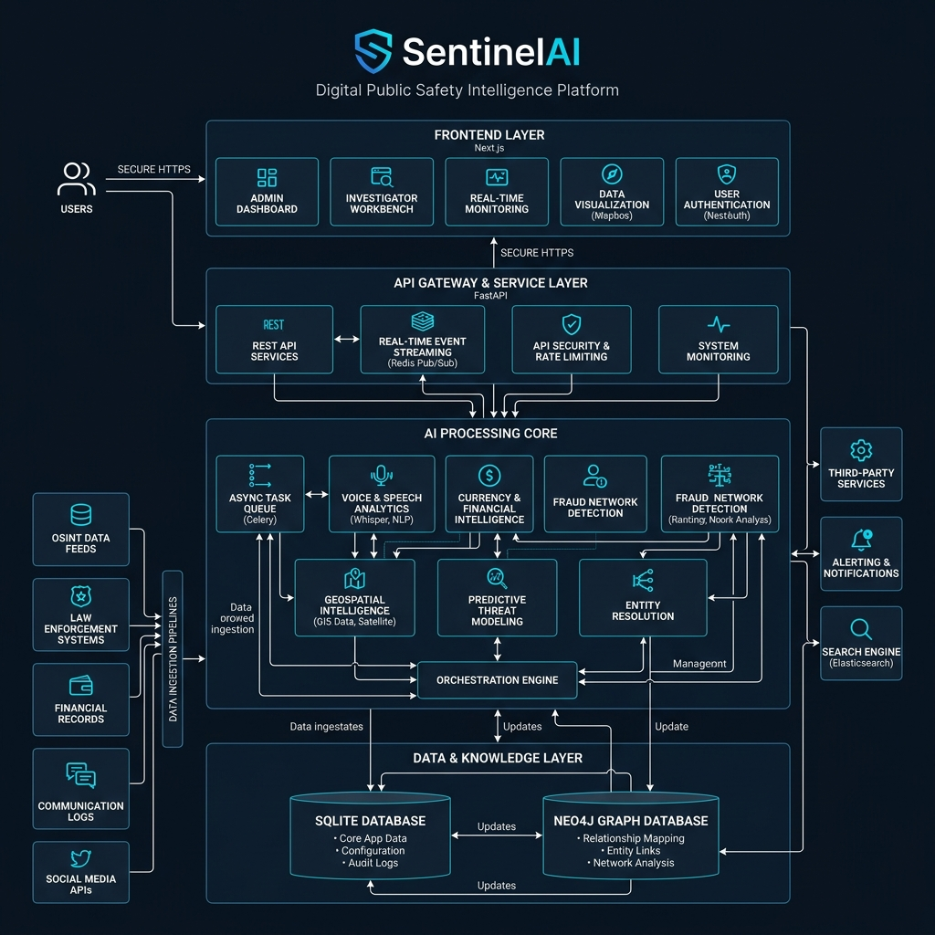
Proposed SentinelAI Model
System Architecture & Connected Flow
Multi-Role Monolith UI
Next.js 16 portals for Citizen reporting, Police Command investigation, Bank hold management, and Telecom disconnects.
KAVACH AI Core Engines
FastAPI background workers running voice scam classification, GNN transaction graphs, and H3 crime hotspot forecasts.
Immediate Webhook Triggers
Automatic account hold flags sent directly to Bank endpoints and blocked SIM alerts to Telecom carriers.

Slide 6
Dataset Specifications
AI Training Inputs & Feature Configurations
• Multilingual Scam Text & Audio
Trained on 35+ categories of Indian voice transcripts (covering digital arrest, courier scams) in 12 regional languages.
• Bank Transaction Logs
Tabular dataset tracking transfers, velocity thresholds, account opening latency, and metadata defining mule characteristics.
• Bank Note Security Features
Database of high-resolution banknote templates specifying security threads, watermarks, UV signatures, and serial shapes.
• Geospatial Coordinate Indices
Historical crime report coordinates labeled with timestamp data, mapped onto H3 hexagon cells for space-time prediction.

Slide 7
Proposed Model Results
System Accuracy & Response Performance
• 🔊 Scam Audio/Text Classification
94.3% F1-score utilizing IndicBERT and pre-trained RoBERTa NLP models for Indian accents.
• 💵 Banknote Counterfeit Detection
99.1% check accuracy combining YOLOv11 boundary markers and EfficientNet-B4 texture checks.
• 🕸️ GNN Transaction Graph AUC
0.97 Area Under Curve (AUC) on GraphSAGE node classification for active money mule rings.
• ⚡ Response Latency Optimization
P95 API latency under 500ms using async FastAPI routes; end-to-end webhook execution complete in under 5 minutes.

Slide 8
Comparison Analysis
Traditional Portals vs. SentinelAI
Feature | Existing Portals (e.g. 1930 Portal) | Proposed SentinelAI
Action Latency | 24 to 72 Hours (Manual review) | Under 5 Minutes (Autonomous webhooks)
Cross-Agency Links | Siloed, requires paperwork | Automated (Instant Bank/Telecom hooks)
AI Analytics Core | None (Citizen forms only) | IndicBERT Voice, GNN graphs, YOLOv11 check
Police Investigation | Static list of entries | Interactive Neo4j graphs & H3 Hotspots

Slide 9
Sustainable Development Goals Alignment
How SentinelAI Maps to United Nations SDGs
• Goal 16: Peace, Justice & Strong Institutions
SentinelAI strengthens national security frameworks, reduces digital extortion/fraud, and creates automated, tamper-proof police briefs.
• Goal 9: Industry, Innovation & Infrastructure
Builds highly resilient, state-of-the-art technological infrastructures and safe digital communication rails for the public safety ecosystem.
• Goal 8: Decent Work & Economic Growth
Protects the financial assets of citizens, micro-merchants, and banks, preserving trust in digital financial transactions and promoting economic stability.

Slide 10
Conclusion
Summary of Achievements & Scope
• Mitigation of High-Risk Scams
Successfully automates digital arrest detection and provides real-time warnings to targets, neutralizing scams at the entry point.
• Minimized Reaction Gap
Replaces legacy manual reporting pipelines with reactive webhook architectures, keeping funds safe within the banking network.
• Ready for Scale
The local monolith codebase runs securely, consumes minimal host resources, and handles load effectively with fallback resilience models.

Slide 11
Future Scope
System Expansion Roadmap
• National 112 Control Center Integrations
Direct backend connections to the MHA and police control dispatch rooms to direct patrolling officers in real-time.
• Edge-Inference Mobile Deployments
Move YOLOv11 currency checks and voice classification models onto edge-capable mobile devices for offline operation.
• Cross-Border Money Trail Analytics
Track international money transfers and overseas caller spoofing endpoints through global intelligence updates.
• AI Self-Retraining Workflows
Retrain scam detection and graph algorithms automatically as new modus-operandi patterns emerge on the field.

Slide 12
Thank You!
Questions & Discussions
🛡️ SentinelAI: Securing India's Digital Future

