Slide 1
SentinelAI
National Digital Public Safety Intelligence Platform
Smart India Hackathon 2024 · Ministry of Home Affairs / I4C

Slide 2
The Public Safety Challenge
• 🚨 Digital Arrest Impersonation
Fraud networks call victims posing as law enforcement (CBI, Customs, ED, TRAI) requesting video custody and illegal money transfers.
• 💵 Counterfeit Currency Flow
Distribution of high-fidelity counterfeit banknotes that bypass standard validation controls at the citizen/merchant level.
• 🕸️ Organized Mule Networks
Layered bank accounts and cloned SIM card structures transfer fraud proceeds out of state boundaries within minutes.
• 🛡️ Lack of Real-Time Coordination
Citizens, local police, financial institutions, and telecom operators work in isolated silos with high latency.

Slide 3
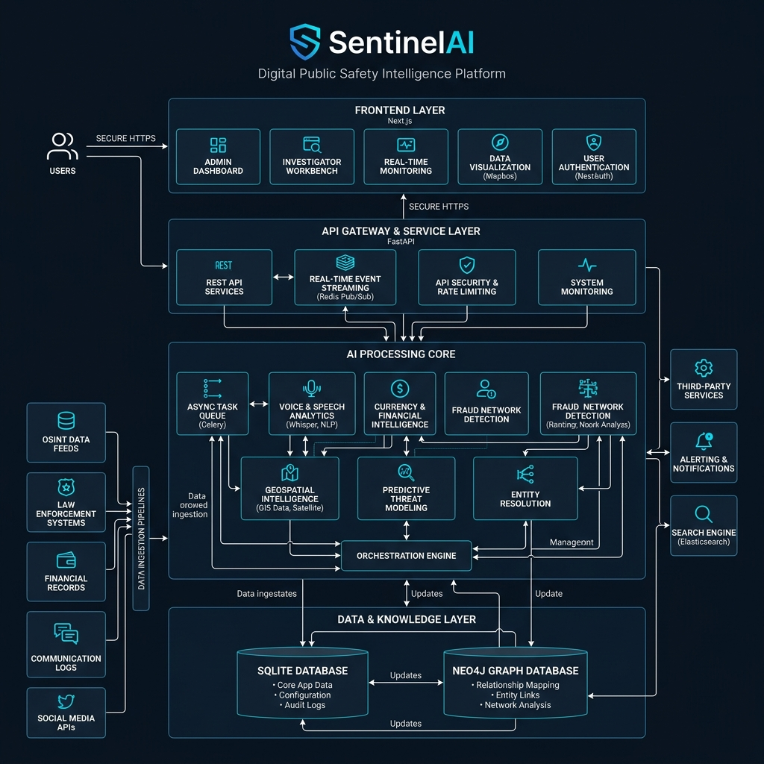
SentinelAI Monolith Architecture
Unified Frontend UI
Next.js 16 + React 19 single-page dashboard serving Citizens, Police Command, Bank Officers, and Telecom operators.
Monolithic API Layer
FastAPI Python backend with SQLAlchemy ORM context matching for fast query resolution.
Dual Database Engines
SQLite local engine (kavach.db) for secure tabular records storage and Neo4j Desktop Graph database for mapping connections.
Neo4j Failover Logic
Graceful mock fallback engine ensures continuous Police Center network visualizations even if the graph DB is offline.

Slide 4
KAVACH AI Modules Core
🎙️ KAVACH-VOICE (Scam Classifier)
IndicBERT + Whisper v3 + ECAPA-TDNN ensemble detecting arrest, banking, and courier scams in 12 Indian languages.
💵 KAVACH-CURRENCY (Counterfeit)
YOLOv11 object localization & EfficientNet-B4 texture parallel feature extraction via mobile camera validations.
🕸️ KAVACH-NET (GNN Fraud Graph)
GraphSAGE & Graph Attention Networks (GAT) analyzing multi-hop transaction trails for mule account rings detection.
🗺️ KAVACH-GEO (Spatial Forecasting)
ST-GCN + Prophet predicting location crime hotspots and calculating police routing index optimizations.
🔮 KAVACH-PREDICT (Mule Detector)
XGBoost and Isolation Forest scoring real-time transactions and broadcasting victim safety prompts.
🧠 KAVACH-AGENT (Autonomous Controller)
LangGraph multi-agent pipeline executing evidence aggregation, fraud updates, bank holds, and police reports in <5m.

Slide 5
Proactive Response Workflow
1. Citizen Reporting
Report submitted via Mobile Dashboard (Text description, Audio recording, Counterfeit photo) triggering immediate asynchronous backend AI workers.
2. Real-Time Scam & Graph Analysis
KAVACH-VOICE verifies scams while KAVACH-NET maps related phone/bank account connections in Neo4j database.
3. Automated Action Triggering
FastAPI server broadcasts instant warning webhooks to Bank portals (initiating holds on accounts) and Telecom interfaces (SIM disconnections).
4. Court-Admissible Police Brief
Platform automatically compiles standard case dossiers containing chronological transaction traces, voice scores, and maps for police dispatch.

Slide 6
Production-Grade AI Metrics
🔊 Scam Detection F1-Score: 94.3%
Using IndicBERT + RoBERTa to handle 12 major Indian languages effectively.
💰 Currency Verification Accuracy: 99.1%
YOLOv11 localized security thread check combined with EfficientNet texture checking.
🕸️ GNN Fraud Network AUC: 0.97
GraphSAGE model trained to distinguish high-risk transaction rings from clean accounts.
⚡ P95 API Latency: <500ms
Optimized database indices and FastAPI async routines ensuring SIH demo speed.
🧠 End-to-End Incident Auto-Action: <5 min
LangGraph agents handling complaints, warning alerts, and automated account blocks.

