Slide 1

Case Study 02 - Attrition data
By: VENKATA-MG-VANGA
Dec-05-2020

Slide 2
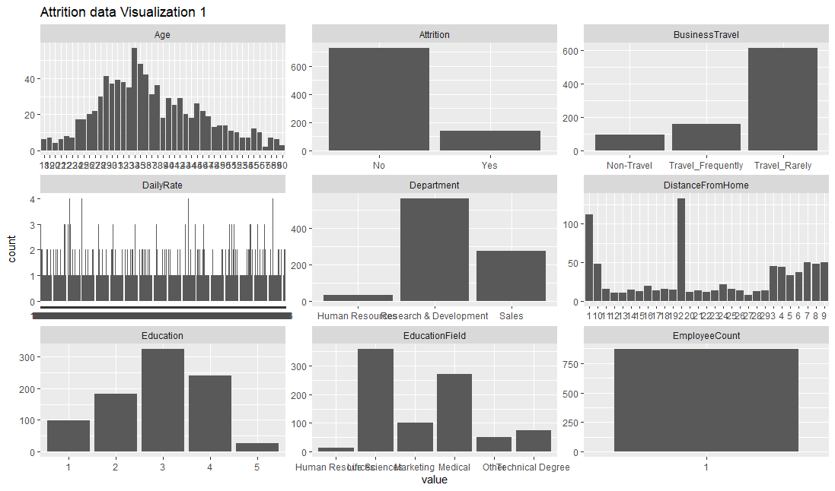
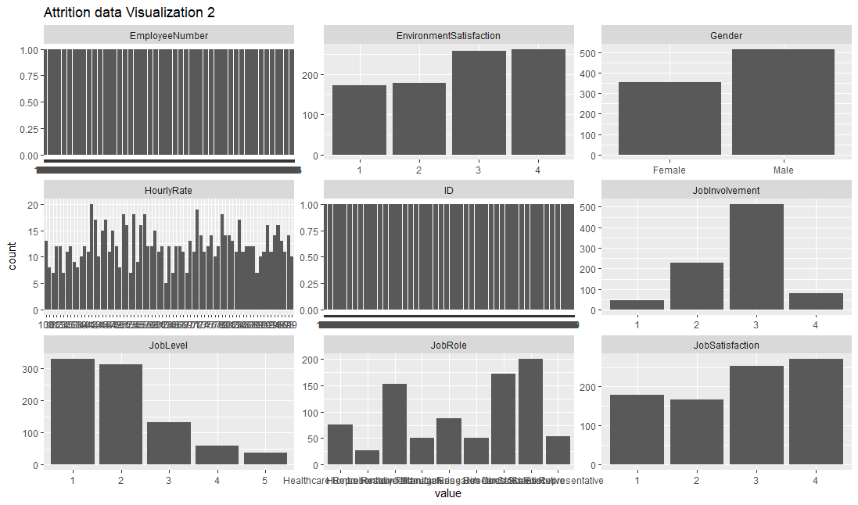
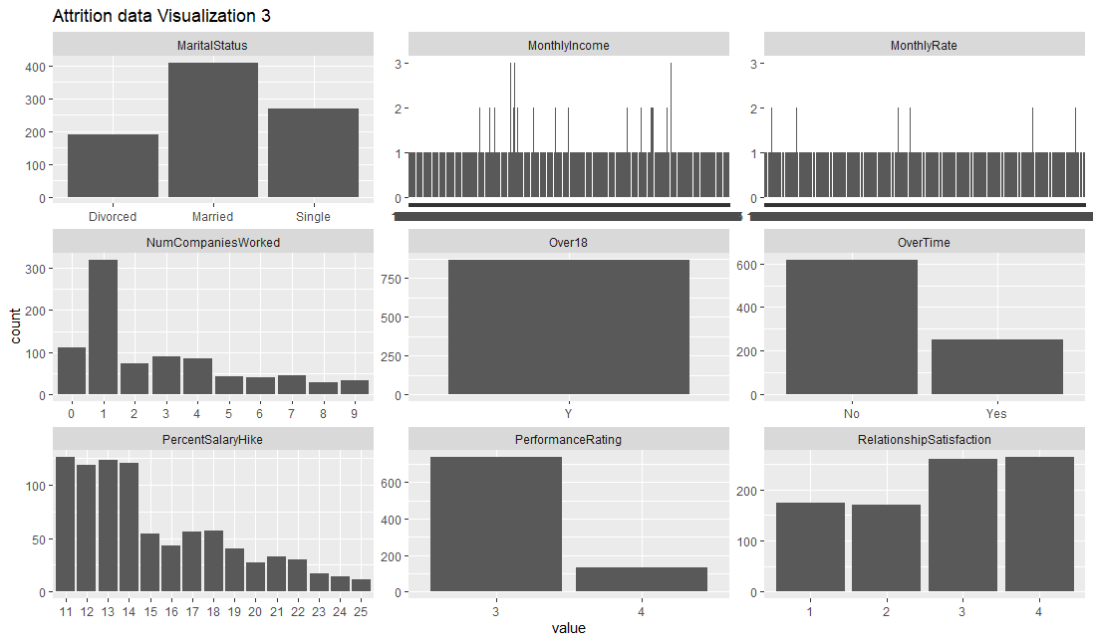
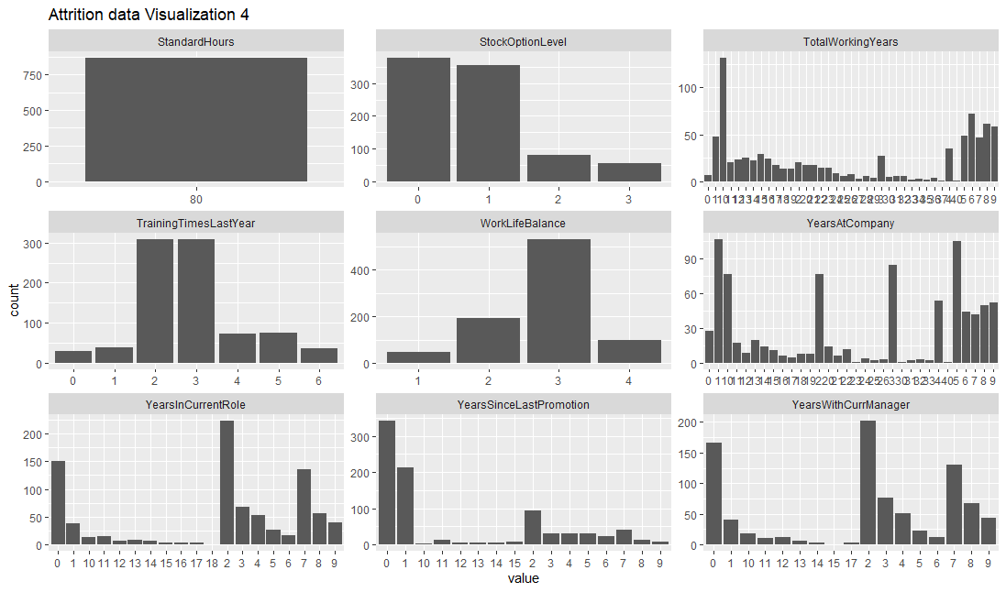
Attrition data - visualization
There are 36 variables in total.
Major attributes which are contributing for attrition upon evaluation are Highlighted in Red.
The data is biased towards non-attrition than attrition.
There are no missing values in the variables.

Slide 3
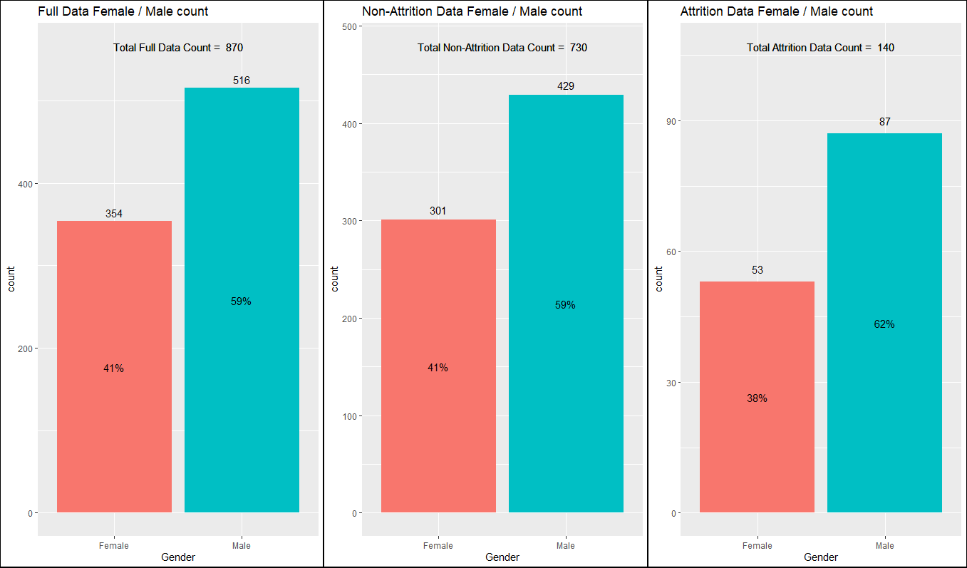
Attrition data - Gender
There is a ~3% increase in attrition of males and the attrition of females decreased ~3% based on the data.

Slide 4
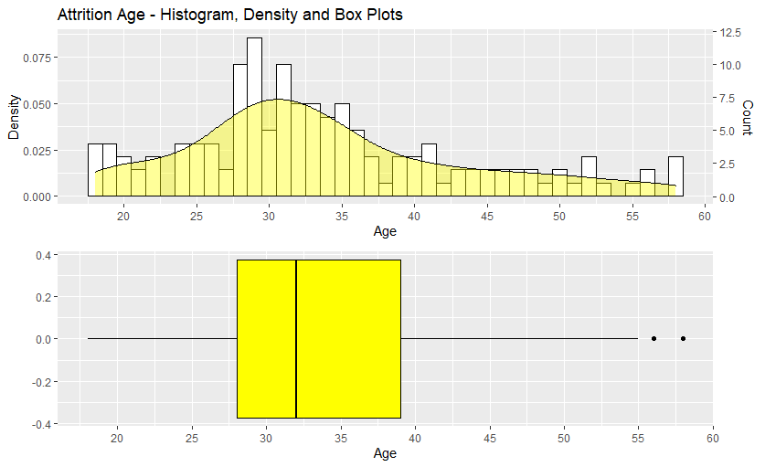
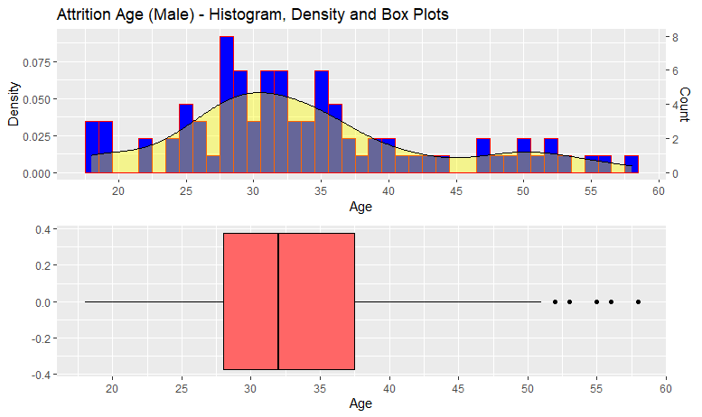
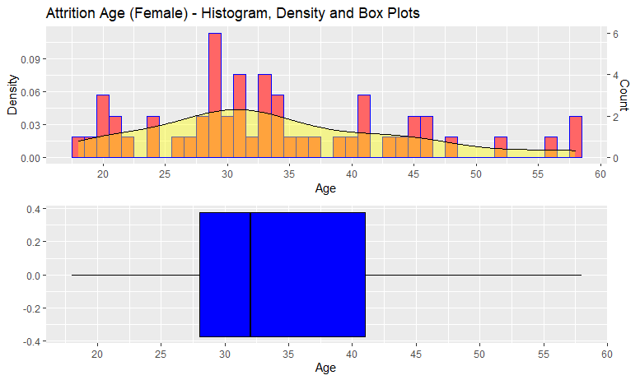
Attrition data - AGE
From the histogram of age for the attrition an average of 27 - 35 years is the where more percentage of attrition takes place.

Slide 5
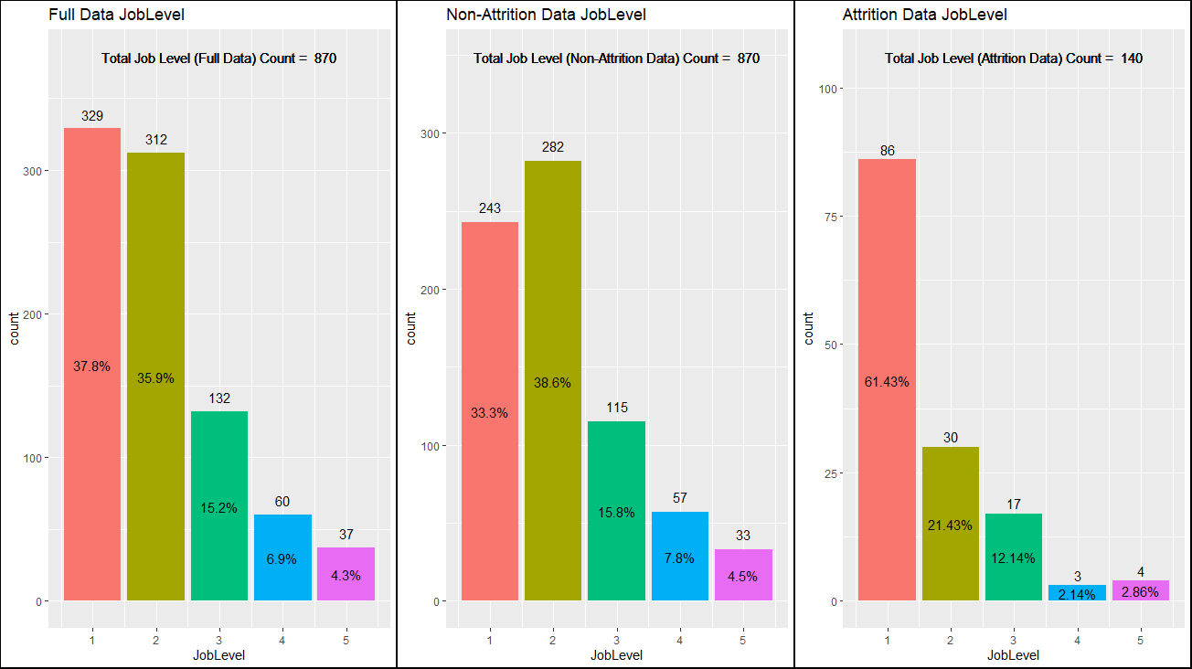
Attrition data – Job Level
There are more employees with job level 1 and 2.
There is a ~30% increase in the attrition for job level 1. This makes job level one of the major attribute for predicting attrition.
* Note: There is a difference in count (y-axis) scale for attrition data

Slide 6
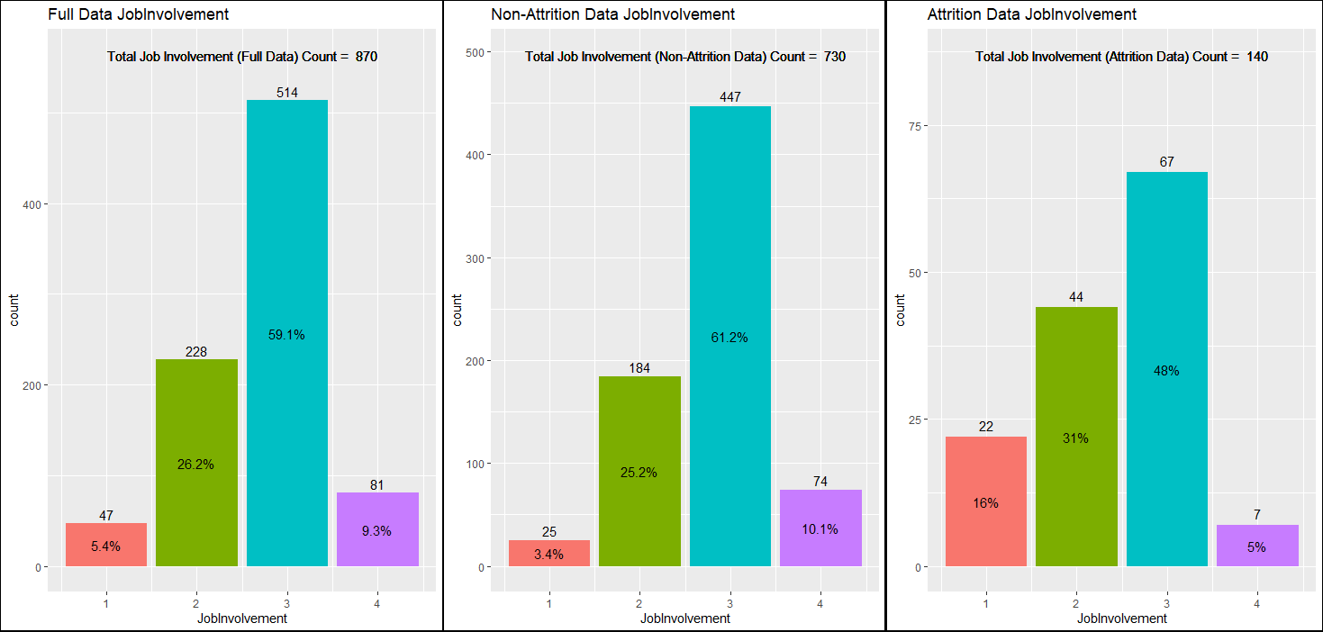
Attrition data – Job Involvement
There are more employees with job involvement 3 category.
There is a ~13% increase in the attrition for job involvement category 1 and ~5% increase in attrition for job involvement category 2. This makes job involvement categories 1 & 2 one of the major attributes for predicting attrition.
* Note: There is a difference in count (y-axis) scale for attrition data

Slide 7
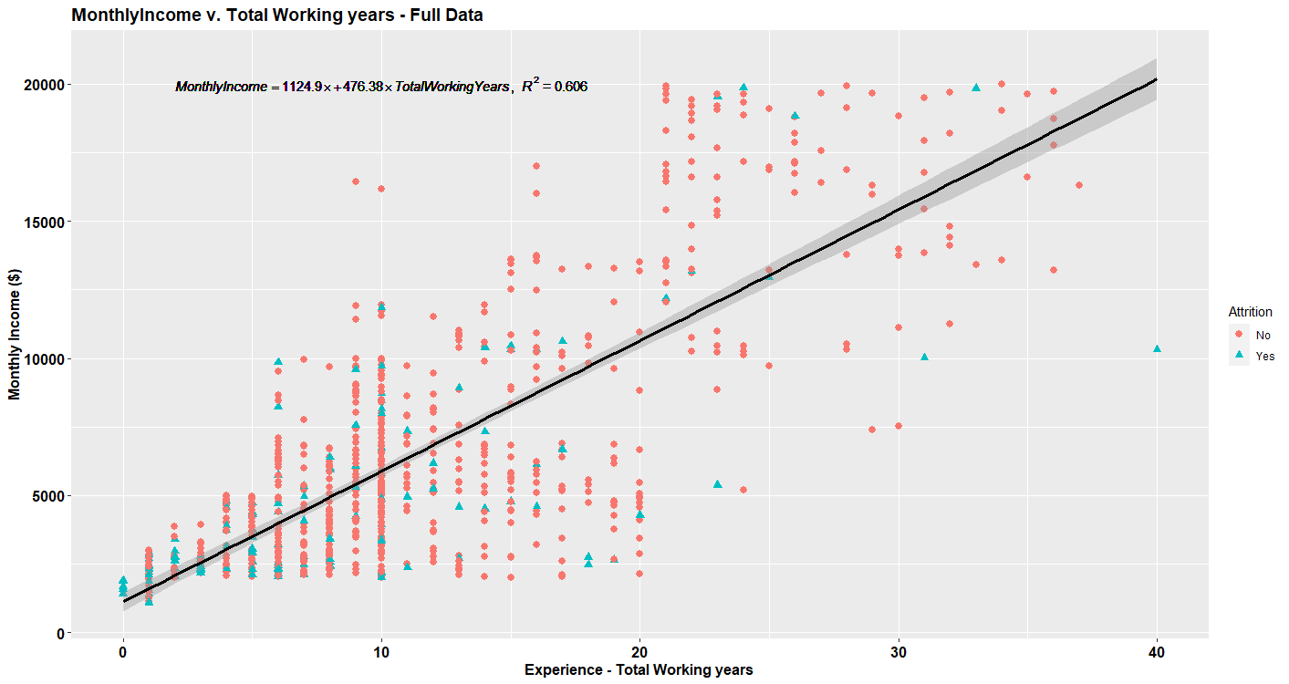
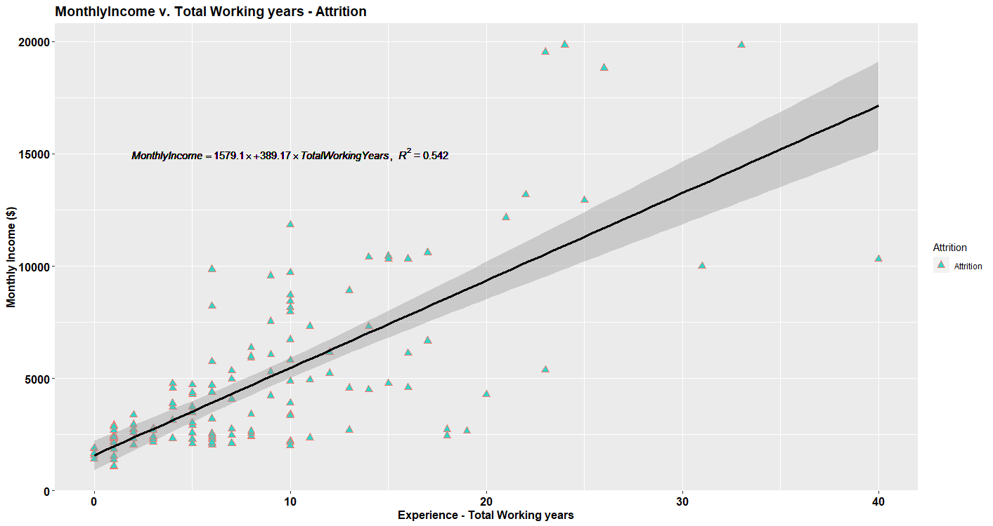
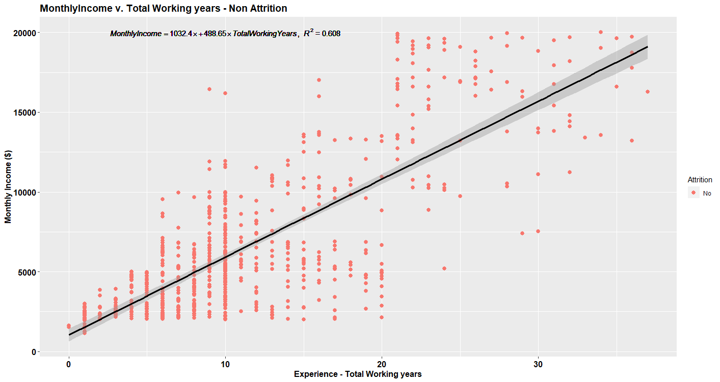

Monthly income v/s. Total working years
Scatter plots for full data, non-attrition data and attrition data are shown
Attrition is more in the lower income employees.
From regression equation the slope 389 i.e., change in income for every one unit change in experience is less, This can be one of the attribute that contributes to regression.
Full Data:
$$Monthly Income = 1124.9 + 476∗ Total working years$$
Non Attrition data:
$$Monthly Income =1032 +489∗ Total working years$$
Attrition data:
$$Monthly Income =1579 +389∗ Total working years$$

Slide 8
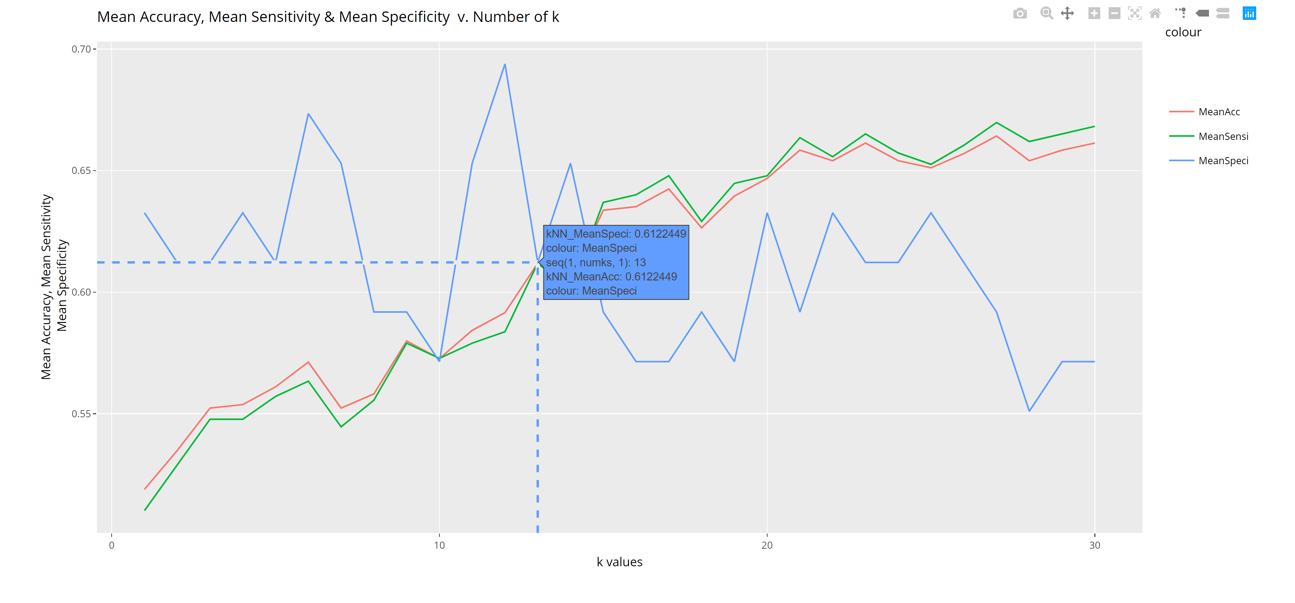
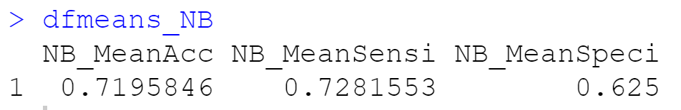
kNN, Naïve Bayes (QOI #1)
Style\K=26 | Attrition |  | Accuracy
 | No | Yes
No | 391 | 19 | ~61.19%
Yes | 248 | 30
Considering the significant variables from above slides.
K = 13 would yield a accuracy of ~60%, mean sensitivity of ~60% and a specificity of ~60%
A Naïve Bayes approach also gave a mean accuracy of ~72%, mean sensitivity of ~72 and mean specificity of ~62%.

Slide 9
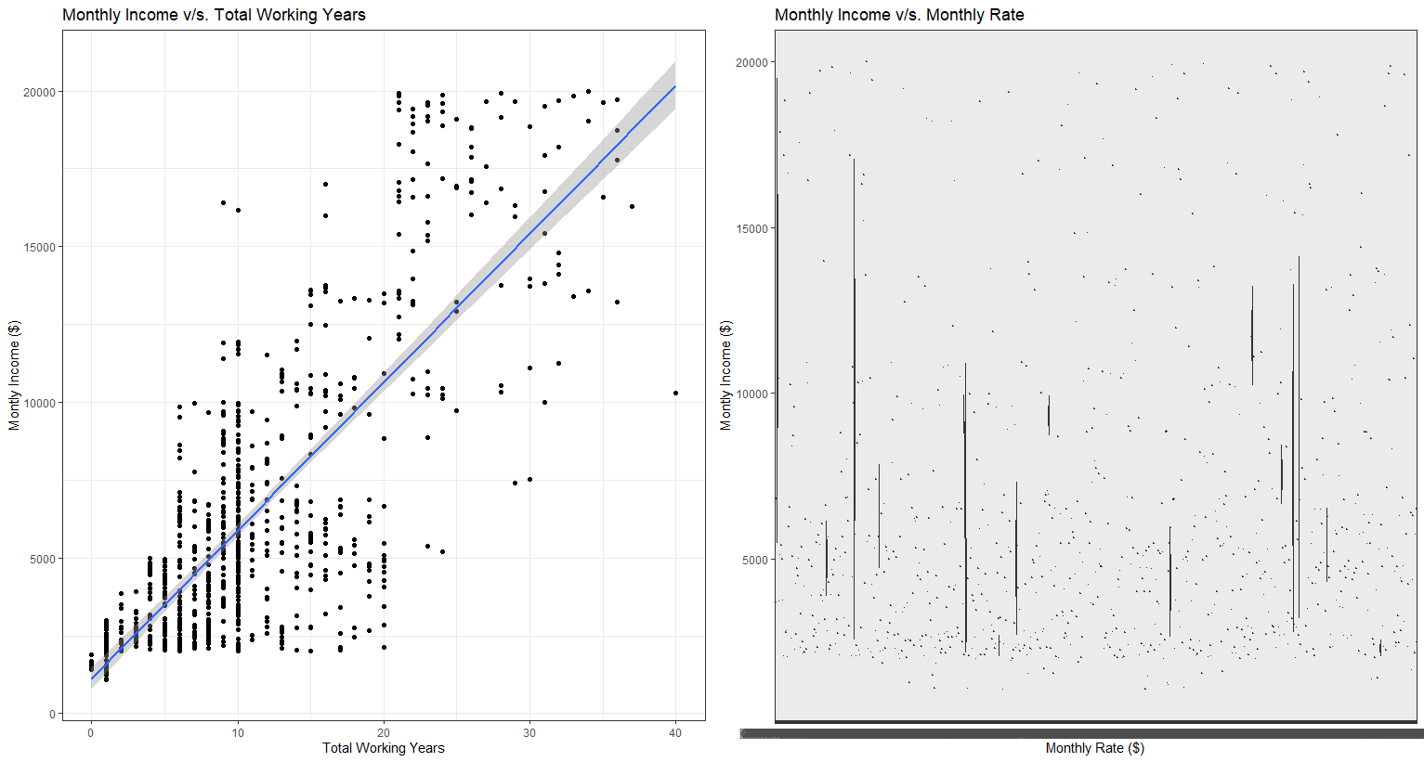
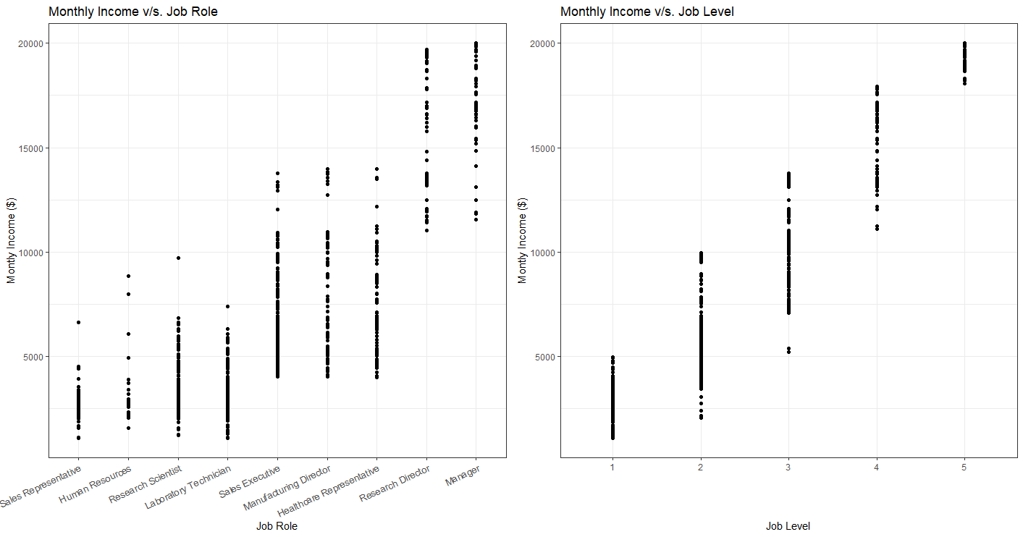
Regression – Monthly income (QOI #2)
Scatter plots for significant variables for linear regression in predicting the Monthly Income.
Regression Equation shown for RMSE <$3000

Slide 10
Conclusion
Based on data male employees have a ~3% more probability of attrition than females.
Age groups between 27 – 35 years are having probability for attrition.
Given data suggests that job level 1 has the highest percentage of attrition.
Job involvement category 1 & 2 also has the high percentage of attrition based on given data.
The monthly income shows a decrease for every unit increase in number of years experience. Also attrition is more prominent in the low income employees.
Employers shows concentrate more on these attributes while considering how to reduce attrition.

Slide 11
Thank You
YouTube Link: https://youtu.be/oSLj7K4_F7g
Github Link: https://github.com/VenkataVanga/MSDS-6306-CaseStudy02-Attrition

