Slide 1

Case Study 01 - beer and brewery
By: VENKATA-MG-VANGA
OCT-22-2020

Slide 2
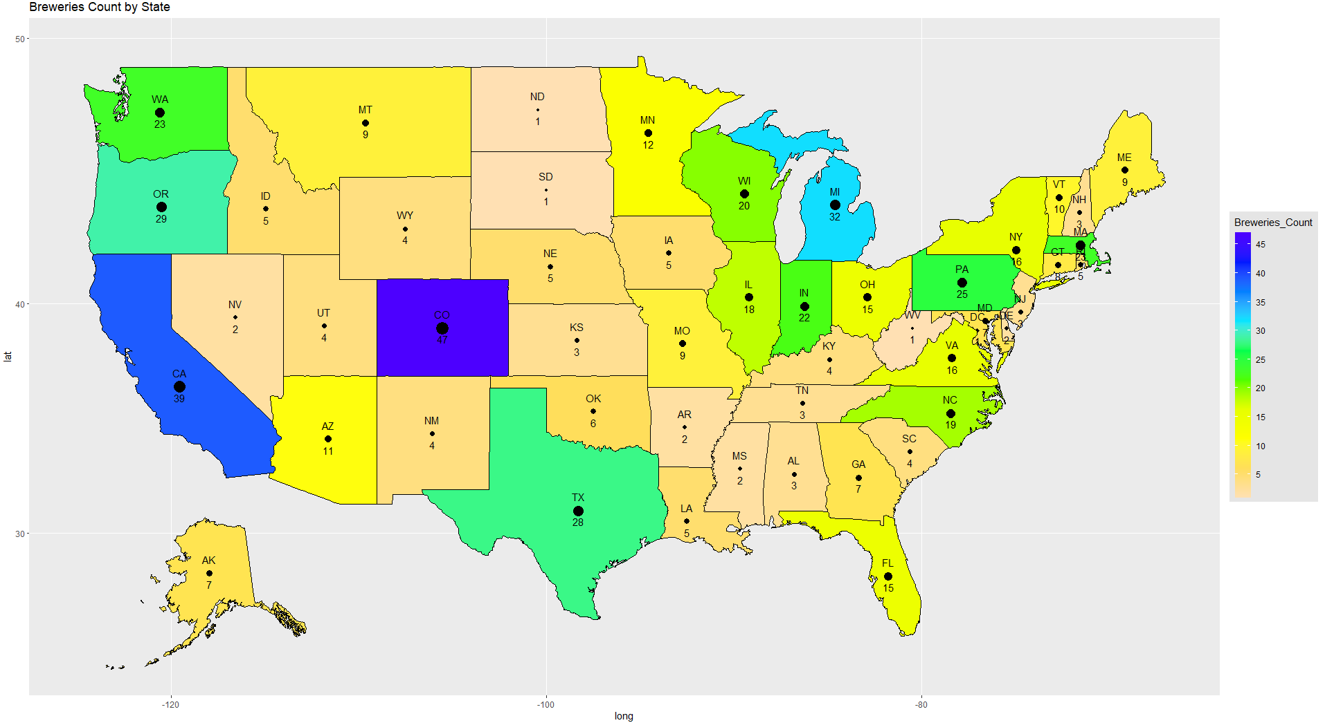
Breweries count by state
Colorado (47) has the most breweries.
California (39), Michigan (32), Oregon (29) and Texas (28) are the next top four states with max breweries.
*Hawaii not shown on map

Slide 3
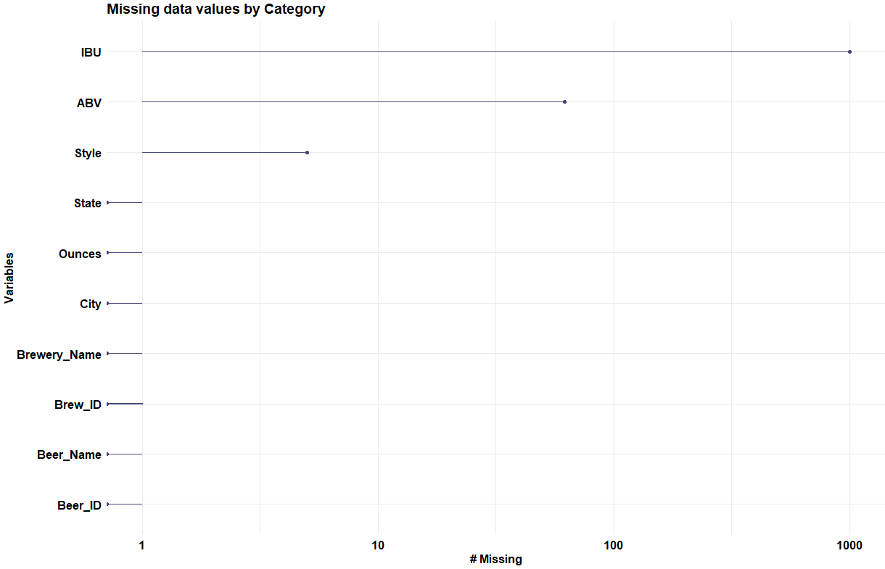
Missing Values
1005 missing values in IBU
62 missing values in ABV
5 missing values in Style
ABV and IBU Missing data imputed using Multivariate Imputation by Chained Equations (MICE) approach.
Style data assigned from internet research.

Slide 4
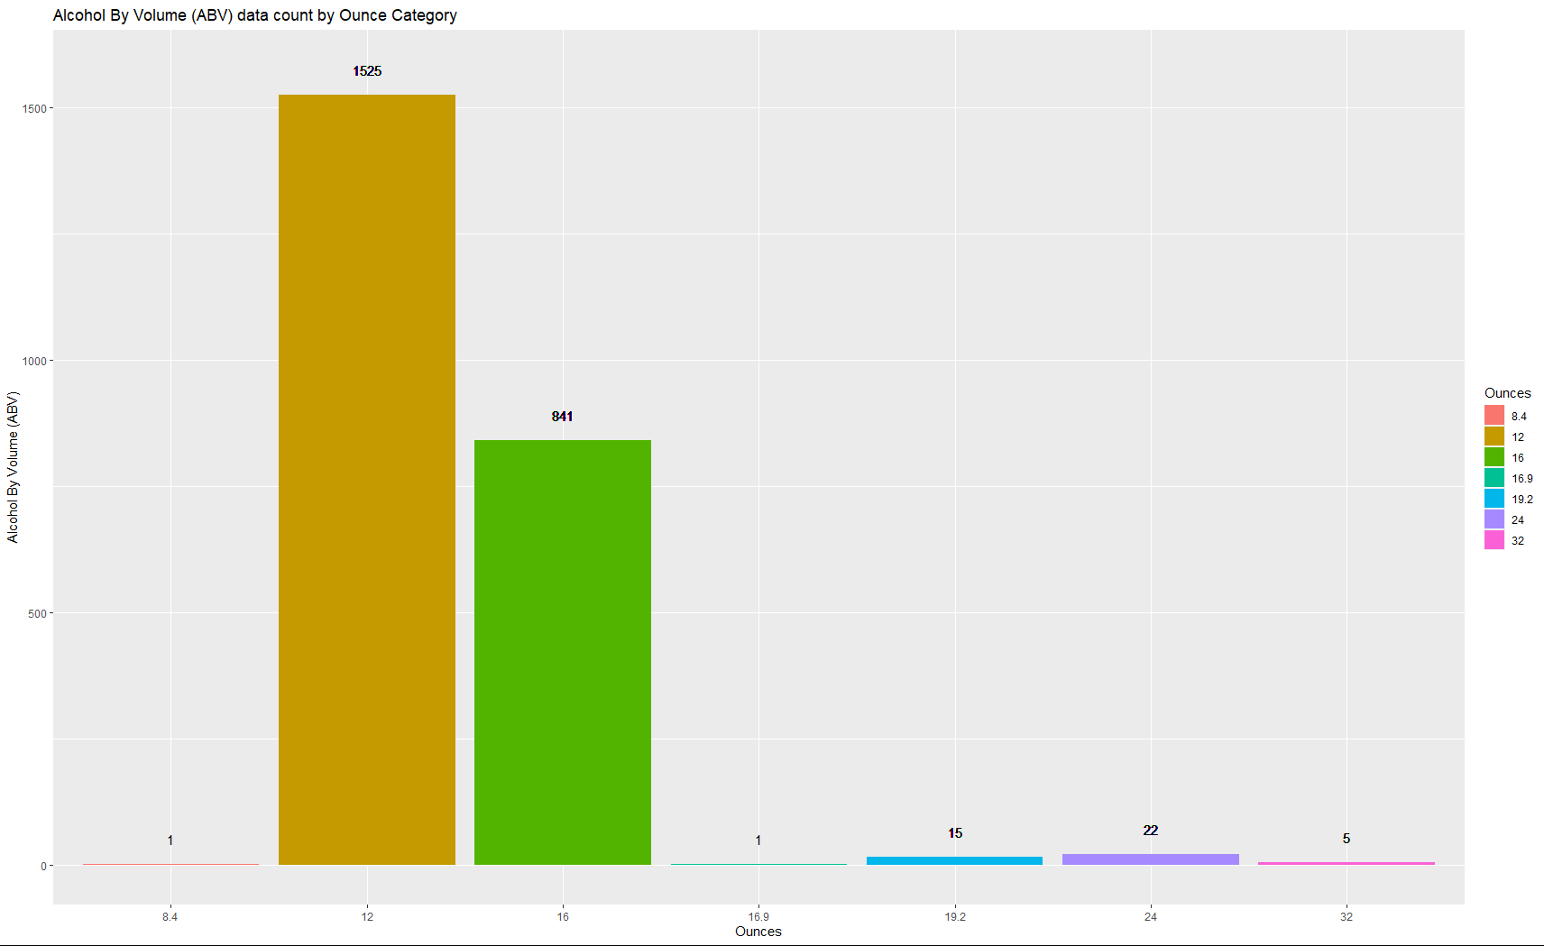
ABV categorized by ounces
Most ABV are categorized by 12 Ounce followed by 16 Ounce category
There are total 2410 ABV values as categorized above in the data set.

Slide 5
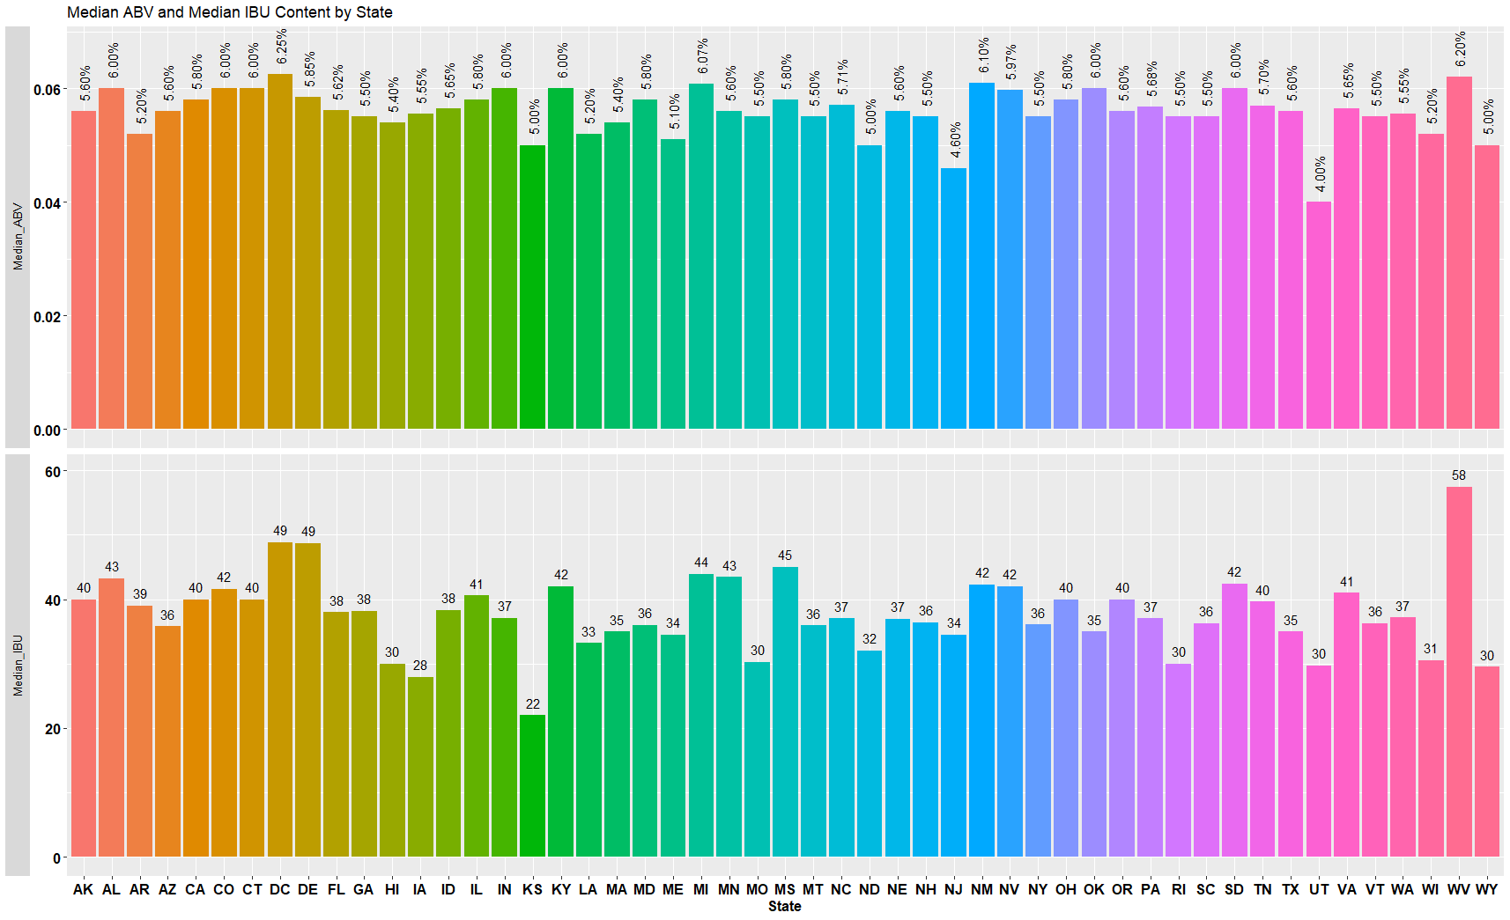
Median ABV and IBU Content by state
Washington DC and has the highest median ABV values which are 6.25%.
West Virginia has the highest median IBU value 58.
Budweiser should target the states based on their median ABV, IBU values and supply for customized beer based on the states taste.

Slide 6
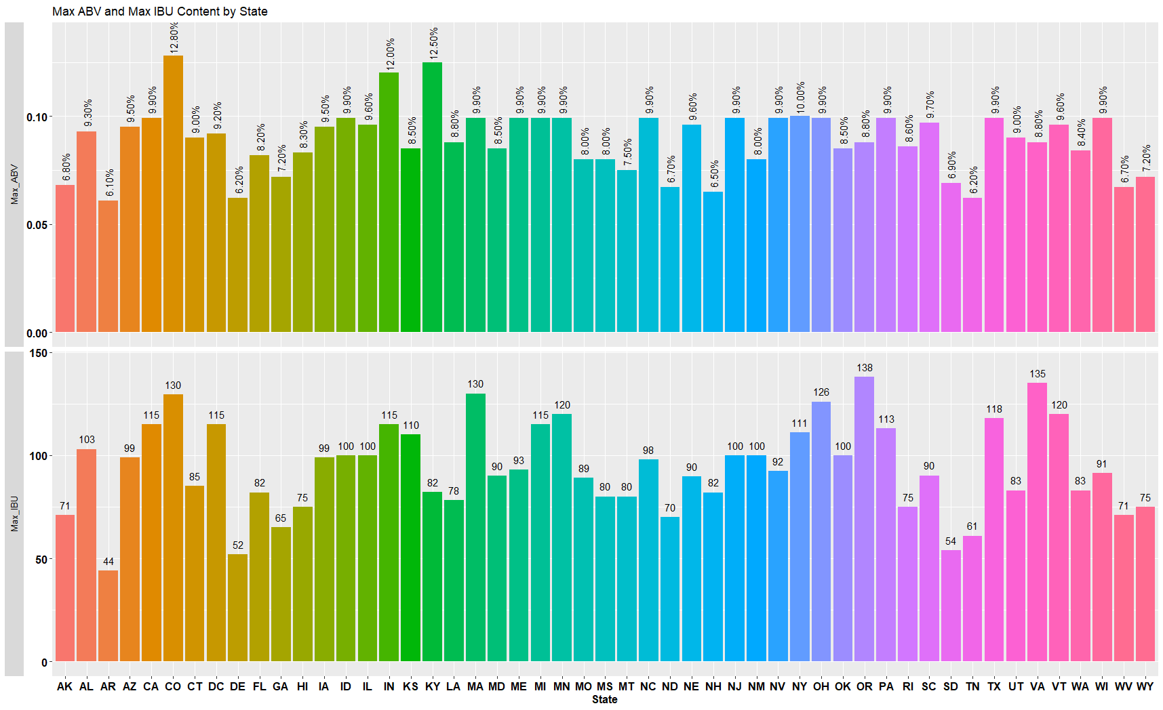
Maximum ABV and IBU by State
Colorado has the maximum ABV beer with 12.8% for ‘Upslope Brewing Company’s Lee Hill Series Vol.5- Belgian Style Quadrupel Ale’.
Oregon has the maximum IBU beer with 138 IBU for ‘Astoria Brewing Company’s Bitter Bitch Imperial IPA’.

Slide 7
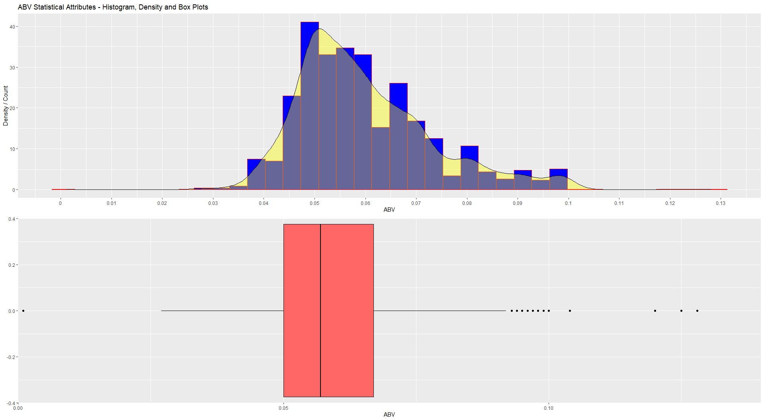
Distribution of ABV
ABV values from 4.90% to 5.95% are the most widely used.
6.65% ABV values show second highest peak from the histogram.
Budweiser can target beers with the ABV values shown above to increase the market share as these ABV values are most in demand.

Slide 8
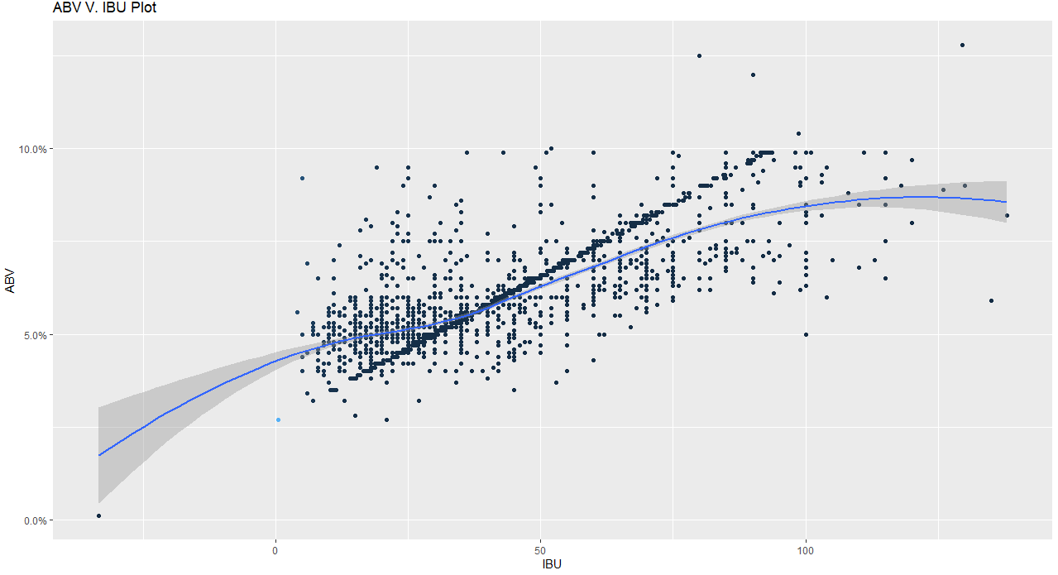
Relationship between ABV and IBU
The scatter plot indicates there is a moderately positive linear relationship (i.e., as IBU increases ABV moderately increases).
Most beers with lower IBU (less than 50) have ABV values around 5%.
When IBU value increases, ABV values spreads out. But most beers with IBU values above 50, their ABV values spread out within the region between 5% and 10%.
Local Polynomial Regression Fitting (leoss) method is used to evaluate the relationship between ABV and IBU.

Slide 9
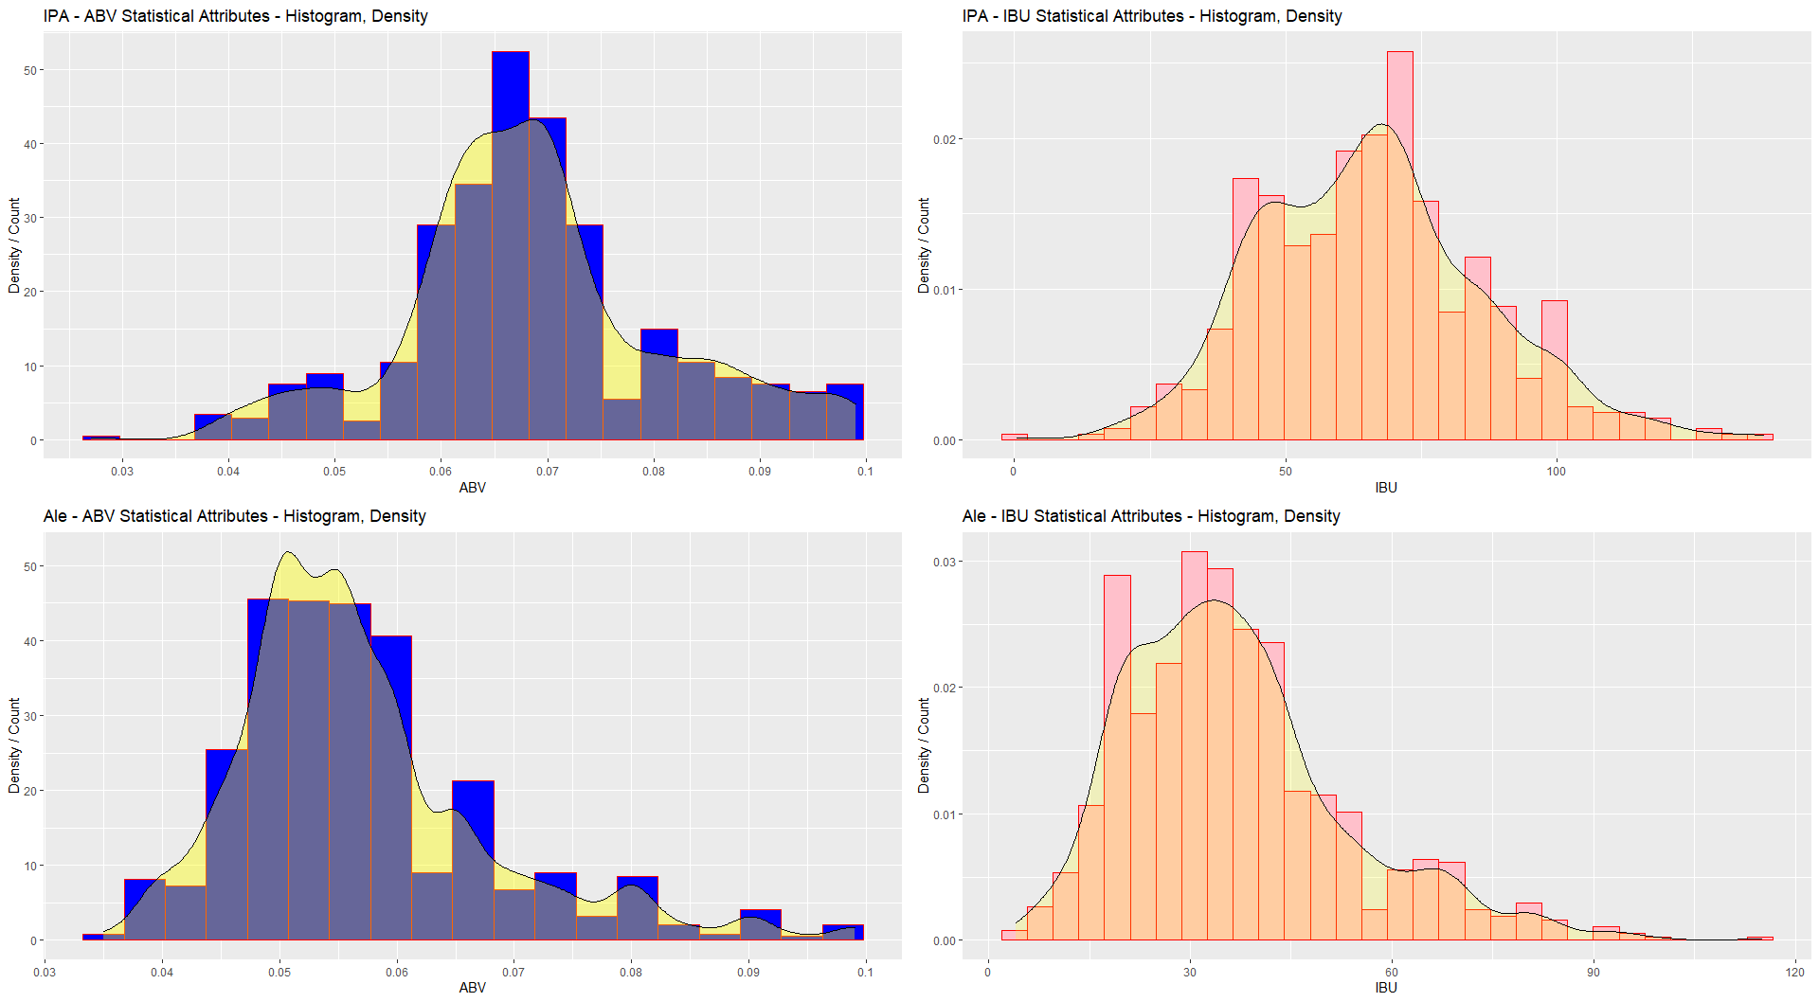
IPA and Ale’s ABV – IBU data
From the histograms, the IPA’s have more alcoholic content than the Ale’s and correspondingly as the IBU and ABV have moderately positive relationship IPA’s are more bitter than the Ale’s.
IPA’s Max range ABV 6.6% – 7.0% IBU 66 – 72
Ale’s Max range ABV 4.9% – 5.9% IBU 30 – 35

Slide 10
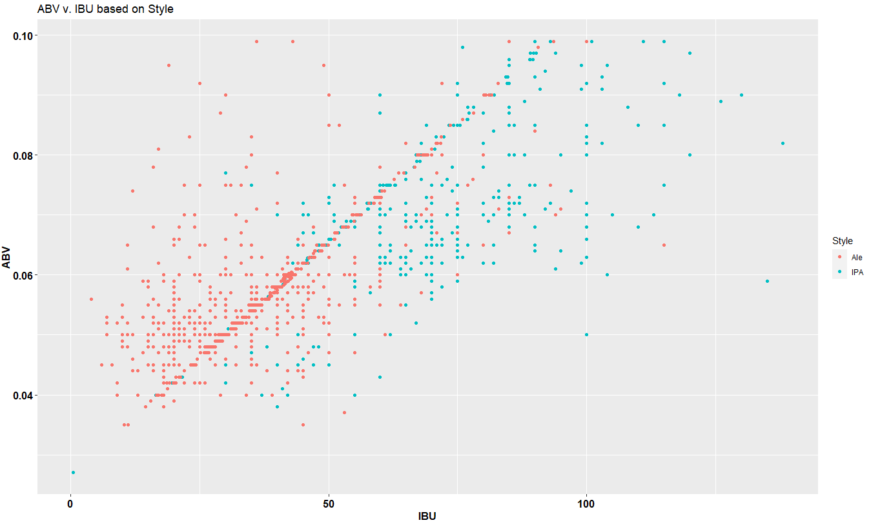
IPA and Ale’s ABV / IBU data - kNN
As discussed IPA’s are more towards the higher end of the plot and Ale’s are towards the lower end.
kNN uses the ‘k’ number of nearest neighbors (ABV/IBU) to give the probability of style of beer.

Slide 11
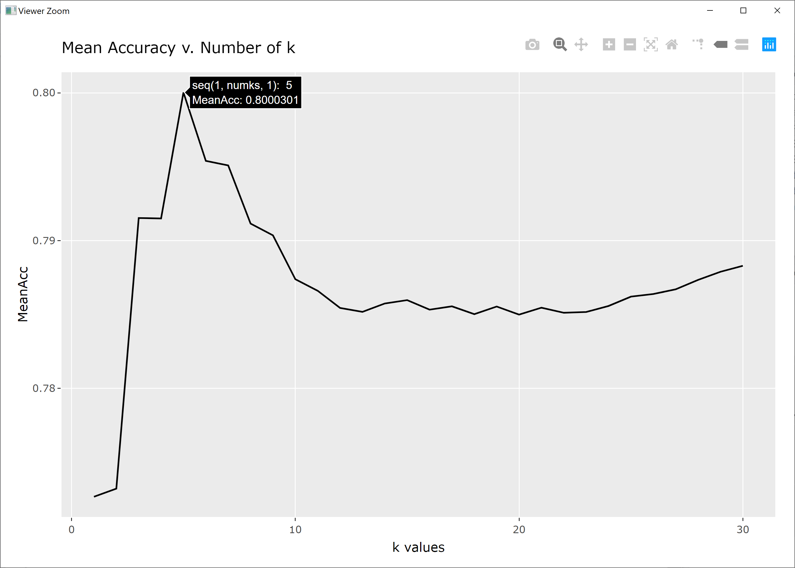
IPA and Ale’s ABV – IBU data kNN & Naïve Bayes
Style\K=5 | Truly Ale | Truly IPA | Accuracy
Ale | 271 | 53 | ~80.43%
IPA | 38 | 103
Considering the data using 70%/30% split and shuffling test and training data 500 times, with K assigned from 1 to 30 during each shuffling, we can achieve the highest mean accuracy 80.0% when K=5.
A Naïve Bayes approach also gave a mean accuracy of 79.32% for predicting the style of beer from given ABV and IBU Values.

Slide 12
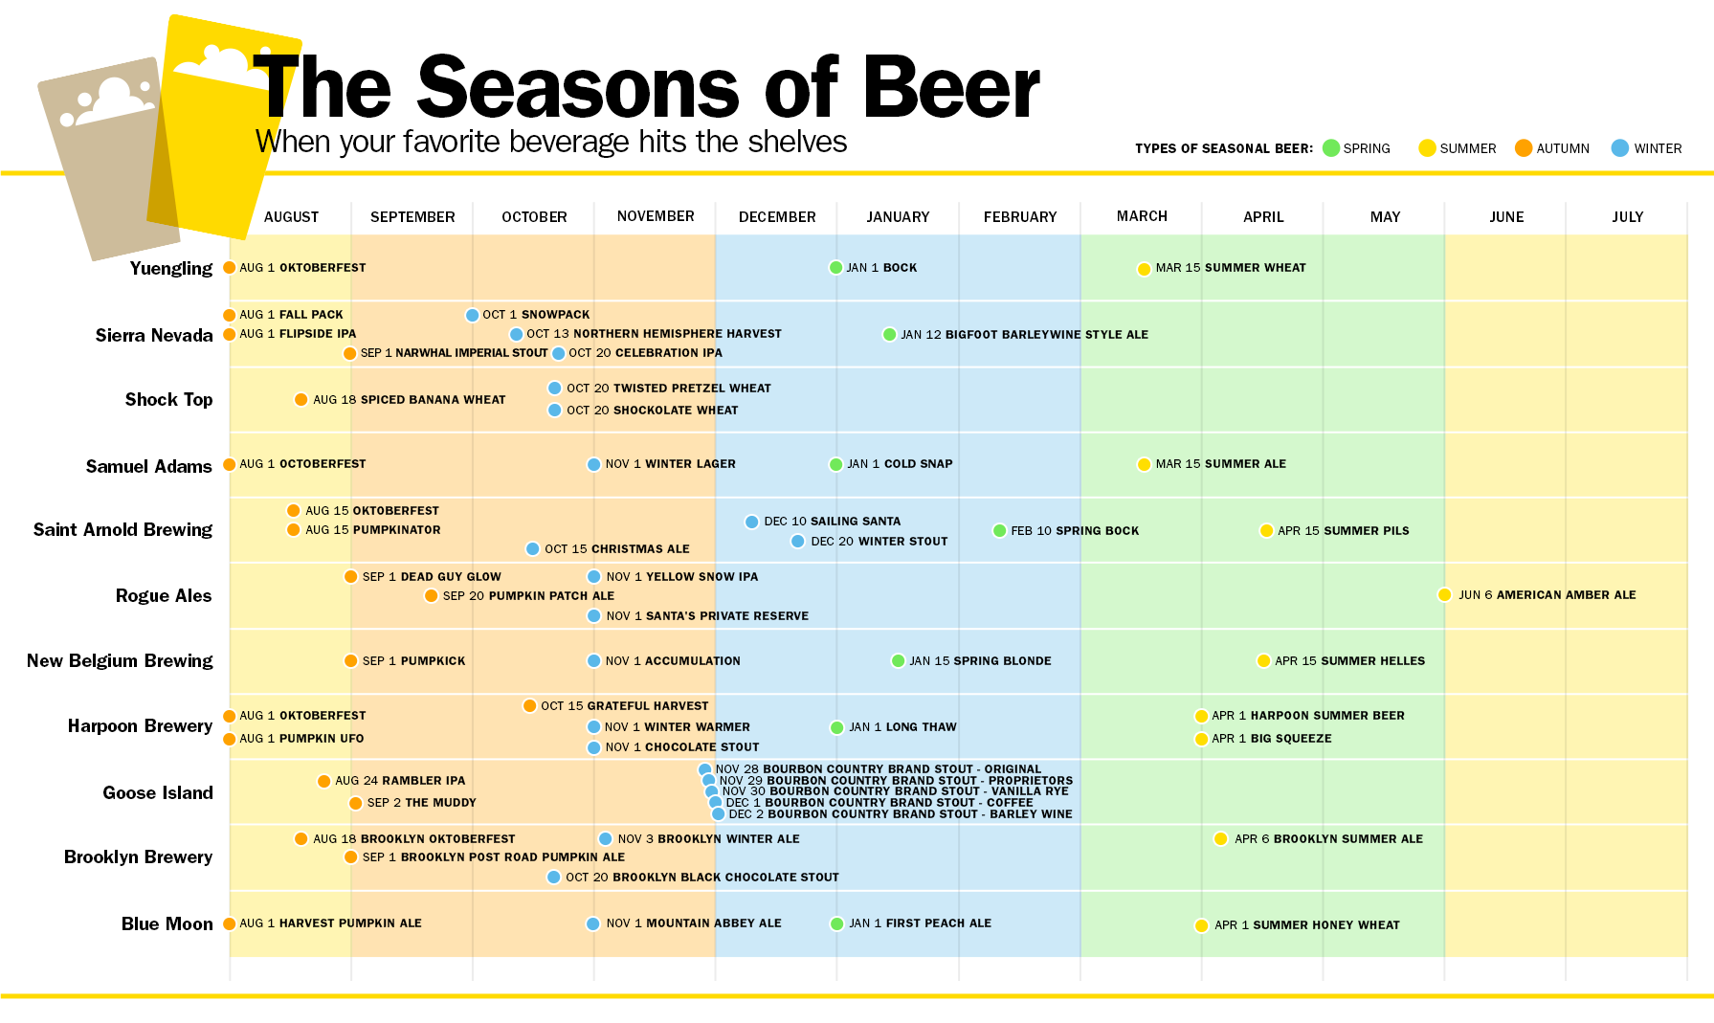
Innovation
Targeting to market the beer at times where the chart shows gaps would increase the market share of Budweiser.
Source: https://time.com/beer-guide/

Slide 13
Conclusion
Budweiser should target the states based on their median ABV, IBU values and supply for customized beer based on the states taste.
Budweiser can target beers with the ABV values 4.9% to 5.95% and 6.65% to increase the market share as beers with these ABV values are most in demand.
Targeting to market the beer at times where other beers are not getting released would increase the market share of Budweiser.

Slide 14
Thank You
YouTube Link: https://youtu.be/6HDO2Y-cEbQ

