Slide 1
Unit VIII initial EDA of beer and brewery study
By: RENFENG WANG & VENKATA-MG-VANGA
OCT-13-2020

Slide 2
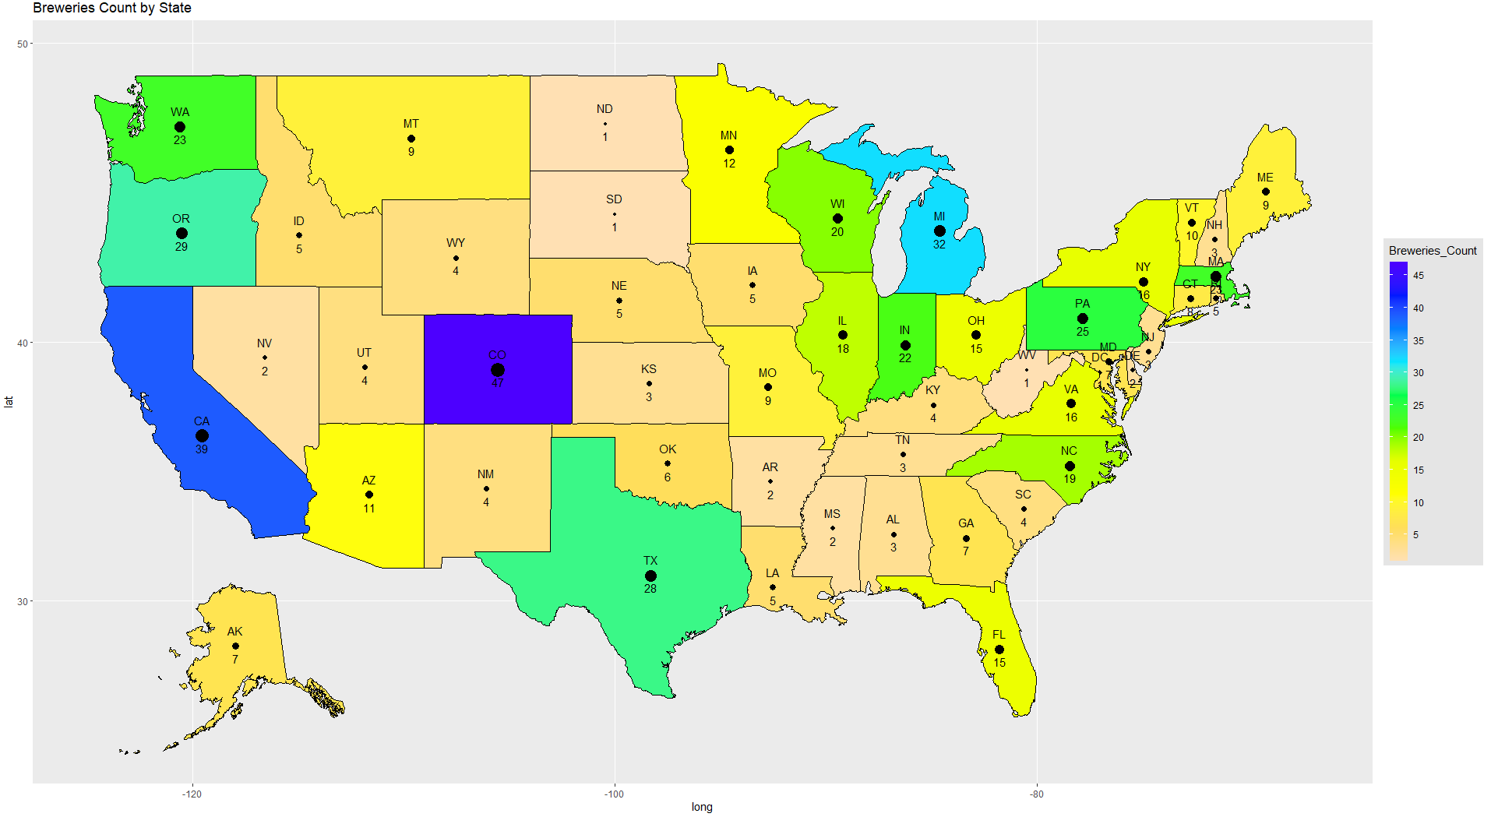
Breweries count by state
*Hawaii not shown on map

Slide 3
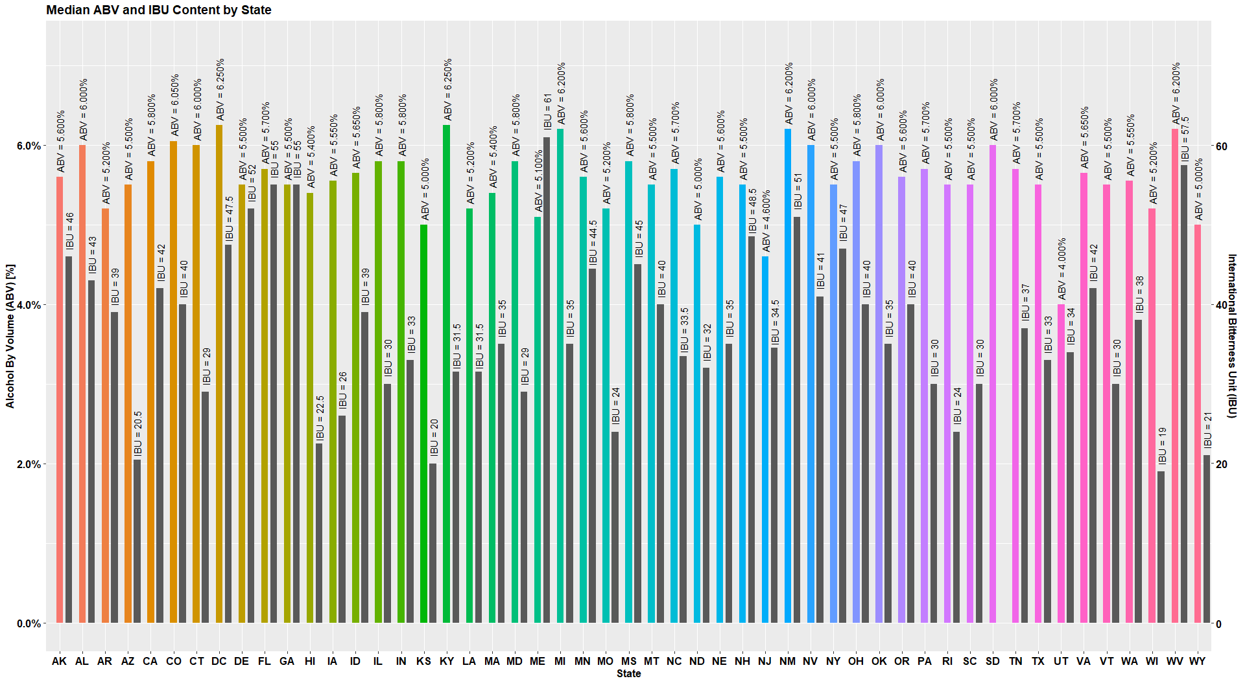
*South Dakota (SD) has no IBU values in data

Slide 4
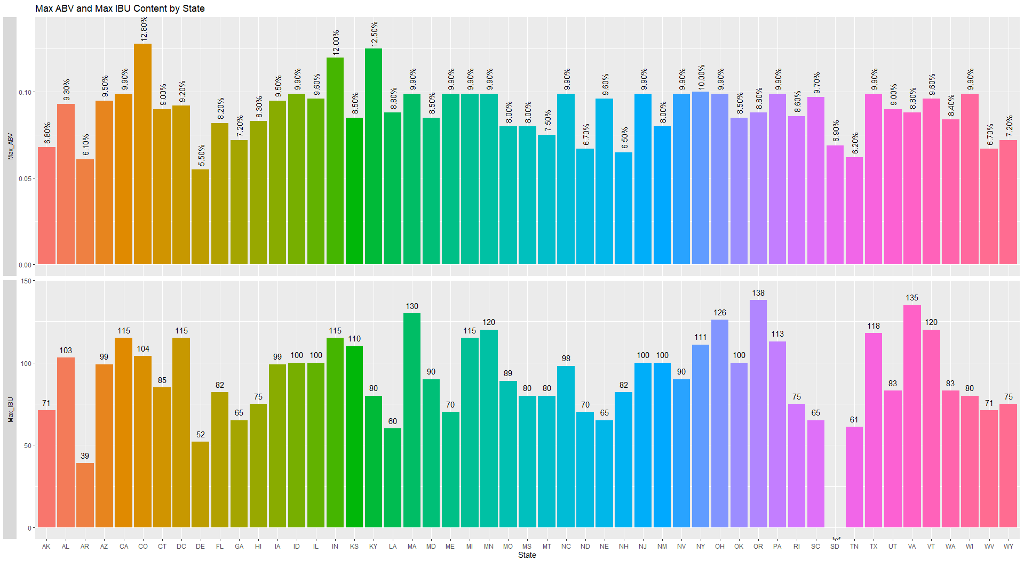
*South Dakota (SD) has no IBU values in data

Slide 5
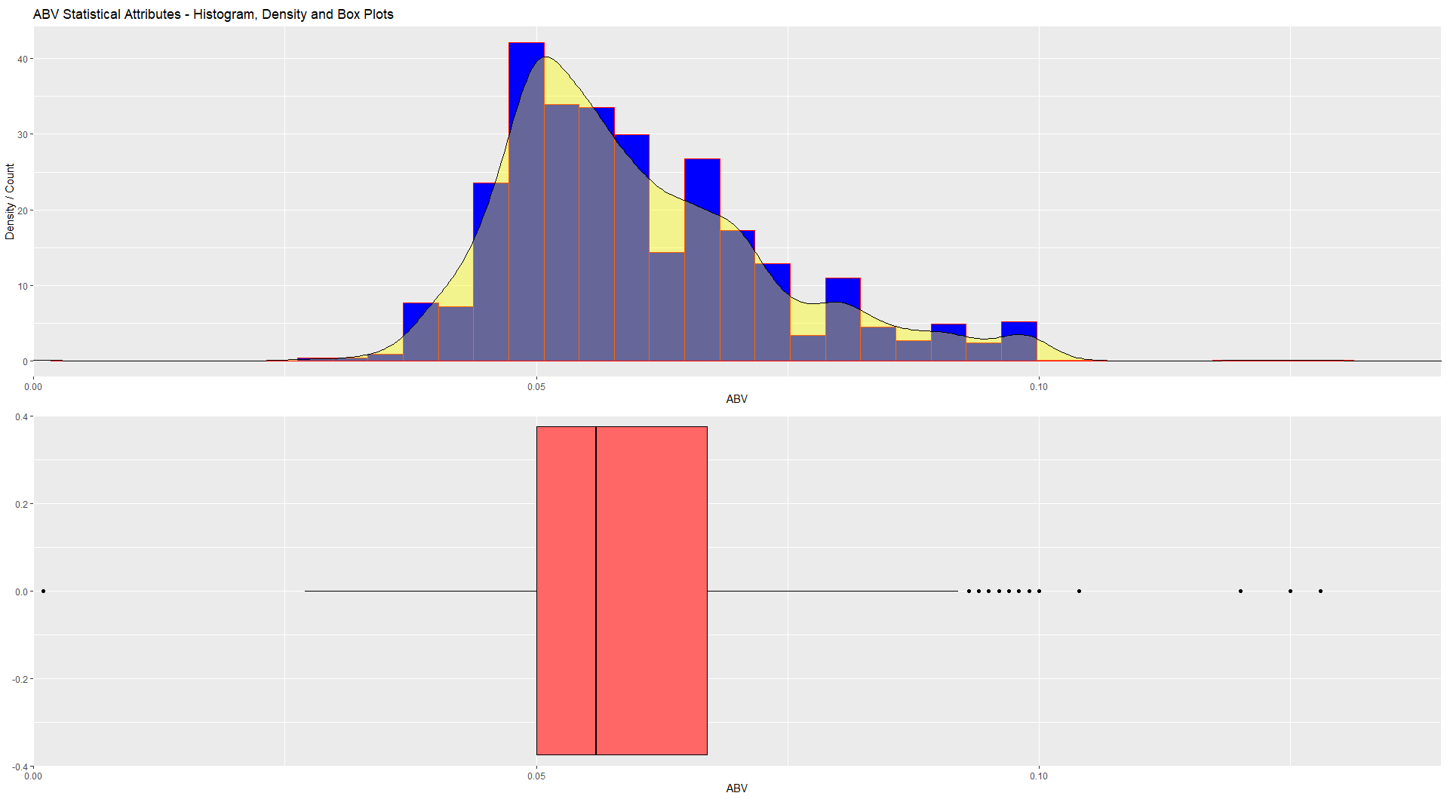
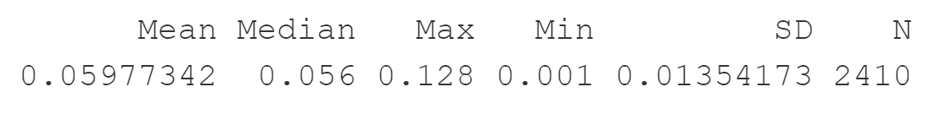
Data suggests a slight right skewness

