Slide 1
ERICSSON BUILD HACKATHON 2026 · DATA STORAGE OPTIMIZATION
1.45 GB
Distill
12 original files
Keep the knowledge. Lose the weight.
25 MB
We turn long recordings and documents into compact, searchable, AI-ready data, and find duplicates across systems.
98.3% less storage
Square areas drawn to scale
Team Distill · Karlskrona · November 2026
Notes:
Thank the Ericsson team for the challenge. One line: we built Distill, which keeps the knowledge in recordings and documents but drops the weight. The two squares are drawn to scale: the whole dataset, 1.45 GB, becomes 25 MB.

Slide 2










Big recordings get deleted, and the knowledge goes with them
THE PROBLEM
OUR IDEA
Keep what matters. Drop the pixels.
SharePoint
OneDrive
Ericsson Play
Text
who said what, when
Slides
one image per slide
The same decks are downloaded and re-uploaded to every platform
1.14 GB video
Speakers
voice fingerprints
Links
to the official file
1.14 GB
7.5 MB 99.4% smaller
for one 2.5-hour meeting recording
Storage fills up → files get deleted → lost for people and for AI
Searchable · time-linked · ready for AI
Notes:
Ericsson stores recordings on SharePoint, OneDrive and Ericsson Play. One meeting is 1.14 GB, so when storage is full, people delete it and the knowledge is gone. Our idea: a video is mostly pixels. We keep the text, one image per slide, the speakers and a link to the official file: 7.5 MB.

Slide 3




Every suggested use case is covered
PITCH POINT 1 · USE CASES
Recordings
Slides in a video
Documents & leavers
Plain-text transcript
Screenshot of each slide
Duplicates across systems
Each speaker identified
Compressed (WebP)
A hash for every slide
Voice sample per speaker
Document + slide number
Revisions stored as changes
Text time-linked to the frame
Linked to the official source
Leaver: delete only if a copy exists
Search returns frame + text
Text prompt to recreate it
Chat history (.msg) kept as text
Recreate as video
Done
Partial: speaker names need a Teams transcript; the rebuilt video is slides + audio
Notes:
These are the challenge's suggested use cases. We cover all of them. Two are partial, and we say so: speakers are separated, but real names only come from a Teams transcript, and the rebuilt video is slides plus audio, not the live camera.

Slide 4









One pipeline, fully offline
ARCHITECTURE
1
2
3
4
5
Sources
Ingest
Distill
Link & dedup
Store & use
SharePoint (official)
Ericsson Play (official)
OneDrive (personal)
SHA-256 of every file
Type, size, date
Doc no. + revision
(Uen | B |)
Video: FFmpeg, Whisper,
pyannote + WeSpeaker,
OpenCV + RapidOCR
Docs: PyMuPDF,
python-pptx, LibreOffice
Frame → deck page
Exact duplicates
Fingerprint per slide
Revisions → delta
SQLite + FTS5 search
Image store (WebP)
Knowledge packets
→ UI: search, levels,
duplicates, offboarding
12
files, 3 sources
12
SHA-256 fingerprints
194
key frames, 1,113 speech segments
36
frames linked to decks
424
searchable pieces
FastAPI backend
Next.js frontend
CPU only, no cloud
Originals never auto-deleted
Notes:
Five steps. Files come from three sources: two official, one personal. Ingest fingerprints every file and reads the Ericsson document number and revision. Distill is the core: video goes through FFmpeg, Whisper, pyannote and WeSpeaker, then OpenCV and RapidOCR for slides; documents are split per page. Then we link frames to official decks, find duplicates and revisions, and store it all in SQLite with full-text search. Everything runs offline on a laptop CPU.

Slide 5





Five small AI models. The rest is plain algorithms.
TOOLS
CPU only · no cloud · no LLM
Whisper base
pyannote 3.0
WeSpeaker
RapidOCR
MiniLM-L6-v2
Speech → text with timestamps
Who speaks when
A voice fingerprint per speaker
Reads the text on screen
Search by meaning
faster-whisper, int8
speaker segmentation
groups the same voice
ONNX, offline
384-number vectors
ALGORITHMS & FORMATS
FFmpeg
audio & frames
OpenCV
slide changes
SHA-256
exact copies
pHash
looks the same
dHash
video fingerprint
Opus 16 kbps
speech audio
WebP q70
slide images
PyMuPDF
read PDFs
python-pptx
read PPTX
LibreOffice
slide previews
SQLite FTS5
keyword search
gzip
text
Notes:
Under the hood: five small offline AI models. Whisper turns speech into text with timestamps. pyannote finds who speaks when, WeSpeaker gives each voice a fingerprint. RapidOCR reads the slides. MiniLM lets you search by meaning. Everything else is simple, verifiable algorithms, so every decision can be checked. No cloud and no large language model: no data leaves the laptop.

Slide 6
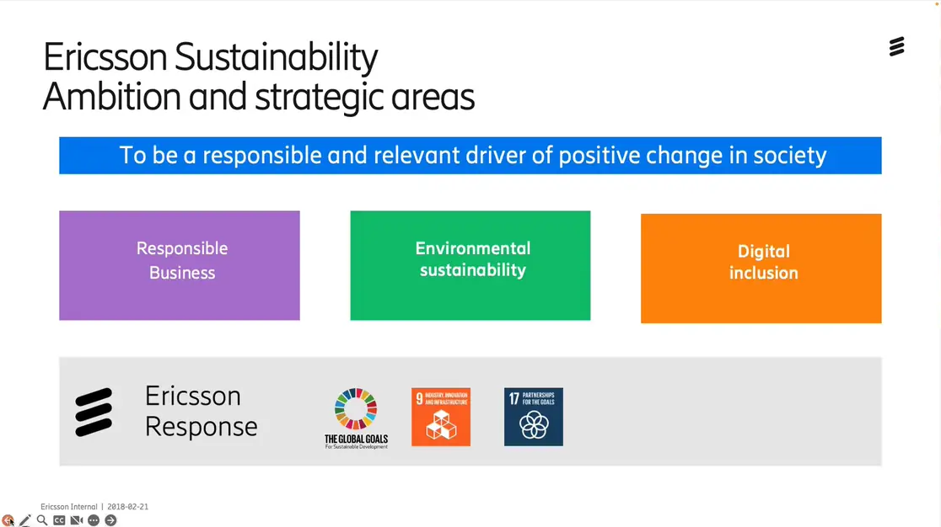
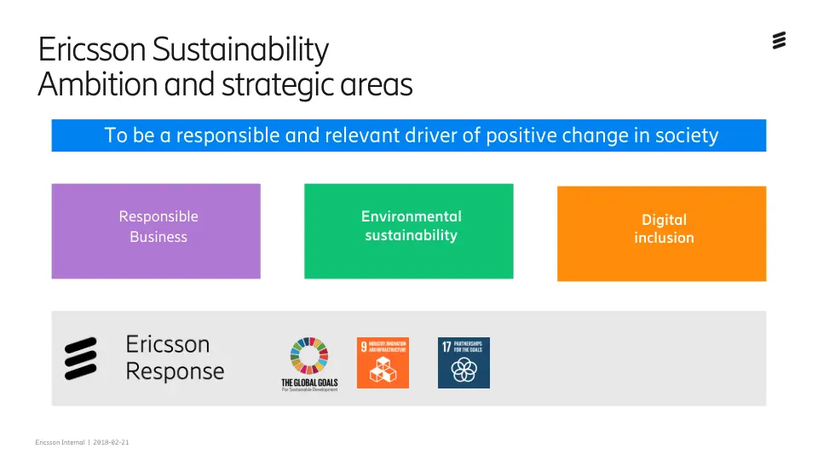
Each slide on screen is matched to its official file
INSIDE A VIDEO · REAL EXAMPLE
Frame from the meeting · 17:35
Ericsson Response Introduction.pdf · page 2
0.743
match score
linked
Text match (OCR words vs PDF words)
Look match (pHash: 30 of 64 bits differ)
Linked only if the score ≥ 0.55
0.814 × 0.75 = 0.61
0.531 × 0.25 = 0.13
0
0.55
1
36 of 156 frames in this meeting link to an official deck. Frames that don't match keep their own screenshot.
Notes:
A real example from the meeting. At 17:35 the camera shows this slide. We compare it with every page of the official decks. Text match is 0.814, look match from pHash is 0.53 because the frame has a toolbar and webcam area. Weighted 75/25 that's 0.743, above our 0.55 threshold, so the frame is linked to page 2 of the Ericsson Response PDF. If nothing matches, the frame keeps its own screenshot: nothing is dropped.

Slide 7





You choose how much to keep
FIVE LEVELS
Example: the 2.5-hour meeting (1,166 MB)
Video
Audio
Slides
Text
Links
1
Original
untouched video
1,166 MB
2
Smaller video
H.264, 5 fps
158 MB* −86%
3
Audio + slides + text
listen again
24.1 MB −97.9%
4
Slides + text
default
7.5 MB −99.4%
5
Text + links
smallest
5.5 MB −99.5%
* Level 2 is estimated for videos over 25 min; all other sizes are measured. Open ring at level 5: only slides with no official match are kept.
Notes:
The user chooses how much to keep. Same meeting at five levels. Level 4, slides plus text, is our default: 7.5 MB, 99.4 percent smaller. Level 5 goes further by replacing slide pictures that exist in an official deck with a link. Level 2 is an estimate for long videos, everything else is measured.

Slide 8


20 check moments: is what we kept still the same?
HOW WE CHECK
03:53
every 7:46
0:00
2:35:19
t = duration × (i + 0.5) / 20
i = 0 … 19. Meeting: 9,319 s → first check at 233 s, then every 466 s
Text on screen (19)
Moving video (1)
EXAMPLE · 27:10
808 / 819
characters found = 98.7%
Text on screen
Picture
Moving video
20+ letters visible
little or no text
dHash changes > 10 bits in 1 s
Score = characters found in the kept text ÷ characters on screen
pHash of frame vs kept image: ≤ 12 of 64 bits different = same
Flagged honestly: a still frame can't keep motion
Missed: “maxelevaion” — an OCR typo, not lost content
Words on more than 60% of frames (names on Teams tiles, menus) are ignored: they are not content.
Notes:
How do we prove nothing important is lost? We pick 20 moments spread evenly across the video with this formula. For the meeting that's every 7 minutes 46. At each moment we look at the original frame and decide what it is. Text on screen: we count how many characters are still in what we kept. A picture: we compare pHash. Moving video: we flag it, because a still can't keep motion. Example: at 27:10 the screen had 819 characters; 808 are in our kept text. The 11 missing are one OCR typo.

Slide 9

Tested on Ericsson's own recordings
MEASURED RESULTS
Meeting
GraalVM talk
Jury & prizes
2 h 35 min · 1,166 MB
16 min · 210 MB
6 min · 85 MB
60% is live camera
Screen text kept
19 text moments
Screen text kept
20 text moments
Pictures kept
17 picture moments
95.8%
99.7%
82.4%
Looks the same (pHash)
all 20 moments
Looks the same (pHash)
all 20 moments
Looks the same (pHash)
all 20 moments
90%
100%
75%
Storage saved
→ 7.5 MB
Storage saved
→ 0.62 MB
Storage saved
→ 0.94 MB
99.4%
99.7%
98.9%
INDEPENDENT CHECK
95.1%
of the words are recovered across 36 slides. The reference is the original PDF text, so OCR is not checking itself.
OCR vs the official deck text
Notes:
Results on Ericsson's own files. Slide talks keep almost everything: 95.8 and 99.7 percent of screen text. The jury video is mostly live camera, so stills keep less: 82 percent, and we report that honestly. And to answer the bias question: we check our OCR against the text of the official PDF, an independent source. 95.1 percent of words recovered across 36 slides.

Slide 10


One official copy. Everything else becomes a reference.
DOCUMENTS & DUPLICATES
FILE
WHAT WE FOUND
BEFORE → AFTER
How we compare
C2L_Presentation_RevB (1).pdf
OneDrive copy
Identical to SharePoint (SHA-256)
3.38 MB → 0 B
SHA-256 of the file
identical bytes = exact copy
Every page / slide
content ID + pHash per slide
Copy of Brief.png
OneDrive copy
Identical (SHA-256)
0.22 MB → 0 B
Revision
from Ericsson's document control table
SD-WAN …final2.pptx
Rev A, older
18 slides same as Rev B, 7 changed
3.30 MB → 0.20 MB
Official copy
SharePoint files always stay original
Chat history.msg
Teams chat
Text extracted + gzip
81 KB → 656 B
Rev A vs Rev B was confirmed from Ericsson's document control table, not from the file name.
Notes:
For documents we keep one official copy. A file with the same SHA-256 as the SharePoint copy becomes a reference: zero bytes. Every slide gets its own fingerprint, so for two revisions of the SD-WAN deck we see 18 slides are identical and only 7 changed: the older revision is stored as just the changes, 0.2 MB. We read the revision from Ericsson's document control table, not from the file name.

Slide 11




Delete only with proof. When in doubt, keep.
WHEN SOMEONE LEAVES
Gonzalo's OneDrive 4 files · 7.0 MB
THE FAIL-SAFE RULE
C2L_Presentation_RevB (1).pdf
3.38 MB
SAFE TO REMOVE
exact copy on SharePoint
If SHA-256, pHash and OCR all fail to find a match, the file is unique, so we keep it.
Copy of Brief.png
0.22 MB
SAFE TO REMOVE
exact copy on SharePoint
Dry run by default
SD-WAN …final2.pptx
3.30 MB
KEEP 7 SLIDES
only the unique slides
A person confirms every removal
Chat history.msg
0.08 MB
UNIQUE · KEEP
no copy anywhere
Quarantine first: undo is possible
Every decision logged with its evidence
6.0 of 7.0 MB can be freed (86%), with nothing unique lost
Notes:
When someone leaves, we analyse their OneDrive against everything else. Two files are exact copies of SharePoint files: safe to remove. The SD-WAN deck shares 18 slides with the official revision, so we keep only its 7 unique slides. The chat history exists nowhere else, so we keep it. The rule: if SHA-256, pHash and OCR all fail to find a match, the file is unique and we keep it. A failed match costs storage savings, never information. And nothing is deleted automatically.

Slide 12




Ask a question, land on the exact moment
PITCH POINT 4 · SEARCH & DATA STRATEGY
global goals sustainability
A future-proof data strategy
Store in open formats
.txt .vtt .jsonl .webp .opus manifest.json: readable without our tool
Meeting @ 18:12
= Ericsson Response Introduction.pdf, slide 2
On screen: Ericsson Sustainability – Ambition and strategic areas
Link to one source of truth
Every frame points to the official document and page
Spoken: [Speaker 16] “…part of the CSR within Ericsson, which means we try to do good things and align with the global goals…”
Feed AI
Each piece is text + time + speaker + slide: ready for RAG and training
Keyword (BM25) + meaning (MiniLM) search over 424 time-linked pieces
Text and time-links make “as you see here” still make sense years later.
Notes:
Search a topic and you land on the exact moment: the frame, what was on screen, what was said, by which speaker, and the official slide it belongs to. For the data strategy: we store everything in open formats, link every frame to one source of truth, and every piece is already in the shape an AI needs: text plus time plus speaker plus slide.

Slide 13





1.45 GB → 25 MB across all 12 files
PITCH POINT 3 · SAVINGS BY SCENARIO
PROJECTION
99.4%
99.7%
98.9%
1,000 meetings like this one
Long meeting
2.5 h, camera + slides
1,166 → 7.5 MB
Slide talk
16 min, mostly slides
210 → 0.62 MB
Video-heavy
6 min, live camera
85 → 0.94 MB
1.14 TB
7.3 GB
100%
94.0%
0%
Same knowledge, still searchable, at Level 4 (slides + text)
Exact duplicate
download + re-upload
3.6 MB → 0 B
Older revision
few slides changed
3.30 → 0.20 MB
Official document
kept as-is, by design
the single source
Measured on the 12 challenge files; the projection multiplies the measured meeting result.
Notes:
Savings depend on the scenario. Slide-heavy recordings save the most, 99.7 percent. Video-heavy content still saves 98.9 percent. Exact duplicates cost nothing, older revisions store only changes, and official documents stay untouched on purpose. Scaled up: a thousand meetings like this one go from 1.14 terabytes to 7.3 gigabytes.

Slide 14

What's not solved yet, and what comes next
PITCH POINT 5 · HONEST LIMITS & NEXT STEPS
Limits today
Next steps
1
Speaker names need a Teams transcript; otherwise “Speaker 1 … 12”
1
Name a voice once, label it in every recording
2
Live demos and webcam become still frames
2
Review queue for medium-confidence matches
3
The text check counts characters, not word order
3
Keep short video clips where motion matters
4
Level 2 size is estimated for long videos
4
Connect directly to SharePoint and Ericsson Play
5
Access rights are not yet copied to distilled files
5
Carry permissions and legal holds; feed internal AI
Notes:
We want to be honest about the limits. Speaker names need a Teams transcript. Live video becomes stills. Our text check counts characters, not word order. Level 2 is estimated for long videos. And access rights aren't copied to distilled files yet. Each limit has a clear next step on the right.

Slide 15
DISTILL
Keep the knowledge.
Lose the weight.
98.3%
95.1%
0
less storage, all 12 files
of slide words match the official deck
originals deleted without proof
Thank you · Questions?
Notes:
Close: Keep the knowledge, lose the weight. 98.3 percent less storage, 95.1 percent of slide words verified against the official deck, and no original is ever deleted without proof. Thank you, happy to take questions or show the live demo.

