Slide 1
AI Based Diabetes Prediction System

Slide 2
Abstract
Many factors can cause a person to get affected by diabetes, like excessive body weight, abnormal cholesterol level, family history, physical inactivity, bad food habit etc. People with diabetes for a long time can get several complications like heart disorder, kidney disease, nerve damage, diabetic retinopathy etc. But its risk can be reduced if it is predicted early. We are going to use machine learning classification methods, that is, decision tree, SVM, Random Forest, Logistic Regression, KNN, and various ensemble techniques, to determine which algorithm produces the best prediction results. The explainable AI approach with LIME and SHAP frameworks is implemented to understand how the model predicts the final results.

Slide 3
Introduction
Diabetes is a chronic disease that directly affects the pancreas, and the body is incapable of producing insulin.
Insulin is mainly responsible for maintaining the blood glucose level.
Many factors, such as excessive body weight, physical inactivity, high blood pressure, and abnormal cholesterol level, can cause a person get affected by diabetes.
In this paper, we have employed machine learning and explainable AI techniques to detect diabetes.

Slide 4
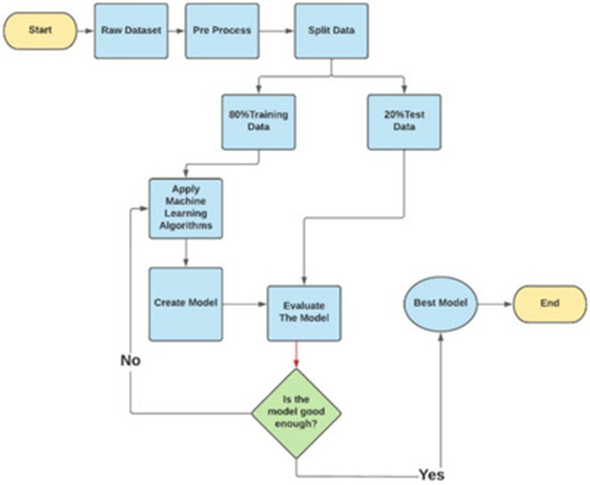
Proposed System

Slide 5
Proposed System
This section describes the working procedures and implementation of various machine learning techniques to design the proposed automatic diabetes prediction system.
First, the dataset was collected and preprocessed to remove the necessary discrepancies from the dataset
Then the dataset was separated into the training set and test set using the holdout validation technique.
Next, different classification algorithms were applied to find the best classification algorithm for this dataset.

Slide 6
Dataset
Several constraints were placed on the selection of these instances from a larger database. In particular, all patients here are females at least 21 years old of Pima Indian heritage.
Pregnancies: Number of times pregnant
Glucose: Plasma glucose concentration a 2 hours in an oral glucose tolerance test
Blood Pressure : Diastolic blood pressure (mm Hg)
Skin Thickness: Triceps skin fold thickness (mm)
Insulin: 2-Hour serum insulin (mu U/ml)
BMI: Body mass index (weight in kg/(height in m)^2)
Diabetes Pedigree Function: Diabetes pedigree function
Age: Age (years)
Outcome: Class variable (0 or 1)

Slide 7
Dataset Preprocessing
In the merged dataset, we discovered a few exceptional zero values.
The zero value has been replaced by its corresponding mean value.
The training and test dataset has been separated using the holdout validation technique, where 80% is the training data and 20% is the test data.
Mutual Information: Mutual information attempts to measure the interdependence of variables. It produces information gain, and its higher values indicate greater dependency .

Slide 8
Machine learning classifiers
Grid Search CV framework has been employed in this research to find the optimal values of different hyper parameters for all the machine learning models to prevent overfitting.
Decision tree: A decision tree represents the learning function provided by a set of rules. The decision tree learning technique performs a method for approximating discrete‐valued target functions.

Slide 9
CONCLUSIONS
In this paper, an automatic diabetes prediction system using various machine learning approaches has been proposed. The open‐source Pima Indian and a private dataset of female Bangladeshi patients have been used in this work.
This research paper reported different performance metrics, that is, precision, recall, accuracy, F1 score, and AUC for various machine learning and ensemble techniques.
There are some future scopes of this work, for example, we recommend getting additional private data with a larger cohort of patients to get better results.

