Slide 1
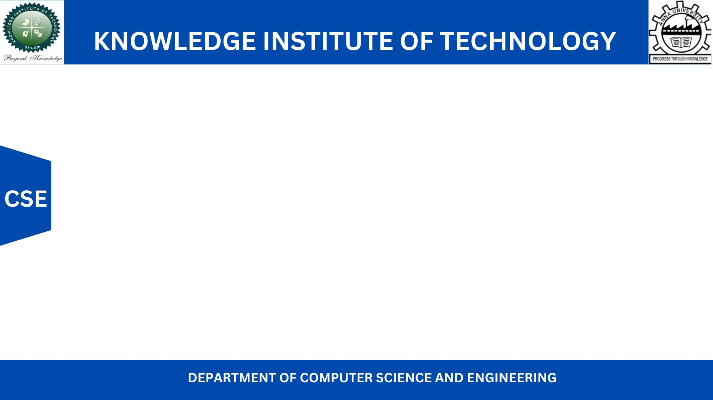
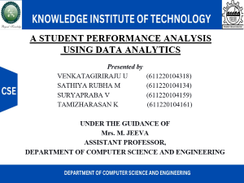
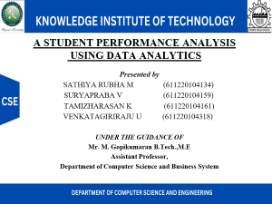
A STUDENT PERFORMANCE ANALYSIS USING DATA ANALYTICS
Presented by
SATHIYA RUBHA M (611220104134)
SURYAPRABA V (611220104159)
TAMIZHARASAN K (611220104161)
VENKATAGIRIRAJU U (611220104318)
UNDER THE GUIDANCE OF
Mr. M. Gopikumaran B.Tech.,M.E
Assistant Professor,
Department of Computer Science and Business System

Slide 2
INTRODUCTION
A country's growth is strongly measured by quality of its education system. Education sector, across the globe has witnessed sea change in its functioning. Today it is recognized as an industry and like any other industry it is facing challenges, the major challenges of higher education being decrease in students' success rate and their leaving a course without completion.
Analyzing student work is an essential part of teaching. Teachers assign, collect and examine student work all the time to assess student learning and to revise and improve teaching. Ongoing assessment of student learning allows teachers to engage in continuous quality improvement of their courses. Many factors can influence a student's performance, including the influence of the parents' educational background, test preparation and so on.

Slide 3
ABSTRACT
The "Student Performance Analysis and Improvement Recommendations" project aims to use IBM Cognos to collect and analyze data on the academic performance of students at individual, class, or school levels.
The project uses various data sources, including grades, test scores, attendance records, and surveys, to identify areas of strength and weakness in academic performance and factors contributing to student success or challenges.
By analyzing the data with IBM Cognos, the project provides tailored instruction and intervention recommendations to improve academic performance.
The project emphasizes the importance of student performance analysis as a critical component of improving academic performance, using IBM Cognos as a powerful tool to achieve these goals.
Over all, the project highlights the importance of data-driven analysis for improving academic performance.

Slide 4
LITERATURE SURVEY
PAPER-I
TITLE: Student Performance Analysis System
AUTHOR: Somya Mishra, Mrunal Lokare, Aniket Patil, Prof. Chandrashekhar Badgujar
This paper reviews online interface for students, faculty, etc. to increase efficiency of record management, reduce access and delivery time, enhance system security, and minimize non-value-added tasks.

Slide 5
DRAWBACKS IN EXISTING SYSTEM
Limited understanding of student context
Potential for data misuse and privacy concerns
Reliance on quantitative metrics
Teacher workload and reliance on technology
Incomplete view of student progress

Slide 6
PROPOSED SOLUTION
Efficient examination of company data facilitated by IBM Cognos Analytics.
Quick retrieval of data.
Reliable data analysis leading to accurate results.
Timely updates on status and progress.

Slide 7
ADVANTAGES
Comprehensive data analysis from multiple sources (grades, test scores, attendance, surveys).
Tailored instruction and intervention recommendations based on individual student analysis.
Data-driven decision-making for curriculum design, instructional strategies, and resource allocation.
Early identification of struggling students for timely intervention.
Efficient resource allocation by targeting areas or students in need of support.

Slide 8
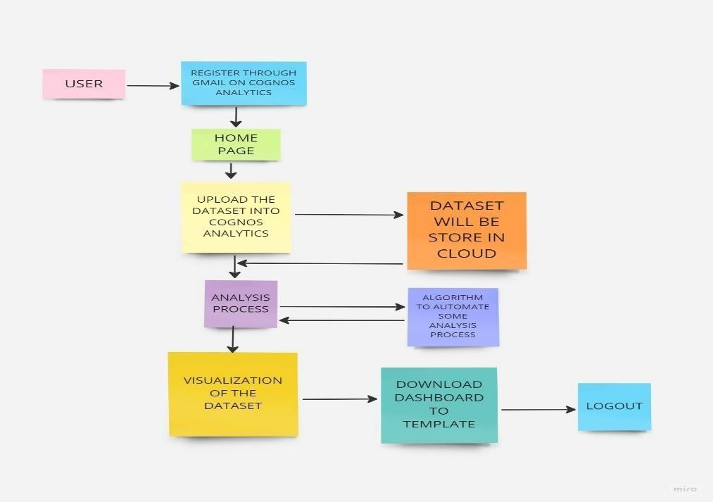
WORKFLOW DIAGRAM

Slide 9
SYSTEM SPECIFICATION
HARDWARE USED:
Processor – Intel Core i5
RAM - 16 GB
Hard Disk -256 GB
SOFTWARE USED:
Language - Python, HTML, CSS and Javascript
Framework - Flask
Package Manager & Build Tool - PIP
Database - IBM_DB2
Service - SendGridAPI(Email)

Slide 10
MODULES
1. Authentication
2. Home
3. About
4. Dash Board
5. Story
6. Report
7. Contact

Slide 11
MODULE DESCRIPTION
1. Authentication: Users can create a new user account or log in to an existing account. It typically requires users to provide a username or email address and a password for authentication purposes. Once authenticated, users can access their personalized content or services on the website.
2. Home: Users will know about the website using the home page. It contains other navigation pages like About, Dashboard, Story, Report and Contact pages. It acts like a starting page of the website.
3. About: About page presents about the team involved in this project and services provided by the website.

Slide 12
MODULE DESCRIPTION
4. Dashboard: A dashboard page presents data in a visually appealing and easily consumable format, allowing users to quickly grasp trends, patterns, and performance indicators.
5. Story: A story page contains sequential and logical flow of information like charts, graphs, images, and formatted text to create a storytelling experience around their data.
6. Report: A report page contains a structured and formatted document that presents data analysis and information in a structured manner.

Slide 13
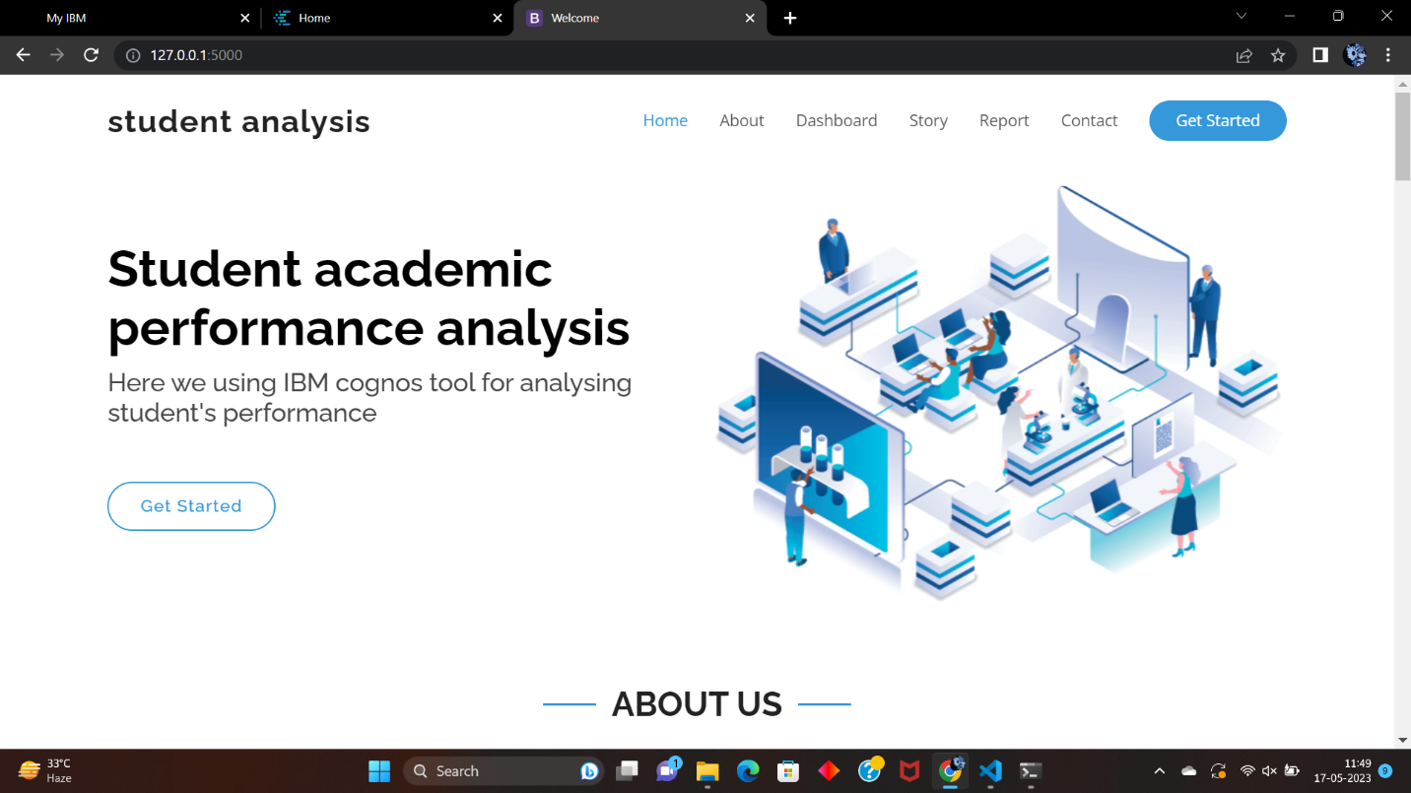
RESULT AND DISCUSSION

Slide 14
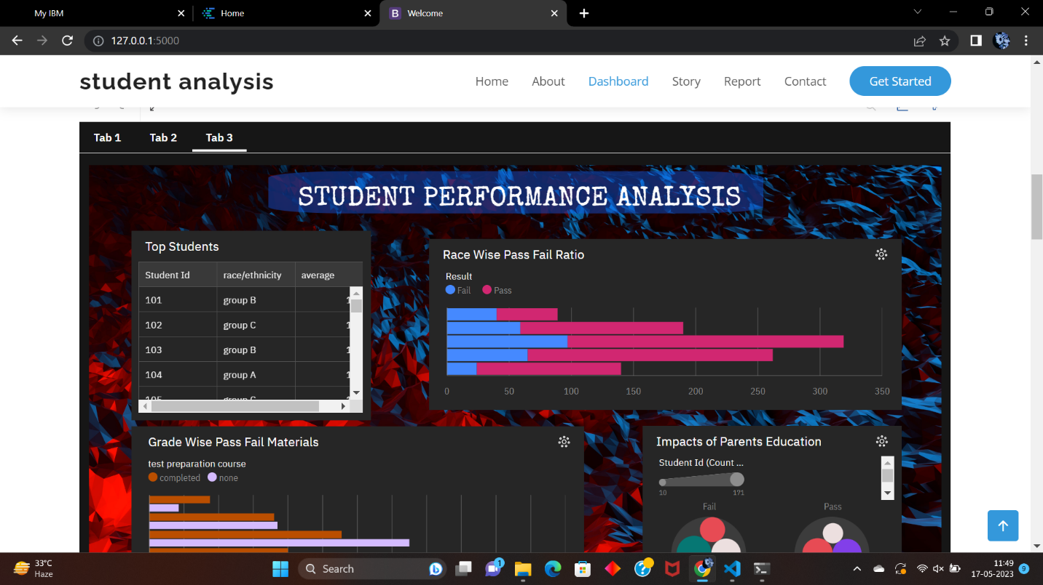
RESULT AND DISCUSSION

Slide 15
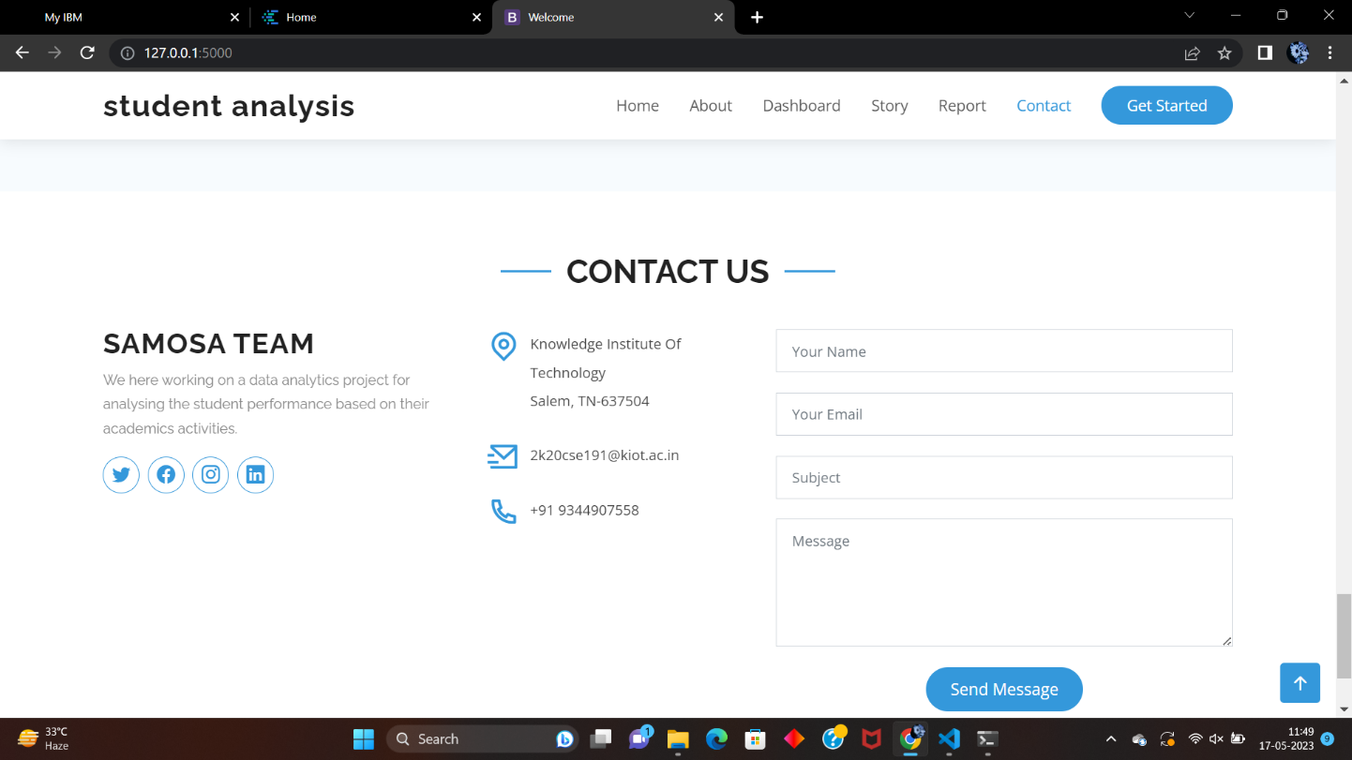
RESULT AND DISCUSSION

Slide 16
CONCLUSION
In conclusion, the "Student Performance Analysis and Improvement Recommendations" project is a data-driven approach to improving academic performance that uses IBM Cognos to collect and analyze data from various sources, including grades, test scores attendance records, and surveys.
The project provides tailored instruction and intervention recommendations to improve student performance by identifying areas or strength and weakness and factors contributing to success or challenges.
The expected outcomes include insights into student performance, identification of areas for improvement, and recommendations for enhancing academic performance.

Slide 17
FUTURE ENHANCEMENTS
Predictive Analytics: Identifying early indicators of academic challenges or success to provide proactive support.
Emotional Intelligence Monitoring: Assessing emotional states, stress levels, and engagement during learning activities to optimize motivation and engagement.
Integration of Multiple Data Sources: Combining diverse data sets, such as academic records, test scores, attendance, and extracurricular activities, for a comprehensive understanding of student progress.
These enhancements leverage advanced algorithms, big data, and emerging technologies to provide more accurate and insightful assessments of student performance.

Slide 18
REFERENCES
[1]. Academic Performance Analysis [Apr 2021]
Mr. M. Thirunavukkarasu, B.J.S.S Sriram, Javvaji Chandrasekhar Reddy
[2]. Student Performance Analysis System [04 Apr 2021]
Somya Mishra, Mrunal Lokare, Aniket Patil, Prof. Chandrashekhar Badgujar
[3]. Student Performance Analysis System using Data Mining [24
Apr 2020]
Disha Kalambe, Anita Labade, Surabhi Khedekar, Komal Mahajan
[4]. Students’ Performance Analysis Using Machine Learning
Algorithms [29 June 2022]
Rosemary Vargheese, AdlenePeraira , Aswathy Ashok and Bassant Johnson

Slide 19
REFERENCES
[5]. Student Performance Analysis System [Jan 2021]
Chew Li Sa, DayangHananibt. Abang Ibrahim, Emmy Dahliana Hossain, Mohammad bin Hossin
[6]. Students Performance Analysis System [06 June 2020]
Vinay Devabhaktuni, Kancharla Sharath Reddy, V. Shiva Teja, G. Kavitha Reddy
[7]. Students Performance Analysis System Using Cumulative Predictor Algorithm [22 May 2022]
Mr. K. Praveen Kumar, K. Sai Pranav, D Gowtham, S. Abhishek
[8]. Student Performance Analysis System [Sep 2020]
Devita Durge, Nikhil Bagul, RushikeshGadge, Siddhesh Bhavsar

Slide 20
THANK YOU!

