Slide 1
HDRISK HARD DRIVE FAILURE DETECTION
Venkatakrishnan
CH.EN.U4AIE20078

Slide 2
OVERVIEW
Cloud computing allows users to access and use these resources on demand, without having to purchase, install, and maintain the underlying hardware and software themselves.
Hardware failure, on the other hand, refers to the inability of a hardware component, such as a disk drive or a motherboard, to function properly due to a malfunction or a physical defect.
In a cloud computing environment, hardware failure can impact the availability and performance of the resources being provided by the cloud provider.
Hard disk failures in large scale data centers can be catastrophic, leading to the potential loss of sensitive and important data. To mitigate the impact of these failures, companies are seeking ways to detect and prevent them.

Slide 3
PROBLEM STATEMENT
The problem that this project aims to address is the potential loss of sensitive and important data due to hard disk failures in large scale data centers. The project proposes to use both supervised and unsupervised learning techniques and detect potential failures. The goal of the project is to compare the performance of these different techniques and determine which are most effective at detecting hard disk failures, in order to mitigate the impact of these failures and protect customer data.

Slide 4
OBJECTIVE
To use machine learning techniques to analyze the S.M.A.R.T attributes of hard disks and identify patterns or indicators of potential failures.
To compare the performance of different machine learning techniques, including XGBoost, Random Forest Classifier, K-means clustering, and Isolation Forest, in detecting hard disk failures.
To develop a model or method that is effective at detecting hard disk failures in a timely manner, in order to mitigate the impact of these failures and protect customer data.
To evaluate the effectiveness of the model or method developed in detecting hard disk failures and its potential for use in real-world data centers.

Slide 5
INTRODUCTION
Hard drive failures in large scale data centers can have catastrophic consequences, leading to the potential loss of sensitive and important data.
Hard drive failures can be caused by a variety of factors, including physical damage to the drive, wear and tear on the drive's components, software or firmware issues, or environmental factors such as temperature or humidity.
There are several approaches to detecting hard drive failures, including the use of machine learning techniques, such as supervised and unsupervised learning algorithms. These algorithms can analyze the S.M.A.R.T (Self-Monitoring, Analysis, and Reporting Technology) attributes of hard drives, which are metrics that provide information about the health and performance of the drive.
The goal of hard drive failure detection is to identify potential failures early on, so that steps can be taken to prevent data loss and minimize the impact of the failure on the operation of the data center.

Slide 6
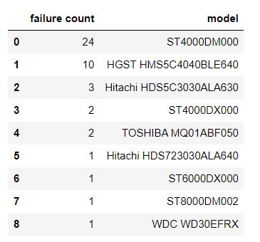
CLEANING DATA

Slide 7
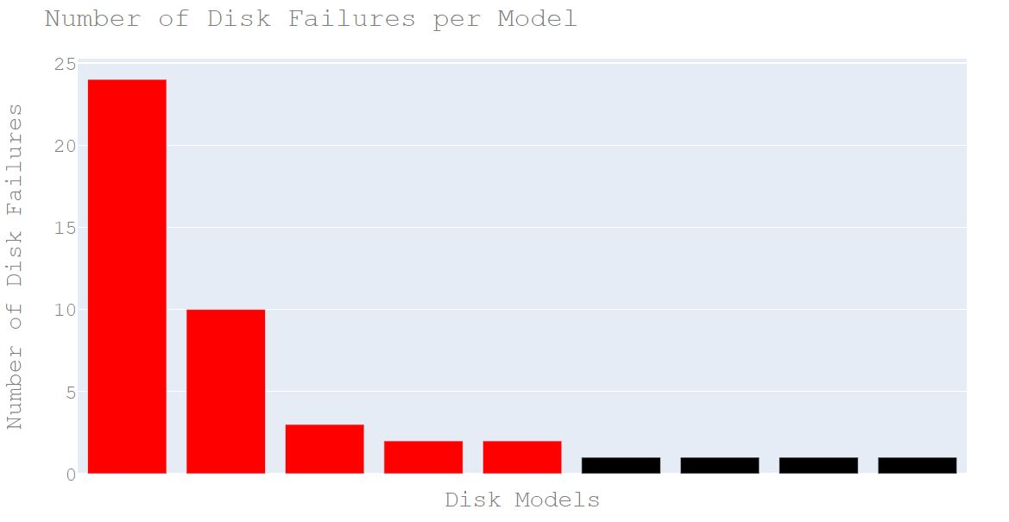

Slide 8
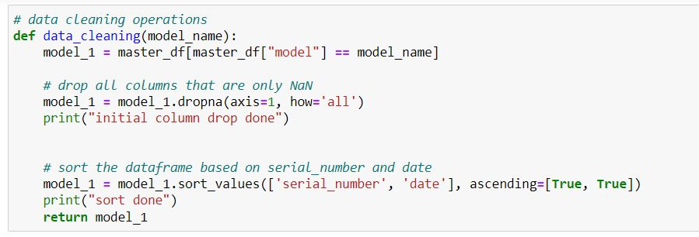
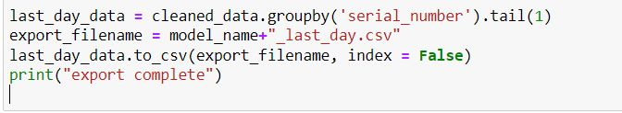
SUPERVISED LEARINNG

Slide 9
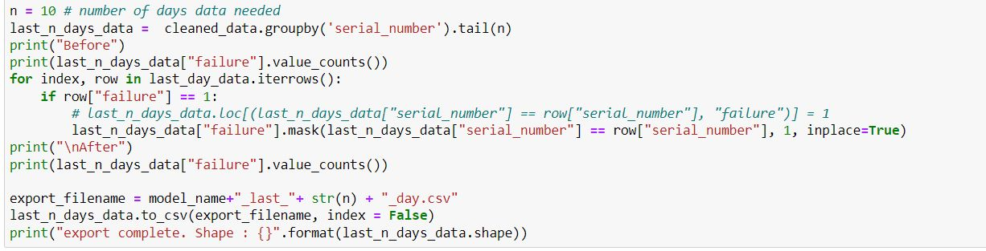

Slide 10
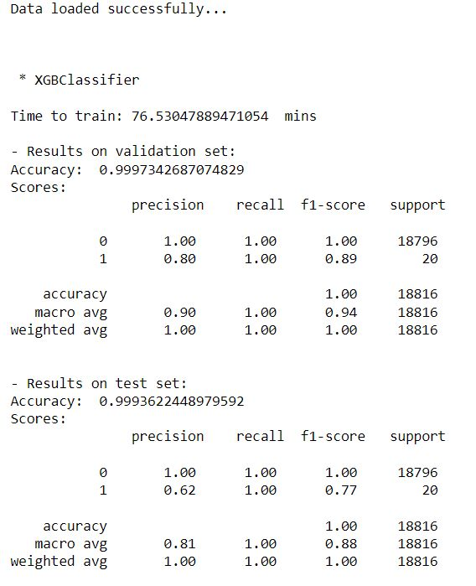
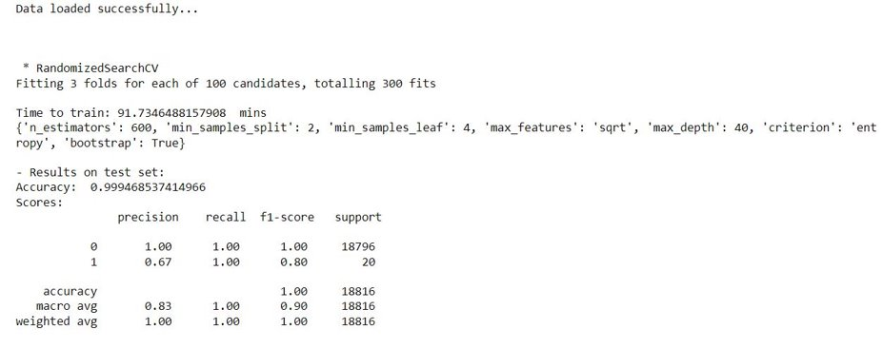
OUTPUT:
Random forest
XGBoost

Slide 11
UNSUPERVISED LEARNING

Slide 12
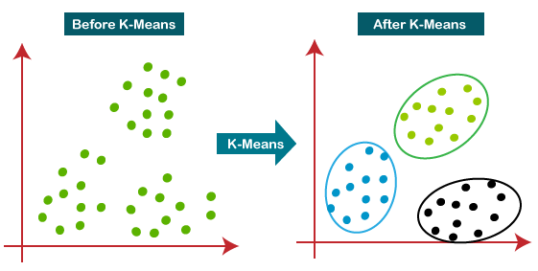
K-means Clustering Algorithm

Slide 13
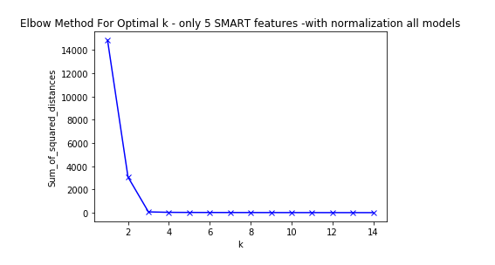
Finding optimal K

Slide 14
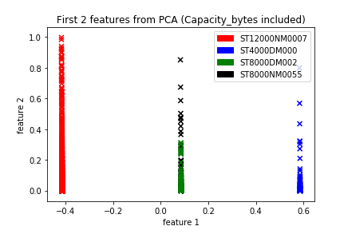
Final Classification

Slide 15
THANK YOU

