Slide 1
Placeholder holding custom values here!

Slide 2
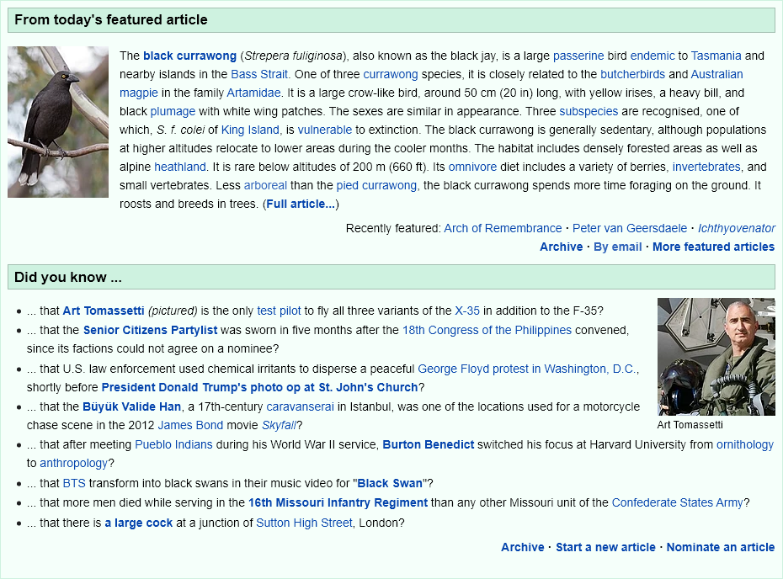
Notes:
This slide holds the image captured from wikipedia through puppeteer!

Slide 3
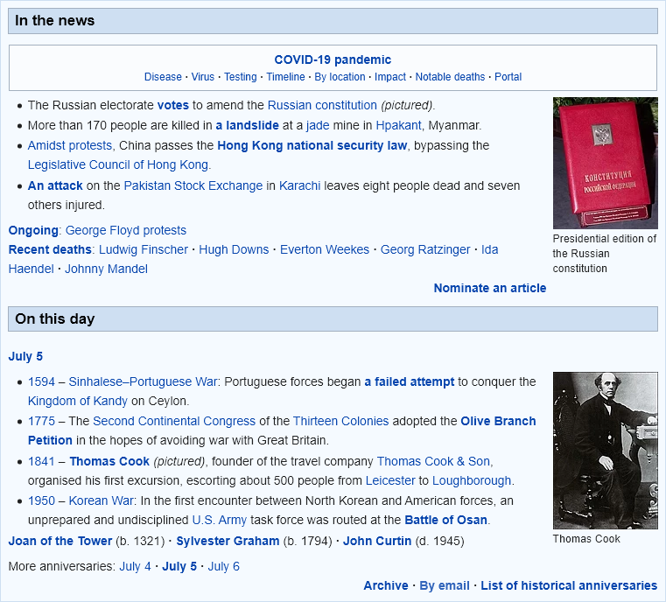
Notes:
This slide holds the image captured from wikipedia through puppeteer!

Slide 4
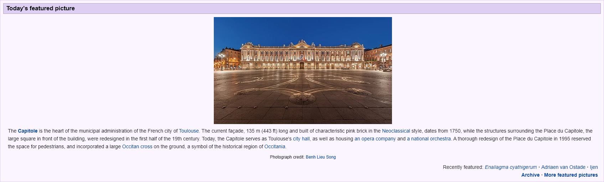
Notes:
This slide holds the image captured from wikipedia through puppeteer!

Slide 5
Thank you!

