Slide 1

Name : M.VENKATAKRISHNAN
NM ID:au412721205056
PROJECT TITLE: COLOR DETECTION SYSTEMS USING AI

Slide 2
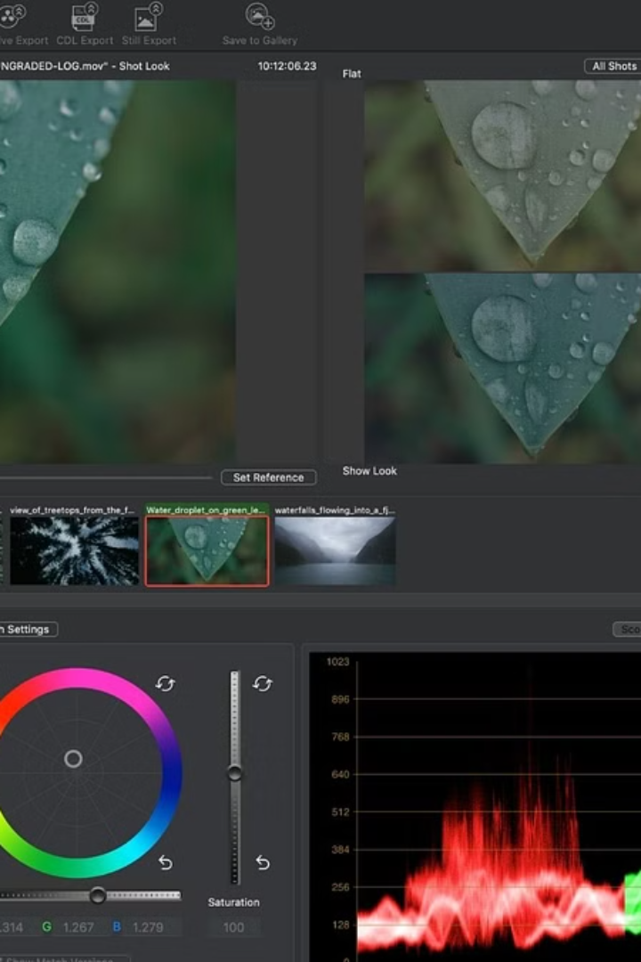
Color Detection Systems Using AI
A color detection system using AI technology is a powerful tool that can identify and differentiate colors with high accuracy and speed. It can be used in various industries including manufacturing, healthcare, and automotive for quality control, diagnosis, and safety enhancement.

Slide 3

Agenda
1
Introduction
Overview of color detection systems and their significance.
2
Technology
Insight into the AI technology used in color detection systems.
3
Applications
Exploring the diverse range of industries benefiting from these systems.

Slide 4

Problem Statement
1
Lack of Accuracy
2
Speed Limitations
Challenges with precise color identification in various environments.
The need for faster color recognition processes to meet industry demands.
3
Adaptability
Issues related to system adaptability to different lighting conditions.

Slide 5
Project Overview
Scope
Timeline
Stakeholders
An outline of the range of colors and environments addressed.
Expected timeframes from development to implementation.
Identification of key individuals and organizations involved.

Slide 6



Who are the End Users?
Manufacturing
Healthcare
Automotive
Usage in quality control & product validation.
Diagnostic tools for identifying health conditions.
Enhancing safety systems in vehicles.

Slide 7




Solution and Its Value Proposition
Precision
Highly accurate color recognition across environments.
Efficiency
Rapid color identification improving operational speed.
Versatility
Adaptability to varying lighting conditions.

Slide 8
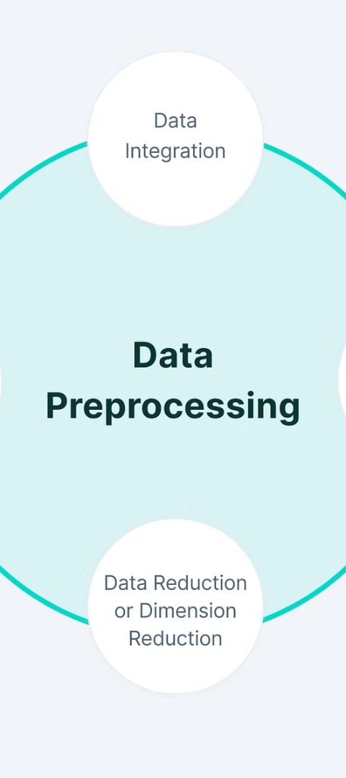
Data Collection and Preprocessing
Data Sources
Cleansing
Identifying sources for comprehensive color data collection.
Process for refining and enhancing collected color data.
Normalization
Standardizing data for AI model training and recognition.

Slide 9
Wow in Your Solution
Real-time Color Recognition
Enhanced Quality Control
Seamless Integration
Efficient Diagnosis
Reduced Error Margin
Adaptable to Complex Environments

Slide 10
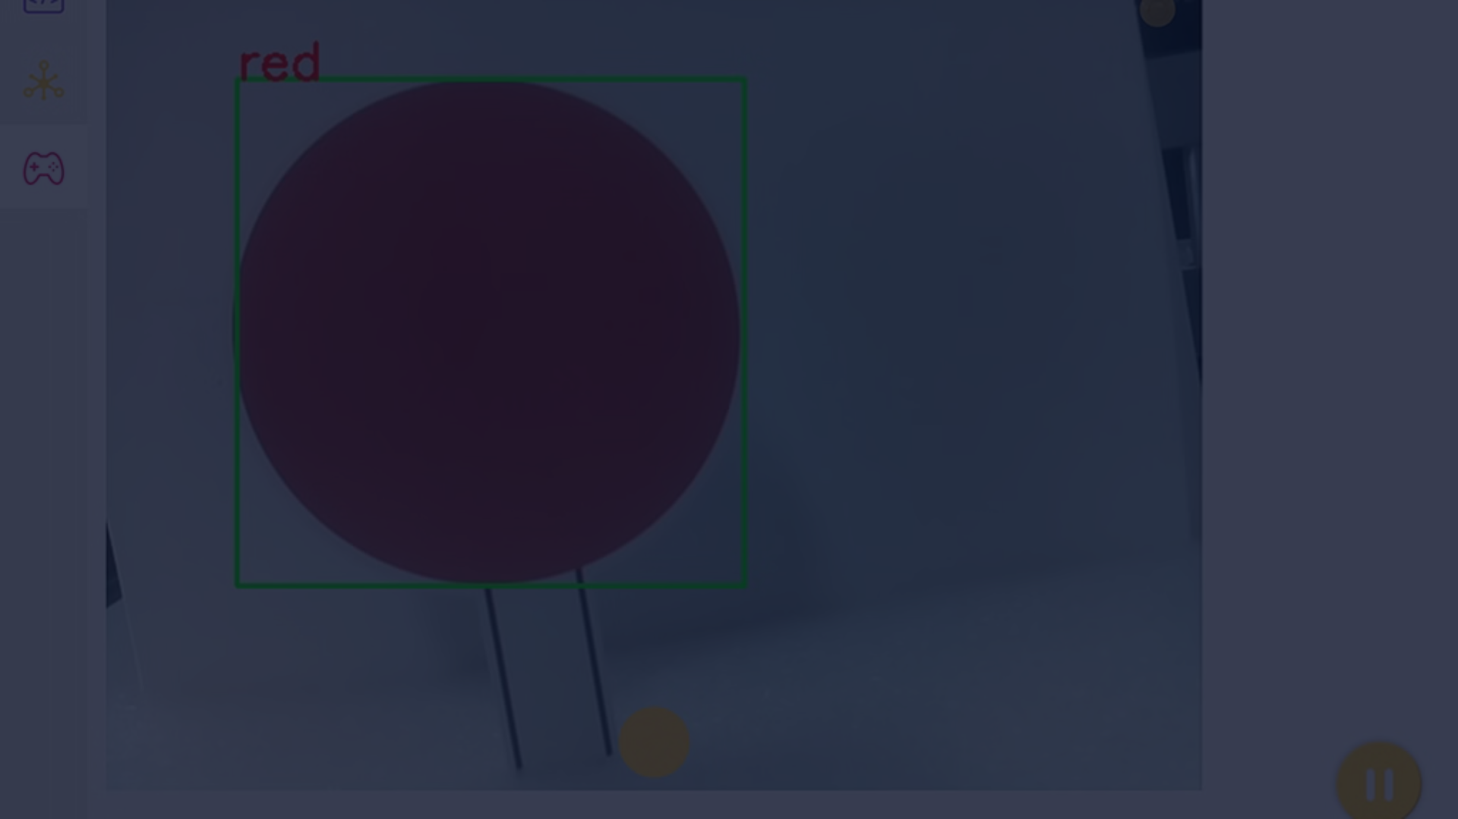
Conclusion
1
Future Development
2
Impact on Industries
3
Technological Progress
Potential advancements and further applications of AI color systems.
The profound transformation of various sectors through AI color detection.
Contributing to the evolution of cutting-edge AI-centric solutions.

