Slide 1
Pulse❤️🩺Check a machine learning application for heart disease risk assessment
-By
Venkatalakshmi Kottapalli

Slide 2
Agenda
Introduction
Problem statement
Solution
Methodology
Data acquisition
EDA findings
Data preprocessing & Feature engineering
Model building
Model evaluation
API
User interface design
Demo
Future enhancements & Recommendations
Conclusion

Slide 3

Introduction
The Heart disease is one of the leading causes of death globally. Early identification of individuals at risk, particularly for heart attacks, can significantly improve survival rates by enabling timely interventions and preventive care. With the advancements in machine learning, predictive models can analyze health data and accurately predict heart disease risk, helping medical professionals identify and treat high-risk patients more effectively.

Slide 4
Problem statement
I am a Data Scientist collaborating with a healthcare organization that is focused on improving early detection and reducing the risk of heart disease. The organization aims to identify individuals at high risk of developing heart disease before they experience severe health complications such as heart attacks, strokes, or other cardiovascular events.
My role involves developing predictive models to assess heart disease risk in patients and provide actionable insights, enabling timely interventions and personalized care plans.

Slide 5

Solution
Pulse Check is a predictive tool designed to assess heart disease risk based on key health indicators like blood pressure, cholesterol, and lifestyle habits. By inputting personal details such as age and health status, users receive real-time predictions of their heart disease risk. This tool aims to support early detection and informed decision-making for both individuals and healthcare professionals.

Slide 6
Methodology
Data Acquisition
Data Preprocessing
Feature Engineering
Model Building
Model Evaluation
API
User Interface
Deployment

Slide 7
Data Acquisition
The dataset used for this project is Heart Disease Health Indicators Dataset (kaggle.com) . It was acquired in CSV format.
HeartDiseaseorAttack | HighBP | HighChol | CholCheck | BMI | Smoker | Stroke | Diabetes | PhysActivity | Fruits | Veggies | HvyAlcoholConsump | AnyHealthcare | NoDocbcCost | GenHlth | MentHlth | PhysHlth | DiffWalk | Sex | Age | Education | Income
0 | 1 | 1 | 1 | 40 | 1 | 0 | 0 | 0 | 0 | 1 | 0 | 1 | 0 | 5 | 18 | 15 | 1 | 0 | 9 | 4 | 3
0 | 0 | 0 | 0 | 25 | 1 | 0 | 0 | 1 | 0 | 0 | 0 | 0 | 1 | 3 | 0 | 0 | 0 | 0 | 7 | 6 | 1
0 | 1 | 1 | 1 | 28 | 0 | 0 | 0 | 0 | 1 | 0 | 0 | 1 | 1 | 5 | 30 | 30 | 1 | 0 | 9 | 4 | 8
0 | 1 | 0 | 1 | 27 | 0 | 0 | 0 | 1 | 1 | 1 | 0 | 1 | 0 | 2 | 0 | 0 | 0 | 0 | 11 | 3 | 6
0 | 1 | 1 | 1 | 24 | 0 | 0 | 0 | 1 | 1 | 1 | 0 | 1 | 0 | 2 | 3 | 0 | 0 | 0 | 11 | 5 | 4
0 | 1 | 1 | 1 | 25 | 1 | 0 | 0 | 1 | 1 | 1 | 0 | 1 | 0 | 2 | 0 | 2 | 0 | 1 | 10 | 6 | 8
0 | 1 | 0 | 1 | 30 | 1 | 0 | 0 | 0 | 0 | 0 | 0 | 1 | 0 | 3 | 0 | 14 | 0 | 0 | 9 | 6 | 7
0 | 1 | 1 | 1 | 25 | 1 | 0 | 0 | 1 | 0 | 1 | 0 | 1 | 0 | 3 | 0 | 0 | 1 | 0 | 11 | 4 | 4
1 | 1 | 1 | 1 | 30 | 1 | 0 | 2 | 0 | 1 | 1 | 0 | 1 | 0 | 5 | 30 | 30 | 1 | 0 | 9 | 5 | 1

Slide 8
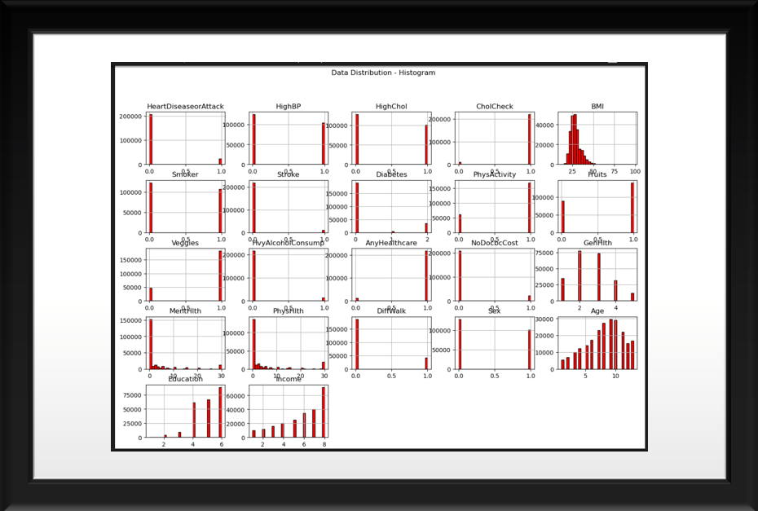
EDA insights
From the EDA, significant class imbalance was observed in the dataset. Additionally, the analysis revealed that individuals with high BMI, older age, high blood pressure, high cholesterol levels, smoking habits, diabetes, and poor general health status are more likely to have heart disease.

Slide 9
Data preprocessing & Feature engineering
Data Cleaning: Removed less important columns like 'NoDocbcCost,' 'HvyAlcoholConsump,' and 'CholCheck' from dataset based on feature importance from the Random Forest model and EDA insights.
Feature Creation: Introduced two new features 'Red Flag' (combining HighBP and HighChol) and combined 'PreDiabetes' and 'Diabetes' into a single 'Diabetes' feature. However, these features did not improve model performance and instead slightly reduced its performance. Therefore, it seems that the original features were more effective for the model than the newly engineered ones.
Encoding: Applied one-hot encoding for categorical variables and ordinal encoding for ordered data.
Scaling: Standard scaling was applied to ensure consistent data range across features.
Class Balancing: Used Synthetic Minority Over-Sampling Technique (SMOTE) to address class imbalance in the dataset.

Slide 10
Models EMPLOYED
Naive Bayes (NB): Acts like a quick triage system, providing fast and interpretable predictions based on individual features like smoking or BMI, ideal for initial screenings.
Logistic Regression (LR): A simplified risk calculator, transparent and effective for estimating heart disease risk based on weighted factors such as age and cholesterol.
Decision Trees (DT): Functions like a decision-making flowchart, providing clear and interpretable rules that model non-linear relationships in both numerical and categorical data.
Random Forest (RF): Acts like a panel of medical experts, capturing complex interactions between features and reducing overfitting by averaging predictions from multiple trees.
Gradient Boosting (GB): Gradient Boosting is like a series of specialists correcting each other’s mistakes. Each model improves on the errors of the previous one, refining the diagnosis.
XGBoost (XGB): XGBoost is like an advanced diagnostic tool optimized for speed and accuracy. It quickly processes large amounts of patient data to make precise risk assessments.
AdaBoost: Like a team of doctors focusing on difficult cases, enhancing weak models by emphasizing previously misclassified instances.
Artificial Neural Networks (ANN): Functions like an advanced brain scan, detecting intricate, non-linear patterns in health data that traditional models may miss.
Convolutional Neural Networks (CNN) & Recurrent Neural Networks (RNN): Tested unconventional approaches to uncover hidden hierarchical relationships and temporal dependencies in health data.

Slide 11
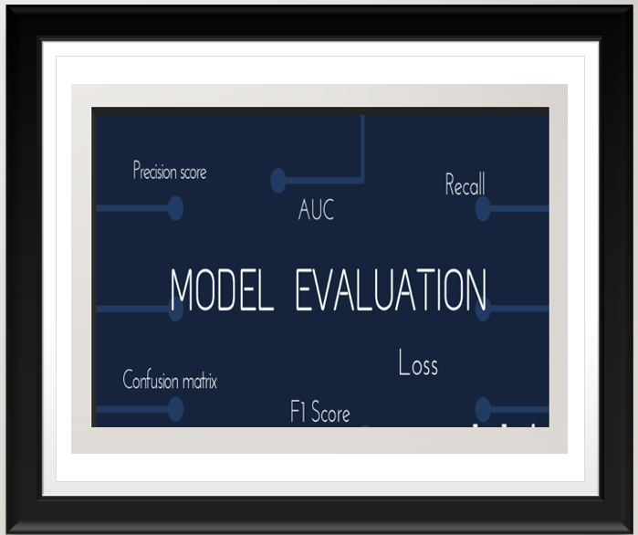
Model Evaluation
Given the class imbalance in heart disease cases, ROU-AUC, precision, recall, and F1 score were prioritized:
Precision: Ensures predictions of heart disease are accurate, minimizing false positives. This is critical to avoid unnecessary alarms in a medical setting, where incorrect predictions could lead to unnecessary treatment or anxiety.
Recall: Focuses on detecting actual heart disease cases, ensuring true positives are captured. This is vital to prevent missing diagnoses, which could lead to severe health complications.
F1 Score: Balances precision and recall, offering a comprehensive view of model performance and ensuring that both false positives and false negatives are minimized.
ROC-AUC: Measures the model’s ability to distinguish between classes, providing an overall performance indicator that is useful for comparing different models.

Slide 12
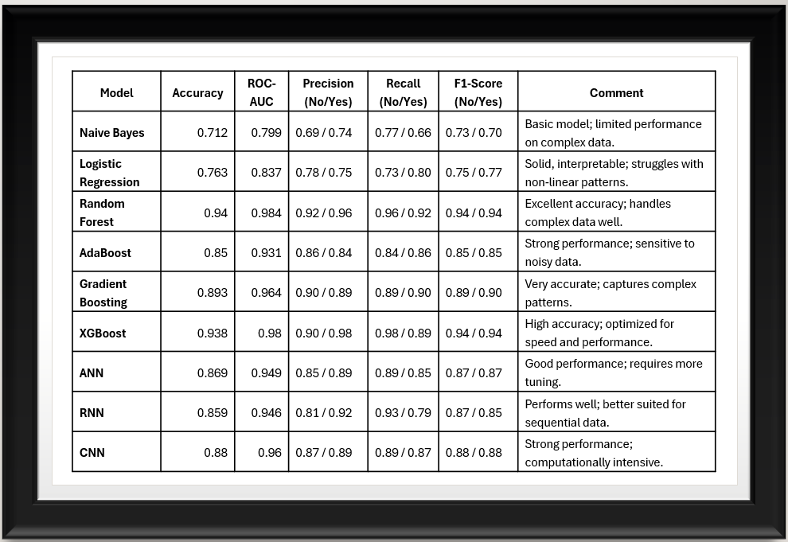
moDel results

Slide 13
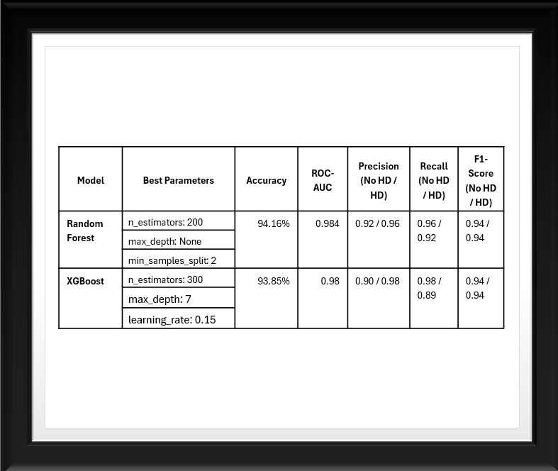
Hyper parameter tuning
Random Forest:
n_estimators: Controls the number of trees. More trees generally improve performance but increase computation time.
max_depth: Limits tree depth to prevent overfitting and ensure better generalization.
min_samples_split: Sets the minimum samples required for a split, reducing overfitting by avoiding splits based on small samples.
XGBoost:
learning_rate: Controls the contribution of each tree to the final prediction. A lower rate helps prevent overfitting but requires more trees.
n_estimators: Sets the number of boosting rounds. Too few may cause underfitting; too many may cause overfitting.
max_depth: Controls tree complexity. Deeper trees capture more patterns but may overfit, so tuning helps balance performance.

Slide 14
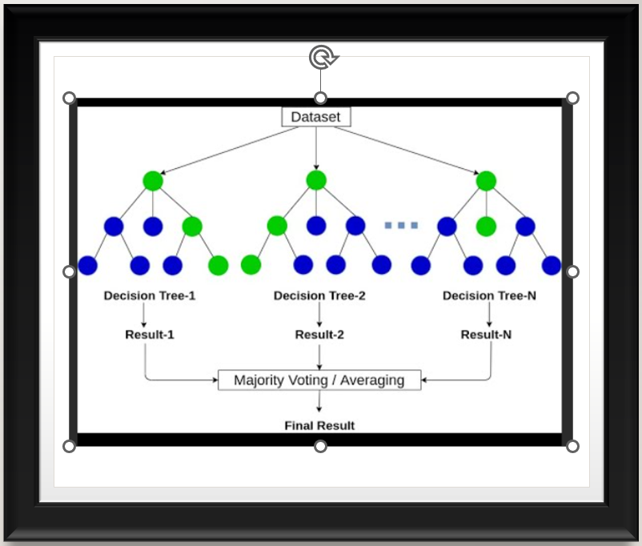
Final Model
The Random Forest model emerged as the final choice due to its robust performance, high accuracy, and interpretability. It effectively captures complex relationships, making it a reliable tool for early heart disease detection.

Slide 15

Api development with flask
An API was developed using Flask to enable seamless communication between the user interface and the backend. This RESTful API allows users to input data, which is then processed by the model to provide real-time predictions. Flask was chosen for its lightweight nature, simplicity, and scalability, ensuring that the API is efficient and easy to integrate into the existing system. The API enhances user experience by providing quick, reliable responses for heart disease predictions, making the model accessible for real-time applications.

Slide 16

User Interface
The user interface, developed with Streamlit and Flask, provides an intuitive and efficient platform for users to interact with the heart disease prediction model. By integrating data input, processing, and output in a seamless workflow, the UI empowers individuals to gain quick insights into their heart disease risk based on their personal health information. Integration with Flask ensures smooth communication between the front-end and the model, allowing for real-time predictions and interactive user experience.
Let’s have a demo

Slide 17

DEployment
The model will be deployed through a user-friendly Streamlit interface, allowing users to input their health information and receive heart disease predictions in real-time. This interactive tool will enable healthcare providers and patients to assess heart disease risk easily, ensuring timely and informed decision-making.

Slide 18

Future Enhancements & Recommendations
Data Enrichment: I would enhance the model by adding diverse data like family history, stress levels, and cholesterol results to improve predictive accuracy.
Marketing and Deployment: I plan to market the model to healthcare organizations and make it accessible to patients via a web platform for early detection and personalized care.
I recommend the client use this model. With an accuracy of 94.16% and a ROC-AUC of 98.44%, it effectively distinguishes between heart disease and no heart disease. The high precision (0.96) minimizes false positives, while the good recall (0.92) ensures most heart disease cases are detected. The balanced F1-score (0.94) demonstrates strong performance in both detection and accuracy, making it suitable for early heart disease detection and intervention.

Slide 19

Conclusion
This project successfully developed a heart disease prediction model using machine learning, with Random Forest achieving the best performance (94.16% accuracy and 0.984 ROC-AUC). The model, enhanced through hyperparameter tuning, shows strong precision and recall, making it effective for early heart disease detection. The user-friendly interface built with Streamlit allows easy access for healthcare providers and patients, offering a reliable tool for timely interventions.

Slide 20

Any questions

Slide 21
THANK YOU
Venkatalakshmi Kottapalli

