Slide 1

Unified Framework for Cyber Threat Prediction, Real-Time Monitoring, and Incident Response Using AI
Presenter: Venkata Naveen Kumar Prabhuleti
Course: MS in Cybersecurity Analytics & Operations University: Pennsylvania State University

Slide 2

Introduction
Modern SOCs face overwhelming volumes of log data and delayed responses.
Manual log triage introduces human error and operational inefficiency.
Real-time classification and response are critical for mitigating threats.
Project proposes an AI-based framework for end-to-end incident automation.

Slide 3
Problem Statement & Objectives
Problem: Delays in identifying and mitigating threats in SIEM logs cause security breaches and require manual analysis from end-to-end.
Objectives:
Build an ML model to classify security incidents by severity.
Automate responses like Alerting and Actions taken.
Develop a live dashboard for real-time threat insights and response tracking.

Slide 4
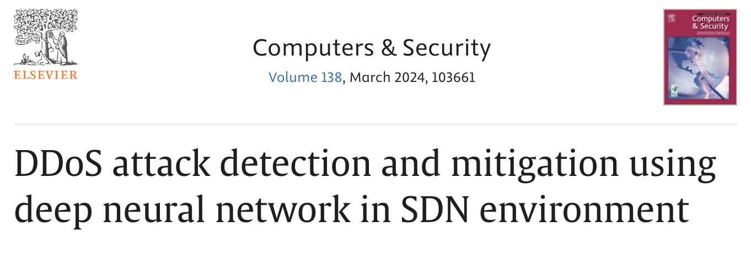
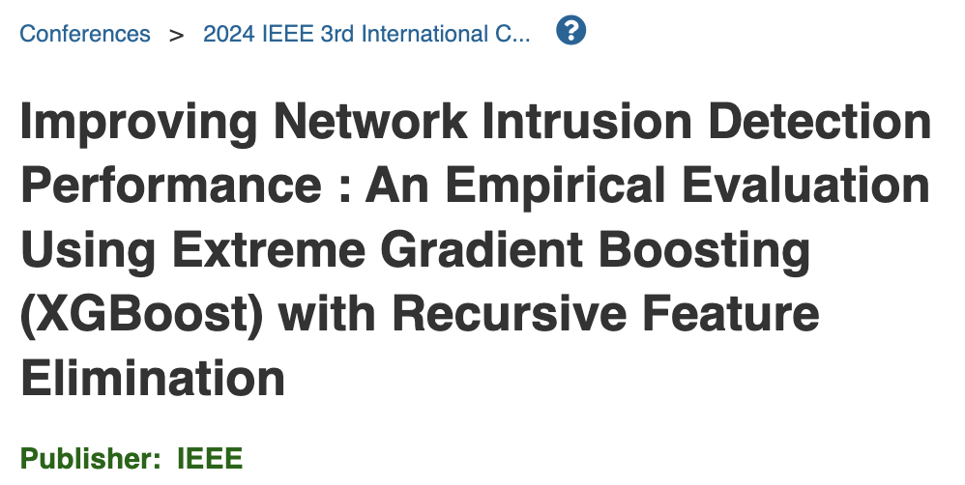
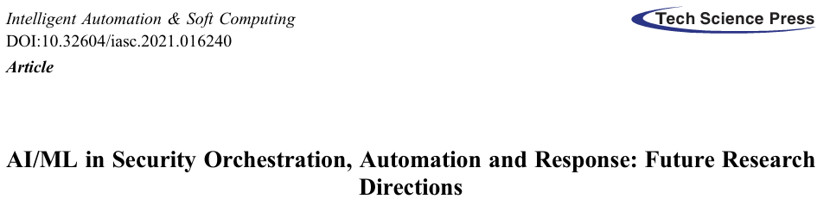
Background: Related Work
Prior efforts focused on ML for security classification, threat detection, and anomaly detection.
Security orchestration platforms explored AI/ML for partial automation.
Deep learning and clustering used for attack detection & mitigation.
Existing research lacked integration of prediction, response, and visualization in a unified pipeline.

Slide 5
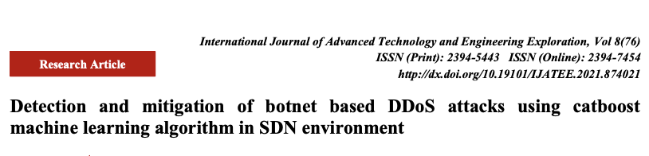
Research Gap
SOAR platforms exist but lack customization and real-time intelligence.
Existing academic work emphasizes either detection or automation—rarely both.
My project fills this gap by combining prediction, response, and visualization.

Slide 6
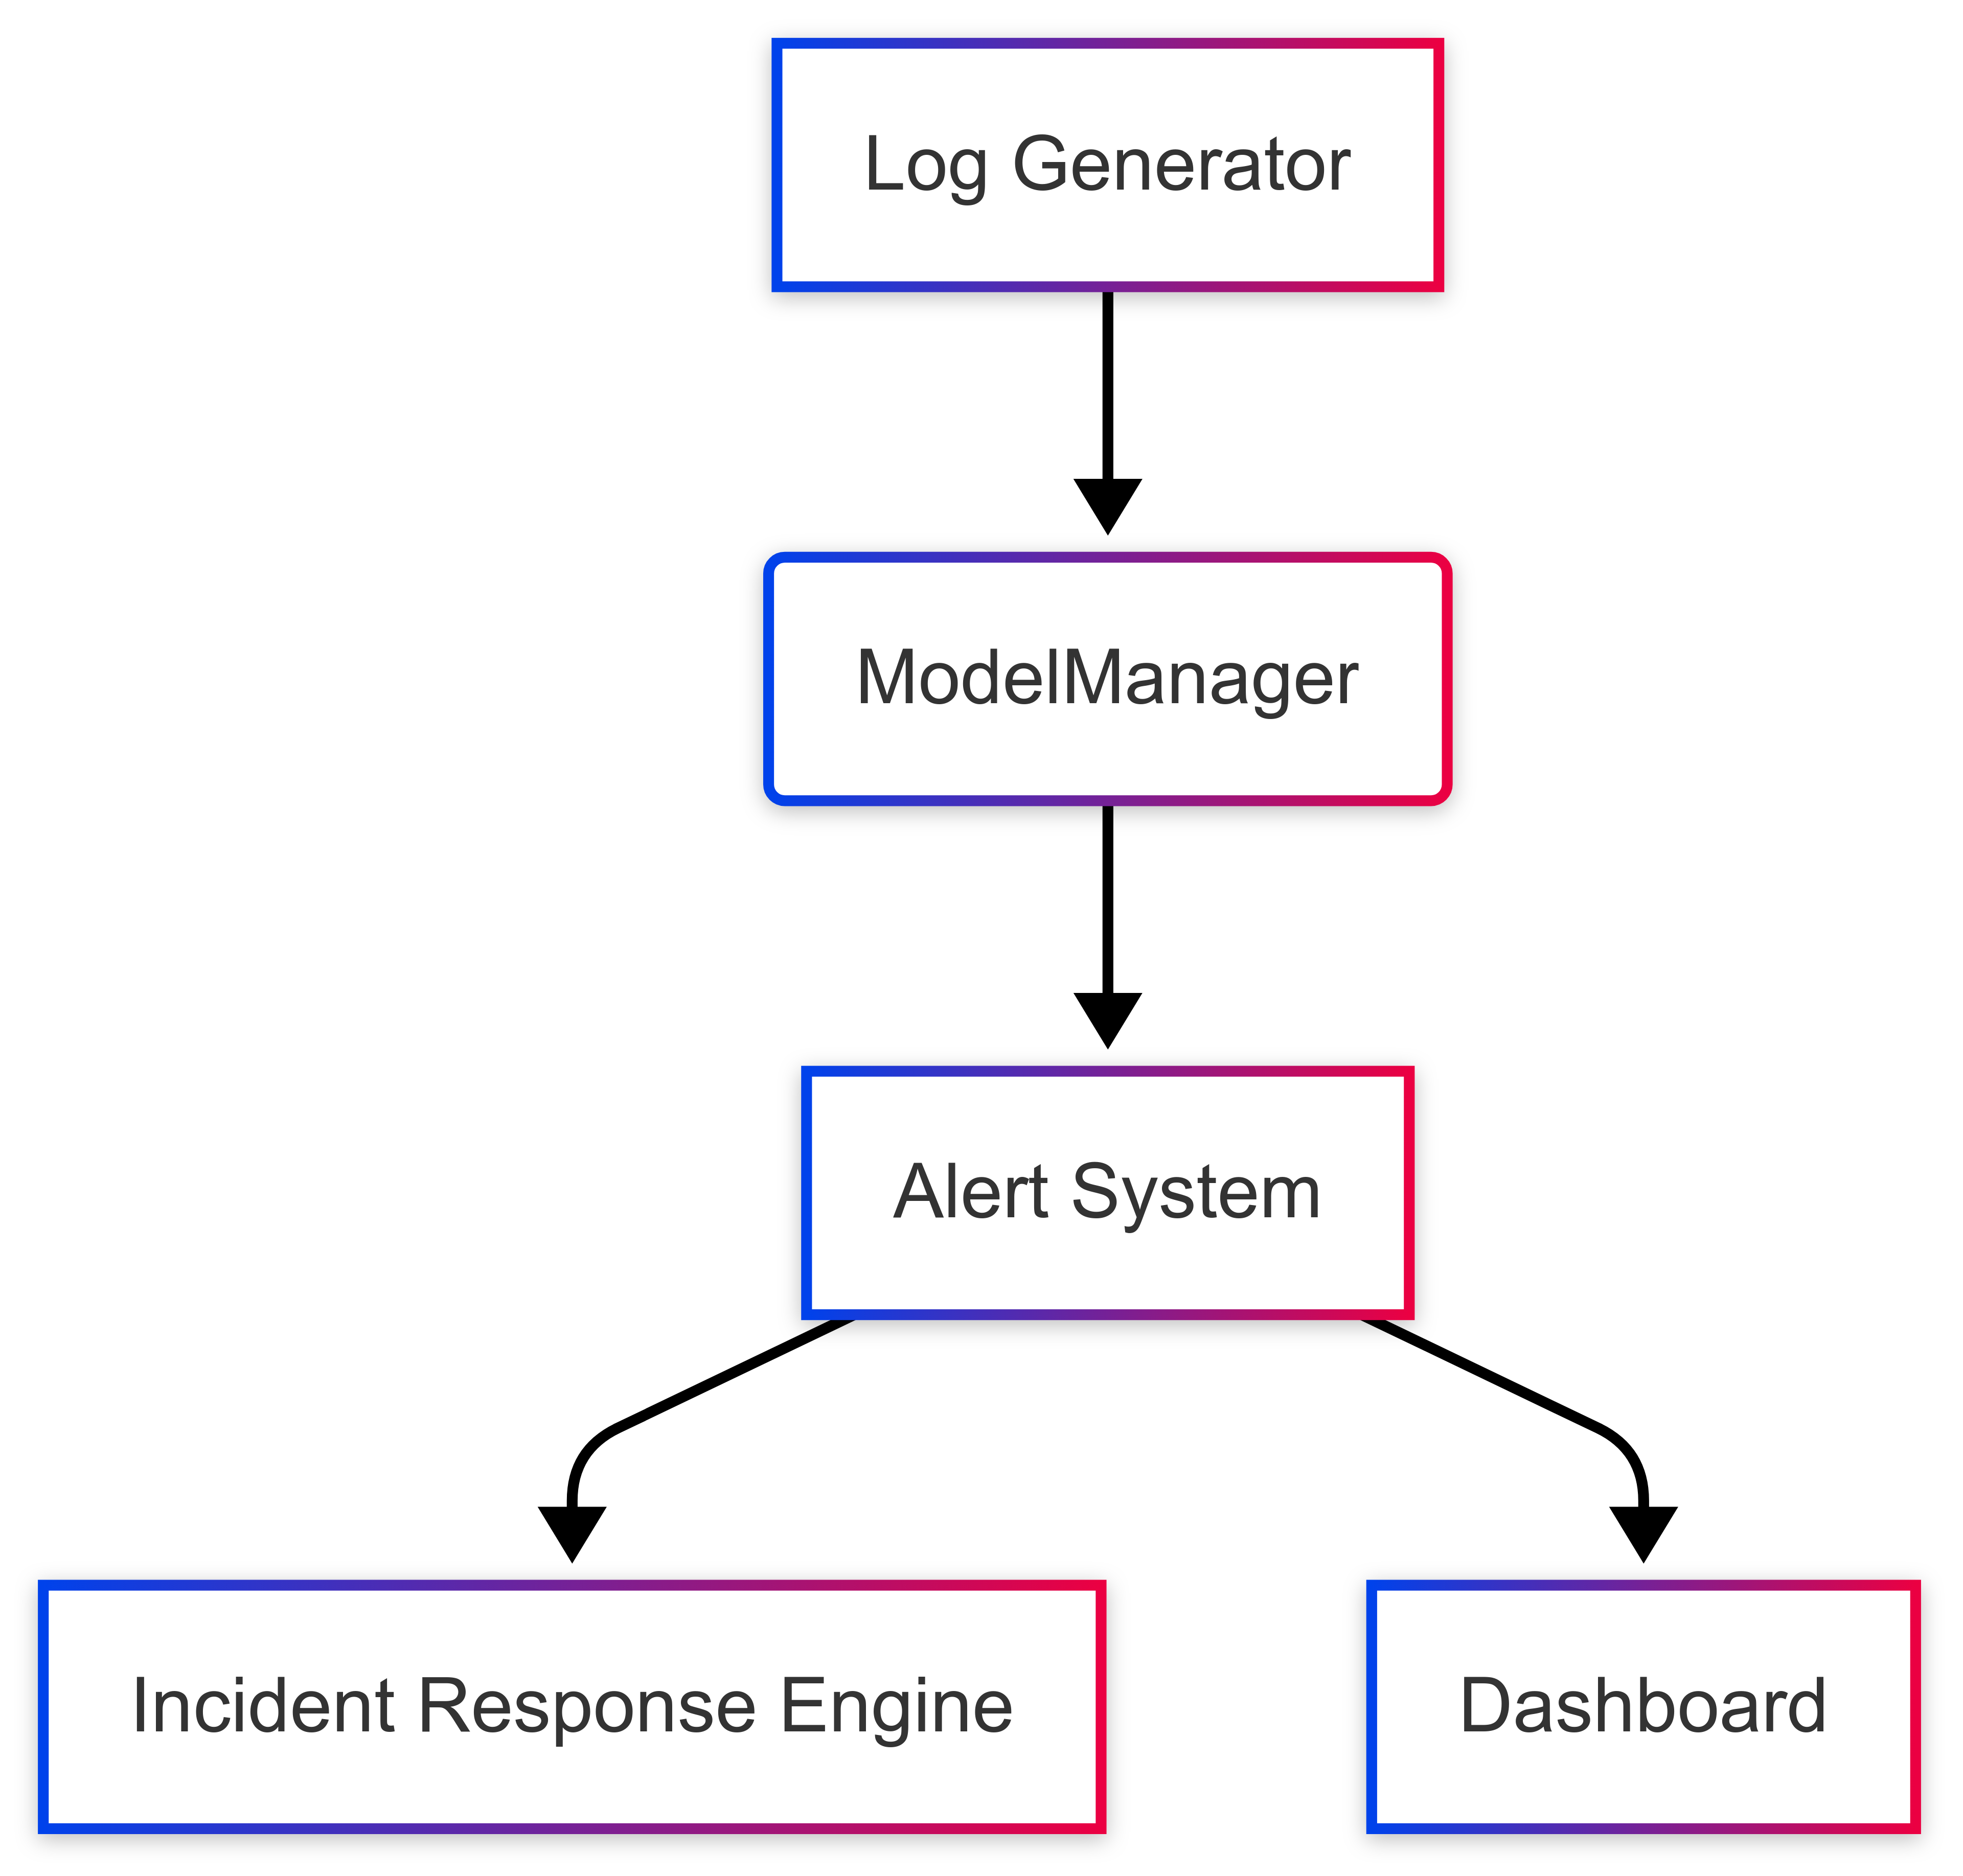
System Architecture
Log ingestion → Model Prediction → Incident Handling → Visualization.
Component integration via REST API and real-time update mechanisms.
Built using Python, Flask, CatBoost, REST API, and HTML/CSS/JavaScript.

Slide 7
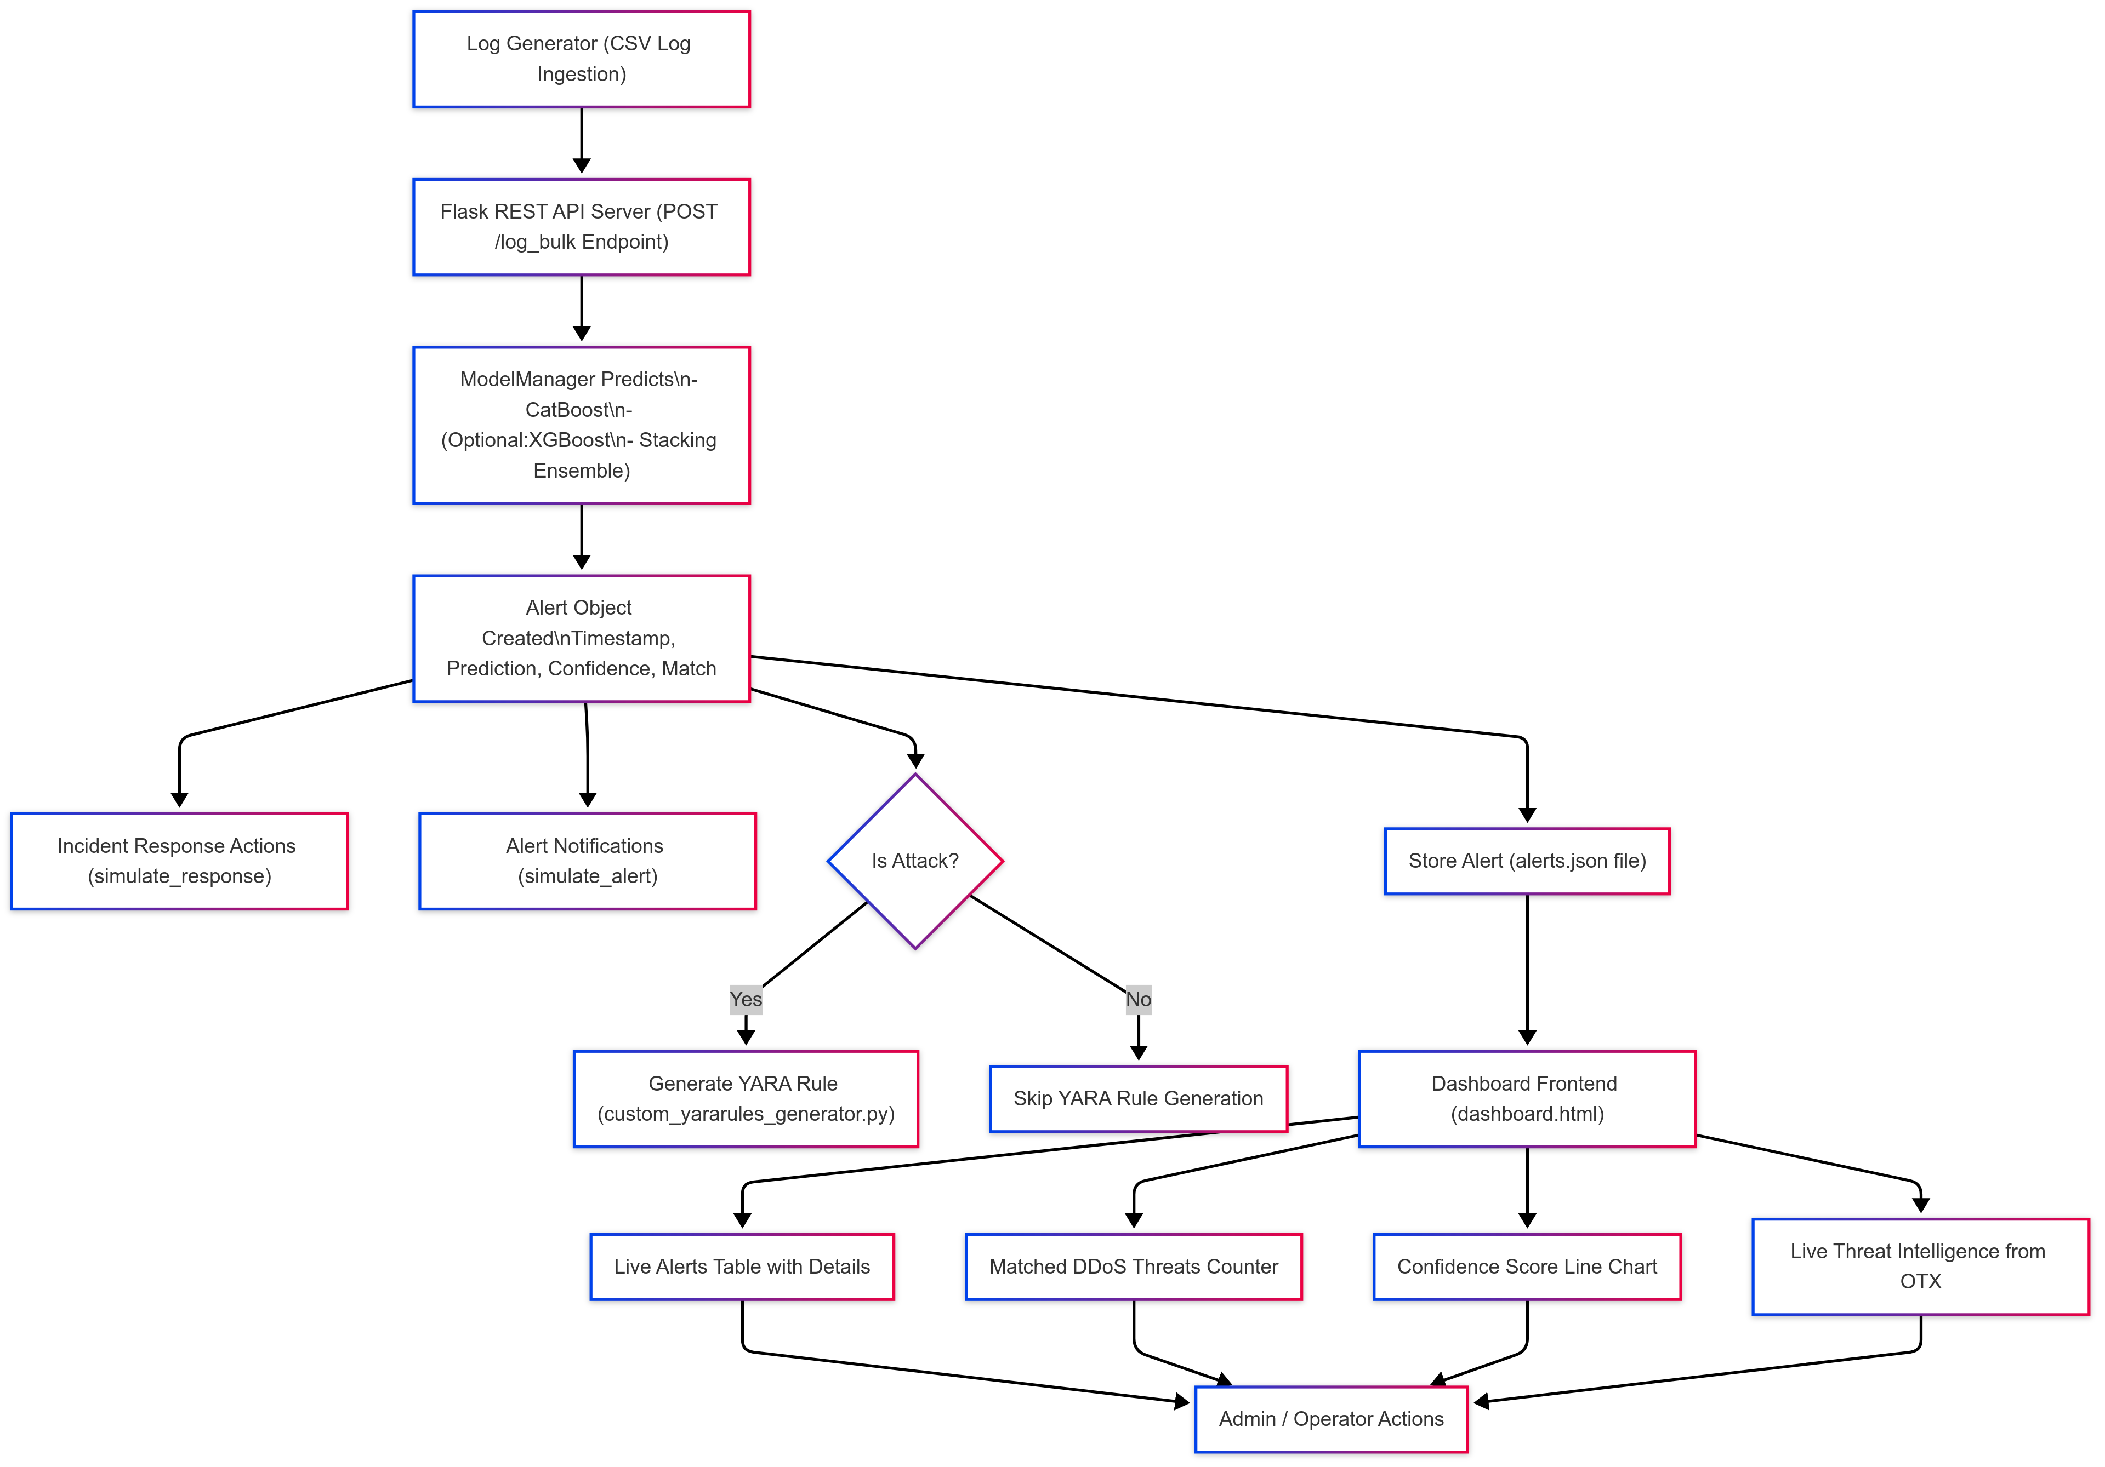
AIRS Architecture
Models trained with ddos_preprocessor(), feature_engineering(), select_top_features(), train_model.py

Slide 8
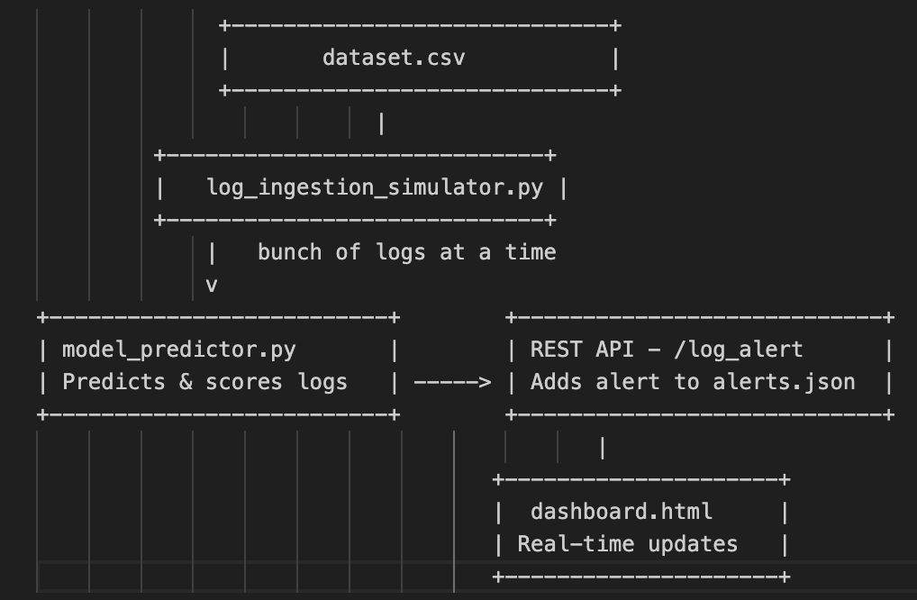
Major Components
Log Generator – Simulates realistic log ingestion.
ModelManager – Applies trained ML models.
Alerting System – Records threat logs & confidence scores.
Response Engine – Blocks IPs or flags malicious actions.
Dashboard – Visualizes alerts and system events.

Slide 9
Dataset & Feature Engineering
CICIDS2017 and CICDDoS2019 datasets (~3.2 GB, 9M+ rows).
Top 16 engineered features selected using statistical and domain-based methods by get_feature_importance() in select_top_features.py
Applied normalization, SMOTE-ENN balancing.

Slide 10
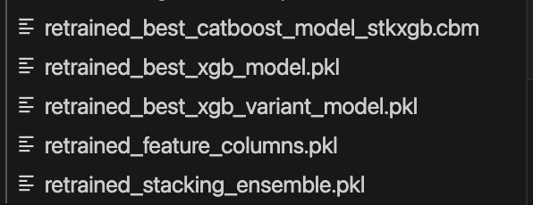

ML Model Design
CatBoost: High accuracy, handles categorical features.
XGBoost Classifier: Known for performance and tree boosting.
XGBoost Variant: Captures edge-case patterns.
Stacking Ensemble: Combines strengths of all above.

Slide 11
Model Performance
Model | Accuracy | Macro F1-Score | Weighted F1-Score
CatBoost | 0.8480 | 0.57 | 0.84
XGBoost | 0.7747 | 0.55 | 0.78
XGBoost Variant | 0.7820 | 0.56 | 0.78
Stacking Ensemble | 0.7743 | 0.55 | 0.78

Slide 12
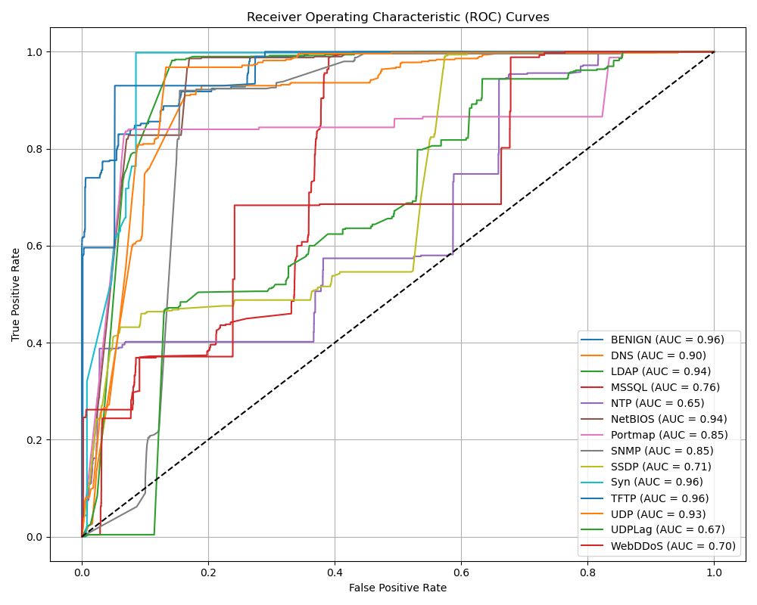
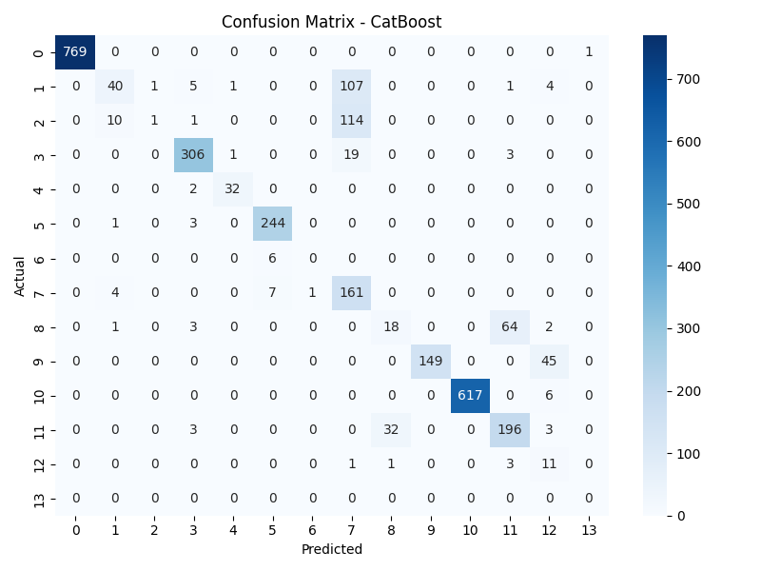
ROC-AUC and Confusion Matrix
ROC-AUC shows high performance in most threat classes (AUC > 0.90 for BENIGN, Syn, UDP, TFTP).
Lower AUC for MSSQL (0.76), UDP-Lag (0.67), and WebDDoS (0.70) indicating classification difficulty.
Confusion matrix highlights accurate detection of BENIGN, SNMP, and TFTP.
Misclassifications observed in DNS, Portmap, and WebDDoS classes.
Useful for tuning model and improving class-wise generalization.

Slide 13
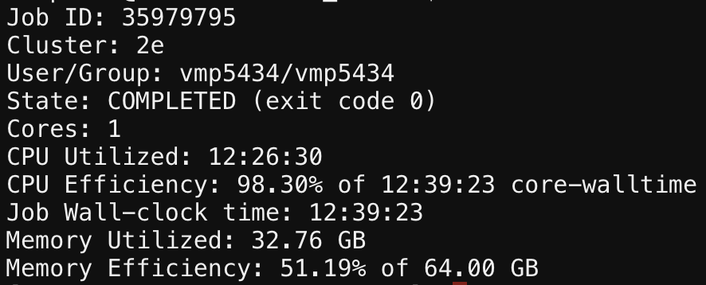
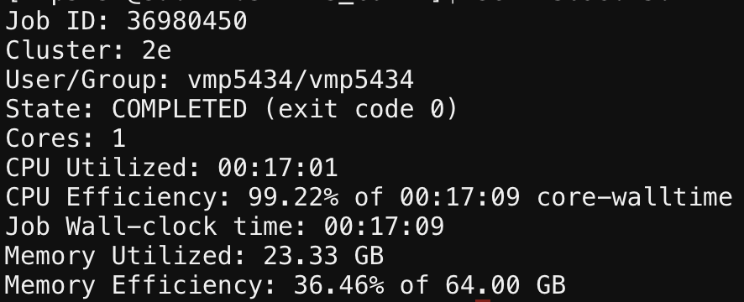
Training -Computing Consumption
Computing Resource – HPC GPU A100 64GB Memory
Computing consumption of Models training with 59 features to four models training
Computing consumption of Models training with 16 features to four models training

Slide 14
Incident Response Automation
Auto-response triggered for DDoS and critical threats.
Actions: IP Blocking, UDP limiting, SYN Investigation.
YARA Rules generated dynamically for DDoS fingerprints.
simulate_alert(): Records alert events with confidence.
simulate_response(): Suggests automated actions per threat.
generate_yara_rule(): Creates YARA rule files for WebDDoS.

Slide 15
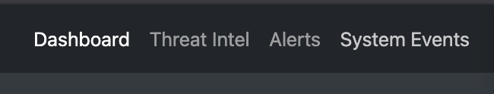

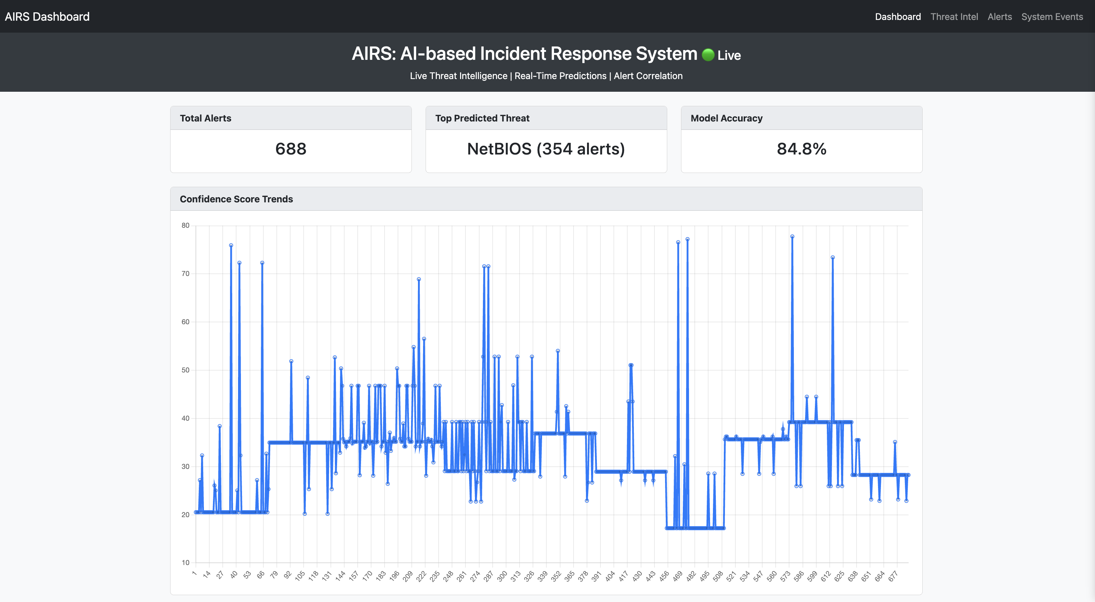
Dashboard and Visualization
Live Alerts View: Classification & threat logs.
System Events Section: Response, alert, and YARA actions.
Threat Intelligence: AlienVault OTX integration.

Slide 16
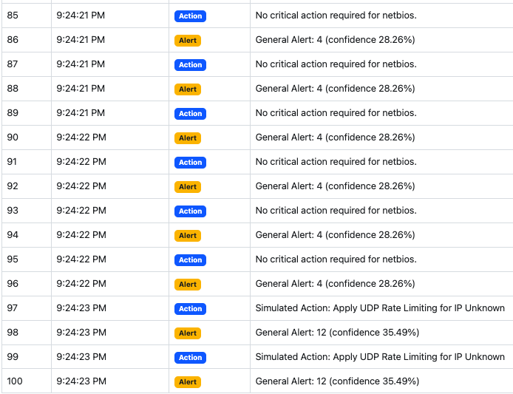
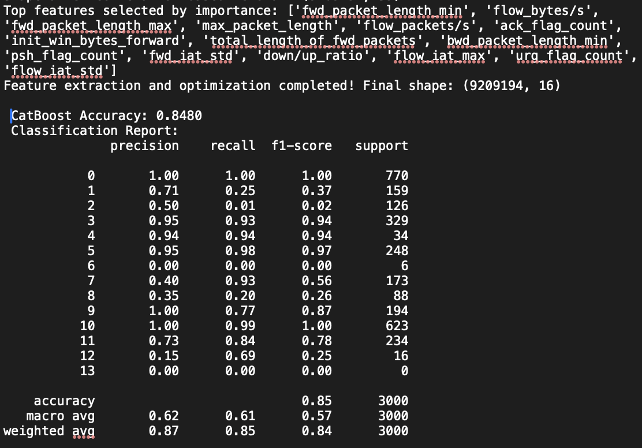
Results & Analysis
Selection of Top features with Classification
values
System Events in the dashboard with alerts and corresponding Actions need to be taken by Security Operations Analysts

Slide 17

Challenges Faced
Long training time due to 3.2 GB dataset.
Missing feature alignment between models.
Training with HPC resources using bash jobs with Scheduler.
Label_Encoder missing while saving Models in .plk format.
Flask API concurrency issues.
Rendering issues on dashboard initially.

Slide 18
Conclusion & Future Work
Successfully built an end-to-end AI-powered incident response system.
Dashboard shows live alerts, system events, and threat intel.
Future: integrate firewall APIs, train on newer datasets, add explainability.

Slide 19
THANK YOU

