Slide 1



E- Commerce webapp for BDM GARMENTS
PROJECT MEMBERS
A.NIKILESH (18ITR061)
S.M.NITIN PRANAV (18ITR065)
R.VENKATA PRASANNA (18ITR110)
PROJECT GUIDE
Dr. M.THANGAMANI
Associate Professor
Department of IT.

Slide 2
KEC-IT
Objective(s)
To design and develop an E-Commerce webapp for BDM Garments and to maintain customer details and product details.
All employees are of above 40
As they suggested that they needed a minimum UI with maximum functions.
2

Slide 3
KEC-IT
CompanyDetails
Company name:
BDM Garments
Address:
S.F No:319/2c,Sri Paramasivan Nagar,
Peruntholuvu Road, Kovil Vazli,
Near Front Line Matriculation School,
Pollikkalipalayam (PO),
Tirupur – 641 665.
Tamilnadu , INDIA.
Contact:
Mobile: +91 94895-77681
Phone: 0421-2358033
3

Slide 4
KEC-IT
Software/Tools used
Front End:
HTML – HTML for page layout
CSS – CSS UI design for page layout
Bootstrap – Mobile view Optimization
Back End:
Nodejs – For backend logic
MongoDB – For product details and description
4

Slide 5
KEC-IT
Module Description
Sales team module:
Which describes the catalogue’s of different garments.
Dispatch module:
Notify every ordered catalogue’s and the balance catalogues that unsold.
Bill module:
Auto bill generated for every order and couriered via Gmail.
5

Slide 6
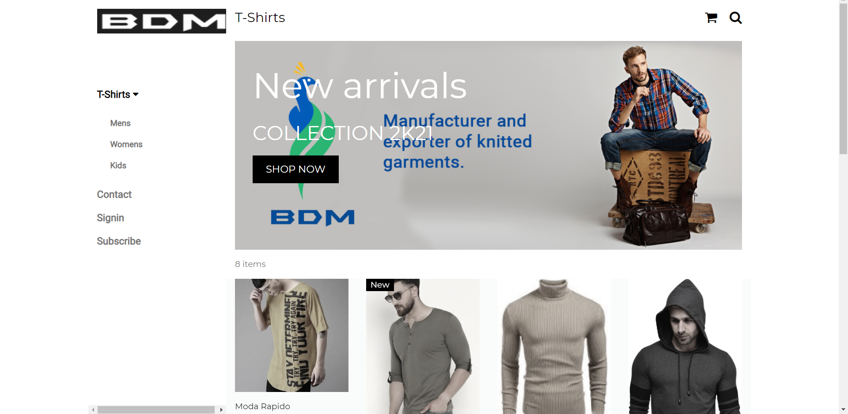
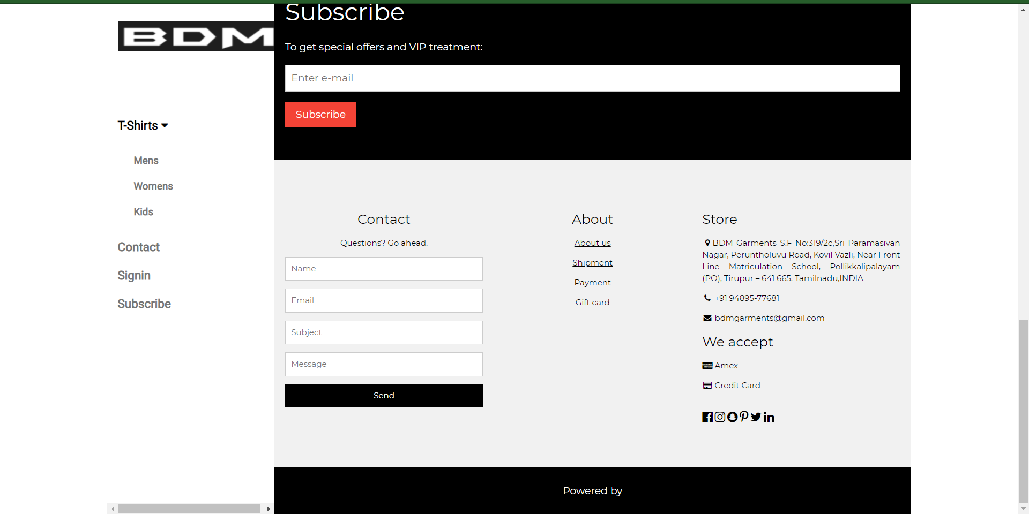
KEC-IT
Module Completed
Sales team module:
describes the catalogue’s of different garments.
6

Slide 7
KEC-IT
THANK YOU
7

