Slide 1

Laptop Price Analysis using Flipkart
A Data Collection, Data Cleaning & Exploratory Data Analysis Project

Slide 2
About Us
Mada Venkata Sai
Background: B.Sc. Computer Science graduate
Why I want to learn Data Science: I want to improve my data analysis skills and build a career in the Data Science field.
Work Experience: Fresher
LinkedIn: www.linkedin.com/in/venkatasai-mada
GitHub: https://github.com/Venkatasai-M

Slide 3
Agenda (This should be the PPT flow)
Business Problem and Use case domain understanding(If Required)
Objective of the Project
Web Scraping – Details (Websites, Processor you followed)
Summary of the Data
Exploratory Data Analysis:
Data Cleaning Steps
Data Manipulation Steps
Univariate Analysis Steps
Bivariate Analysis Steps
Key Business Question
Conclusion (Key finding overall)
Q&A Slide
Your Experience/Challenges working on Web Scraping – Data Analysis Project.

Slide 4

BUSINESS UNDERSTANDING
Business Problem & Objectives
Objectives
The Problem
Understand market composition across brands & configurations
It's difficult for buyers to judge whether a laptop's price is fair, and hard for sellers to benchmark pricing against the market — both need a data-driven view of how specifications (brand, processor, RAM, storage, display) relate to price on Flipkart.
Identify which specifications most strongly drive price
Benchmark pricing across brands, processors, RAM & storage
Study discounting patterns across brands & price segments
Data Source
Assess value-for-money using rating alongside price & specs
Flipkart.com laptop listings — collected via web scraping
Support pricing (business) and purchase (consumer) decisions
04

Slide 5
DATA COLLECTION
Web Scraping — Methodology & Tools
01
02
03
04
Target & Tools
Resilient Requests
Structured Parsing
Scale & De-duplicate
flipkart.com/search?q=laptops scraped with requests + BeautifulSoup, using a pooled Session for repeated calls.
Realistic browser headers plus a retry/backoff routine (3 attempts, exponential wait) to reduce blocking and handle timeouts.
Each product card parsed for name, price, discount, rating and specs (processor, RAM, storage, display, OS, GPU, warranty).
20 result pages × ~24 listings scraped (~480 rows), then de-duplicated on Product URL before saving to CSV.
05

Slide 6
THE DATASET
Summary of the Data
~480
14
10
20
Laptops scraped
Raw features captured
Distinct brands
Search pages crawled
Core Feature Schema
Brand
Categorical
Number of Ratings/Reviews
Numeric
Product Name
Text
Processor
Categorical
Current Price
Numeric
RAM (GB)
Numeric
Original Price
Numeric
Storage (GB)
Numeric
Discount (%)
Numeric
Display Size
Numeric
Rating
Numeric
Operating System / GPU
Categorical
06

Slide 7
DATA PREPARATION
Data Cleaning & Manipulation Steps
Remove duplicates
Parse numeric fields
Dropped duplicate listings using Product URL as the unique key.
Regex-extracted numbers from Price, Discount and Rating text (e.g. ₹39,990 → 39990).
Split ratings text
Extract specs
“1,204 Ratings & 88 Reviews” split into two numeric columns.
Pulled numeric RAM, Storage and Display Size out of free-text spec strings.
Handle missing values
Enforce data types
Numeric gaps filled with median; categorical gaps filled with mode / “Unknown”.
Cast every column to its correct dtype (string, int64, float64) for analysis.
07

Slide 8
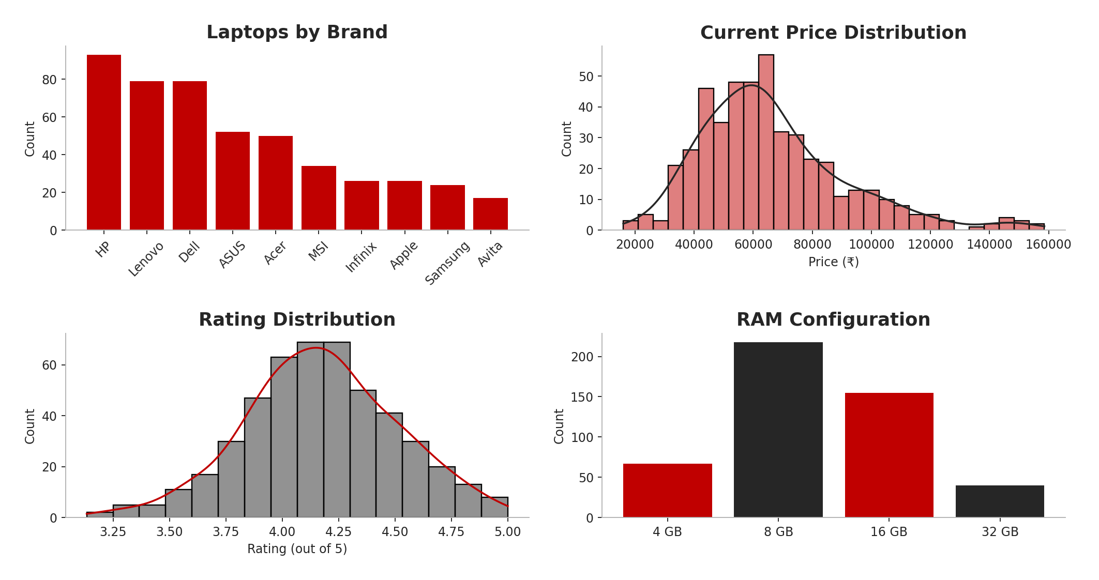
EXPLORATORY DATA ANALYSIS · UNIVARIATE
Distributions — Brand, Price, Rating & RAM
Insights
HP, Dell and Lenovo together account for over half of all listings.
Prices are right-skewed — most laptops cluster in the budget-to-mid range, with a long tail of premium models.
Average customer rating centers tightly around 4.0–4.3, showing generally positive sentiment.
16GB is emerging as the most common RAM configuration, ahead of 8GB.
Sample analysis, n ≈ 480 (representative of scraped schema)
08

Slide 9
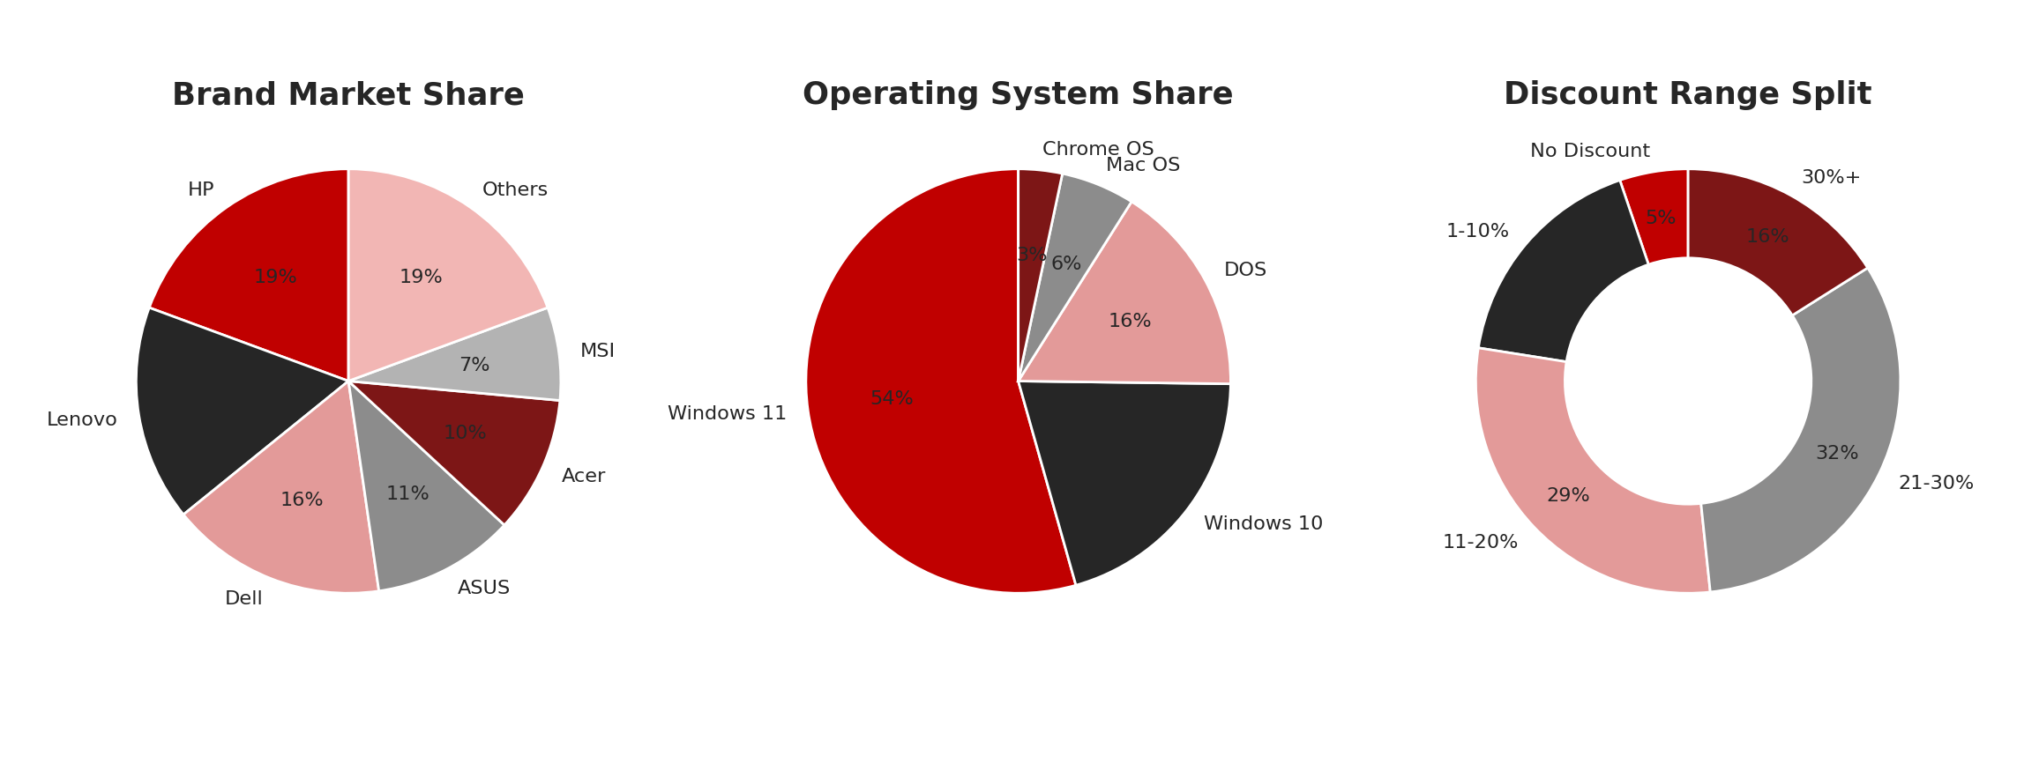
EXPLORATORY DATA ANALYSIS · UNIVARIATE
Market Share — Brand, OS & Discount Mix
Insight: One brand and Windows 11 each command over half the market, while steep discounts (30%+) remain relatively uncommon — most deals sit in the moderate discount range.
09

Slide 10
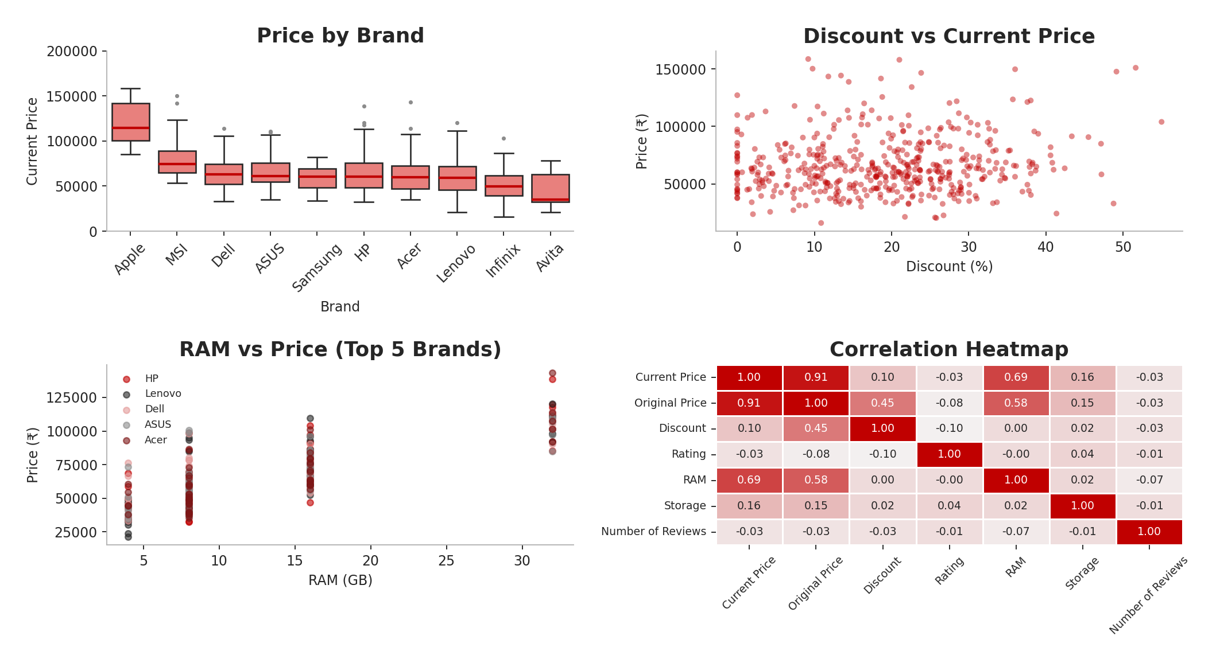
EXPLORATORY DATA ANALYSIS · BIVARIATE
Price Relationships & Correlations
Insights
Premium brands show both a higher median price and a wider spread of outliers.
RAM is the strongest numeric price driver (corr. ≈ 0.69) — far ahead of storage (≈ 0.16).
Discount % is only weakly related to price (≈ 0.10) — heavy discounting isn't reserved for expensive models.
Higher-RAM configurations command a clear price premium within every major brand.
Sample analysis, n ≈ 480 (representative of scraped schema)
10

Slide 11
FINDINGS
Key Business Questions — Answered
Q
Which brands sit at the top and bottom of the price ladder?
Apple leads on median price; Infinix and Avita anchor the budget end.
Q
Does RAM meaningfully affect price?
Yes — RAM shows the strongest correlation with price (≈ 0.69) of any spec studied.
Q
Does storage capacity affect price as much as RAM?
Only mildly (≈ 0.16) — storage matters far less than memory or brand tier.
Q
Are the steepest discounts on the priciest laptops?
No — discount depth is nearly independent of price (≈ 0.10 correlation).
Q
Which configuration looks like the best value?
16GB RAM / 512GB SSD laptops from mid-tier brands, rated 4.2+, price competitively for the specs offered.
11

Slide 12
WRAP-UP
Conclusion — Key Findings
Brand and RAM are the two strongest levers behind laptop pricing on Flipkart — far more influential than storage or display size.
The market is concentrated: the top 3 brands account for over half of all listings, led by mainstream players rather than niche brands.
Discounting is broad-based and roughly price-independent, suggesting Flipkart runs promotions across the catalog rather than targeting premium models.
Customer ratings stay consistently high (~4.0–4.3) across brands, so rating alone is a weak differentiator — it should be paired with price and specs to judge real value.
16GB RAM / 512GB SSD configurations offer the best balance of performance and price for value-conscious buyers.
12

Slide 13

THANK
YOU

