Slide 1



OPTIMIZATION AND SCHEDULING APPLIANCES PRIORITY FOR
Residential Buildings
Under the Guidance of Dr. Prakash Pawar
Annamaneni Rohit - 20BCS019
Sai Tarun Parasa - 20BCS096
Venkata Sai Nikhil Vemprala - 20BCS135
Sowmya S - 20BDS053

Slide 2

CONTENT
01
02
03
04
Problem
formulation
Objective function
& Constraints
Introduction
Related work
05
06
07
Algorithms
Results
Conclusion

Slide 3
INTRODUCTION
Smart Grids (SGs) introduced to address energy challenges.
Bi-directional SGs enable efficient information exchange between providers and consumers.
Demand Side Management (DSM) strategies play a pivotal role.
DSM optimizes energy consumption by shifting usage from peak to off-peak hours.
Key DSM components:
Demand Response (DR)
Load Management.
These elements lead to a more efficient and cost-effective electricity distribution system.

Slide 4
RELATED WORK
PAPER 1
PAPER 2
PAPER 3
Minimize the total cost.
Parameter Tuning
Comparision between FDP and BPSO
Subworms are used for increasing the solution probabilities
Minimizing PAR and electricity cost.
EWA for generatig new solutions
HSA selects new solution from memory.
Hybrid EHSA (EWA + HSA)
Real Time Pricing (RTP)
Time of Use (TOU)
Critical Peak Pricing (CPP)
Optimzing using TLBO and SFL
Shiftable, Sheddable and Non-Sheddable load categories
M. A. A. Pedrasa, T. D. Spooner and I. F. MacGill, "Scheduling of Demand Side Resources Using Binary Particle Swarm Optimization,"
Hassan, Smart Grid Energy Optimization and Scheduling Appliances Priority for Residential Buildings through Meta-Heuristic Hybrid Approaches.
Derakhshan, Ghasem & Shayanfar, Heidarali & Kazemi, Ahad. (2016). The optimization of demand response programs in smart grids.

Slide 5


PROBLEM FORMULATION
The problem at hand requires a solution which is a curtailment schedule.
Solution is a (t,n) shaped matrix where t = number of hours and n = number of appliances.
solution(t, i) is equal to 1 if the i th appliance is being curtailed during the hour t.
Each of the appliances is given a capacity and a curtailment rate which is indicative of the cost incurred from curtailing the appliance.
The appliances also have an associated maximum off duration and minimum on duration that they must adhere to.

Slide 6
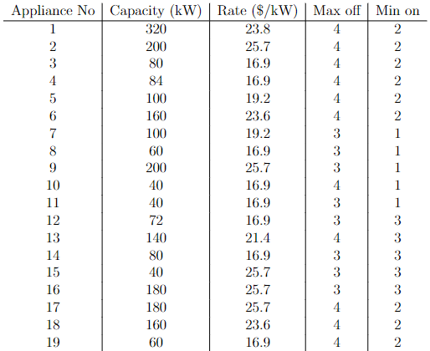
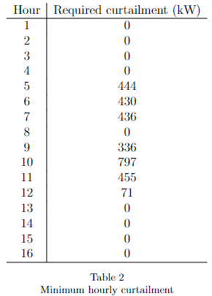
PROBLEM FORMULATION
Additionally, the appliances are divided into three priority levels. Each of the priority levels indicates how frequently the appliances can be curtailed with priorities ranging from 1 to 3.

Slide 7
OBJECTIVES
Minimize curtailment cost to check hourly curtailed load.
Minimize instances of under curtailment.
Prevent repeated curtailment of appliances.
Adhere to min on hours and max off hours.
Minimize peak to average ratio to reduce excess curtailment.

Slide 8

OBJECTIVE FUNCTION
CURTAILMENT COST
UNDER CURTAILMENT

Slide 9



OBJECTIVE FUNCTION
CURTAILMENT FREQUENCY
OFF AND ON PENALTY

Slide 10

OBJECTIVE FUNCTION
PAR RATIO
Based on empirical results, it was found that the following weights provide the best representation of solution fitness

Slide 11
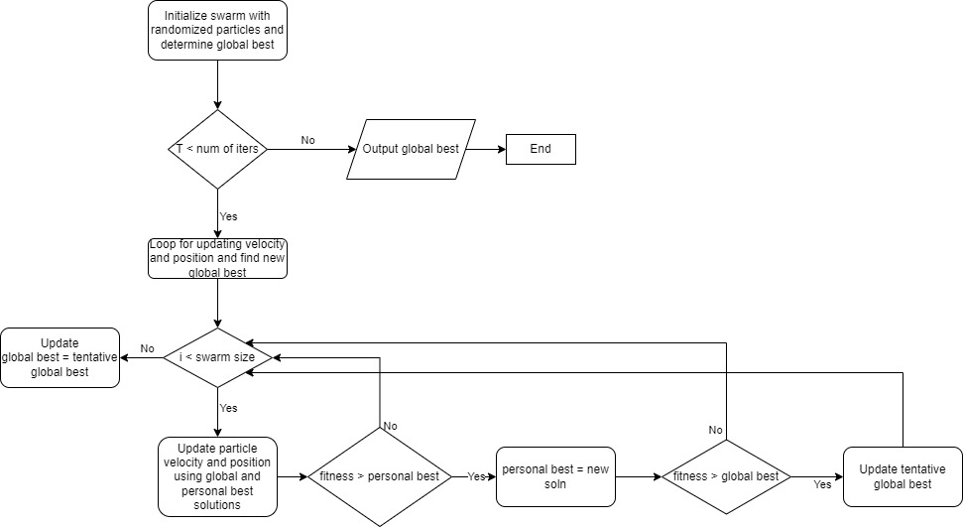
ALGORITHMS
Binary particle swarm optimization

Slide 12
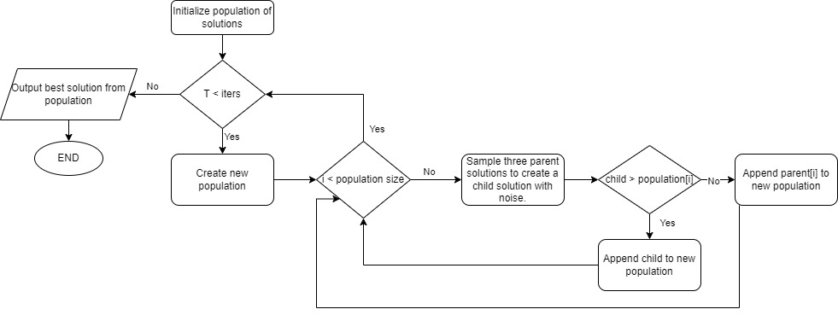
ALGORITHMS
Differential evolution

Slide 13
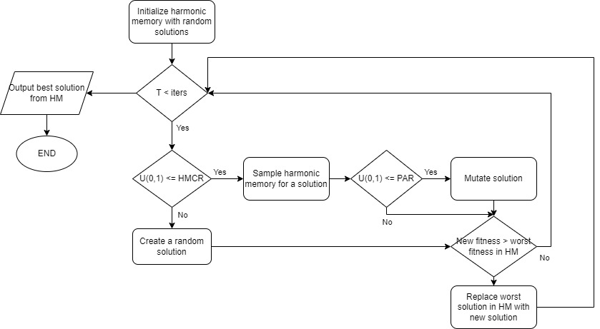
ALGORITHMS
Harmonic Search Algorithm

Slide 14
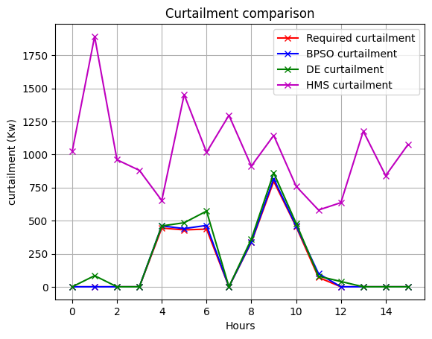
RESULTS

Slide 15
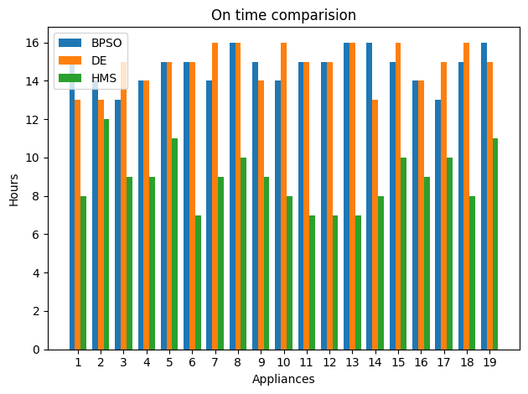
RESULTS

Slide 16
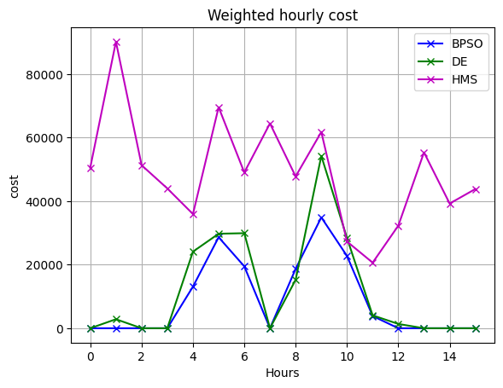
RESULTS

Slide 17
RESULTS
Algorithm | Priority 1 | Priority 2 | Priority 3
BPSO | 3 | 11 | 10
Differential evolution | 4 | 10 | 8
Harmonic search | 54 | 42 | 39
Priority wise curtailment freq

Slide 18
RESULTS
Algorithm | Average iteration runtime
BPSO | 0.401 secs
Differential evolution | 0.099 secs
Harmonic search | 0.015 secs
Algorithm | PAR
BPSO | 1.090
Differential evolution | 1.102
Harmonic search | 1.342
Algorithm | Fitness
BPSO | 152366.0
Differential evolution | 201868.0
Harmonic search | 9456108.8
Peak to average ratios
Algorithm runtimes
Fitness comparision

Slide 19
CONCLUSION
BPSO provided valuable insights into the efficient management of energy consumption within residential buildings.
BPSO effectively minimized peak loads while maintaining optimal appliance schedules.
Additionally, BPSO Algorithm has proven to be highly efficient in terms of Peak to average ratios when compared to Differential Evolution and Harmonic Search.

Slide 20
REFERENCES
REFERENCES 1
M. A. A. Pedrasa, T. D. Spooner and I. F. MacGill, "Scheduling of Demand Side Resources Using Binary Particle Swarm Optimization," in IEEE Transactions on Power Systems, vol. 24, no. 3, pp. 1173-1181, Aug. 2009, doi: 10.1109/TPWRS.2009.2021219.
REFERENCES 2
Derakhshan, Ghasem & Shayanfar, Heidarali & Kazemi, Ahad. (2016). The optimization of demand response programs in smart grids. Energy Policy. 94. 295-306. 10.1016/j.enpol.2016.04.009.
REFERENCES 3
Hassan, C.A.u.; Iqbal, J.; Ayub, N.; Hussain, S.; Alroobaea, R.; Ullah, S.S. Smart Grid Energy Optimization and Scheduling Appliances Priority for Residential Buildings through Meta-Heuristic Hybrid Approaches. Energies 2022, 15, 1752.

Slide 21
THANK YOU

