Slide 1
COMPILER DESIGN HACKATHON 2026
GrammarFix
nested_if_else.js
if (a) {
if (b) {
x = 10;
} else {
x = 20;
}
}
Dangling-Else Resolver
A visual tool to detect dangling-else ambiguity and demonstrate its resolution through grammar transformation.
PROBLEM PS-04
UNIT II • PARSING
TOP-DOWN
TEAM MEMBERS
PS-04 / UNIT II
PARSING (TOP-DOWN)
N. Shashidhar Reddy • V. Venkata Sreeshanth
CM. Varun • T. Rama Tejaswi Reddy
ROLL NOS: 2420030006 • 2420030717 • 2420030722 • 2420090113
GRAMMAR TRANSFORMATION • PARSE TREES • AMBIGUITY RESOLUTION

Slide 2
Abstract
COMPILER DESIGN HACKATHON 2026
PROJECT OVERVIEW
GrammarFix is a web-based educational application designed to demonstrate and resolve dangling-else ambiguity in nested if-else statements. It accepts conditional statements, identifies situations where an else clause can be associated with more than one unmatched if, and displays the possible parse structures. The application explains the nearest-unmatched-if rule and demonstrates how an ambiguous grammar can be rewritten using matched and unmatched statements. Developed using HTML, CSS and JavaScript, GrammarFix presents compiler-design parsing concepts through a clear and interactive visual experience.
CORE CONCEPT • Dangling-else ambiguity • Parse-tree comparison • Matched / unmatched grammar
GRAMMARFIX | PS-04 | UNIT II – PARSING (TOP-DOWN)
02 / 12

Slide 3
Problem Statement
COMPILER DESIGN HACKATHON 2026
The dangling-else problem occurs in nested if statements when an else clause can be attached to more than one if, allowing an ambiguous context-free grammar to produce multiple parse trees for the same input.
THE CHALLENGE
THE PROJECT RESPONSE
• An else clause may appear to match different unmatched if statements.
• Multiple parse trees make the program's intended structure uncertain.
• Manual analysis can be difficult for students learning parsing.
• Detect and demonstrate the possible parse structures.
• Explain the nearest-unmatched-if rule.
• Apply matched and unmatched grammar to show an unambiguous structure.
GOAL • Make the source of dangling-else ambiguity visible and explain how grammar transformation resolves it.
GRAMMARFIX | PS-04 | UNIT II – PARSING (TOP-DOWN)
03 / 12

Slide 4
Objectives
COMPILER DESIGN HACKATHON 2026
01
Accept input
02
Detect ambiguity
03
Generate trees
Accept nested if and if-else statements as input.
Identify dangling-else situations in nested conditions.
Generate and display possible parse trees.
04
Transform grammar
05
Explain the rule
06
Support learning
Convert ambiguous grammar into an unambiguous form.
Demonstrate the nearest-unmatched-if rule.
Help students understand parsing concepts visually.
GRAMMARFIX | PS-04 | UNIT II – PARSING (TOP-DOWN)
04 / 12

Slide 5
Grammar Transformation
COMPILER DESIGN HACKATHON 2026
ORIGINAL AMBIGUOUS GRAMMAR
TRANSFORMED GRAMMAR
S → if (E) S
S → if (E) S else S
S → statement
S → M | U
M → if (E) M else M
M → statement
U → if (E) S
U → if (E) M else U
M = matched statement (every if has an else) | U = unmatched statement (an if still needs an else)
GRAMMARFIX | PS-04 | UNIT II – PARSING (TOP-DOWN)
05 / 12

Slide 6
Working Methodology
COMPILER DESIGN HACKATHON 2026
01
Input
02
Validate
03
Analyze
User enters a nested if-else statement.
Application checks the input structure.
Grammar analysis is performed.
06
Transform
05
Detect
04
Generate
Matched and unmatched grammar is applied.
The application identifies ambiguity.
Possible parse trees are generated.
07
Resolve
The resolved parse-tree structure is displayed.
PROCESS FLOW • Input → Validation → Analysis → Parse trees → Ambiguity detection → Grammar transformation → Resolution
GRAMMARFIX | PS-04 | UNIT II – PARSING (TOP-DOWN)
06 / 12

Slide 7
Sample Input and Output
COMPILER DESIGN HACKATHON 2026
SAMPLE INPUT
EXPECTED ANALYSIS
if (a)
if (b)
x = 10;
else
x = 20;
Number of if statements
2
Number of else statements
1
Ambiguity
Yes
Possible parse trees
2
RESOLVED RULE: nearest unmatched if
The original grammar permits two interpretations: the else may be associated with the inner if or the outer if. The transformed grammar enforces the nearest-unmatched-if rule, attaching the else to the closest unmatched if.
GRAMMARFIX | PS-04 | UNIT II – PARSING (TOP-DOWN)
07 / 12

Slide 8
Technology Stack
COMPILER DESIGN HACKATHON 2026
HTML
Application structure
Defines the page elements and input interface.
CSS
Visual presentation
Controls layout, colors, typography and responsive styling.
JavaScript
Grammar analysis
Implements input checks, ambiguity logic and visual behavior.
Visual Studio Code
Development environment
Used to create and edit the project files.
Live Server
Local execution
Launches the application in a browser for demonstration.
GRAMMARFIX | PS-04 | UNIT II – PARSING (TOP-DOWN)
08 / 12

Slide 9
Testing and Validation
COMPILER DESIGN HACKATHON 2026
TEST CASE
EXPECTED RESULT
Basic dangling else
2 possible parse trees
Three nested ifs with one else
3 possible parse trees
Simple if-else
1 parse tree
Fully matched nested if-else
1 parse tree
Invalid input
Validation message
Empty input
Error message
TESTING OBJECTIVE • Verify ambiguity detection, parse-tree generation and grammar transformation.
GRAMMARFIX | PS-04 | UNIT II – PARSING (TOP-DOWN)
09 / 12

Slide 10
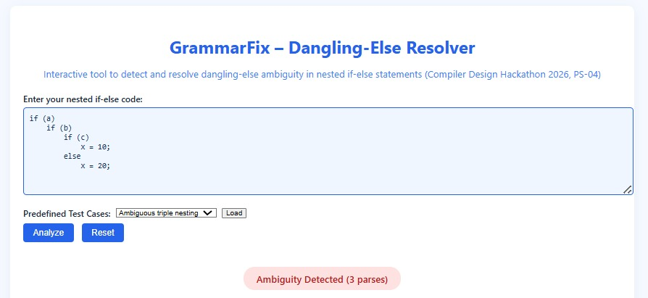
Execution Result — Ambiguity Detection
Live application output showing the nested if-else input and detection of three competing parse interpretations.
GRAMMARFIX | PS-04 | COMPILER DESIGN HACKATHON 2026 10 / 12

Slide 11
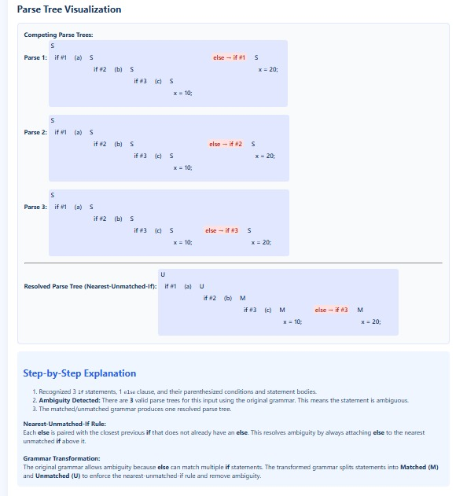
Execution Result — Parse Tree Visualization
The application compares competing parse trees and displays the resolved nearest-unmatched-if structure with an explanation.
GRAMMARFIX | PS-04 | COMPILER DESIGN HACKATHON 2026 11 / 12

Slide 12
Conclusion
COMPILER DESIGN HACKATHON 2026
GrammarFix makes dangling-else ambiguity visible and demonstrates how grammar transformation resolves it.
VISUALIZATION
GRAMMAR SOLUTION
LEARNING VALUE
Shows alternative parse structures for nested conditional statements.
Uses matched and unmatched statements to remove ambiguity.
Explains how parsing rules determine program structure.
An interactive learning aid for Compiler Design — Unit II: Parsing (Top-Down).
THANK YOU
GRAMMARFIX | PS-04 | UNIT II – PARSING (TOP-DOWN)
12 / 12

