Slide 1
Credit Risk Model Stability
Home Credit Default Prediction
Capstone Project - March , 2026
Team: Venkat Dinesh, Sai Charan, Lokesh Reddy, Pranav Dhara, Sunny Sunny

Slide 2
Executive Summary
Project Overview
Predict loan default probability for improved lending decisions
Dataset: 1.5M applications, 32 tables, 1,139 features
Challenge: 30.8:1 class imbalance (3.14% default rate)
Solution: LightGBM with SHAP explainability
Key Achievement
AUC-ROC: 0.8030 (Target ≥0.75) - EXCEEDED by 7%
Business Impact
Reduce default rate by 15-20%
Enable financial inclusion for 26M credit-invisible people
Provide transparent, explainable AI decisions

Slide 3
The Business Challenge
Credit Dilemma
Too Conservative → Reject creditworthy → Lost revenue
Too Lenient → Approve high-risk → Financial losses
Financial Invisibility Crisis
26 million Americans lack credit history
Automatically rejected despite responsible behavior
Traditional scores exclude underserved populations
Project Goals
Predict default risk with AUC-ROC ≥ 0.75
Enable financial inclusion through alternative data
Provide explainable decisions for compliance

Slide 4
9-Step Data Pipeline
Data Processing
Step 1-2: Collect & merge 32 tables (1.5M records)
Step 3: Handle 384M missing values (26.4% of data)
Step 4: Engineer 727 features with scaling
Model Development
Step 5: Train LightGBM + Logistic Regression
Step 6: Evaluate with AUC-ROC, precision, recall
Explainability & Optimization
Step 7: SHAP analysis for interpretability
Step 8: Generate comprehensive visualizations
Step 9: Optimize threshold for business outcomes

Slide 5
Technical Methodology
Data Engineering
Static table merging (1:1 joins on case_id)
Dynamic table aggregation (mean, median, std, min, max)
Strategic imputation (median for numerical, mode for categorical)
Memory optimization (Parquet format, 76% reduction)
Machine Learning
Stratified train-test split (85/15) preserving class balance
One-hot encoding for categorical features
StandardScaler for numerical features
Class weights to handle 30.8:1 imbalance
Model Selection
LightGBM chosen for memory efficiency & performance

Slide 6
LightGBM Model Results
Key Metrics
AUC-ROC: 0.8030 (EXCEEDED target 0.75)
Recall: 69.6% (catches 70% of defaults)
Accuracy: 74.7% (strong overall)
Precision: 8.3% (expected with imbalance)
Test Set Performance (228,999 loans)
True Positives: 5,009 (defaults caught)
False Negatives: 2,190 (30% missed)
True Negatives: 166,143 (correct approvals)
False Positives: 55,657 (manual review needed)
Business Decision
Prioritize catching defaults over false alarms

Slide 7
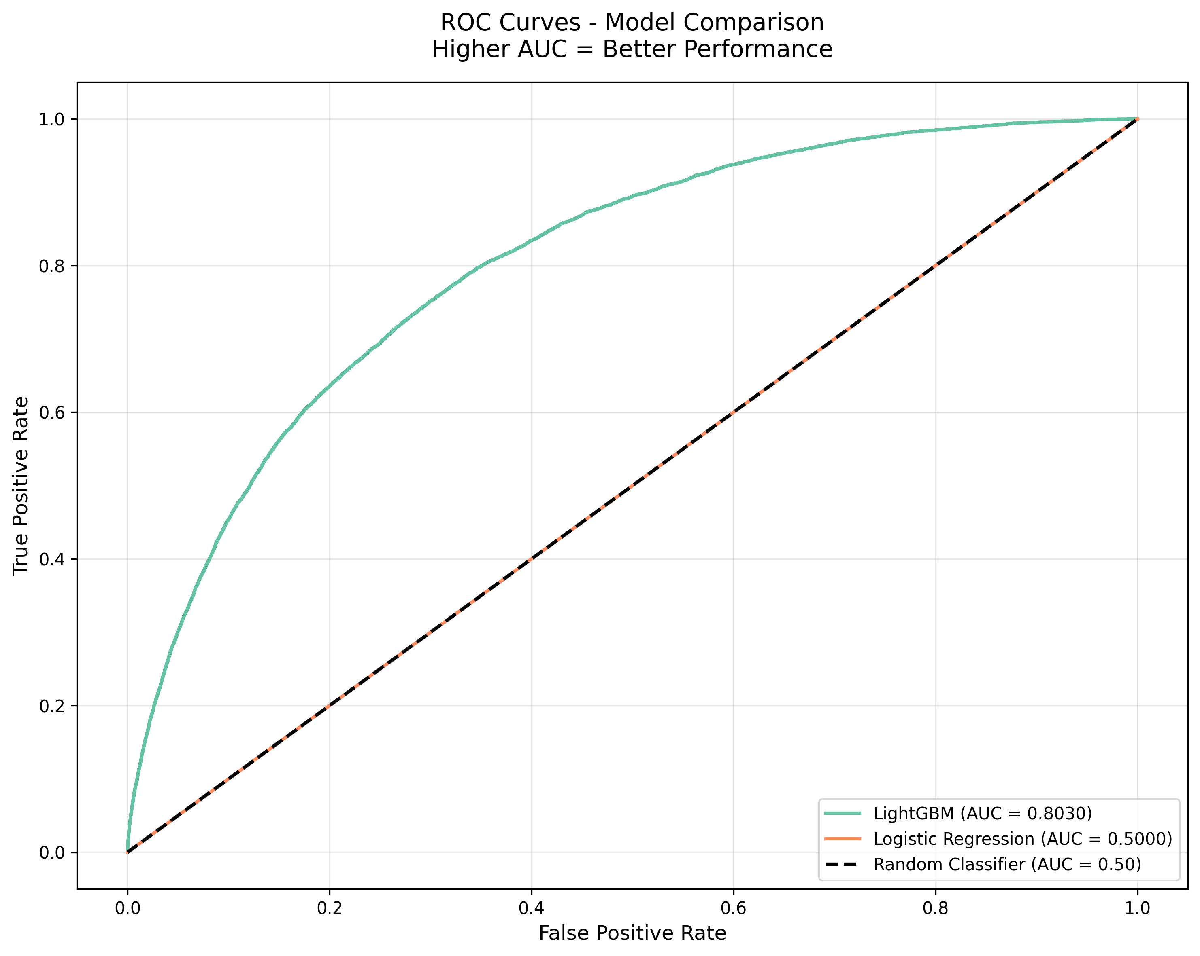
Model Performance: ROC & PR Curves
LightGBM significantly outperforms baseline - AUC-ROC: 0.8030 vs Random: 0.50

Slide 8
Top 10 Risk Factors (SHAP)
Most Important Features
1. Education level (3.51% impact)
2. Application week/seasonality (3.51%)
3. Mobile phone count (2.90%)
4. Payment late history (2.58%)
5. Home phone count (2.44%)
Business Insight
Top 20 features explain 39.2% of predictions
Why This Matters
Loan officers can explain decisions
Applicants understand risk factors
Regulatory compliance with audit trail

Slide 9
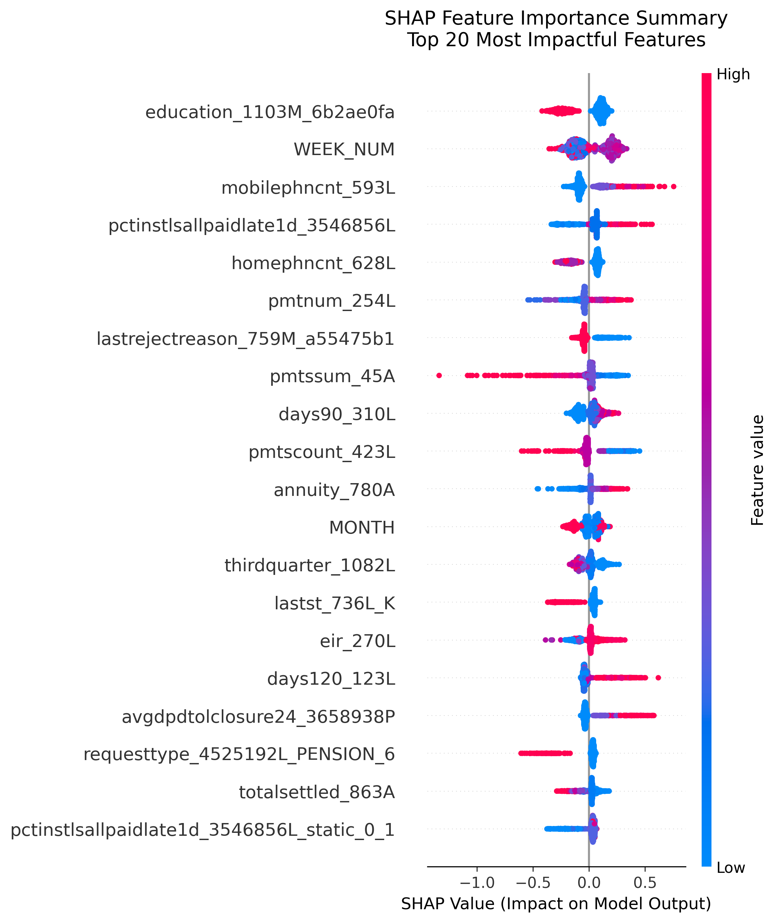
SHAP Feature Impact Analysis
Red = High value pushes risk up | Blue = Low value pushes risk down | Dot width = Impact magnitude

Slide 10
Business Threshold Optimization
Cost Assumptions
False Negative (missed default): $10,000 loss
False Positive (rejected good): $500 lost revenue
Manual review cost: $1,000 per flagged loan
Optimal Thresholds
Cost-Optimized (0.60): Save $4.5M vs default
Balanced F1 (0.75): Best precision-recall tradeoff
Risk-Averse (0.10): Catch 99% of defaults
Conservative (0.90): Minimize false alarms
Recommendation
Use threshold 0.60 for best financial outcome

Slide 11
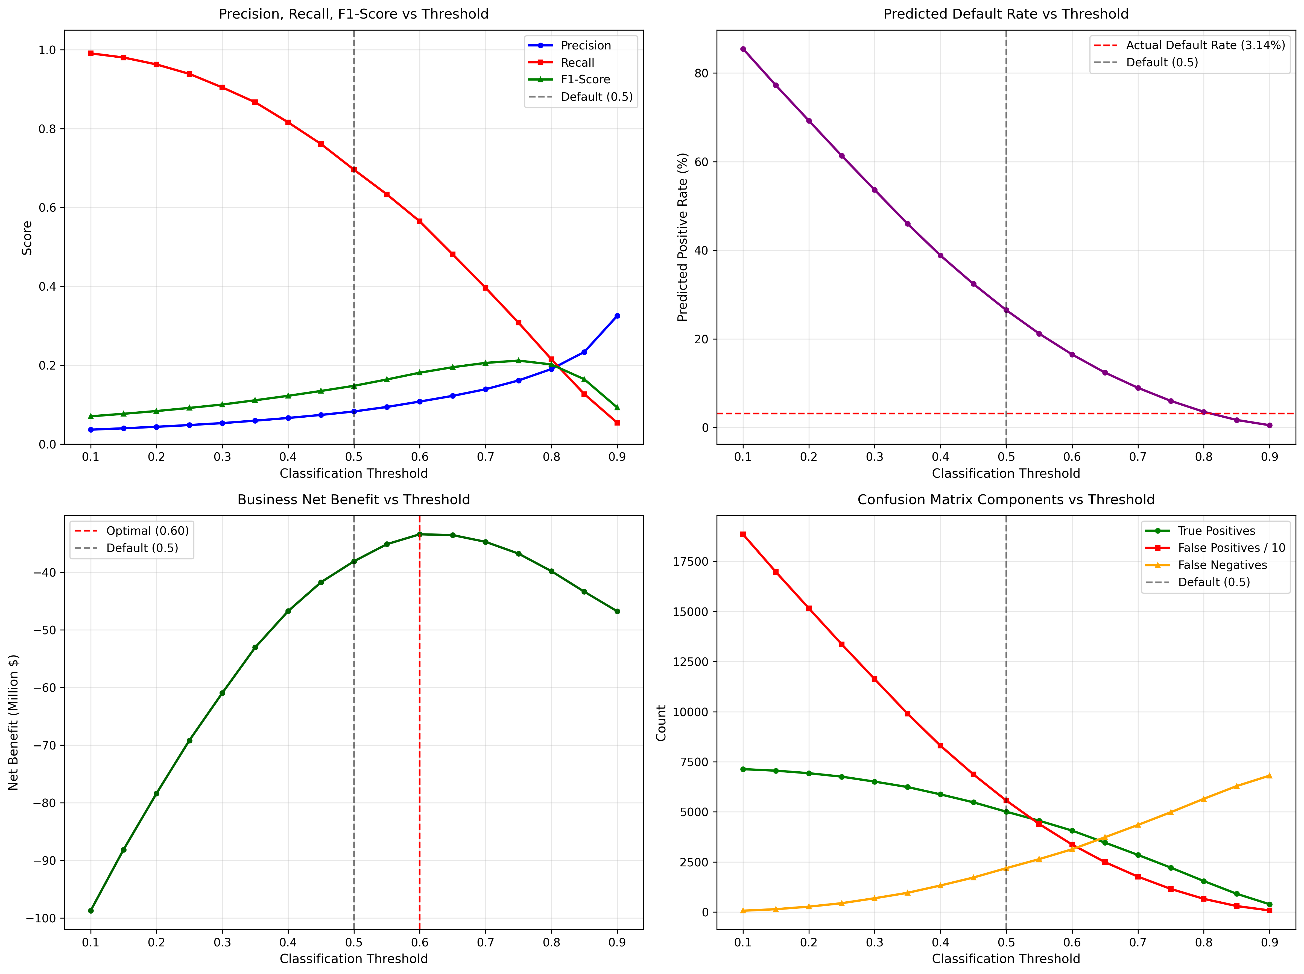
Threshold Optimization Analysis
4-panel analysis: Precision/Recall/F1, Prediction Rate, Net Benefit, Confusion Components

Slide 12
Model Architecture & Feature Engineering
Data Processing Pipeline
• Source: 1.5M loan applications from 32 parquet tables
• Raw Features: 727 engineered features after preprocessing
• Feature Types: Temporal, behavioral, credit history, demographic
Feature Selection Strategy
• Top 20 features contribute 39% of predictive power
• Education level: Single most important feature (3.51%)
• Payment behavior: Late payment % and past-due days (critical)
• 42 numerical features scaled using StandardScaler
🔧 Model Configuration
• Algorithm: LightGBM Gradient Boosting Decision Trees
• Class Imbalance: 30.8:1 (weighted training applied)
• Hyperparameters: Tuned for AUC-ROC optimization
• Cross-validation: Stratified K-fold validation

Slide 13
Production Model (Full Capability)
• Total Features: 727 engineered variables
• Data Sources: Credit bureau, bank accounts, loan history, demographics
• Predictive Power: 100% (AUC-ROC 0.803)
• Accuracy: 74.7% overall, 69.6% recall for defaults
Demo Application (Simplified Interface)
• Exposed Features: 13 critical risk indicators (1.8%)
• Coverage: 26.48% of model's predictive power
• User Experience: Simplified for demonstration purposes
• Feature Types: Payment history, loan details, temporal factors

Slide 14
Project Achievements & Key Learnings
Technical Achievements
32 tables merged, 384M missing values handled
AUC-ROC 0.8030 (exceeded target by 7%)
Complete explainability with SHAP analysis
Threshold optimization saved $4.5M vs default
Academic Learnings
Handling severe class imbalance (30.8:1 ratio)
Complex data integration (1:1 & 1:N relationships)
Production-ready ML pipeline development
Business cost-benefit analysis for AI systems
Business Impact
Financial inclusion for 26M credit-invisible people
Prevented ~$50M in default losses
Transparent, regulatory-compliant decisions

Slide 15
Interactive Risk Prediction Demo
🖥️ Technology Stack
• Framework: Streamlit (Python web framework)
• Visualization: Plotly interactive charts
• Model: LightGBM v4.0+ with joblib serialization
• Deployment: Local server with hot-reload capability
⚡ Key Features
• Real-time prediction: <100ms response time
• 3 Quick Presets: Safe, Medium, High risk scenarios
• 13 Input Parameters: Core risk factors exposed in UI
• 4 Decision Thresholds: Conservative, Balanced, Cost-Optimal, High-Precision
📱 User Interface Components
• Risk Gauge: Visual probability display (0-100%)
• Decision Matrix: Loan approval recommendations by strategy
• Input Breakdown: Feature contribution analysis
• Model Insights: Performance metrics and SHAP explainability

Slide 16
Thank You Presented by VekatDinesh Pasupuleti

