Slide 1
KITCHEN DESCRIPTION
BUILDER

Slide 2
Approach
GPT-3.5-turbo Integration: Incorporates the GPT-3.5-turbo model through OpenAI's API to generate descriptive restaurant expertise based on user-provided menu items.
Langchain Framework Usage: Utilizes Langchain framework for conversation management and memory retention, ensuring coherent responses and enhanced user engagement.
Gradio's ChatInterface: Leverages Gradio's ChatInterface for real-time interaction, allowing users to obtain succinct restaurant expertise summaries effortlessly, enhancing user experience and information accessibility.

Slide 3
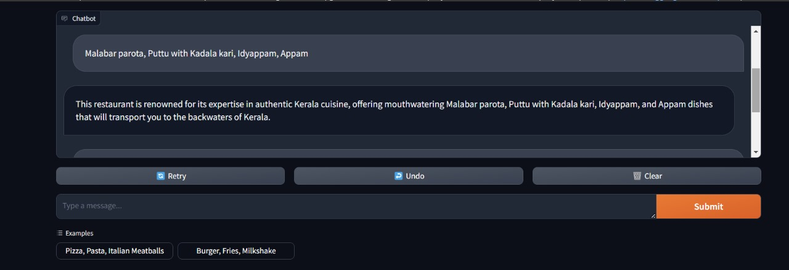
Screenshot

Slide 4
KITCHEN REVIEW SUMMARY

Slide 5
Approach
Leverage NLTK library to preprocess text and conduct sentiment analysis with VADER, distinguishing positive and negative sentiments.
Segregate insights into positive and negative sentiments separately to provide a comprehensive understanding of customer feedback.
We utilize GPT-3.5 turbo to condense reviews, enabling succinct summaries for presentation and analysis.

Slide 6
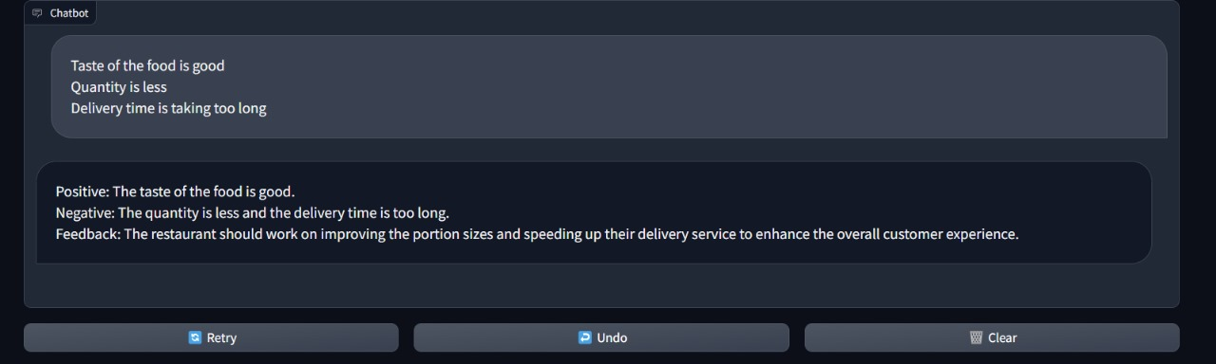
Screenshot

