Slide 1
PROJECT TITLE
AgriMind: A Mobile IoT-Robotic System for Paddy Monitoring
Team Name
VORTEX
Team Members
Venkatesan V
Nakshatra Sree S
Dharun Raj H
J Tanushree

Slide 2
AGENDA
Abstract
Scope and Motivation
Introduction
Literature Survey
Objective
Problem Statement
Proposed Work
Block Diagram
Novel idea
Modules
Module Description
Algorithm
Software & Hardware Requirements
Implementation
Results and Discussion-Comparison with Existing Work
Conclusion
Future Work
Reference
Outcome

Slide 3
ABSTRACT
In Tamil Nadu, traditional paddy farming depends on manual inspection and
even irrigation, which wastes water and makes it hard to keep an eye on the
root zone. This project introduces AgriMind, a mobile IoT-robotic system
for monitoring paddy in real time and changing the way water is applied.
The system uses an ESP32-based robot that is connected to IoT sensor nodes
and a GPS module to map fields based on where they are. It checks the soil’s
moisture, pH, temperature, and humidity. It also uses bio-impedance to
check the health of the roots. The robot probes the depth of roots in several
areas, and sensor fusion creates insights that are specific to each area. Data is
sent to a cloud platform that lets you control things in a closed loop and by
stage. Results show that you can save up to 42% of water, get 28% more
yield, and work less. The system is cheap, can grow, and helps with
precision farming.

Slide 4
Scope and Motivation
Scope
Development of a GPS-enabled IoT robotic system for paddy field monitoring.
Real-time measurement of soil and environmental parameters using multiple sensors.
Mobile robot-based root-zone soil probing across different field locations.
Cloud-based data visualization and remote monitoring system.
Automated irrigation and drainage using closed-loop control.
Motivation
Traditional farming causes high water wastage due to manual irrigation.
Lack of real-time soil data leads to poor decision-making.
Inefficient fertilizer usage reduces crop productivity.
High labor dependency increases cost and effort.
Need for smart, sustainable, and data-driven agriculture solutions.

Slide 5
Introduction
Farmers in Tamil Nadu require large amounts of water and nutrients to grow paddy rice. Farmers in this region use manual methods to check their fields and apply consistent methods for both irrigation and fertilization.
Traditional farming methods waste resources because they fail to trace underground systems which determine plant health and crop production. Research shows that improper or excessive irrigation can lead to a yield loss of about 20 to 21% compared to better water management practices.
The application of excessive nitrogen fertilizer creates inefficiency because only 30 to 40% of the nitrogen applied is actually absorbed by the crop. The process results in nitrogen losses which occur through leaching and evaporation and runoff, which cause almost 50% of the nitrogen to disappear. The farming operations face economic losses because of these operational problems. The process of over-watering a hectare of land leads to losses which exceed ₹20.7 thousand while the inefficient use of fertilizer adds another ₹10.4 thousand in losses. The total financial damages to the land amount to ₹31.1 thousand for each hectare of land.

Slide 6
Literature Survey
Sl.No | Title of the Paper | Published Journal and Year | Author | Concept | Inference
1 | Smart Saffron Cultivation: An IoT-Based Environmental Monitoring and Control System with GSM Alert Integration | 10th International Conference on Communication and Electronics Systems (ICCES), Coimbatore, India, 2025 | V. Chittem, S. K. Mukunda, E. S. R. Mudumala and G. C. V | This paper shows that integrating IoT + automation + GSM communication can transform traditional saffron farming into a smart, efficient, and high-yield system, reducing risks and improving productivity | The system shows that IoT-based monitoring and automation with GSM alerts can significantly improve saffron yield, quality, and reduce manual effort. It provides a scalable precision farming solution, though it depends on reliable connectivity and involves higher initial setup cost.

Slide 7
OBJECTIVES
Conventional paddy farming relies on manual observation and set procedures, which offer little real-time insight into field and root-zone conditions.
Continuous monitoring of soil and environmental parameters during various stages of crop growth is necessary for effective paddy management.
Localized soil sensing and necessary field monitoring like irrigation and drainage are carried out by an autonomous ESP32-based robot.
Real-time monitoring of soil moisture, pH, temperature, humidity, and light intensity is provided by multi-sensor IoT nodes.
A closed-loop paddy management system is created when a single cloud platform combines field data and provides the robot with stage-based control decision

Slide 8
PROBLEM STATEMENT
Research from Tamil Nadu Agricultural University and field-level surveys in Tamil Nadu's main paddy-growing regions show that manual field monitoring and uniform irrigation scheduling cause major inefficiencies in traditional paddy cultivation methods.
According to these studies, uneven distribution, seepage losses, and a lack of real-time root-zone condition awareness cause a significant amount of irrigation water applied to paddy fields to be inefficiently used by the crop. Improved monitoring and management techniques can increase water productivity by almost 50–60% in some areas, according to TNAU field evaluations; under better-managed irrigated conditions, yield improvements of about 25–30% have been noted.
This emphasizes the need for an affordable, automated, and useful smart paddy management system that facilitates data-driven and enhances overall field performance embedded acoustic signal processing and multi-sensor sound detection.

Slide 9
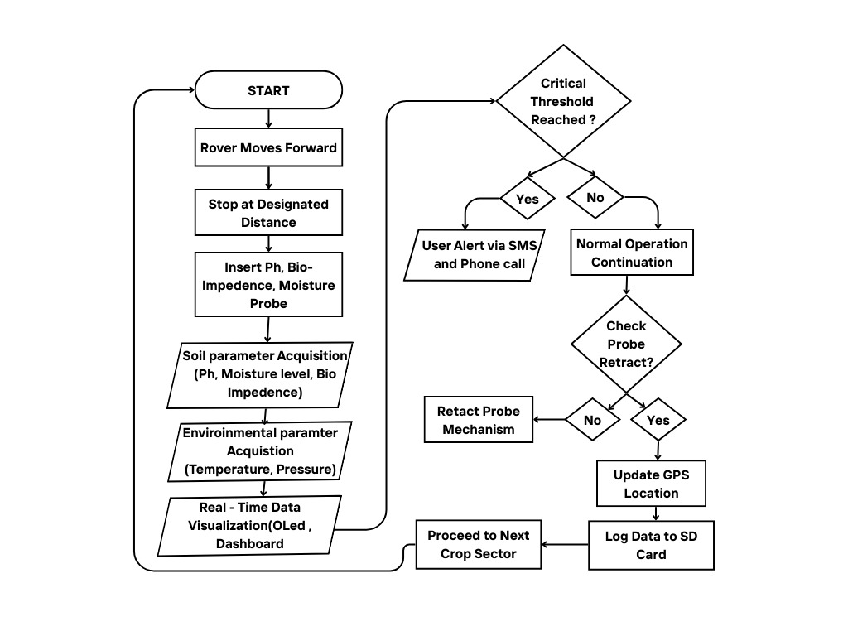
BLOCK DIAGRAM

Slide 10
NOVEL PROPOSED
GPS-based location-aware monitoring for precise field mapping.
Mobile robot designed to operate in paddy slurry conditions.
Root-zone soil probing for accurate underground data collection.
Multi-point sensing with sensor fusion for higher accuracy.
Integration of IoT, robotics for smart farming.

Slide 11
PROPOSED-MODULES
Sensor Module
Sensors collect soil and environmental data.
Robot Navigation Module
Robot navigates and probes field locations.
Data Processing Module
Processing unit performs data fusion and analysis
Communication Module
Communication module sends data via WiFi.
Geo Fencing Module
Gps module updates the location 0f the robot.

Slide 12
SOFTWARE & HARDWARE REQUIREMENTS
HARDWARE REQUIREMENTS
ESP32 Microcontroller – Controller for processing and communication
Soil Moisture Sensor – Measures water content in soil
pH Sensor – Detects soil acidity/alkalinity
Temperature & Humidity Sensor(BMP280) – Monitors environmental conditions
GPS Module (NEO-6M) – Provides location tracking for field mapping
DC Motors + Motor Driver (L298N) – Robot movement control
SOFTWARE REQUIREMENTS
Arduino IDE – Programming ESP32
Embedded C / C++ – Code development
WiFi Communication – Wireless connectivity

Slide 13
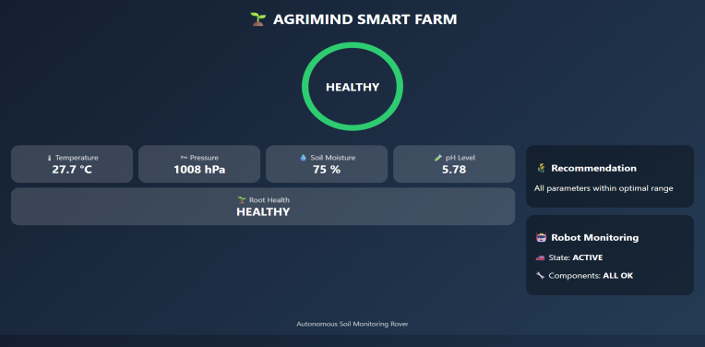
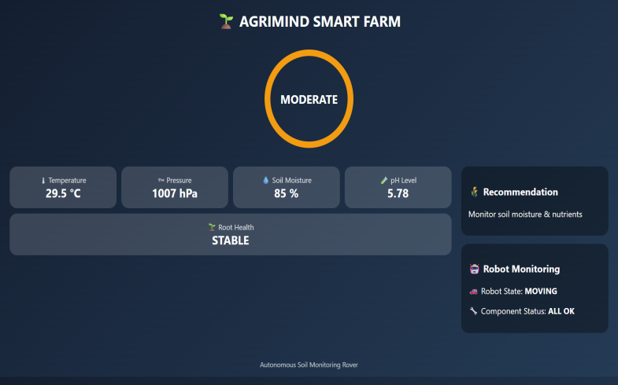
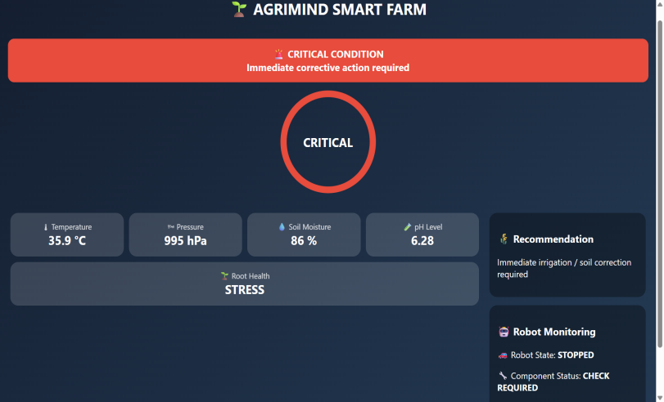
MODULE OUTPUT

Slide 14
RESULTS AND DISCUSSIONS
Parameter | Traditional Method | FarmBot Genesis (Existing System) | Proposed AgriMind System
Monitoring Type | Manual inspection | Automated but fixed system | Mobile + IoT + GPS
Field Coverage | Limited | Fixed area only | Full field (dynamic coverage)
Mobility | No | No (gantry-based) | Yes (mobile robot)
Data Accuracy | Low | Medium | High (multi-point sensing)
Root-zone Analysis | No | No | Yes
Sensing Type | Surface level | Surface level sensors | Root-zone + multi-sensor
Automation Level | None | Partial automation | Full (closed-loop control)
Crop Yield | Low | Moderate | High (≈28% improvement)
Labor Requirement | High | Medium | Low (≈32 hrs reduction)
GPS Mapping | No | No | Yes
Real-time Monitoring | No | Yes (limited) | Yes (continuous)
Scalability | Low | Limited | High
Suitability for Paddy Fields | Poor | Not suitable | Highly suitable

Slide 15
CONCLUSION
Integrated System Proven
First unified platform combining IoT monitoring + autonomous actuation
Quantified Benefits –
42% water savings, 28% yield improvement, 32 hrs/month labor reduction
Affordable & Scalable
ROI accessible to small farmers
Bridges the Gap
Transitions traditional farming → data- driven precision agriculture
Foundation for AI
Enables future integration of machine learning and advanced analytics
Rural Transformation
Potential to revolutionize agricultural livelihoods in India

Slide 16
FUTURE SCOPE
V2X Communication with Drone
Advanced ML/AI
Predictive analytics for yield forecasting, early pest/disease detection
Water Prediction and Control
Automated irrigation and drainage of excess water for minimal water wastage
Multi-Robot Swarms
Coordinate multiple robots for large-scale farm coverage
Blockchain Integration
Secure data sharing, traceability, farmer-to-market transparency
Solar & Battery Optimization
Extended autonomous operation, reduced energy costs
Farm Equipment Interoperability
Seamless integration with existing farm machinery.

Slide 17
References
M. Ayaz, M. Ammad-Uddin, Z. Sharif, A. Mansour and E. -H. M. Aggoune, "Internet-of-Things (IoT)-Based Smart Agriculture: Toward Making the Fields Talk," in IEEE Access, vol. 7, pp. 129551-129583, 2019, doi:10.1109/ACCESS.2019.2932609.
M. N. Islam Sarker, M. Wu, B. Chanthamith, S. Yusufzada, D. Li and J. Zhang, "Big Data Driven Smart Agriculture: Pathway for Sustainable Development," 2019 2nd International Conference on Artificial Intelligence and Big Data (ICAIBD), Chengdu, China, 2019, pp. 60-65,doi:0.1109/ICAIBD.2019.8836982.
P. Revathi and C. Rajasekaran, "Energy efficient wireless monitoring system for Agarian areas in Indian agricultural system using GPRS module," 2015 International Conference on Communications and Signal Processing (ICCSP), Melmaruvathur, India, 2015, pp. 0322-0326, doi: 10.1109/ICCSP.2015.7322897.
V. Chittem, S. K. Mukunda, E. S. R. Mudumala and G. C. V, "Smart Saffron Cultivation: An IoT-Based Environmental Monitoring and Control System with GSM Alert Integration," 2025 10th International Conference on Communication and Electronics Systems (ICCES), Coimbatore, India, 2025, pp. 665-669, doi: 10.1109/ICCES67310.2025.11337189

