Slide 1
RESEARCH PROJECT PRESENTATION • HEALTHCARE AI
HandRehab-AI: A Multimodal Framework Fusing Attentive Patient Diaries and Markerless Joint Kinematics
Longitudinal Telerehabilitation Monitoring via Multi-Task Recurrent NLP and Browser-Native Computer Vision
PROJECT HIGHLIGHTS & ARCHITECTURE OVERVIEW
• Clinical NLP: Multi-head BiLSTM + Additive Attention extracting Pain, Stiffness, Mobility, and Grip severities with causal attribution.
• Computer Vision: Real-time client-side MediaPipe Tasks Vision (21 3D landmarks, PIP flexion angles, active ROM 0°–100°, rep counter).
• Temporal Forecasting: 14-day sliding window Multi-Task GRU predicting next-day physical recovery and detecting plateaus/flare-ups.
• System Architecture: Privacy-preserving offline browser runtime with zero video stream transmission to remote servers.
⚠️ Clinical Notice: Observational telerehabilitation monitoring aid, not a diagnostic medical device. Synthetic/simulated datasets utilized. Alerts instruct patients: 'Consult your physiotherapist'.

Slide 2
01 | PROBLEM & OBJECTIVES
Clinical Background & Motivation: The Post-Surgical Rehab Void
1. Post-Surgical Healing Window
• High-Risk Conditions:
Flexor & extensor tendon repairs, distal radius wrist fractures, and metacarpal fractures.
• Early Mobilization Paradox:
Gentle active tendon gliding is mandatory within days 1–30 to avoid permanent scar tissue adhesions.
• Catastrophic Failure Modes:
Over-straining risks acute tendon rupture; under-straining leads to permanent joint contracture and stiffness.
• Daily Precision Required:
Consistent home exercises must adhere strictly to safe angular thresholds.
2. The Telerehabilitation Void
• Infrequent Clinic Visits:
Patients typically see their physical therapist only once every 2 to 4 weeks due to clinic capacity and travel costs.
• Blind Recovery Between Visits:
Clinicians have zero visibility into daily exercises performed during the 14–28 days at home.
• Silent Flare-Ups & Plateaus:
Secondary inflammatory flare-ups or recovery plateaus go unnoticed until irreversible loss of mobility occurs.
• Adherence Deterioration:
Over 60% of home patients gradually drop adherence without interactive, objective feedback.
3. Shortcomings of Existing Tools
• Paper / Unstructured Diaries:
Subjective, prone to retrospective recall bias, irregular logging, and completely non-actionable.
• Mechanical Goniometers:
Only usable by trained clinicians during in-person visits; impossible for patients to measure their own hand angles.
• Sensorized Gloves:
Commercial cybergloves cost $1,000–$5,000, require frequent calibration, and cause tactile discomfort on injured tissue.
• Siloed Solutions:
Current vision tools ignore subjective pain/stiffness; NLP tools ignore physical Range of Motion (ROM).

Slide 3
01 | PROBLEM & OBJECTIVES
Problem Formulation & Four Core Research Objectives
Problem Statement
Post-surgical hand telerehabilitation lacks an integrated, accessible framework that simultaneously captures subjective patient narratives and objective physical joint kinematics.
Key Unresolved Challenges:
1. Semantic Distortion in NLP: Standard clinical text processing strips negations and qualifiers (e.g., 'no pain but very stiff' misclassified as severe pain).
2. High Hardware Barrier: Existing kinematic measurement demands costly wearable sensors, preventing equitable home monitoring.
3. Anomaly Blindness: Tele-rehab platforms rely on static slope thresholds that collapse under daily physiological sensor noise, failing to catch plateaus and flare-ups.
Objective 1: Multi-Head Explainable Clinical NLP
Develop a multi-task sequence architecture (BiLSTM + Attention) predicting 4 discrete symptom severities (0–3) for Pain, Stiffness, Mobility, and Grip, maintaining negations and causal token attribution.
Objective 2: Markerless Real-Time Optical Kinematics
Implement client-side MediaPipe Tasks Vision in JavaScript/WASM to compute 21 3D joint landmarks, PIP flexion angles, active ROM (0°–100°), and rep counting without specialized hardware.
Objective 3: Longitudinal Forecasting & Flare-Up Detection
Train multi-task recurrent sequence models over 14-day historical trajectories to forecast next-day physical recovery and classify trajectory state (Normal vs. Plateau vs. Acute Relapse).
Objective 4: Integrated Privacy-First Web Architecture
Build an offline-ready, responsive dashboard (Flask + SQLite + Chart.js) with zero external video streaming, condition-specific exercise guidance, and ethical non-diagnostic transparency.

Slide 4
02 | LITERATURE SURVEY
Critical Review of Prior Works & Identified Research Gaps
Research Domain | Representative Works | Methodology & Strengths | Critical Limitations & Gaps
Sensorized Gloves & Hardware | Simone et al. (2007) Kramer et al. (CyberGlove) Lin et al. (2020) | High physical precision; measures strain gages and bend angles directly on hand joints. | Prohibitive cost ($1,000–$5,000); discomfort on swollen tissue; requires frequent calibration; non-scalable.
Clinical NLP & Sentiment Models | BioBERT (Lee et al., 2020) ClinicalBERT (Alsentzer) Dernoncourt et al. (2017) | Extracts clinical entities from hospital EHR notes; high general linguistic capability. | Generic stopword lists drop vital negations ('no pain'); lack hand-specific functional severity heads (0–3).
Markerless Computer Vision | Lugaresi et al. (MediaPipe 2019) Cao et al. (OpenPose) Mathis et al. (DeepLabCut) | Zero hardware cost; monocular RGB landmark tracking; accessible via standard webcams. | Operates in a physical silo; completely blind to internal patient symptoms (pain, stiffness, grip fatigue).
Longitudinal Trend Analytics | Rule-Based Tele-Rehab (2018) Moving Average Models Standard Linear Slopes | Simple heuristics for clinical reporting; easy to interpret in dashboards. | Fails under daily sensor noise; cannot distinguish temporary rest from genuine recovery plateaus.
🎯 Core Research Gap Addressed by HandRehab-AI:
No prior framework unifies daily patient narrative self-reports with markerless optical joint kinematics in an offline, privacy-first web architecture. HandRehab-AI bridges this divide by fusing explainable NLP severity extraction with 3D joint biomechanics and longitudinal recurrent sequence forecasting.

Slide 5
03 | PROPOSED SYSTEM
HandRehab-AI: Multimodal Rehabilitation Framework
Pillar 1: Negation-Preserving Diary NLP
• Clinical Multi-Task Heads: Simultaneous prediction of 4 severity scores (0 to 3) for Pain, Stiffness, Mobility Limitation, and Grip Weakness.
• Negation & Qualifier Integrity: Strict retention of negation operators ('no', 'not', 'never', 'without') and qualifiers ('bit', 'slightly', 'barely').
• Frozen Semantic Embeddings: GloVe 100d word vectors frozen to evaluate true generalization under fixed semantic spaces.
• Explainable Causal Attribution: Leave-one-out token occlusion and attention weights highlighting causal symptom words (e.g., 'sharp', 'throbbing', 'stiff') directly in the UI.
Pillar 2: Markerless Joint Kinematics
• Edge WebAssembly Execution: MediaPipe Tasks Vision running locally inside JavaScript; zero raw video streamed to remote servers.
• 3D Anatomical Trigonometry: Real-time PIP joint angle computation (Index: 5-6-7, Middle: 9-10-11) via 3D vector dot products.
• Active Range of Motion (ROM): Functional flexion computed in degrees (0°–100°) dynamically tracking finger curl depth.
• Adaptive Exercise Guidance: Condition-specific routines tailored to 6 distinct post-surgical conditions (Flexor Tendon, Extensor Tendon, Wrist Fracture, Carpal Tunnel, Metacarpal, General).
Pillar 3: Longitudinal Forecasting
• 14-Day Temporal Window: Sequence models process 5 daily features [Pain, Stiffness, Mobility, Grip, ROM] over a two-week historical context.
• Dual Multi-Task Objectives: Simultaneous 1-day ahead physical trajectory regression (MAE, RMSE) and 3-state clinical status classification.
• Robust Anomaly Classification: Detects Normal Progression, Recovery Plateaus, and Acute Flare-Ups while filtering daily noise spikes.
• Patient-Centric Transparency: Separates objective real data charts from AI forecasts; alerts strictly instruct consultation with physiotherapist.

Slide 6
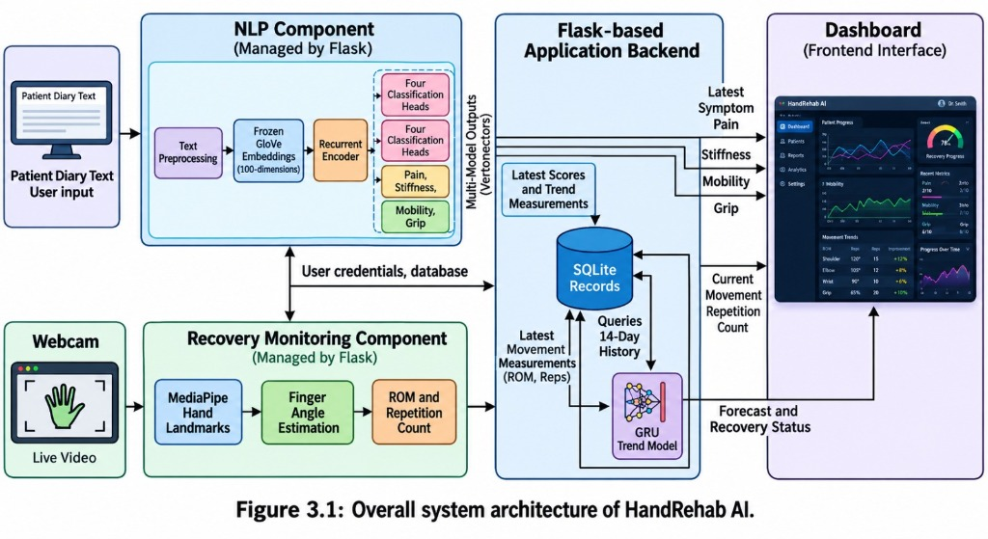
04 | SYSTEM ARCHITECTURE
End-to-End Multimodal System Architecture
Layer 1: Data Ingestion & Preprocessing
• Text Tokenization with Negation & Qualifier Preservation ('no', 'not', 'slightly').
• Local WebAssembly Video Stream decoding 21 3D landmarks at 30+ FPS.
• SQLite Patient Profile and Longitudinal Historical Repository.
Layer 2: AI Core & Deep Learning Engine
• Multi-Head BiLSTM + Additive Attention NLP (Frozen GloVe 100d).
• 3D Trigonometric Joint Angle & Active Range of Motion (ROM) Engine.
• Multi-Task Temporal GRU (14-day window for regression + anomaly classification).
Layer 3: Clinical Presentation & Telerehabilitation
• Flask REST API exposing POST /api/diary, /api/trend, and /api/user/record.
• Responsive Dashboard with Chart.js visualization (3 dedicated patient charts).
• Explainable causal word attribution chips and non-diagnostic alert banners.

Slide 7
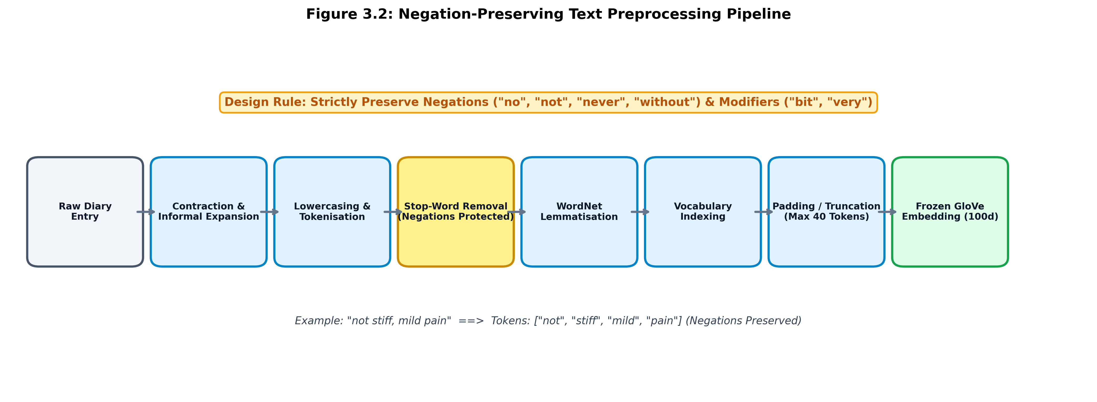
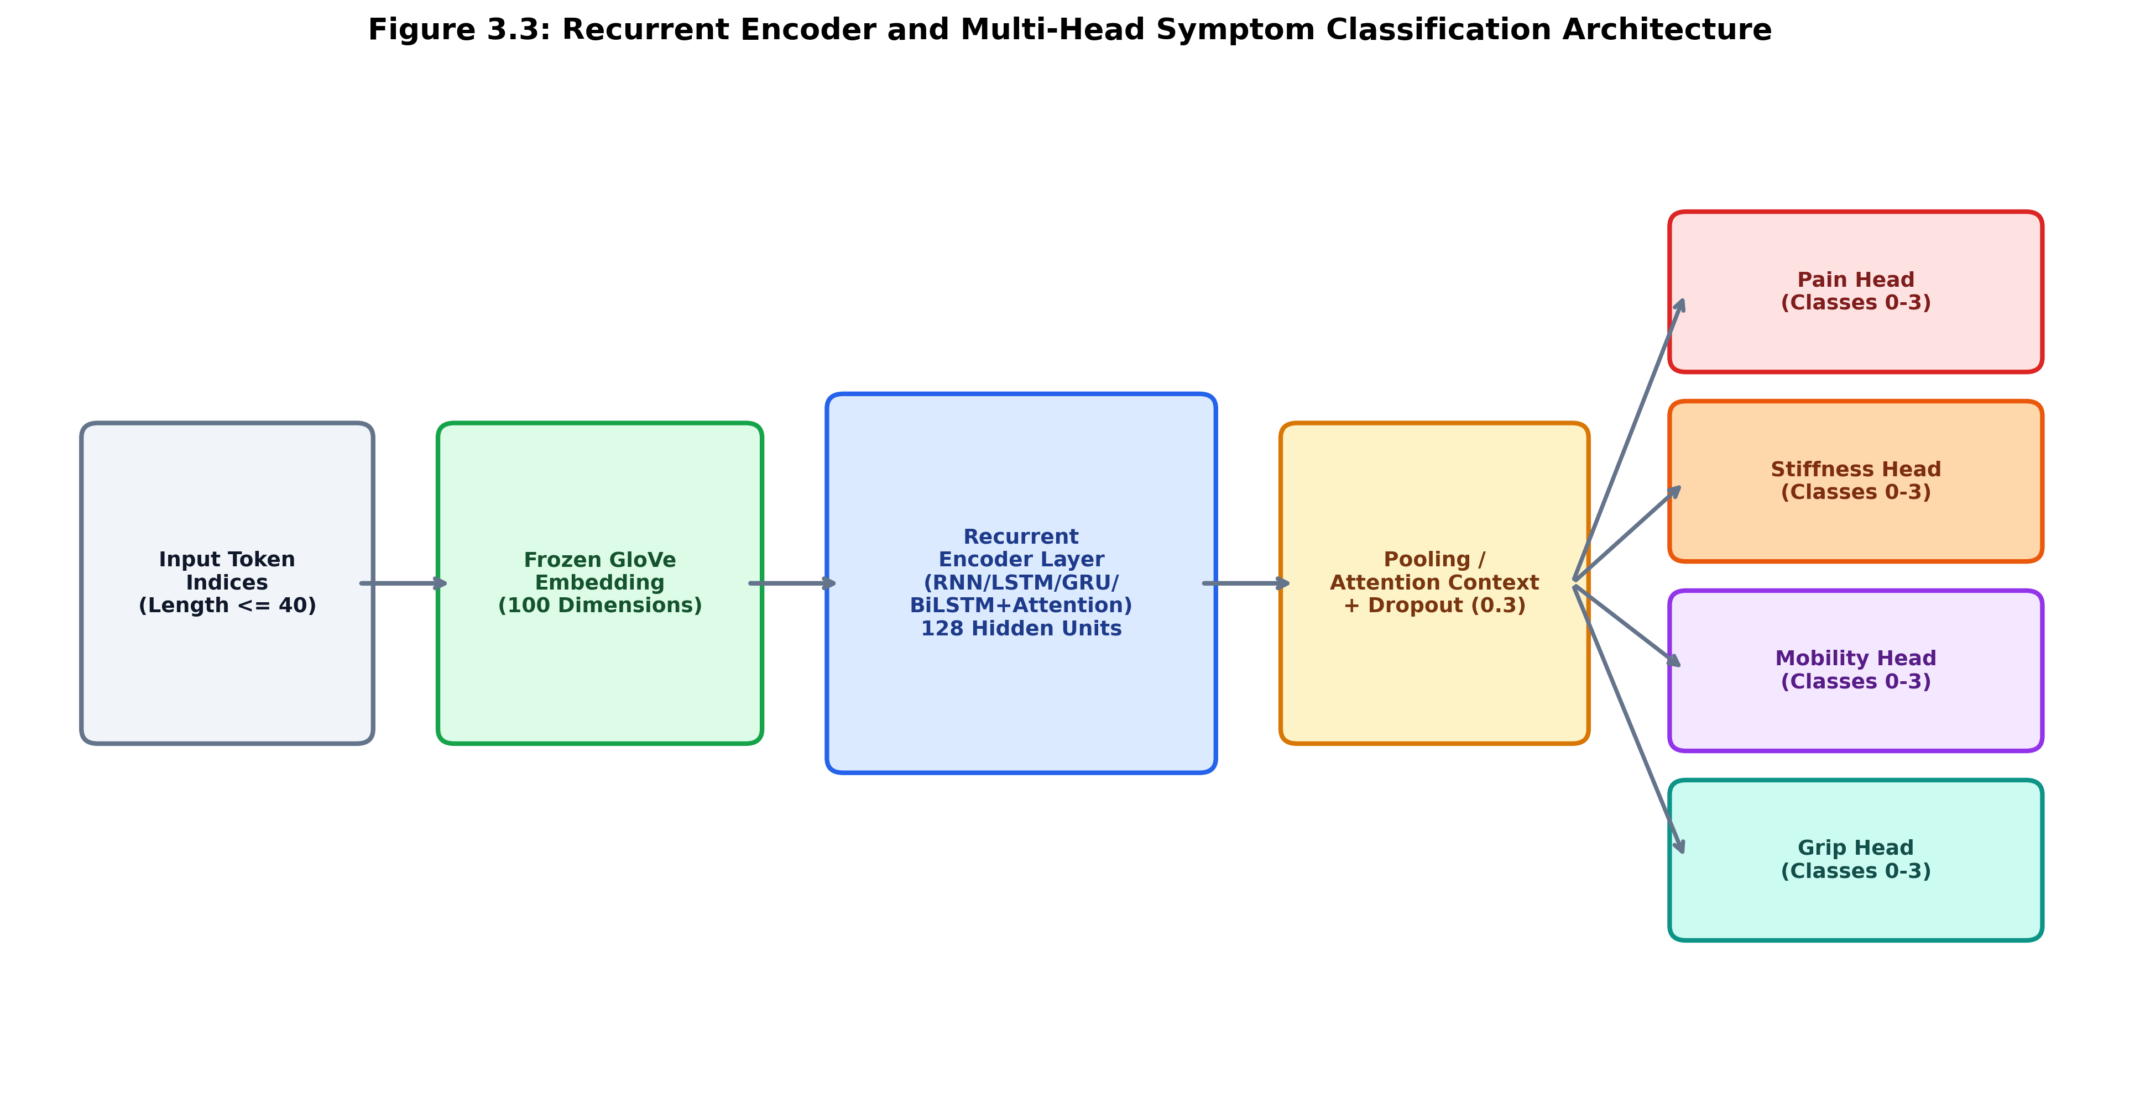
05 | IMPLEMENTATION & DEMO
Methodology: Negation-Preserving NLP & Causal Attribution
Negation Preservation & Multi-Head Scheme
• Tokenization & Lemmatization with Negation Guard: Words like 'no', 'not', 'never', 'without' and degree modifiers ('bit', 'slightly', 'barely') are explicitly exempt from stopword pruning.
• Formulation: 4 symptom dimensions (Pain, Stiffness, Mobility, Grip) × 4 severity levels (0=None, 1=Mild, 2=Moderate, 3=Severe) = 16 classification heads.
• Frozen GloVe 100d Embeddings ensure fair, fixed semantic evaluation without vocabulary drift.
Attention & Leave-One-Out Causal Attribution
• Additive Sequence Attention: Context vector c = Σ α_t h_t allows the network to weight high-salience symptom tokens.
• Causal Attribution via Leave-One-Out Occlusion:
Δ_i = Σ_s || P(Y_s | X) - P(Y_s | X_\i) ||_1
• Quantifies exact probability shift induced by removing word i; tokens exceeding the causal threshold are rendered as interactive highlighted chips in the UI.

Slide 8
05 | IMPLEMENTATION & DEMO
Methodology: Markerless Computer Vision & 3D Kinematics
1. Markerless Optical Kinematics
• MediaPipe Tasks Vision Edge Inference:
Executes natively in client browser using WebAssembly. Detects 21 3D hand landmarks at 30+ FPS without transmitting video to any cloud server.
• 3D PIP Joint Angle Calculation:
Computed via 3D vector dot product across proximal interphalangeal joints (Index: 5-6-7, Middle: 9-10-11):
θ = arccos((BA · BC) / (||BA|| ||BC||))
Robust against camera perspective skew and depth variations.
• Active Range of Motion (ROM):
Quantifies functional active flexion (0°–100°):
ROM = clip(180.0° - θ_PIP, 0.0, 100.0)
• Hysteresis Repetition State Machine:
FLEX_THRESH ≤ 85.0° triggers FLEXED state;
EXTEND_THRESH ≥ 140.0° registers +1 Rep and resets to EXTENDED state, preventing false bounces.
2. Multi-Task Longitudinal Modeling
• 14-Day Sliding Window:
Processes sequence X = [x_{t-13}, ..., x_t] containing 5 daily physical features: [Pain, Stiffness, Mobility, Grip, ROM].
• Dual Prediction Head:
• Head 1 (Continuous Regression): Predicts next-day physical recovery vector y_{t+1} (Loss: Mean Squared Error).
• Head 2 (Clinical Status Classification): Predicts trajectory health state c_{t+1} ∈ {Normal Recovery, Plateau, Flare-Up} (Loss: Cross-Entropy).
• Multi-Task Loss Balancing:
L_total = L_regression + λ * L_classification
Trained with early stopping on validation loss across fixed seeds (42, 43, 44).
• Noise Robustness:
GRU temporal recurrence acts as an adaptive low-pass filter, maintaining alert accuracy where rule-based heuristics fail under noisy real-world data.

Slide 9
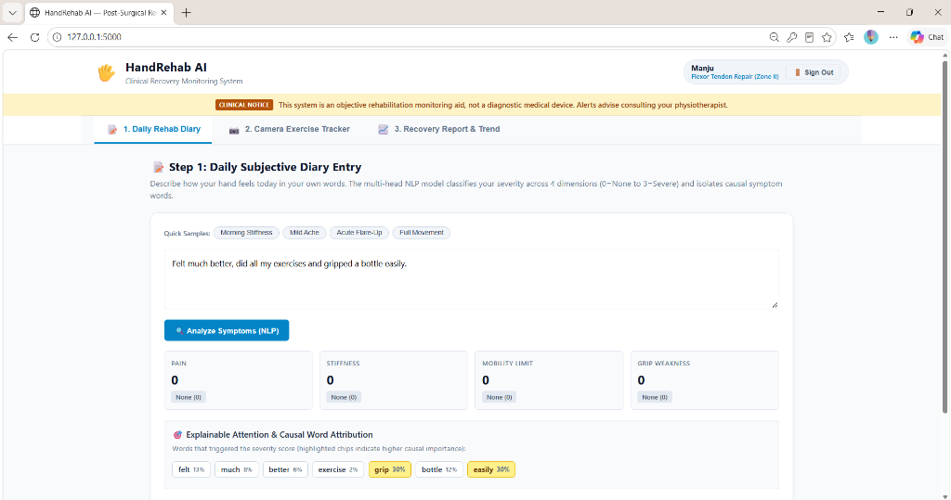
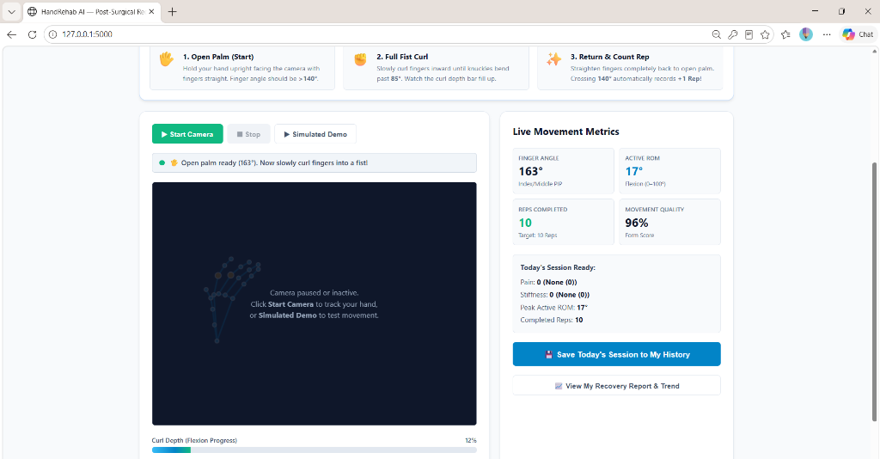
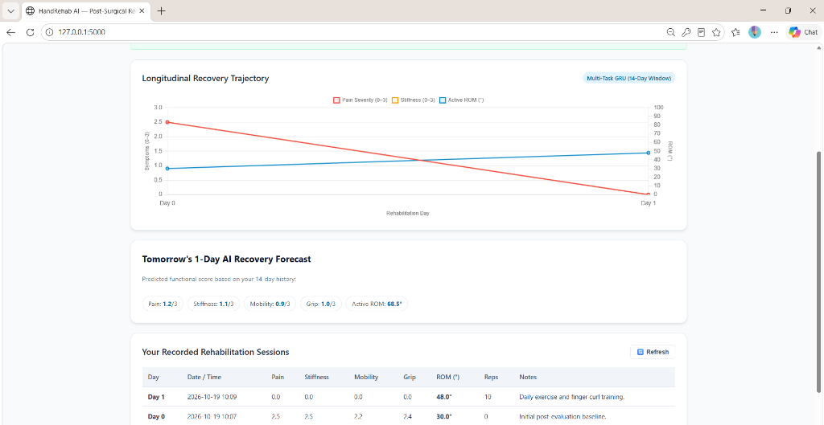
05 | IMPLEMENTATION & DEMO
System Implementation: Three-Step Clinical Patient Workflow
Step 1: Daily Rehab Diary
• Natural language self-report input.
• Instant extraction of 4 symptom scores.
• Explainable causal attention chips.
• Today's Session Summary & Save actions.
Step 2: Camera Exercise Tracker
• Real-time MediaPipe hand landmark tracking.
• Live joint angle & active ROM display.
• Curl depth progress bar & rep counter.
• Condition-guided 3-step exercise cues.
Step 3: Recovery Progress
• 3 real-data charts (Pain/Stiff, ROM, Grip).
• 6 patient-friendly recovery cards.
• Plain-English ROM educational definitions.
• AI-estimated recovery & clinical alert banner.

Slide 10
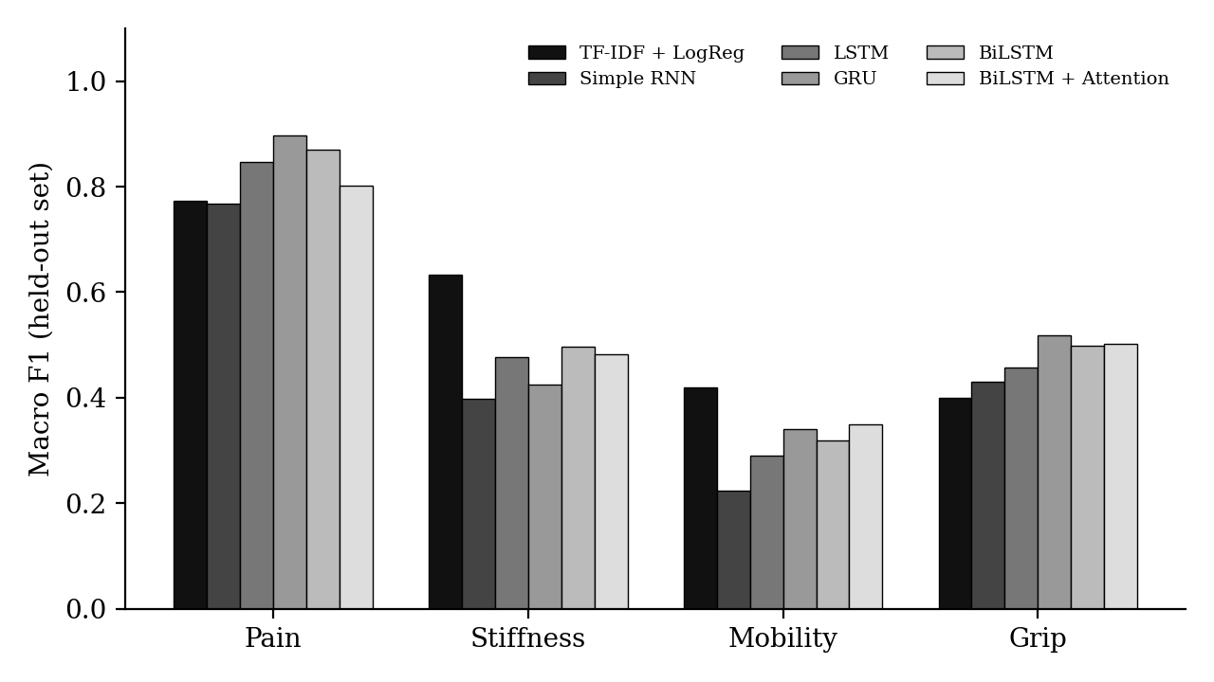
06 | RESULT & DISCUSSION
Experimental Results: Multi-Head Diary NLP Benchmarks
Model | Synth Acc | Synth F1 | Held-Out Acc | Held-Out F1 (95% CI)
TF-IDF + LogReg | 0.985 ± 0.000 | 0.985 | 0.726 ± 0.000 | 0.556 [0.47, 0.62]
Simple RNN | 0.714 ± 0.002 | 0.685 | 0.586 ± 0.018 | 0.455 [0.38, 0.51]
LSTM | 0.901 ± 0.009 | 0.891 | 0.667 ± 0.007 | 0.518 [0.44, 0.58]
GRU | 0.927 ± 0.008 | 0.919 | 0.695 ± 0.008 | 0.545 [0.46, 0.61]
BiLSTM | 0.939 ± 0.008 | 0.933 | 0.696 ± 0.007 | 0.546 [0.46, 0.61]
BiLSTM + Attention | 0.930 ± 0.008 | 0.924 | 0.679 ± 0.019 | 0.534 [0.45, 0.60]
Key Findings & Analytical Discussion:
• Synthetic-to-Real Generalization Gap: Models achieve >90% Macro F1 on synthetic test templates, but drop to 51.8%–55.6% on the held-out set (N=62) due to complex compounding syntax and colloquial expressions.
• Overlapping Bootstrap 95% CIs: The held-out confidence intervals for TF-IDF ([0.47, 0.62]), BiLSTM ([0.46, 0.61]), and GRU ([0.46, 0.61]) heavily overlap, demonstrating that n-gram baselines remain competitive on short clinical texts, while BiLSTM provides token-level attention explainability.
• Symptom Sensitivity Asymmetry: Pain achieved highest sensitivity (F1 up to 0.897 with GRU), while Mobility and Grip exhibited lower F1 (0.32–0.52) due to clinical symptom overlap in patient descriptions.

Slide 11
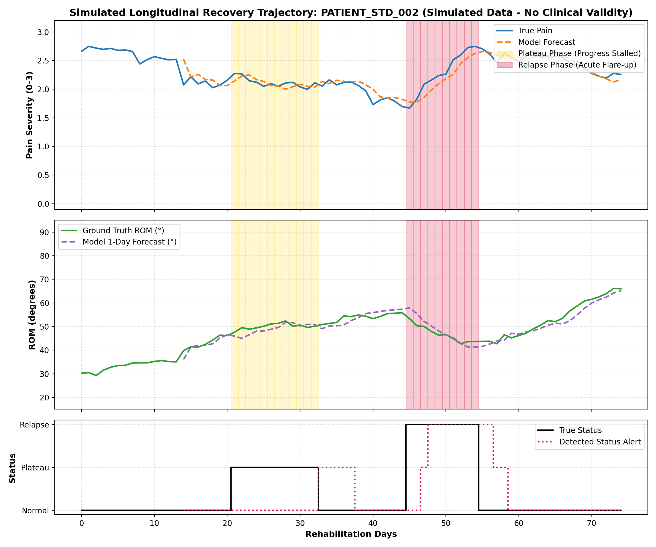
06 | RESULT & DISCUSSION
Experimental Results: Recovery Trajectory Forecasting & Alerts
Model | Forecast MAE | ROM MAE (°) | Status Acc | Status Macro F1
Tomorrow = Today (Naive) | 0.284 | 1.21° | 0.745 | 0.285 (Fails Anomaly)
7-Day Moving Avg | 0.673 | 2.92° | 0.745 | 0.285 (Fails Anomaly)
Rule-Based Threshold | 0.284 | 1.21° | 0.720 | 0.509 (Clean Data)
Rule-Based (Noisy) | 0.701 | 2.87° | 0.473 | 0.307 (Degrades Under Noise)
LSTM (Standard) | 0.563 ± 0.016 | 2.37 ± 0.09° | 0.737 ± 0.013 | 0.582 ± 0.006
GRU (Selected Best) | 0.475 ± 0.027 | 1.99 ± 0.12° | 0.758 ± 0.006 | 0.611 ± 0.009 (Best)
Forecasting vs Alerting Asymmetry & Key Takeaways:
• Forecasting Asymmetry: Naive Persistence ('Tomorrow = Today') achieves lowest MAE (0.284) because biological healing progresses smoothly day-by-day. Neural models exhibit slight regression shrinkage that inflates 1-day point MAE.
• Anomaly Classification Superiority: Persistence fails completely on clinical alerts (Macro F1 = 0.285, unable to detect state transitions). Rule-based slopes collapse under realistic sensor noise (F1 drops 0.509 -> 0.307).
• Selected Architecture (GRU): Multi-Task GRU achieves highest Status Macro F1 (0.611 on standard, 0.438 on out-of-distribution noisy patients) by capturing 14-day temporal context and filtering daily noise spikes.

Slide 12
06 | RESULT & DISCUSSION
Discussion: Clinical Insights, Ethical Positioning & Trade-offs
1. Synthetic-to-Real Domain Shift
The empirical drop from >90% to ~55% F1 on held-out text mirrors real clinical deployment challenges. Template generation guarantees grammatical purity, while actual patient notes contain compound sentences, misspellings, and mixed-sentiment clauses. This underscores the necessity of continuous feedback loops in post-surgical monitoring.
2. Explainability & Causal Attribution
Black-box AI is unacceptable in healthcare tele-monitoring. By coupling additive sequence attention with leave-one-out probability shifts (Δ_i), HandRehab-AI renders the exact symptom tokens driving scores into interactive UI chips, allowing physical therapists to verify that clinical reasoning aligns with medical intent.
3. Privacy-Preserving Edge Computer Vision
Transmitting private patient home webcam video over the internet introduces immense regulatory, HIPAA, and ethical hurdles. Executing MediaPipe Tasks Vision entirely client-side via WebAssembly provides zero-trust privacy: landmarks and ROM are computed locally, and only numerical vectors are saved.
4. Honest Limitations & Non-Diagnostic Stance
HandRehab-AI is deliberately positioned as an observational pair-monitoring aid, not a diagnostic medical device. Synthetic and simulated datasets are explicitly disclosed. Warning banners systematically instruct patients: 'Consult your physiotherapist', maintaining clinical safety and ethical compliance.

Slide 13
07 | CONCLUSION & FUTURE WORK
Concluding Remarks & Strategic Future Roadmap
Summary of Contributions
• Multimodal Fusion:
Demonstrated that combining subjective patient diaries with objective markerless joint kinematics bridges the tele-rehab monitoring gap.
• Negation & Semantic Integrity:
Preserving negations ('no', 'not', 'without') eliminates critical clinical misclassification in patient self-reports.
• Explainable Architecture:
BiLSTM + Attention with leave-one-out causal attribution makes deep learning predictions transparent and auditable for therapists.
• Robust Anomaly Detection:
Multi-Task GRU successfully detects clinical plateaus and inflammatory relapses while filtering everyday sensor noise spikes.
• Zero-Cost Accessible Delivery:
Fully client-side browser runtime provides accessible, offline-capable tracking without requiring expensive sensorized gloves.
Strategic Future Roadmap
• 1. Sign-Language Dexterity Gamification:
Transform finger curl exercises into interactive sign recognition challenges (ASL/ISL finger spelling), boosting patient motivation through motor gamification.
• 2. Whisper Multilingual Voice Diary:
Integrate hands-free automatic speech recognition (OpenAI Whisper) to enable effortless voice self-reporting for patients with severe bilateral hand trauma.
• 3. Pretrained Biomedical LLM Fine-Tuning:
Benchmark domain-specific transformers (BioBERT, ClinicalBERT, Med-PaLM) against lightweight recurrent models to evaluate inference latency vs semantic nuances.
• 4. Dynamic Exercise Progression Engine:
Develop automated adaptive recommendation algorithms that adjust rep targets and flexion goals as patient recovery progresses.
• 5. Prospective Clinical Cohort Validation:
Partner with post-surgical orthopedic clinics to benchmark HandRehab-AI against physical therapist goniometric evaluations on real recovering patients.

Slide 14
Thank You!
HandRehab-AI: Open, Objective & Attentive Post-Surgical Tele-Monitoring
VERIFIED PROJECT ARTIFACTS & DELIVERABLES
✔ Complete Project Documentation: docs/HandRehab_AI_Project_Report.docx (Full IEEE-formatted academic project report).
✔ Automated Test Suite: 59 passed unit tests (100% passing rate across NLP, Vision, Trend, and API endpoints).
✔ Functional Web Dashboard: Local Flask backend + JavaScript frontend running on http://127.0.0.1:5000 (offline ready).
✔ Rigorous Reproducibility: PyTorch, fixed random seeds (42, 43, 44), 1,000 bootstrap confidence intervals, and benchmark CSVs in results/.
Questions & Discussion • HandRehab-AI Research Group

