Slide 1

Internship 1 (ADA23IN101)
FINAL REVIEW
Project Type / Domain: Internal / Machine Learning & Medical Computer Vision
Project Title: RetinaVision AI: Dual Attention-Enhanced CNN Ensemble for Explainable Diabetic Retinopathy Classification
Presented By: 1. Paarkavi M R (E0324045)
2. Manju V (E0324051)
Guided By: Dr. Deena S, Assistant Professor, Dept. of AI & DA

Slide 2
Contents
1. Introduction (Background Research)
2. Problem Statement
3. Literature Survey (Min. 4 Research Papers)
4. Objective
5. Workflow Diagram
6. Methodology
7. Tools and Techniques
8. Implementation (Dataset / Setup / Metrics)
9. Result Analysis (Graphs & Screenshots)
10. Timeline
11. Conclusion
12. Future Scope
13. References (Min. 10 References)

Slide 3
Introduction
Diabetic Retinopathy (DR) is a progressive microvascular complication of diabetes mellitus, damaging retinal capillaries and remaining a principal cause of preventable adult blindness worldwide.
The disease progresses silently through five international clinical severity stages: No DR (Stage 0), Mild DR (Stage 1), Moderate DR (Stage 2), Severe DR (Stage 3), and Proliferative DR (Stage 4).
Timely clinical intervention in early stages can prevent over 90% of severe visual impairment, but manual fundus examination is time-consuming, expensive, and constrained by specialist shortages.
RetinaVision AI develops an automated, end-to-end deep learning framework coupling dual-attention CNN backbones (ResNet50 + EfficientNet-B0) with Grad-CAM visual explanations for transparent screening.

Slide 4
Problem Statement
Subtle Inter-Stage Lesion Boundaries: Discriminating between adjacent severity stages (e.g., subtle microaneurysms in Mild vs. hard exudates in Moderate) is challenging due to continuous pathological progression.
Extreme Dataset Class Imbalance: Medical fundus datasets naturally contain predominantly healthy cases, causing standard classifiers to heavily bias toward majority classes while failing on critical severe stages.
Lack of Clinical Interpretability ('Black-Box' Nature): Standard deep neural networks produce bare numerical predictions without spatial evidence, severely restricting clinician trust and diagnostic utility.
Proposed Solution: We design RetinaVision AI—a dual-attention ResNet50 and EfficientNet-B0 ensemble trained with multi-class Focal Loss and equipped with Grad-CAM visual heatmaps for trustworthy clinical decision support.

Slide 5
Literature Survey
Research Paper Title & Year | Author & Publication | Methodology | Advantages | Limitations
Development and Validation of a Deep Learning Algorithm for Detection of Diabetic Retinopathy (2016) | Gulshan et al. JAMA | Deep CNN (Inception-v3) trained on 128,175 retinal fundus images for automated DR detection. | High sensitivity (97.5%) and specificity (93.4%); benchmark clinical validation. | Binary screening only; unable to grade 5 distinct DR severity stages; lacks visual interpretability.
Deep Learning for Diabetic Retinopathy Screening (2017) | Quellec et al. Medical Image Analysis | Weakly-supervised ConvNet with backpropagation saliency heatmaps for DR grading. | Provides lesion localization without requiring manual pixel-level bounding-box annotations. | Prone to false alarms on imaging artifacts; lower recall on intermediate mild/severe cases.
CBAM: Convolutional Block Attention Module (2018) | Woo et al. Proc. ECCV | Sequential channel-wise and spatial-wise attention mechanism for deep feature recalibration. | Lightweight plug-and-play module; adaptively boosts subtle lesion features and suppresses noise. | Evaluated on natural scene images; requires domain-specific tuning for retinal fundus images.
Grad-CAM: Visual Explanations from Deep Networks via Gradient Localization (2017) | Selvaraju et al. Proc. IEEE ICCV | Gradient-weighted class activation mapping producing 2D visual heatmaps from final conv layers. | Model-agnostic interpretability; provides visual validation for human-in-the-loop review. | Coarse spatial resolution; cannot delineate minute microvascular boundaries or single microaneurysms.

Slide 6
Objective
Design and develop RetinaVision AI, an automated, end-to-end deep learning framework for classifying retinal fundus images into five clinical Diabetic Retinopathy severity stages.
Implement a Dual-Attention ResNet50 architecture incorporating sequential channel and spatial attention modules to effectively capture subtle microvascular lesions.
Construct a confidence-weighted ensemble combining ResNet50 (0.7) and EfficientNet-B0 (0.3) to maximize multi-scale feature representation and classification robustness.
Formulate a class-imbalance-aware training strategy utilizing multi-class Focal Loss and stratified 70/15/15 dataset partitioning to boost minority-class sensitivity.
Integrate Grad-CAM for transparent visual feature attribution and deploy a lightweight, interactive Flask web application for research demonstration and real-time screening.

Slide 7
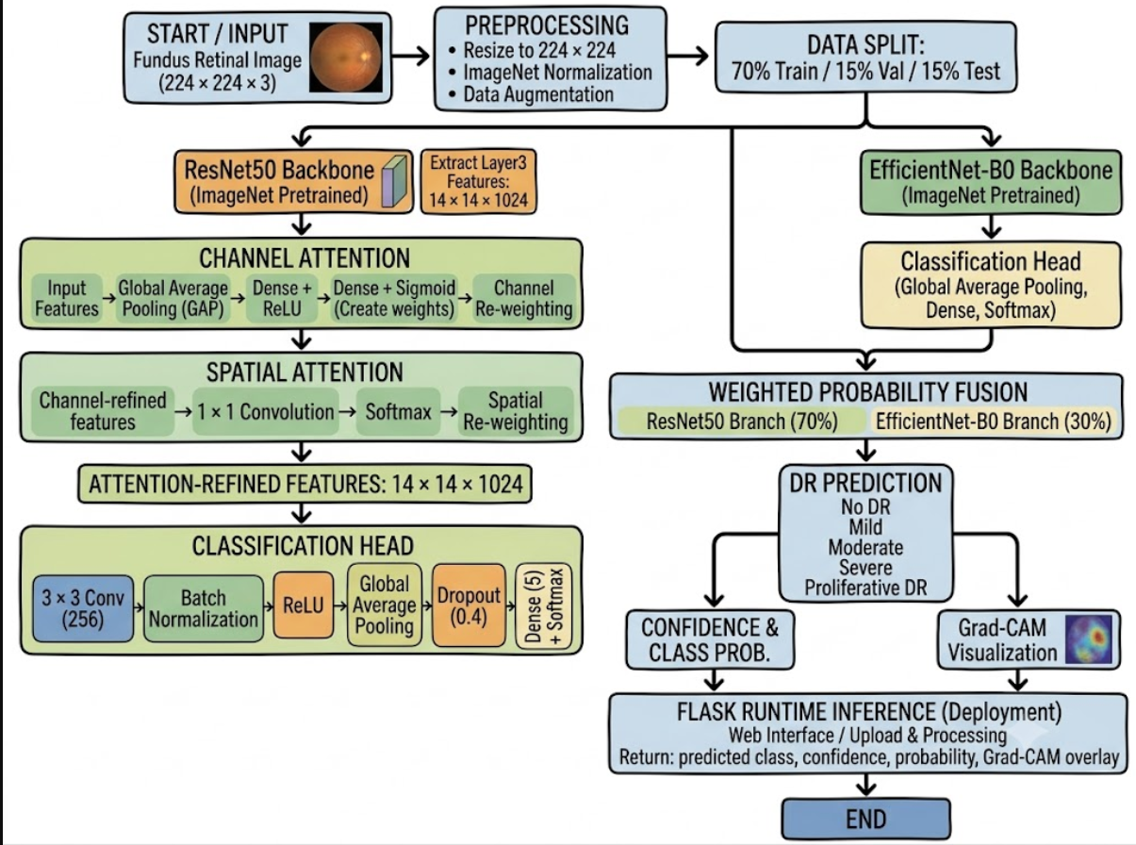
Workflow Diagram
Figure 1: End-to-End System Architecture and Workflow Pipeline of RetinaVision AI

Slide 8
Methodology
Dual-Branch Deep Architecture: ResNet50 extracts rich hierarchical representations, while EfficientNet-B0 provides complementary compound-scaled multi-scale features.
Sequential Dual-Attention Unit: Channel Attention (GAP -> FC -> ReLU -> FC -> Sigmoid) adaptively recalibrates feature channel weights; Spatial Attention (1x1 Conv -> Softmax) highlights lesion coordinates on layer 3 feature maps.
Classification Head & Loss Strategy: Attention features pass through 3x3 Conv, BatchNorm, ReLU, Global Average Pooling, Dense(128), and Dense(5). Trained via Multi-class Focal Loss (gamma = 2.0) with AdamW optimization and ReduceLROnPlateau scheduler.
Confidence-Weighted Ensemble & Explainability: Merges branch softmax probabilities via 0.7 x P(ResNet50) + 0.3 x P(EfficientNet-B0). Computes class-specific Grad-CAM gradients from ResNet layer 3 to produce 224x224 JET heatmap overlays.

Slide 9
Tools and Techniques
Deep Learning Framework: PyTorch 2.x, Torchvision, and CUDA GPU acceleration for robust tensor operations, model backbones, and gradient backpropagation.
Neural Architectures & Attention: Pretrained ResNet50, EfficientNet-B0, and custom Convolutional Block Attention Modules (CBAM: Channel + Spatial attention).
Preprocessing & Augmentation: OpenCV, PIL, and Torchvision transforms (Random Resized Crop, Horizontal/Vertical Flips, Rotation, and Color Jitter).
Explainable AI (XAI): Grad-CAM (Gradient-weighted Class Activation Mapping) for visual saliency heatmap generation and feature attribution.
Deployment & Web Stack: Python 3.10 backend with Flask RESTful API (/predict, /sample, /health), coupled with HTML5, CSS3, and JavaScript frontend.
Evaluation & Optimization: Scikit-learn, Matplotlib, and Seaborn for confusion matrix generation, per-class recall, precision, and Cohen's quadratic weighted kappa.

Slide 10
Implementation
Dataset Description: Evaluated on Kaggle Gaussian-filtered fundus images comprising 3,661 scans across 5 clinical stages: No DR (1,805), Mild (370), Moderate (999), Severe (193), and Proliferative DR (295).
Partitioning & Augmentation: Stratified 70/15/15 split preserving class proportions across Train (2,562), Validation (546), and Held-out Test (553) sets. Images resized to 224x224 and normalized using ImageNet statistics.
Environment Setup: Implemented in Python 3.10 and PyTorch with CUDA GPU acceleration, automated checkpoint validation monitoring (best_model_accuracy_RECOVERED.pth), and deterministic test pipelines.
Evaluation Metrics: Comprehensive evaluation assessing Overall Accuracy, Macro/Weighted Precision, Macro/Weighted Recall, Macro F1-Score, and Cohen's Weighted Quadratic Kappa (kappa).

Slide 11
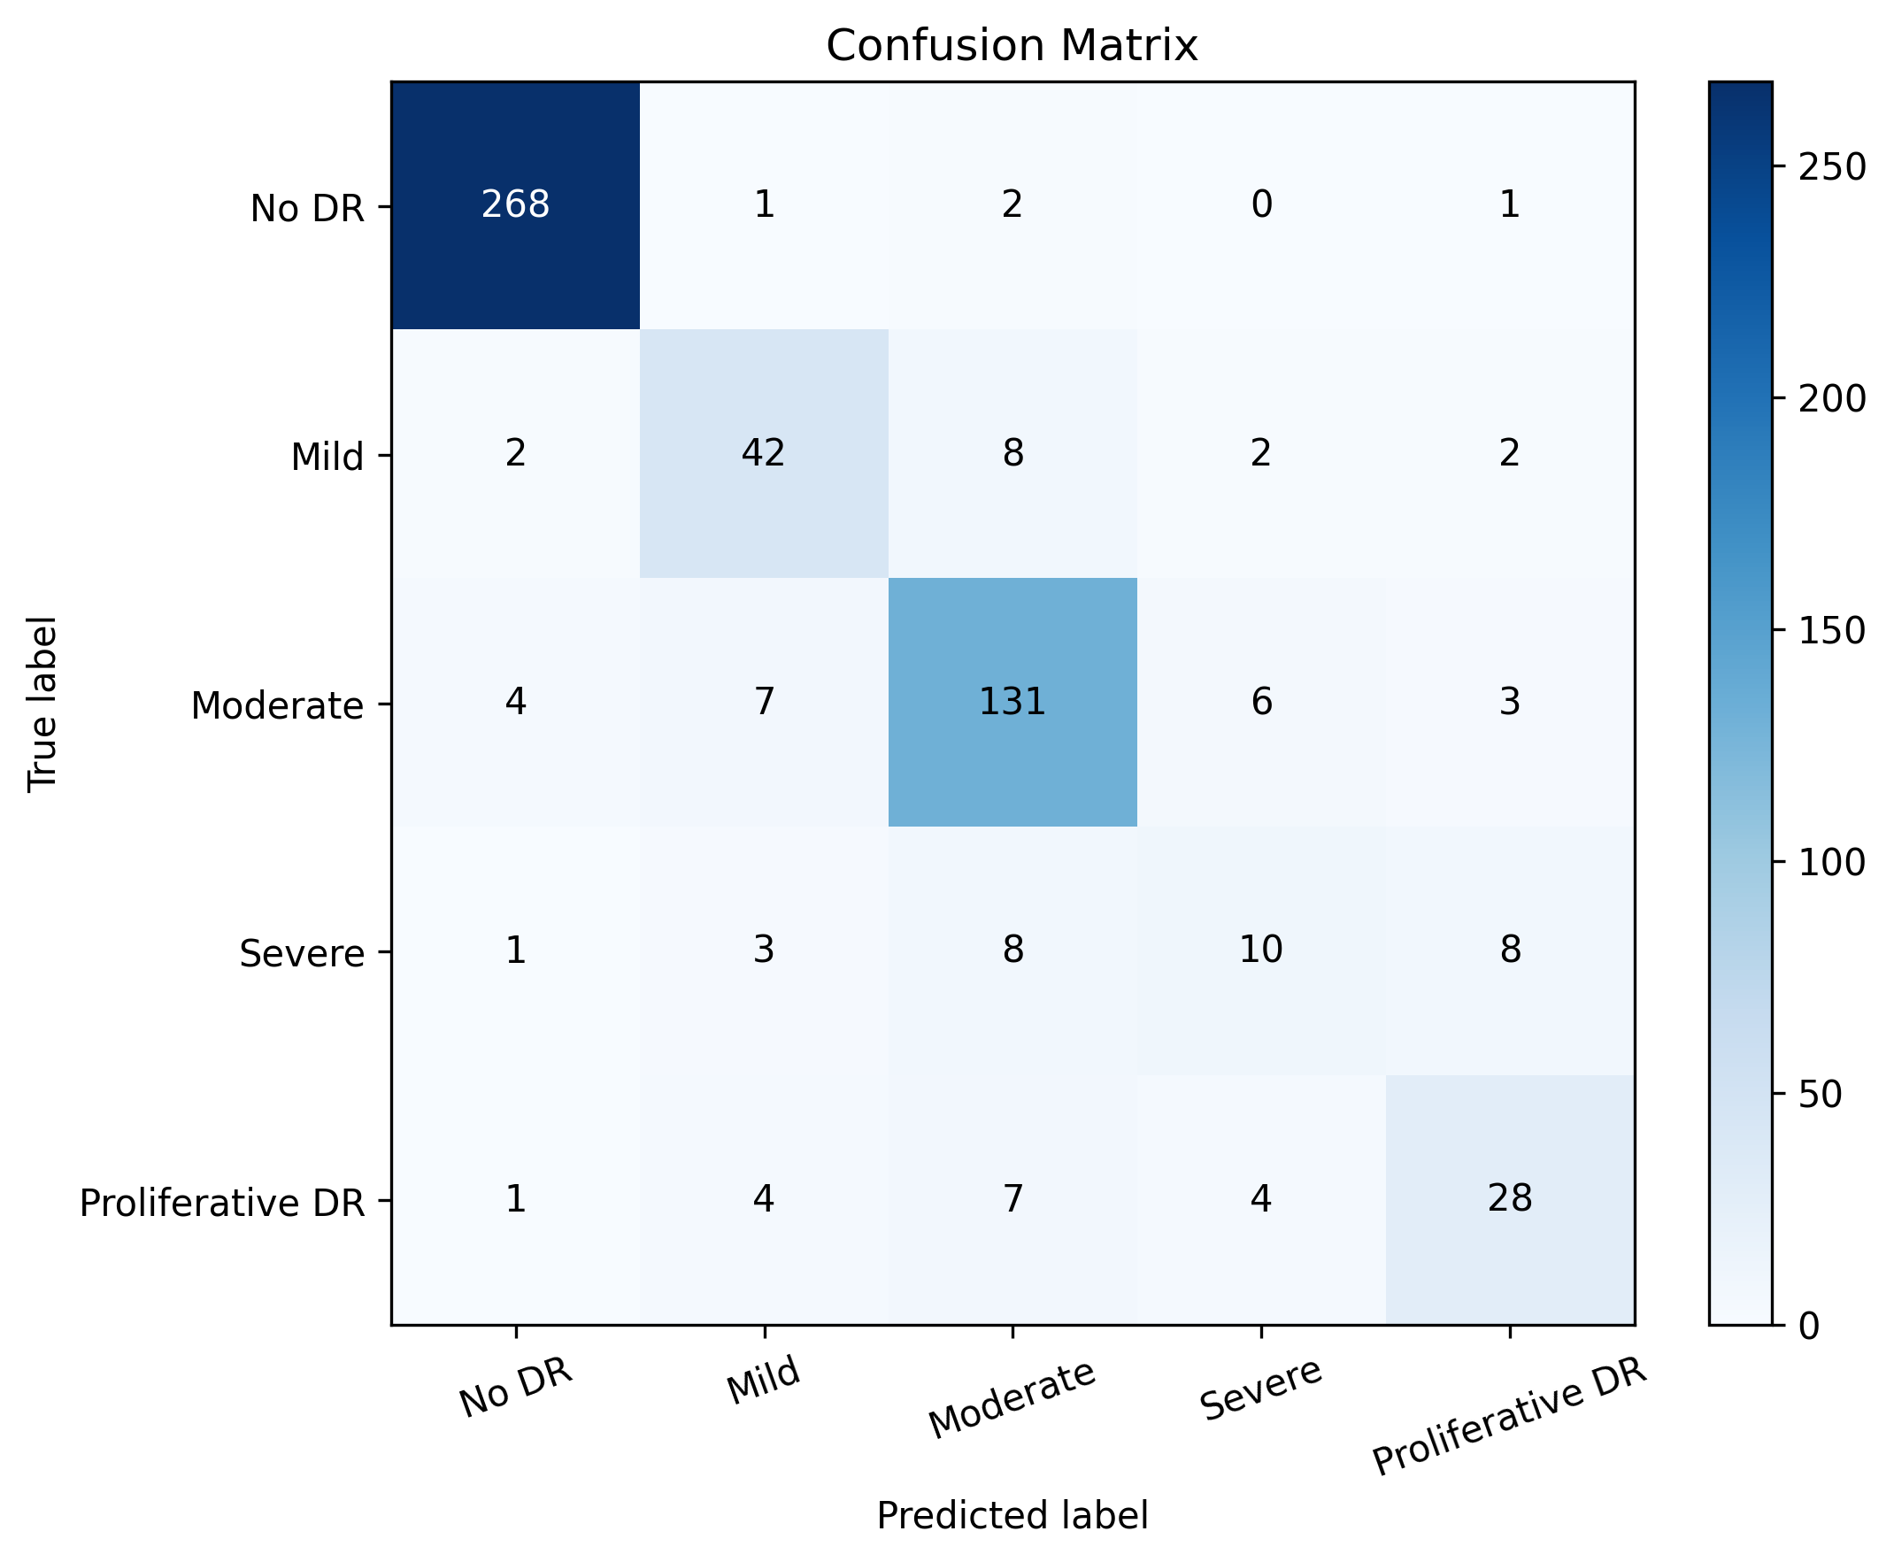
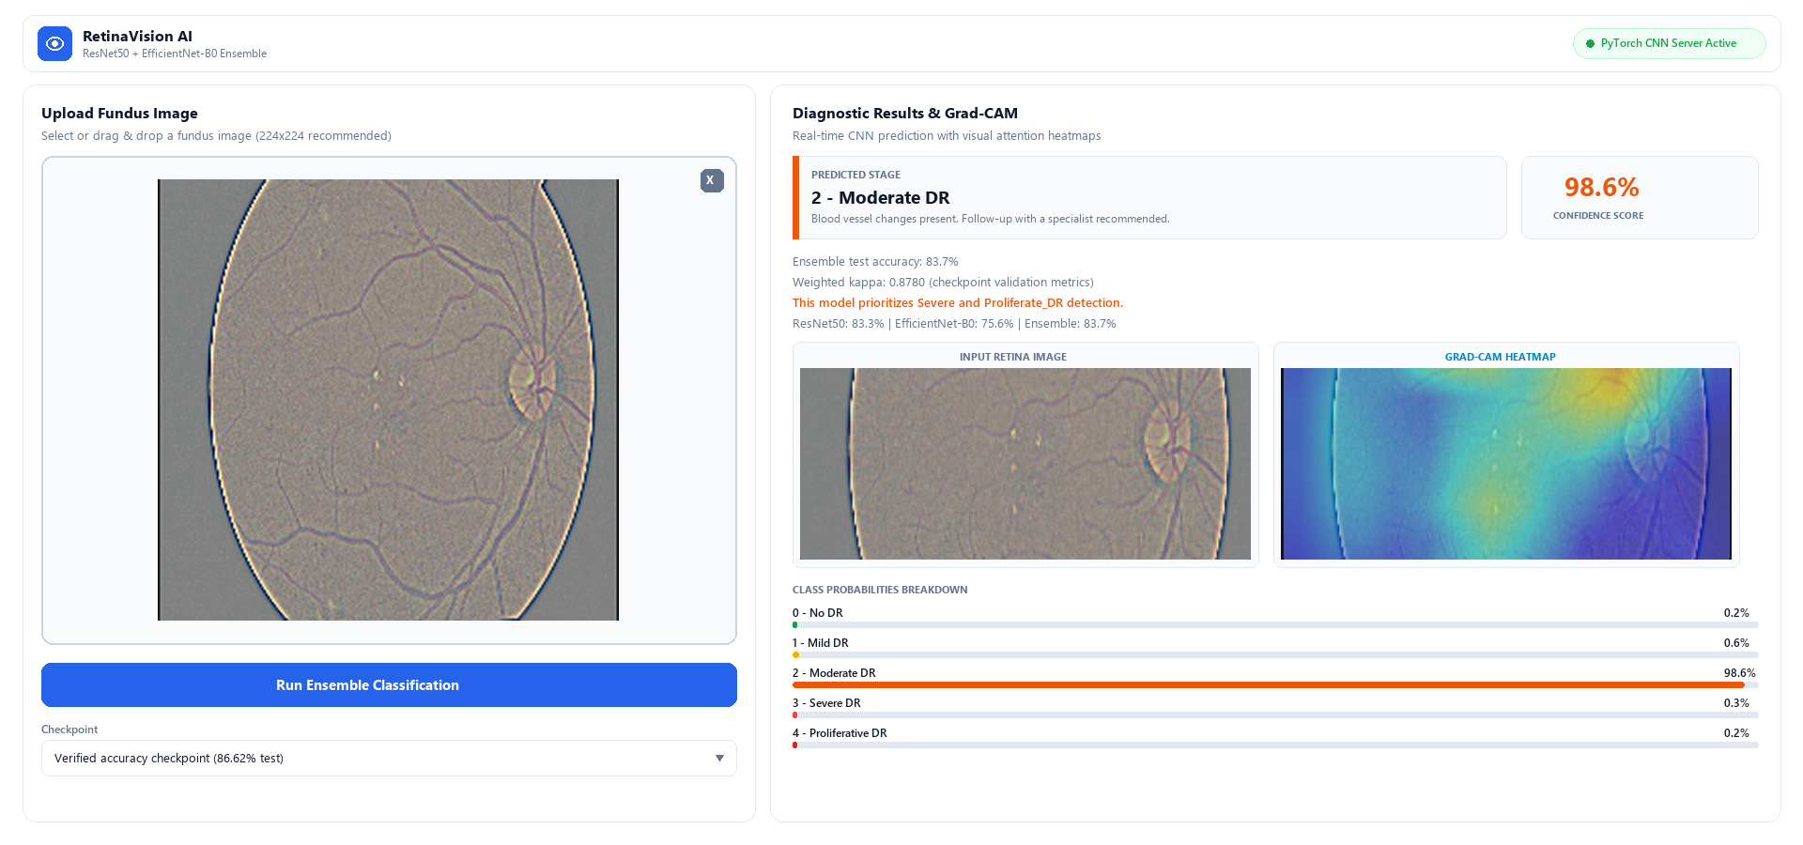
Result Analysis
Held-Out Test Results (N=553):
Overall Test Accuracy: 86.62%
Validation Weighted Kappa: 0.8780
Macro Precision / Recall: 77.07% / 71.45%
Macro F1-Score: 73.43%
Weighted Precision / Recall: 85.98% / 86.62%
Weighted F1-Score: 86.01%
Ensemble vs. ResNet50 alone: 86.62% vs. 85.90%
Ensemble vs. EfficientNet: 86.62% vs. 77.40%
Per-Class Recall (No DR / Mod): 98.5% / 86.8%
Minority Recall (Mild / Prolif): 75.0% / 63.6%
Fig 3: Flask Web Inference & Grad-CAM Output
Fig 2: Test Confusion Matrix

Slide 12
Timeline
06/05/25 - 13/05/25 (Duration - 8 days) : Literature survey on DR, dataset acquisition & exploratory data analysis.
14/05/25 - 20/05/25 (Duration - 7 days) : Data cleaning, 70/15/15 stratified train-val-test splitting & augmentation pipeline.
21/05/25 - 27/05/25 (Duration - 7 days) : Designing Dual-Attention ResNet50 (sequential Channel & Spatial attention).
28/05/25 - 03/06/25 (Duration - 7 days) : EfficientNet-B0 branch integration, ensemble weighting (0.7/0.3) & Focal Loss setup.
04/06/25 - 10/06/25 (Duration - 7 days) : Model training with AdamW, ReduceLROnPlateau, validation monitoring & checkpointing.
11/06/25 - 17/06/25 (Duration - 7 days) : Held-out test evaluation (553 images), confusion matrix & Grad-CAM XAI integration.
18/06/25 - 24/06/25 (Duration - 7 days) : Interactive Flask web app deployment, comprehensive project reporting & final review.

Slide 13
Conclusion
Successfully developed RetinaVision AI, an explainable dual-branch deep learning framework for five-stage Diabetic Retinopathy classification from retinal fundus photographs.
The confidence-weighted ensemble (ResNet50 0.7 + EfficientNet-B0 0.3) attained 86.62% test accuracy on 553 held-out scans and 0.8780 validation quadratic kappa, outperforming standalone backbones.
Dual attention (channel + spatial) effectively focused feature extraction on microvascular lesions, while multi-class focal loss successfully tackled acute clinical class imbalance.
Grad-CAM visual heatmaps provided essential clinical transparency and localization of lesion regions, significantly enhancing trust for clinical screening support.
Delivered a complete, reproducible software pipeline featuring automated checkpointing, comprehensive evaluation, and a real-time interactive Flask web interface.

Slide 14
Future Scope
Multi-Center External Validation: Evaluate cross-domain generalization across external clinical datasets (e.g., EyePACS, Messidor-2, and IDRiD) captured with different fundus cameras.
Synthetic Data Generation: Incorporate Latent Diffusion Models or GANs to synthesize high-fidelity fundus images for scarce severe and proliferative DR minority classes.
Vision Transformer Backbones: Explore hybrid CNN-Transformer architectures (e.g., Swin Transformer, Med-SAM) to capture long-range contextual spatial relationships across retinal vasculature.
Multimodal Clinical Fusion: Integrate clinical patient metadata (HbA1c levels, blood glucose, blood pressure, disease duration) and Optical Coherence Tomography (OCT) scans.
Mobile & Edge Optimization: Apply INT8 model quantization and TensorRT/ONNX runtime optimization to enable real-time diagnostic screening on low-power edge devices in rural clinics.

Slide 15
References
1. Almalki, FA, Ben Othman, S, A Almalki, F & Sakli, H 2021, 'EERP-DPM: Energy Efficient Routing Protocol Using Dual Prediction Model for Healthcare Using IoT', Journal of Healthcare Engineering, vol. 2021, no. 1, pp. 9988038.
2. Gulshan, V, Peng, L, Coram, M, Stumpe, MC, Wu, D, Narayanaswamy, A, et al. 2016, 'Development and Validation of a Deep Learning Algorithm for Detection of Diabetic Retinopathy in Retinal Fundus Photographs', JAMA, vol. 316, no. 22, pp. 2402-2410.
3. He, K, Zhang, X, Ren, S & Sun, J 2016, 'Deep Residual Learning for Image Recognition', in Proceedings of the IEEE Conference on Computer Vision and Pattern Recognition (CVPR), pp. 770-778.
4. Tan, M & Le, Q 2019, 'EfficientNet: Rethinking Model Scaling for Convolutional Neural Networks', in Proceedings of the 36th International Conference on Machine Learning (ICML), pp. 6105-6114.
5. Woo, S, Park, J, Lee, JY & Kweon, IS 2018, 'CBAM: Convolutional Block Attention Module', in Proceedings of the European Conference on Computer Vision (ECCV), pp. 3-19.
6. Selvaraju, RR, Cogswell, M, Das, A, Vedantam, R, Parikh, D & Batra, D 2017, 'Grad-CAM: Visual Explanations from Deep Networks via Gradient Localization', in Proceedings of the IEEE International Conference on Computer Vision (ICCV), pp. 618-626.
7. Quellec, G, Lamard, M, Josselin, P, Cazuguel, C, Cochener, B & Cazuguel, G 2017, 'Deep Learning for Diabetic Retinopathy Screening', Medical Image Analysis, vol. 39, pp. 30-42.
8. Lin, TY, Goyal, P, Girshick, R, He, K & Dollar, P 2017, 'Focal Loss for Dense Object Detection', in Proceedings of the IEEE International Conference on Computer Vision (ICCV), pp. 2980-2988.
9. Ting, DSW, Cheung, CYL, Lim, G, Tan, GSW, Quang, ND, et al. 2017, 'Development and Validation of a Deep Learning System for Diabetic Retinopathy Using Retinal Images', JAMA, vol. 318, no. 22, pp. 2211-2223.
10. Pratt, H, Coenen, F, Broadbent, DM, Harding, SP & Zheng, Y 2016, 'Convolutional Neural Networks for Diabetic Retinopathy', Procedia Computer Science, vol. 90, pp. 200-205.

Slide 16
Thank you!
Questions & Answers
Presented by:
1. Paarkavi M R (E0324045) | 2. Manju V (E0324051)
Guided by:
Dr. Deena S, Assistant Professor
Department of Artificial Intelligence and Data Analytics
Sri Ramachandra Faculty of Engineering and Technology
Sri Ramachandra Institute of Higher Education and Research, Porur, Chennai

