Slide 1



DEPARTMENT OF ELECTRONICS AND COMMUNICATION ENGINEERING
18ECP105L-MINOR PROJECT- III
PROJECT REVIEW
TITLE: HYPERLOCAL INFORMATION EXCHANGE PLATFORM
PRESENTED BY:
SUJEETH T (927622BEC217)
VARUN NATRAJ V (927622BEC244)
VENKATESH T P (927622BEC246)
GUIDED BY,
DR.C.NANDHAGOPAL M.E.,Ph.d.,

Slide 2

OBJECTIVE
It enables individuals within a community to connect, communicate, and collaborate seamlessly.
Ensure data privacy through robust user authentication and admin-controlled access.
Privacy and security are prioritized with robust measures to ensure safe information sharing.
It misinformation and inappropriate content, the platform includes moderated content-sharing mechanisms and restrictions on forwarding

Slide 3
ABSTRACT
Hyperlocal Connect is a web-based platform designed to foster community engagement and economic growth. Leveraging HTML, CSS, JavaScript, Node.js, and MongoDB, it offers features like real-time chat, social media integration, a job finder, and interactive posts. Prioritizing user privacy and data security, the platform ensures a safe and inclusive digital space. By combating misinformation and promoting local job opportunities, Hyperlocal Connect aims to be a scalable solution for community development and economic prosperity. The platform's intuitive interface and robust backend infrastructure enable seamless user interaction and efficient data management. Additionally, its focus on accessibility and inclusivity ensures that individuals from diverse backgrounds can participate and benefit from the platform's offerings. By empowering communities to connect, collaborate, and thrive, Hyperlocal Connect plays a vital role in shaping the future of local development and social innovation.

Slide 4

INTRODUCTION
It offers a user-friendly interface and real-time features like chat and notifications.
Prioritizing user privacy and security.
Platform implements secure authentication and content moderation.
Combating misinformation and promoting local job opportunities.
Community development.
Shaping the future of local development and social innovation.

Slide 5
LITERATURE SURVEY
S.NO | TITLE | AUTHOR & YEAR | DESCRIPTION
1 | A study for an easy UI based communication platform. | Mohan Pandey, Anubhav Bhatt, Ambuj Pathak. 2023 | UI is the most important aspect in creating any communication-based application and the developer has to make sure that the user interface should be appropriate for every type of user regardless of their backgrounds and their working area.
2 | COMMUNICATION PLATFORMS: NEW POSITIONS AND APPOINTMENT | Anzhelika Dosenko, Inga Pohrebniak, Gaiana Iuksel, Aleksandra Synowiec. 2020 | There are acute problem of identification of modern information and communication technologies, which known as communication platforms of the XXI century. The problem is due to the concept outlined. There is no unified definition and classifications that would clearly define the terminological series of the concept as a theoretical and practical unit.

Slide 6
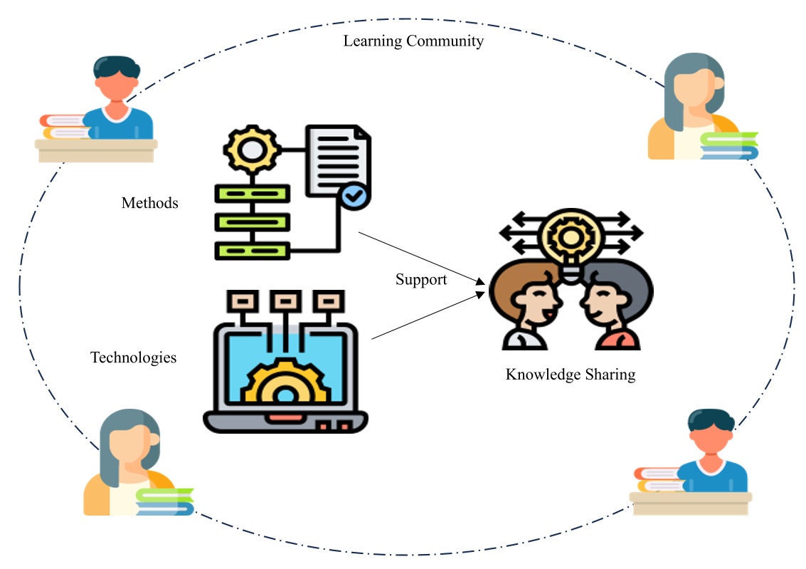
EXISTING METHOD/PROBLEM STATEMENT
In many communities, there is a lack of effective platforms for hyperlocal communication and information sharing. Existing methods, such as traditional community boards or social media platforms, often fall short in addressing the specific needs of localized communities. These methods may lack features like real-time communication, job-specific functionalities, and robust privacy and security measures.

Slide 7
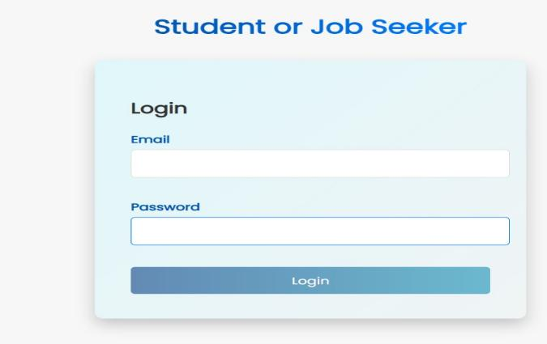
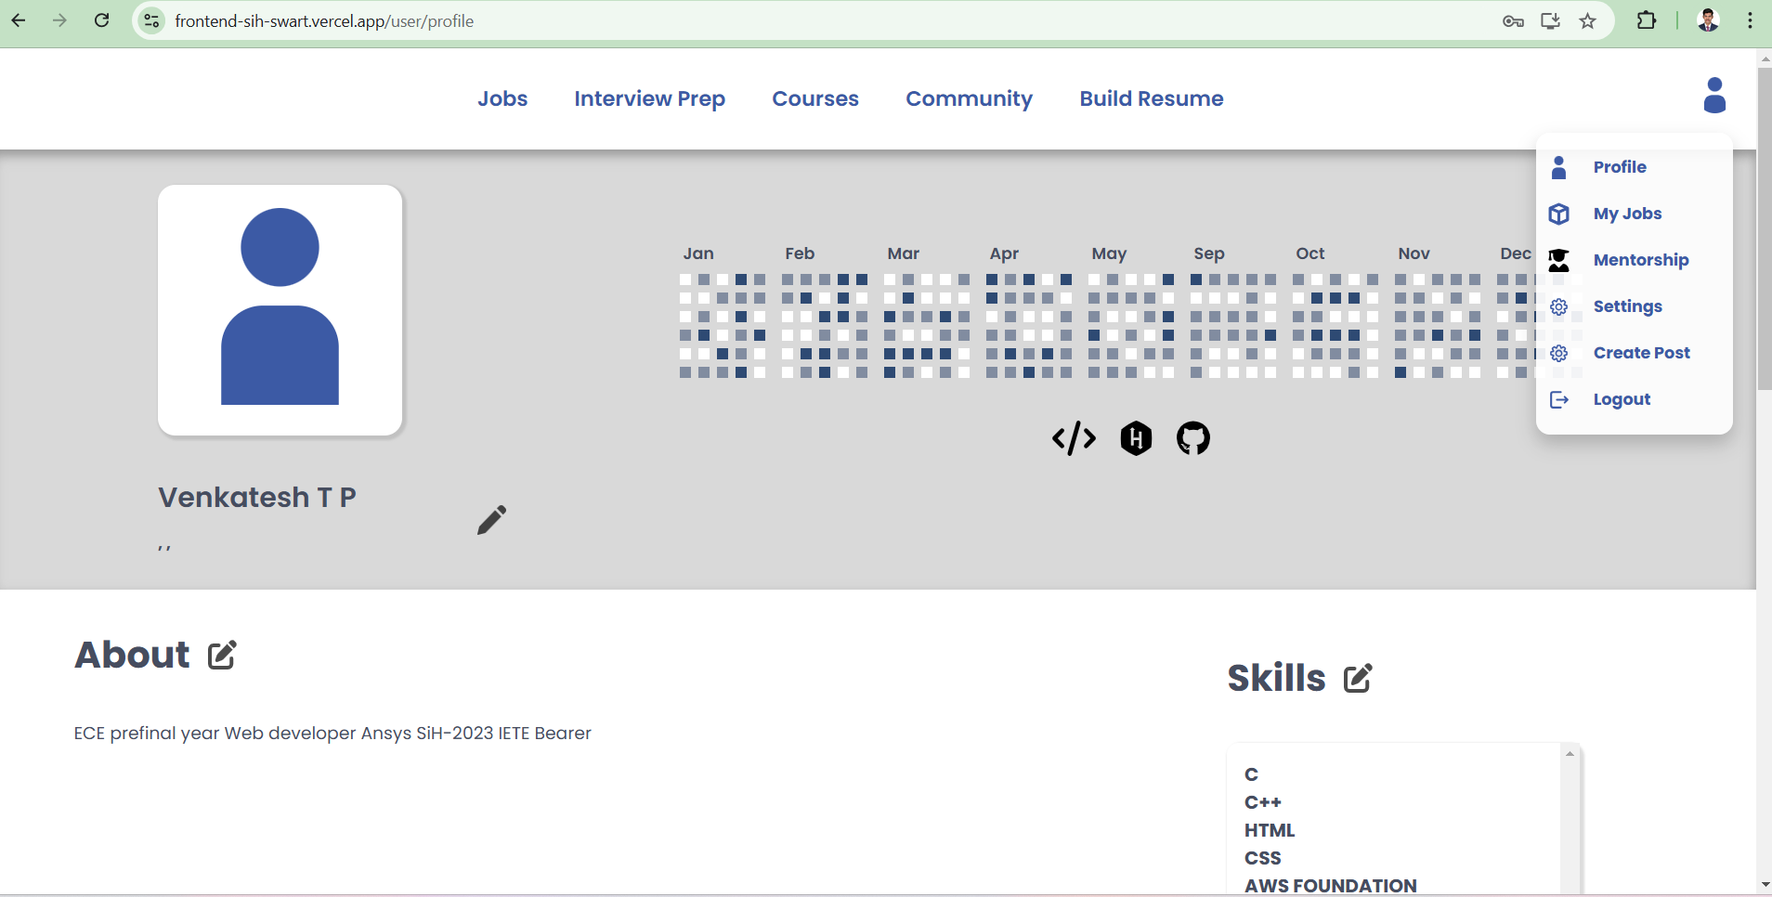
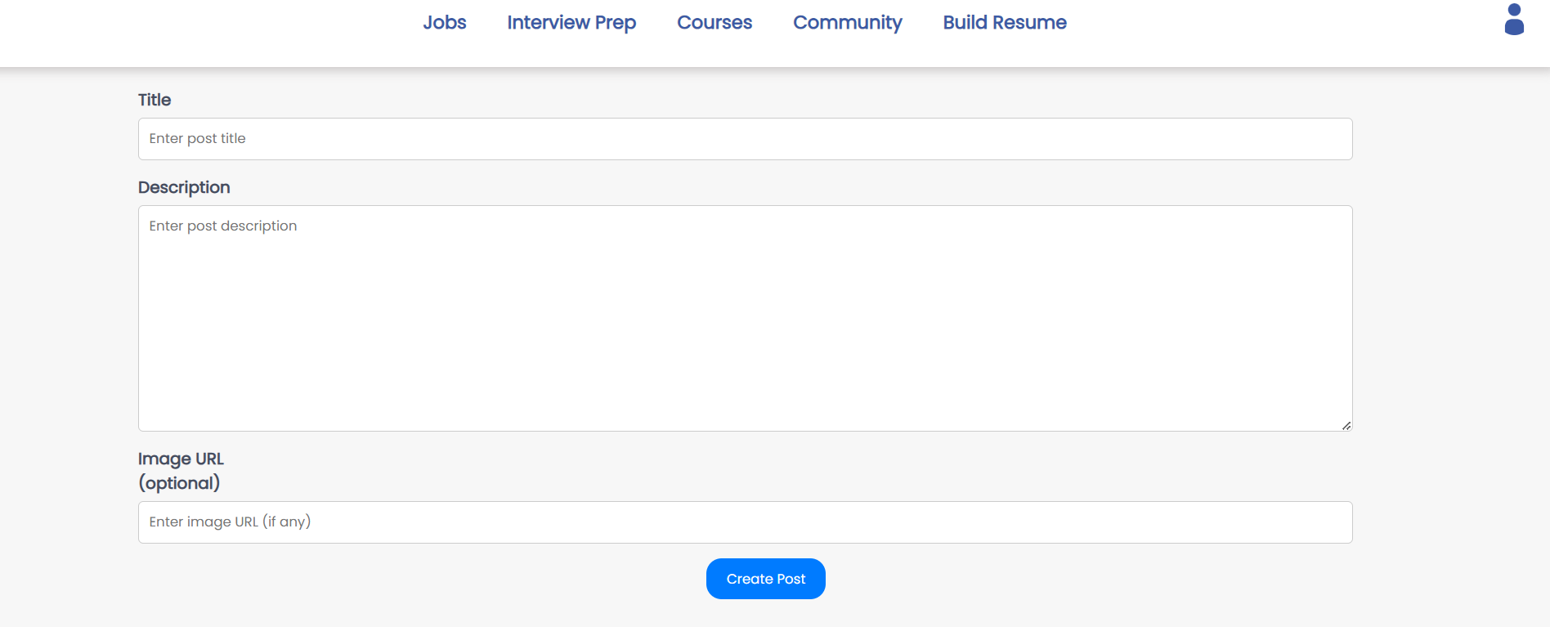
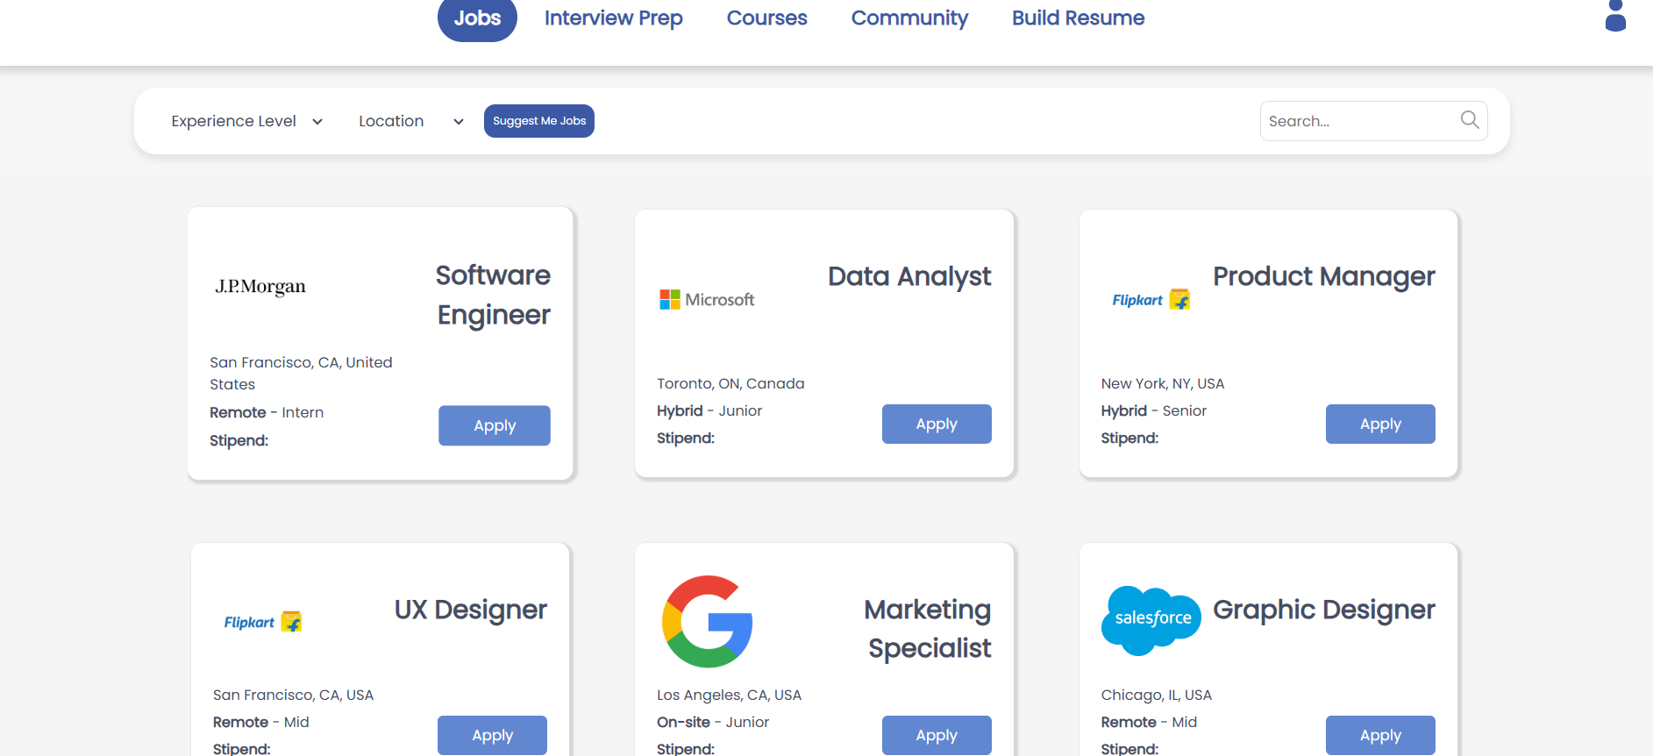
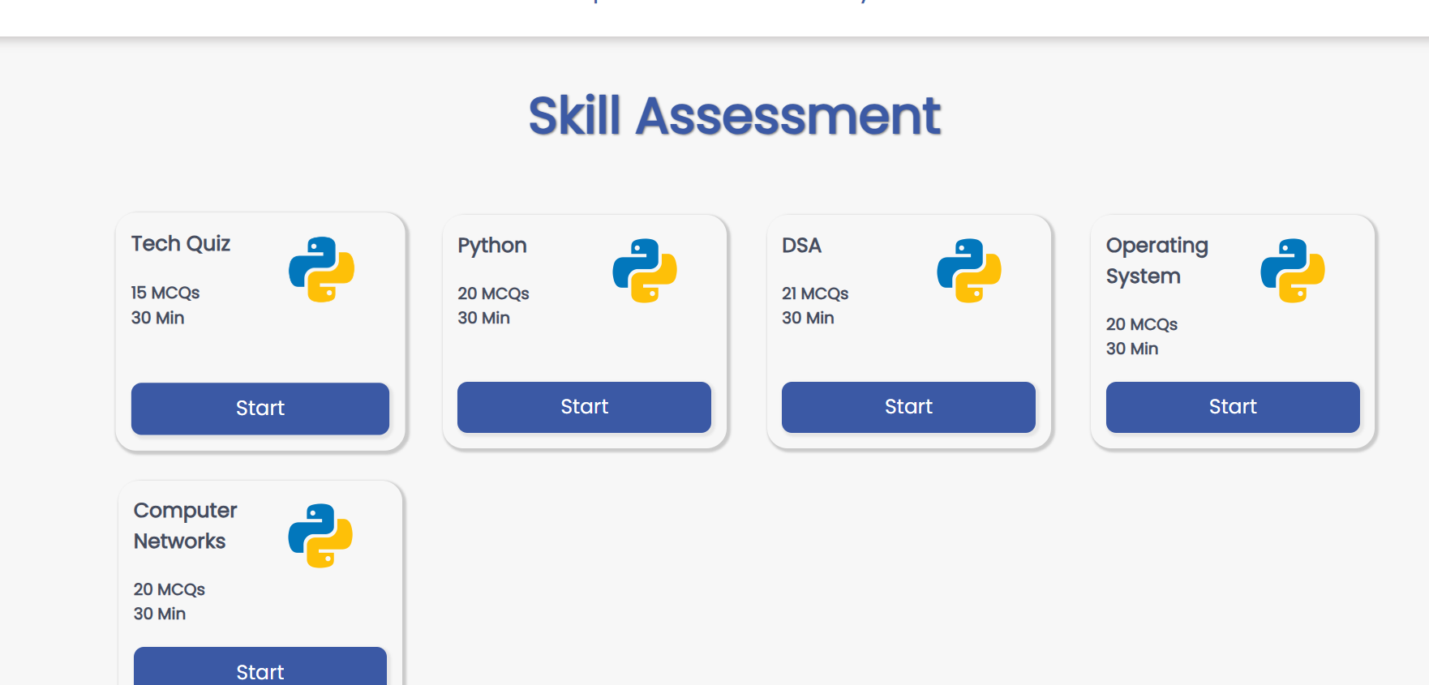
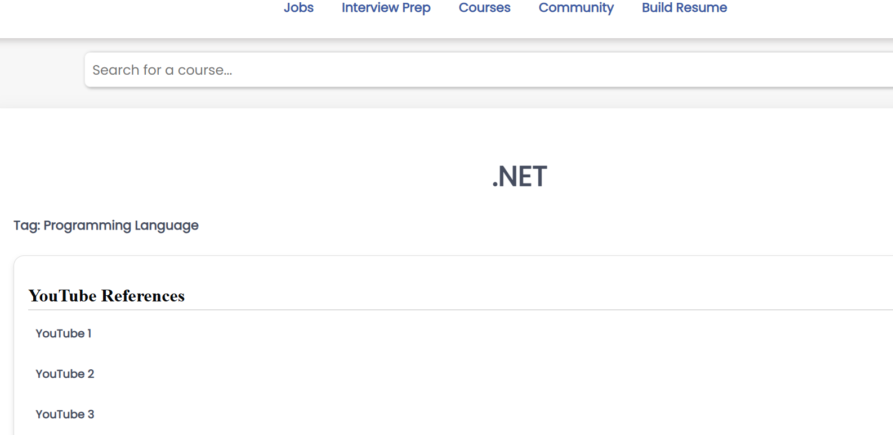
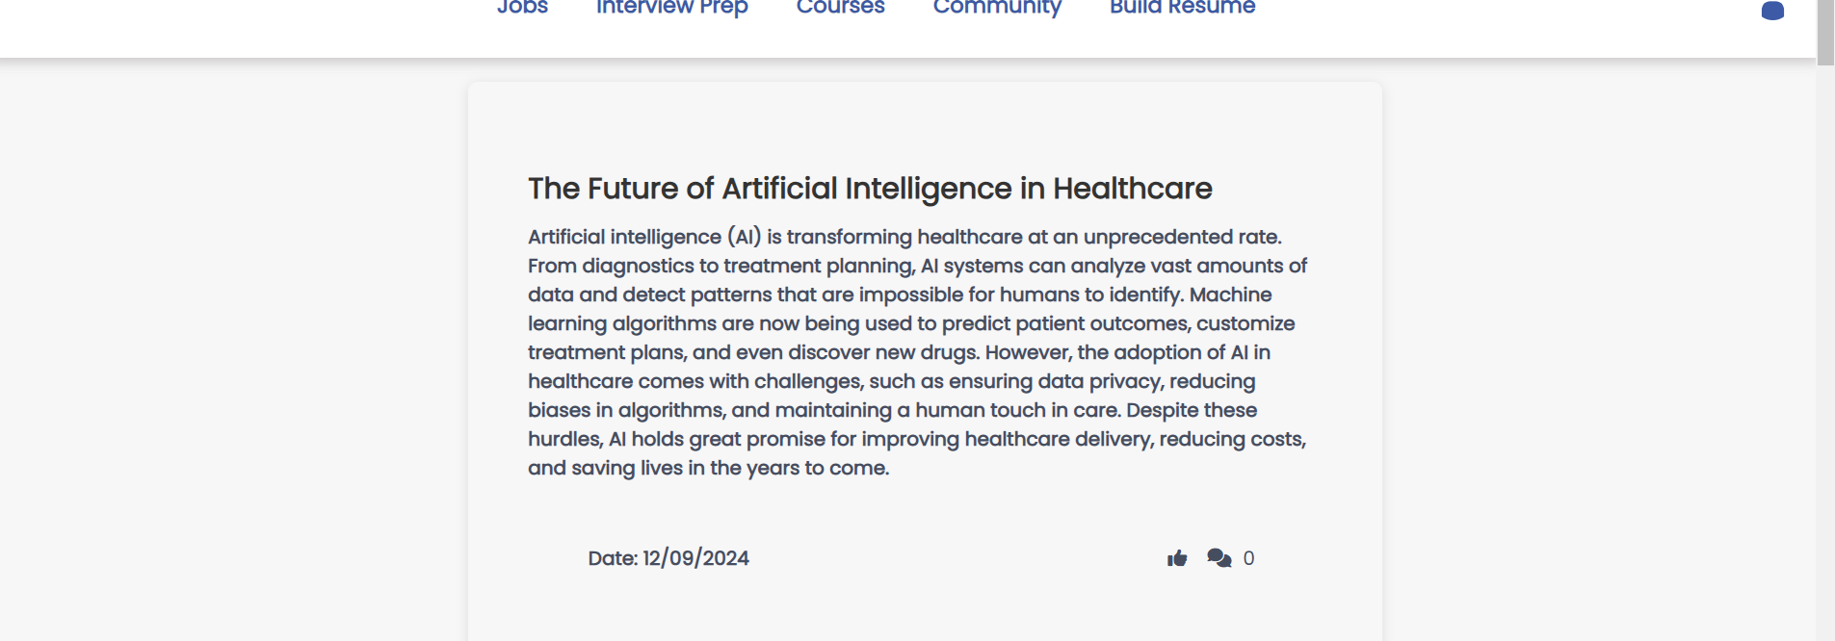
PROPOSED METHOD
1 2 3
LOGIN HOME PAGE POST
7 6 5 4
JOB TRAINING LEARNING COMMENT

Slide 8
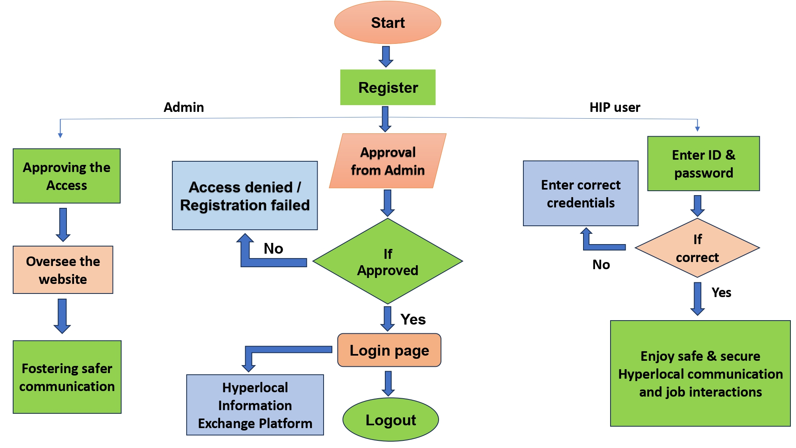
BLOCK DIAGRAM OF PROPOSED IDEA

Slide 9




TOOL USED
Frontend: (HTML, CSS, JavaScript): Design and interact with the platform's UI for registration, login, and media sharing.
2. Backend: (Node.js, Express): Manage user authentication, sessions, and data exchange.
3. Database (MongoDB): Store user data, posts, and media securely.
4. Email Verification (Nodemailer): Send verification emails during registration.

Slide 10
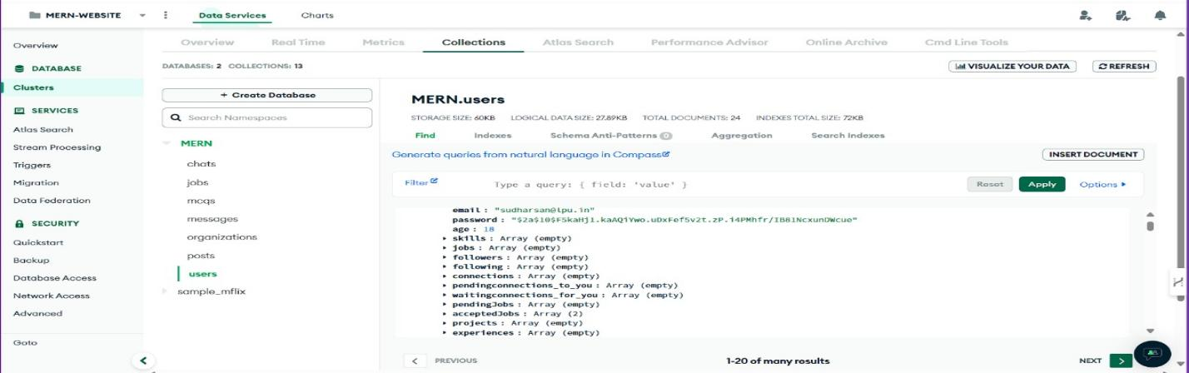
RESULT & DISCUSSION
Its job-seeking module adds practical value by connecting users to localized employment opportunities, making the platform more versatile.
Rigorous testing confirmed seamless functionality, responsive design, and ease of use across various devices, though initial challenges

Slide 11

CONCLUSION & FUTURE WORK
The Hyperlocal Information Exchange Platform (HIP) successfully addresses the need for a secure and efficient system for sharing sensitive and confidential information within controlled environments.
Enhanced Security Features: Integrating advanced encryption methods and biometric authentication for even stronger data protection.
Mobile App Development: Expanding the platform to mobile devices for broader accessibility and real-time engagement.
AI-Based Moderation: Leveraging AI to assist admins in monitoring content, identifying potential violations, and automating routine tasks.

Slide 12



ADVANTAGES
Enhanced Data Security
User Trust
Customizable Community Pages
User-Friendly Interface
Reliable Moderation
Prevention of Unauthorized Sharing
Confidential Communication
Local Engagement
Scalability
Encourages Accountability

Slide 13



APPLICATIONS
Corporate Communication
Government and Public Services
Educational Institutions
Non-Governmental Organizations
Community Management
Military and Defence
Event Management

Slide 14
REFERENCES
Information Systems Research:
https://www.sciencedirect.com/journal/information-systems
MDN Web Docs: HTML Reference:
https://developer.mozilla.org/en-US/docs/Web/HTML/Reference
MDN Web Docs:
CSS Reference: https://developer.mozilla.org/en-US/docs/Web/CSS/Reference
MDN Web Docs:
JavaScript : https://developer.mozilla.org/en-US/docs/Web/JavaScript/Reference

Slide 15

PROJECT OUTCOME
We have successfully applied for our project to be presented at the IEEE conference. Currently, we are awaiting approval from the conference organizers. Given the innovative nature of our hyperlocal information transfer platform and its potential impact on local communities, we are confident that the proposal will be accepted. Once approved, it will provide an excellent opportunity for further validation, collaboration, and sharing of insights within the academic and professional community.

Slide 16
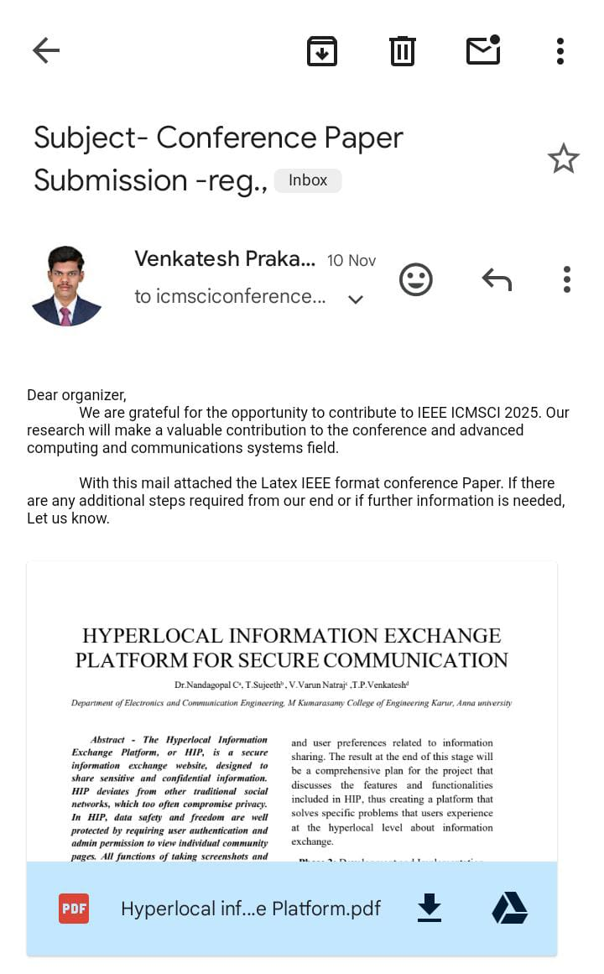
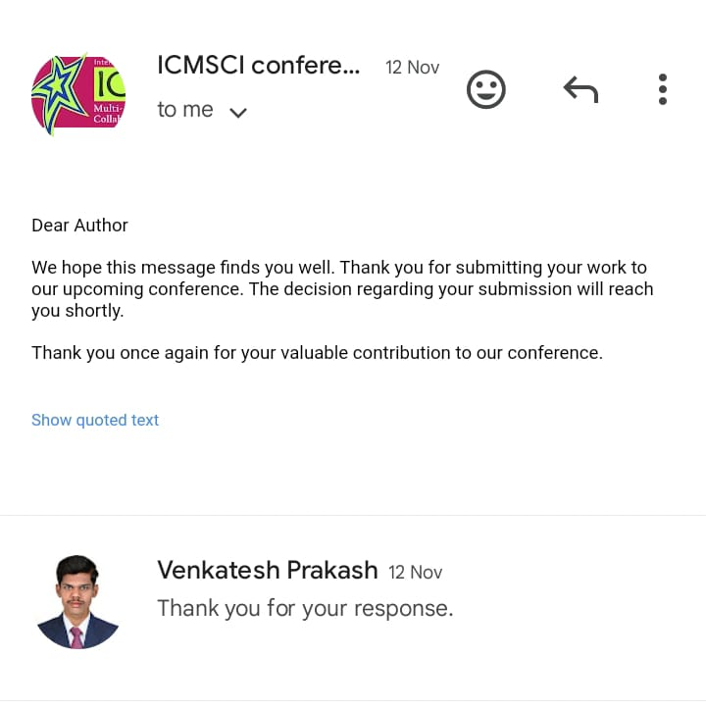
APPLIED FOR IEEE CONFERENCE IN SURYA COLLEGE OF ENGINEERING, VILLUPURAM

Slide 17


